Slide 1

Developing AI Fluency at UoS
Professor Kate Borthwick, Lead for AI in Education
University of Southampton
30 April 2026

Slide 2

AI Fluency: guiding principles
Proactive, institution-wide approach aligned to triple helix and coordinated through AI@Southampton
Theme of empowerment, agency, human-centred
Collaboration, co-creation
Transparency
Continuous learning
Criticality and creativity
Flexibility and adaptation (we acknowledge that one size won’t fit all disciplines)

Slide 3
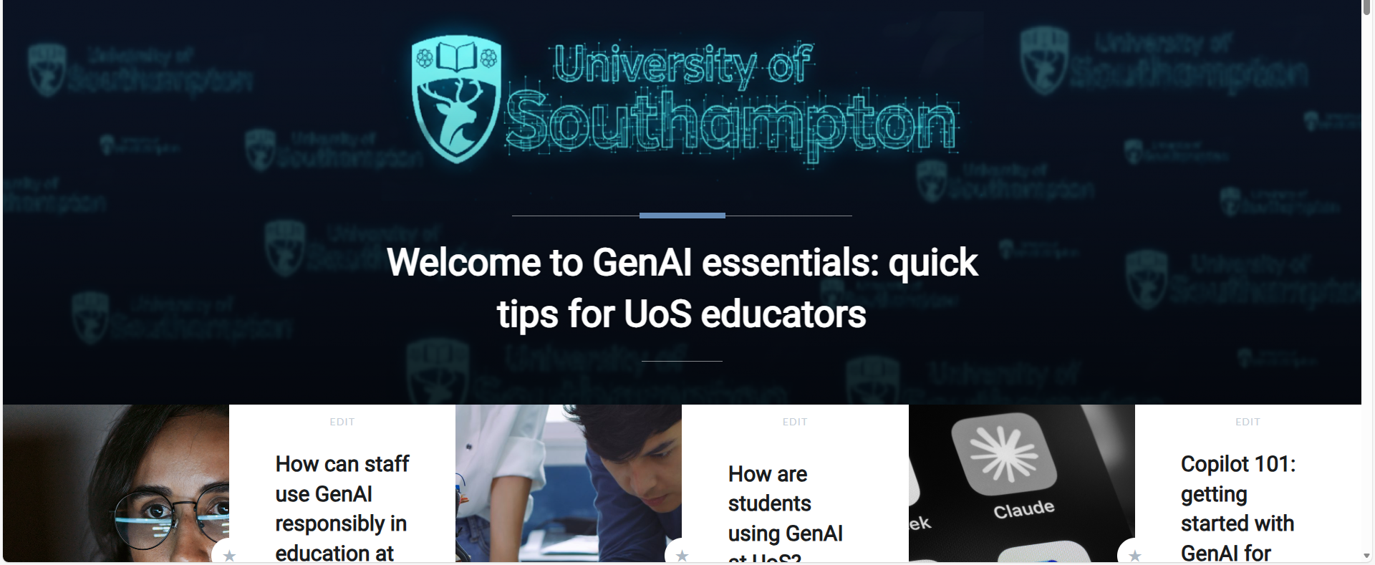
Staff training/activity
A large volume of talks, workshops, working groups across all Faculties
Range of individual Faculty AI protocols/policies/advice
Flexible staff training in a variety of modes (CHEP, Digital Learning)
Encouraging experimentation and piloting of AI tools
Alignment to strategic projects as vehicles of change (Advancing Assessment)
Academic standards (assessment re-design)
Multiverse apprenticeships (Mostly PS staff)

Slide 4
Transformation is underway – where would we like to be in 5 years?
AI is disrupting and transforming:
how our students discover, process and produce information
how we teach, undertake research and work in Higher Education
the world our students will graduate into
In five years: our staff and students will:
Have developed AI literacy to understand the strengths and weaknesses of AI; to understand AI in a discipline context, and have practical, critical skills to use AI responsibly and creatively = to empower and augment their practice
Be effective in living, working and shaping the AI-enabled world beyond Southampton.

