Slide 1
“Social prescribing is a holistic, non-clinical and person-centred approach to people’s health and wellbeing. It is an approach that connects people to activities, groups, and services in their community to meet the practical, social and emotional needs that affect their health and wellbeing." - NHS definition.
Student Social Connect:
Peer Support through Social Prescribing
Social prescribing is a holistic, non-clinical and person-centred approach to people’s health and wellbeing. It is an approach that connects people to activities, groups, and services in their community to meet the practical, social and emotional needs that affect their health and wellbeing." - NHS definition.
SHU Wellbeing & Peer Support
HSU Student Rights & Campaigns

Slide 2
Context & Starting Off
Evidence from the HSU Hallam How’re We Doing Survey indicated a need for increased and varied wellbeing interventions for students. The survey showed the main reasons students consider dropping out of university were mental health (54%), loneliness (27%), lack of support network (19%) and struggling to make friends (17%).
HSU had a pre-existing infrastructure that could be tapped into as a wellbeing resource, rather than reinventing the wheel or outsourcing a service. Sports clubs, events, GIAGs, societies, volunteering brokerage, academic opportunities, jobs.
Invested in the idea of “University community” in practice
An opportunity for meaningful peer support/student staff opportunity

Slide 3
​
Student Social Connect is a peer-to-peer social prescribing program​
The pilot involved Connectors (Student Staff) working with students to co-create wellbeing plans, ranging from activities, events, societies, lifestyle changes etc for up to 6 weeks to support them with low-risk wellbeing issues such as loneliness & low-level anxiety & depression. ​
Student Social Connect was born!

Slide 4
The Social Connect Pilot
Held over 5 months in Semester 2 of the 23/24 academic year.
Recruited 3 student community leaders for the project from the university
Completed some basic training, including GDPR and safeguarding
Connectors signed a confidentiality agreement
Created a process for referrals and ongoing support for the connectors
Advertised the service to Student Wellbeing and there was also a way for student's to directly refer.

Slide 5
-If student no longer needs/wants support, ending call to complete evaluation
-Connectee confirms support is ended by message on Teams
Referral
Received by WB in Wellbeing via CRM or email
Logged and recorded on CRM
Student must be registered with Wellbeing
Screen referral
-Check referral meets criteria. Review Wellbeing info. Check for risk.
-Send email to student acknowledging referral and arranging time to call
'Welcome call' completed
- Into to service
-Are they able to engage?
-Are they safe to access the service?
-Are they motivated to engage?
-Info sharing agreement – to share info with SU and Connector
-evaluation
-Book appointment with Connector on Teams calendar
Link with Connector
-Referral form completed (incl basic info about what they are interested in, brief MH details, date of initial appointment)
-Referral form shared with Connector and WBC (SU)
Connector makes initial contact with student connectee via Teams messaging. Confirming date, time and place of initial meeting
Initial meeting Connector and Connectee
-In person meeting on campus
-Consider what connectee is interested is
-Create plan with student
6 weeks of support
-Connector checks in with student
-Sends reminders and updates to student via Teams
-Arrange in person reviews
-Attends activities/groups with student
Ongoing Support to Connectors
-Fortnightly meetings with Connectors
-Regular check in via Teams with Connectors
-HSU/SHU staff available for any issues which occur
Ending Support
-Support is reviewed at fortinghtly check ins
The process

Slide 6
How did it go?
A total of 27 students were referred
15 students were matched with a student
The connectors averaged around 4 hours with each connectee
Students took part in a range of activities, from social sport, volunteering, nature walks, ice skating

Slide 7
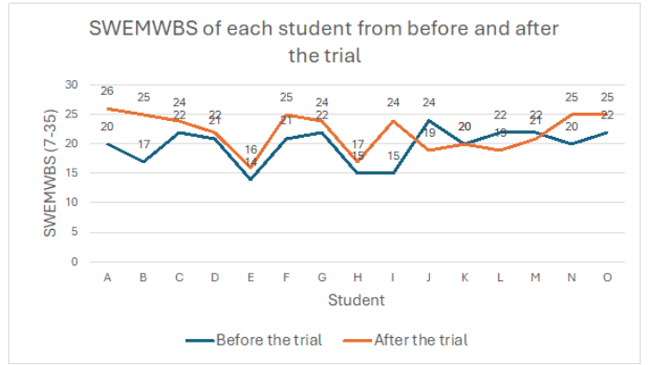
Does it work? SWEMWBS
Short Warwick Edinburgh Mental Well-Being Scale (SWEMWBS):
SWEMWBS asks the participant to respond to 7 statements relating to wellbeing: a sense of optimism, usefulness, how relaxed they are, how they deal with problems, thinking clearly, feeling close to other people and making their mind up about things.
73% of students’ wellbeing score improved over the trial.
J, K, L and M did not meet up in person with their connector in person
Notes:
Evaluation - 2 scores at the beginning and end.
Verbal feedback at the end of the students involvement.
Scale 1: Short Warwick Edinburgh Mental Well-Being Scale (SWEMWBS)
-The scale is used to measure people's happiness and rate the pleasure they are finding in life.
-Asks students to score themselves on a scale of 1-5 about how they have been feeling about particular aspects of their life ( whether they've been feeling optimistic about the future, feeling useful, relaxed, dealing with problems well, thinking clearly for instance).
-So this scale found that 80% of student's happiness improved over the trial. Interestingly for the students who actually went to activities with their connector (which not all did) this score increased to 100%

Slide 8
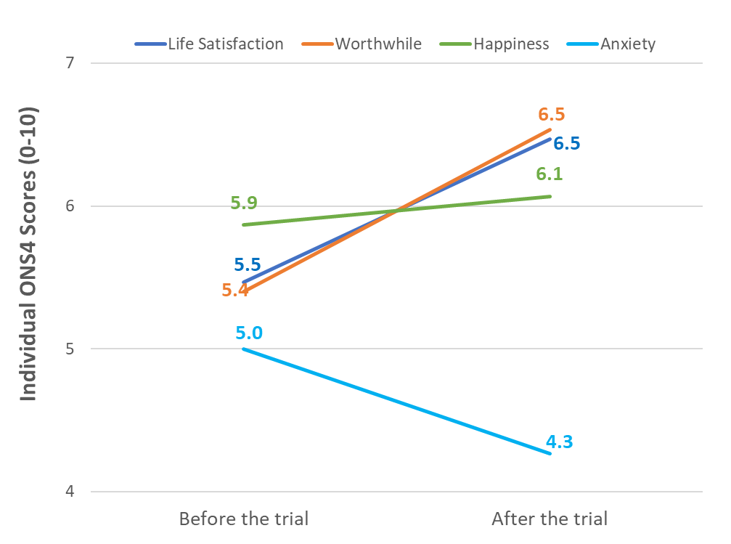
Does it work? ONS4:
Notes:
Scale 2: Office for National Statistics Personal Wellbeing Domain. This was the 2nd scale we asked students about in evaluation.
-this measures people's personal wellbeing
-asks student to score themselves on a score of 1 –10 about different aspects of their life (life satisfaction, how worthwhile their life is, how happy they felt yesterday, how anxious they were yesterday).
Overall, these results show positive change over the time of the pilot. It's interesting that th escores are even positive for those students who didn't actually go to any activities with their connector. But those that did go to an activity all had an increase in their happiness score (on the first scale).

Slide 9
Student Case Studies – Student I
Student I was an International PGT student, who described themselves as feeling low in mood and missing social networks from home, they wanted to meet more people in Sheffield and feel more involved in a community here.
Student I decided to book onto a volunteering day at Burngreave library. Although the slots were all full upon trying to book, Hallam SU was able to use their existing volunteering coordinator contacts to get them a space. They now regularly volunteer at Burngreave library
They stated in the evaluation that the presentation of activities of interest by the Connector was really helpful and having options isolated down helped them.
They stated their connector was calm, approachable and made the process relaxed.
They felt more sociable, less lonely and that it felt good to get a volunteering opportunity.
This was our first and only self-referral student.
Their SWEMWBS score went from 15 to 24.

Slide 10
Student Case Studies – Student B
Student B stated they were struggling with low mood as they were a victim of homophobic abuse on their course. They felt very isolated and were looking at changing universities.
They were paired with the Connector (student staff), who upon meeting the student raised the concerns mentioned in the referral form as she felt concerned and we were able to react quickly to this and work with Report and Support, SSA and the wellbeing service to ensure all parties were up to speed and they were being adequately supported and that they were suitable for the programme.
Student B and the Connector then went to a GIAG ice skating session which Student B really enjoyed and continued to attend after the scheme ended.
Student B's SWEBS score increased from 17 to 25 in the pre and post eval survey.
A quote provided by their connector: “Thanks again for going with me, I really enjoyed it. Never had this much fun since I came to Hallam, see you around :)”
On the evaluation scheme Student B said, “I’ve got exactly what I needed from Social Connect.” “I feel much more connected to people now.” “I feel much more stable in my mental health” and “feels much happier in Sheffield.”
Notes:
To illustrate how the service worked, we've got a couple of case studies of two of the student's who accessed the service.

Slide 11
What did students find helpful?
Connectors - all students have been positive about their Connector – commenting on them being friendly, calm, approachable. Several students have commented that they really enjoyed meeting their Connector. One comment that they were pleased the Connector was a student. Comment: the students who help are “the best part.”
Method of contact (via Teams or face to face). Several students have commented that messaging on Teams has been helpful. One students liked being prompted on messages about what was going on. -Another student said the most useful thing was their Connector ‘checking on her’ and gave her a chance to share her emotions about how she was feeling.
Finding activities - 10 students have made comments about it being helpful to have someone that finds activities for them, having a list to choose from has been helpful, having a list based on interest was helpful, having activities ‘isolated things down’ for him which made things easier to choose, helping them to find what was available, that their Connector has gone out of their way to find activities. One student felt their Connector found things that they wouldn’t of been able to. Comment: The most useful thing was all the information about what was available and what the SU had on offer.
Going to activities with their connector
Not all students went to activities with their Connector. Many only had contact over Teams messaging. One student who went to with connector commented that it made him feel less alone. Without this he may not have gone. Someone else commented that having a connector there at a sports activity helped.
Notes:
From the comments which student made these are the features of Social Connect which have been highlighted as being helpful.

Slide 12
What did students find helpful?
Mostly having somebody else to push to try new things.
“It’s really great – especially for students far away from home. I hope students take this opportunity. It’s a very good initiative.”
He said that he’d found the social connect service really helpful to meet some ‘normal’ people and he feels much more connected to people now.
"More confident doing things by myself. Went to badminton. Having Connector there helped."

Slide 13
Positive Student Job Opportunity
Skills which Connectors says they have gained:
speaking to different people – improved communication and interpersonal skills
taking leadership of situations
patience
emotional intelligence
gained greater awareness of the issues which other people face
time management and organisation skills
What Connectors have said:
“Being a connector holds value not only in professional realms but also in personal development, fostering relationships and forging new connections that contribute to personal growth and development. Witnessing the benefit that arise for those involved in the programme is also particularly rewarding.” – Connector
“It’s challenged me to get out of my comfort zone and explore activities I may never have known existed. The students I’ve met on the scheme have provided me with positive feedback and appear to have genuinely gained value from the service.” - Connector
Notes:
We completed a focus group with the Connectors to review how they think the service had gone and get their views on how the service could be improved. These are some of the benefits they said they got from it.

Slide 14
Did it make a difference to your Wellbeing?
"Just getting out has helped." Overall – going once to badminton he feels more at ease and ready to work through his depression.
Student thinks it did, he felt/feels more sociable, and it was good to get a volunteering opportunity. He says he felt less lonely after the scheme.
"Yes, it has given me more confidence to try something else"
"The scheme makes me feel like I actually want to try other things. "
Feels much more stable in his mental health and doesn’t feel he needs any other form of support from student Wellbeing. Feels much happier in Sheffield and even though he has a stressful exam period coming up he isn’t feel stressed and feels ok about the exams.
Notes:
Here's some of the comments which Students made about whether it made a different to their wellbeing.

Slide 15
Challenges
Referral Process | In the pilot the process was completed by SHU in Wellbeing due to Connectees having to be registered with Wellbeing. This means that: -SU was not included in this process -Students had to be registered with wellbeing which which we felt was barrier to engagement and excluded other students the service.

Slide 16
Challenges
Student engagement | 27 students referred. 12 of these referrals didn’t access the service From feedback from Connectors we know that many of the students accessing the service have been difficult to engage; often don’t reply to messages, don’t want to attend activities, cancel meets ups and needs lots of promoting to confirm attendance.
Safeguarding concerns | Several issues raised on pilot around safety of students: -One student telling their connector they had a large amount of prescribed tablets and indicating they may take an overdose -another student telling connector about being bullied and victim of homophobia/racism -Inappropriate student referred to the scheme as a serious mental health concern was later flagged
Notes:
The pilot has been really useful to consider how the service could work, and there are many areas which we need to address before we'd be able to offer the service again. This includes looking again at the training we provide to Connectors and some of our processes.
These are just some of the concerns which we found during the pilot and which we need to consider going forwards.

Slide 17
Student Social Connect 2.0 Recommendations:
Use a form type on Microsoft Teams which will help ensure suitable students access the scheme. Questions around mental health, desire to engage and reasons for engaging will help filter suitable students through to the registration form, while also signposting and redirecting students to suitable information/support should they indicate they aren’t suitable for the scheme.
Students should be given 6 sessions over 4-6 weeks, rather than a 6-week timeslot on the scheme, following a more “traditional” social prescribing/therapy/support schedule.
Introduction of using Shifts on Teams
Introduce UCLA3 and MYCaW as evaluation methods as well as ONS4 and remove SWEMBWS.
Hired four student social connectors for next academic year, hoping to reach 200 students
Notes:
We feel a social connect service could be a really useful intervention for students.
-we'd like to be able to offer the service again next year but need to address some of the chalenges first including
We’re currently looking into how we expand our referral process to other key departments at the University, such as Disabled Student Services and Access & Development.
-we'd like to apply for funding from the Hallam Fund but application are currently closed so development work is paused for the current time.

Slide 18
Any questions?
Notes:
Thanks for listening.
Does anyone have any questions? Or thoughts about the service. Open to any ideas....

