Slide 1
Train the Trainer
Bite size
Sarah Ellis
(she/her)

Slide 2
INTRODUCTION
Who am I?
People & Development Consultant at Atkinson HR
15 years experience in students’ unions, from being an elected officer to a CEO
What is this session?
Usually a 2 day course, this will focus on one key aspect

Slide 3
Ice breaker
Split into pairs, ideally someone you don’t work with day to day
Talk to the other person about something you’re passionate about (one minute!), they’ll then report back to the group...depending on numbers

Slide 4
Ice breaker
Why do we have ice breakers?
What are the qualities of a good icebreaker?

Slide 5
The Training Cycle
What are you trying to achieve?
Continuous improvement
Review &
Evaluation
Identify needs
& planning
How do you know your learners have learned?
Assessing
learning
Designing
training
Where, when, what, who, how?
Facilitating
learning
What methods are you using?

Slide 6
What are some of the subjects you train on?

Slide 7
Training methods
.Learning objectives:
Name a range of training methods
Analyse and critique a variety of training methods
Case study
Demonstration
Discussion
Game/quiz
Energisers
Icebreaker
Idea storming
Simulation
Lecture/presentation
Media clip
Pair work
Project/assignment
Question and answer
Role play
Skills practice

Slide 8
Training methods- activity
Arrange yourselves small groups
Collect training cards
Discuss your training methods
Take notes, and feedback
In small groups answer the following questions;
Why would you choose this method?
How would you use it?
When would you not choose this method?

Slide 9
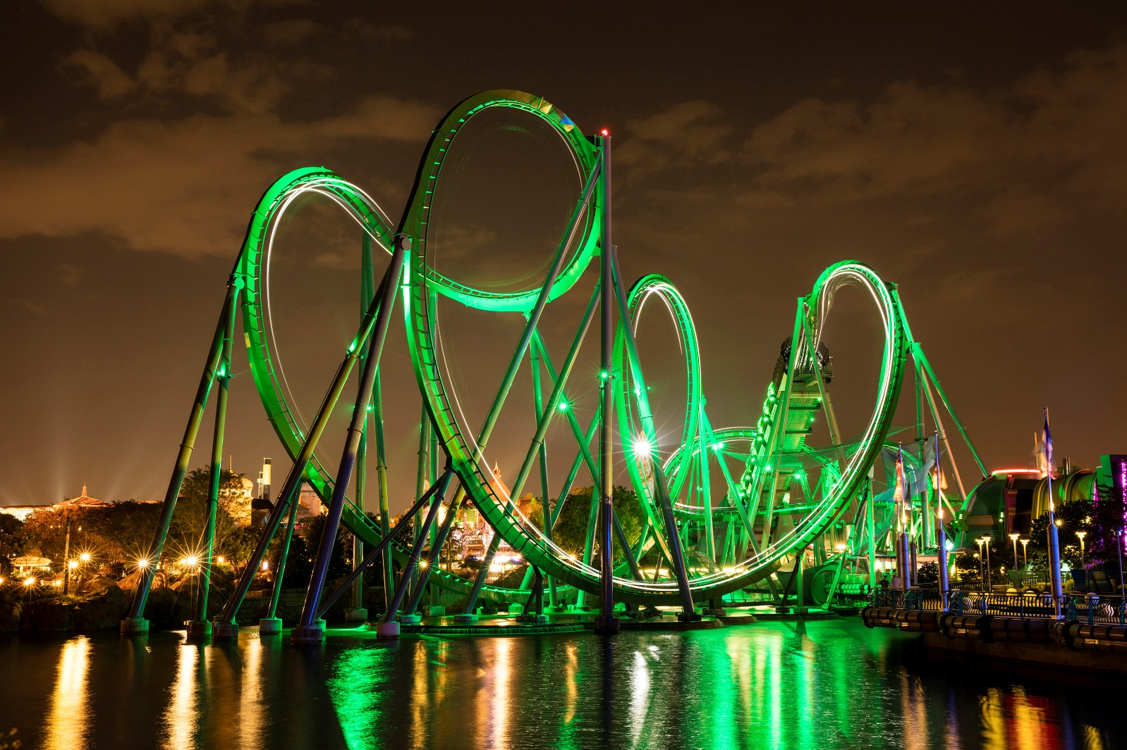
Effective, relevant communication
What I mean…
What I say…
What they hear…
What they understand.

Slide 10
What do you want to achieve?

Slide 11
What have you learned today?
Arrange yourselves small groups
What is your key takeaway from this?
How will you use it in your next training?
Take notes, and feedback

Slide 12
Thank you!!
Stay in this room for a session on inclusive training

