Slide 1
Mapping for the Future - Curriculum and Decolonisation Mapping
Lizzie Rodulson & Ruth Dalton
Liverpool Guild of Students

Slide 2
Curriculum Mapping Journey
Collaboration with SOS-UK
Student volunteers map their modules for inclusion of UN’s SDGs
Move from mapping module descriptions to weekly auditing
Clear home for Lina's (23/24 Officer) work
Notes:
Clear home for Lina’s work
Addition of the Decolonising Criteria:
- 1st SU to pilot this work with SOS-UK
Work with students and SOS-UK to develop cross cutting decolonising criteria for students to map the current curricula against
Use the data as a springboard to investigate and tackle the Awarding Gap
Ensure findings from the curriculum mapping project are applied to the curriculum. It is crucial that this is incorporated into the University Curriculum Review.
Identify new routes to disseminate information to academics and key stakeholders such as working in collaboration with the University’s sustainability team and the CIE
Key people to inform include the Directors of Education, APVCs and Directors of Teaching, Deans of Schools, staff involved in Student Staff Liaison Committees, curriculum managers and other relevant colleagues.
Relationships development with individual academics
Jump in budget – total now approx. £5000, but included additional training/workshops/criteria development

Slide 3
Decolonisation
What did we want to achieve?
Provide information to the University on the extent to which decolonisation is currently embedded into a sample of the curriculum
Support students in creating a decolonisation criteria to support their wider academic experience within the curriculum and beyond
Notes:
Officer led work

Slide 4
Aims of the project
Provide information to the University on the extent to which the SDGs are currently embedded into a sample of curricula.
Map the curriculum in depth across a range of modules by encouraging student volunteers to map their teaching on a weekly basis.
Identify areas of best practice which can then be published as case studies.
Inform module leaders and module approval boards of the potential to embed the SDGs into their delivery plans, with the aim of enhancing relevance to current issues arising from social, environmental, and economic sustainability
Provide an opportunity for students to take a lead on influencing the change in their curriculum and pushing the University to take a more impactful approach to sustainability in Higher Education
Provide an opportunity for students to participate in SOS-UK Curriculum Mapping Training that will allow them to develop auditing, critical evaluation and analysing skills that will further their knowledge in SDGs.

Slide 5
Criteria for Sustainability
Sustainability = SDGs + wider aspects and methods of learning (e.g. ethics and values, critical thinking, challenging business as usual)

Slide 6
Criteria for Decolonisation
Content
My module draws on many types of knowledge, teaching styles, sources, and lived experiences from academics as well as a broad range of other informal and formal educators (I.e. community elders, community organisers) in the UK and globally. ​
My module explores the impact of the discipline on communities and the role of intersectionality in applying our understanding (e.g. healthcare/medicine in Black communities, artificial intelligence and colourism etc.)​
My module explores how key theories, frameworks and/or models used in the discipline have been produced and exchanged. It recognises and acknowledges potential bias in the development of these theories or models and seeks to explore the historical context of the development of the discipline where relevant.
Notes:
Addition of the Decolonising Criteria –
Work with students and SOS-UK to develop cross cutting decolonising criteria for students to map the current curricula against
Use the data as a springboard to investigate and tackle the Awarding Gap
Developed with students in workshops led by SOS-UK

Slide 7
Criteria for Decolonisation
Skills
My module supports students to practice, value and hone empathy, care for others, creativity and communication alongside other skills deemed traditionally employable.​
My module equips students to challenge the status quo, within their discipline, institution within and in real life challenges.​

Slide 8
Criteria for Decolonisation
Culture
My module sees students' lived and cultural experiences as valuable and legitimate forms of knowledge and encourages students to share their knowledges and experiences with peers and educators, in many different ways (e.g. personal reflection, presentations, storytelling etc.).
My module supports collaboration across all levels, seeing students, educators and other stakeholders (community members, activists, PhD students etc.) as all equal co-creators in learning.
My course supports both educators and students to learn, unlearn, and challenge teaching content, in a safe, transparent, and inclusive environment.
My course encourages students to think holistically and to feel comfortable with content as opposed to mastering, or memorising content for assessment.

Slide 9
Project Steps 23/24
Decolonising Criteria Workshops
Volunteer Recruitment
Volunteer Training
Volunteer Support
University Support
Mapping
Results, analysis & dissemination
Notes:
Workshops: Advertised to all student leaders & across the Uni
Also developed survey for those who couldn’t attend workshop
Recruitment: Volunteer platform
Refreshers Fair & Training/SLC/SVW/Sustainability Week: Sem 2
HLS
Training:
SOS-UK 3 hour session on how to map
Guild in attendance to provide context, explaining the wider support that is available for students as volunteers and both the Guild and University’s current approach to sustainability and decolonising the curriculum. The Guild covered the principles, background and importance of decolonising the curriculum as well as our specific criteria
Support:
High level of staff support, networking and further leadership opportunities
Regular in person mapping sessions
HEAR
University support:
Sustainability Team
CIE/Curriculum Review/Responsible Futures
Individual academics championing the work
Mapping:
Weekly
Enhancement Projects
Results, analysis & dissemination
Student-staff discussion: develop this idea, about whether students will want to present findings & suggestions to staff/tutors/module leaders themselves
Where to present the project: EDI Committee, Sustainability Board, Student Success Board, Uni’s Education Leadership Team, statement to APVCs, presentations at SSLCs, reporting to all student volunteers involved in the project, all staff whose modules have been mapped etc.

Slide 10
2023/24 Statistics: Overall
Number of mappers: 14
Number of modules mapped: 48
Total number of submissions: 241
Department coverage: Humanities and Social Sciences greatest number of submissions (125), then Science and Engineering (70) and finally Health and Life Sciences (46).
Level of study coverage: First year (94), Second year (67), Masters (29), Third year (7).
High scoring modules measured as inclusion of SDGs and a variety of teaching methods (not including decol):
Introduction to German Studies 2 (43.5), Big Data – Algorithms and Platforms (39.8), Data Visualisation (37.5).
Notes:
Sustainability out of 64

Slide 11
2023/24 Statistics: SDGs
High scoring modules measured as inclusion of SDGs and a variety of teaching methods:
Module | Faculty | Score (max. 64)
Introduction to German Studies 2 | Humanities and Social Sciences | 43.50
Big Data - Algorithms and Platforms | Humanities and Social Sciences | 39.80
Data Visualisation | Humanities and Social Sciences | 37.50
Artificial Intelligence and Communication | Humanities and Social Sciences | 34.60
An introduction to Critical Discourse Analysis | Humanities and Social Sciences | 34.00
Notes:
Sustainability out of 64
*Lowest scoring modules*

Slide 12
2023/24 Statistics: SDGs
Low scoring modules measured as inclusion of SDGs and a variety of teaching methods:
Module | Faculty | Score (max. 64)
Comparative Politics | Humanities and Social Sciences | 1.40
Public Law | Humanities and Social Sciences | 1.81
Criminal Law | Humanities and Social Sciences | 2.00
Introduction to Chinese Studies 1 | Humanities and Social Sciences | 2.78
Studying Politics Successfully: Skills and Methods | Humanities and Social Sciences | 2.92
Notes:
Sustainability out of 64
*Lowest scoring modules*

Slide 13
Free text: Sustainablity
This week we learnt how to build a chatbot and critical evaluation of chatbots. It was very interesting and the lecture covered several citations for SDG goal
We were able to utilise the work and ideas of previous students to self-assess and critically analyse our own idea about observing animal behaviour which was really helpful. This topic in the module was a missed opportunity to cover the value of and historical ignorance towards indigenous knowledge/techniques in science.
Most of the module has had at least one of the SDGs involved, but mostly predominant in gender equalities, peace, justice and strong institutions. It could use a bit more SDGs. Looking for content that can link business practices in reducing poverty or climate action
This class focused a lot on researcher wellbeing when researching sensitive or potentially harmful areas which was a great way of discussing sustainability in a way that also helped to ensure the (mental) health of the students.
Could have definitely covered the impacts of global warming on the physiology, lifestyle, and distribution of marine animals much more seeing as half of this week's content was dedicated to how they survive in the ocean temperature with regards to temperature.

Slide 14
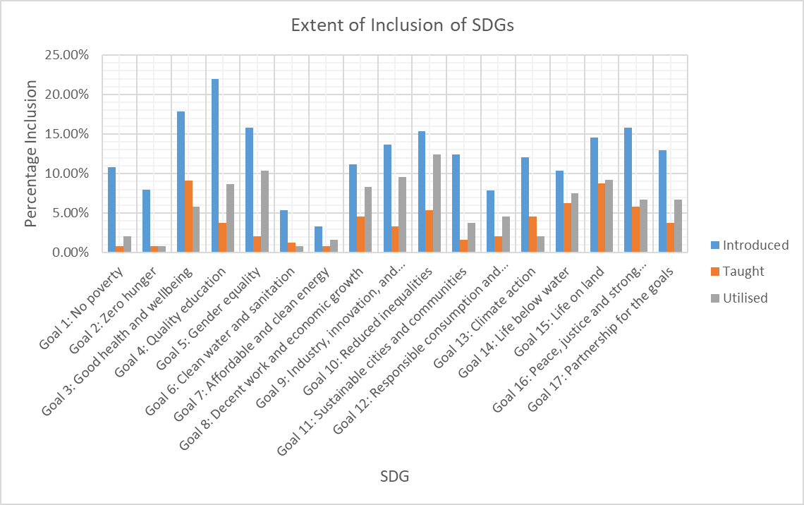
Extent of Inclusion of SDGs across all faculties

Slide 15
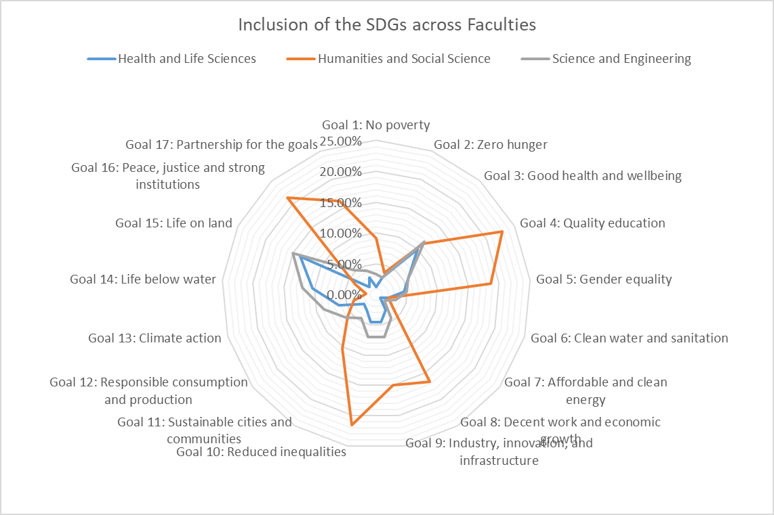
Inclusion of SDGs across Faculties

Slide 16
2023/24 Results: Decolonisation
Modules with a high decol score:
Participatory action research (36), Artificial Intelligence and Communication (35), Introduction to German Studies 2 (34.5)
4 modules were in the top 5 of both SDG and Decol score: Data Visualisation, Artificial Intelligence and Communication, Introduction to German Studies 2 and An Introduction to Critical Discourse Analysis
Notes:
*lowest scoring modules*

Slide 17
2023/24 Statistics: Decolonisation
Module | Faculty | Score (max. 36)
Participatory Action Research | Humanities and Social Science | 36.00
Artificial Intelligence and Communication | Humanities and Social Science | 35.00
Introduction to German Studies 2 | Humanities and Social Science | 34.50
Data Visualisation | Humanities and Social Science | 33.25
An Introduction to Critical Discourse Analysis | Humanities and Social Science | 32.00

Slide 18
2023/24 Statistics: Decolonisation
Module | Faculty | Score (max. 36)
Public Law | Humanities and Social Science | 0.81
Criminal Law | Humanities and Social Science | 2.50
Personal and Professional Development | Humanities and Social Science | 4.00
Geomorphology: Ice Sea and Air | Science and Engineering | 4.33
Cell Signalling in Health and Disease | Health and Life Sciences | 4.56

Slide 19
Free text: Decolonisation
"Both the lecturer and me (student rep) had reached out to each other on the teaching, we had a discussion on this and learnt that teachers have little time and ideas to create more stimulating lecturers. As part of the enhancement project, we planned to "take over" a tutorial session to challenge this status quo, we would love to work with SOS-UK and Liverpool Sustainability Guild to create this."
"In this module, we learned about dubbing video game audios into regional languages , rather than focusing on the main , international languages (such as French). We were able to freely discuss the pros and cons of projects like these, and it helped us to understand the importance of sustainable development- growing your business for other reasons than profit. Students were able to draw from their personal experiences to help them to form opinions."
"This module focused on the French influence in Louisiana, and the importance of the existence of institutions which protect this. We were able to understand some of France’s colonial past and relate our learnings to other countries with French presence. The module also enabled us to evaluate the necessity of regional dialects in wider societies"
"This module is an introduction to a completely new way of working (with databases and large datasets) for most of the students on the course so is definitely a space to challenge our previous ideas and get comfortable with the content/techniques."
"This module had a very large cohort (~200 students). Lectures were very much just the lecturer going through the content and students listening. This isn't necessarily bad, just explains why there aren't many/any opportunities for cross-level collaboration and chances to learn, unlearn, and challenge content."

Slide 20
Project 24/25
Meet with the University’s Sustainability Team, CIE and University colleagues with expertise in decolonisation (& new Guild Officers) to discuss the project going forward and the plan for the following academic year.
Decolonisation now embedded in the curriculum mapping project & will continue
New SRO to continue the work
Curriculum Review/Responsible Futures
Ownership of results & impact from the Uni
Starting project in Semester 1, rather than Semester 2

Slide 21
Any questions?
Lizzie (Democracy & Campaigns Manager): e.rodulson@liverpool.ac.uk
Ruth (Deputy Director of Membership Services): r.dalton@liverpool.ac.uk

