Slide 2
We’re on a mission!
LBSU’s whole organisation approach to community organising

Slide 3
Our context
Post 1992 Uni
C. 25,000 students, changing demography
New chief exec 2022
Uni financial stable, but facing the same challenges as everyone else
SU following traditional organisational model, with a bar & venue at 2 sites
Finances ok, but a challenge to budget each year

Slide 4
Student Engagement
Post covid slump – engaging with campus differently, feeling of a general malaise
Not out of step with the sector, but need to increase engagement and range of views
Demography moving rapidly with growth of international students (and these students disproportionately engaging with the SU)
COST OF LIVING
B3 metrics…

Slide 5
Things are changing – we need a strategy… (2022)
SU had undertaken significant research for a strategy before the pandemic, but the strategy never took route
Staff surveys were clear that there was a need for clear strategic direction from leadership
Students weren’t clear on what the SU was for or what it did…
University was seeking clarity form the SU about value for money
Call for a ‘democracy & governance review’ to ‘fix’ democratic engagement
Belief that more funding was the key to improving services and impact

Slide 7
Research and planning (2023)
Financial projections
Further forward than in the past to understand what might happen through the strategy – we run out of money in 2026- without change…
Commercial strategy
Disconnection from our core work, need for clarity of purpose
Engagement & Democracy
Commissioned a review with TPX impact

Slide 8
Research project with TPX impact - background
A realisation that two of the things commonly cited as being brilliant about working for a Students’ Union were no longer true at Leeds Beckett (that every day is different, and that you get to make major positive impacts on the lives of students)
Not that we weren’t doing valuable work, but that our methods had become somewhat ‘rinse and repeat’ and weren’t delivering anywhere near the levels of engagement and impact relative to the investment
Acknowledgement that engagement wouldn’t just recover following the pandemic era – the issues existed before this and we needed to be honest about this
Recognising the need for a methodology of engaging with our members that is understood throughout the organisation, by our members, and the right fit for Leeds Beckett

Slide 9
Research project with TPX impact – why use an external partner if we knew the problems?
The need to add capacity to deliver a comprehensive review of our democratic engagement
A desire to be completely open to new ways of doing things, including outside the sector
Partnered with TPXimpact, whose approach put our staff, Officers and students at the centre of the review, and on a practical level
Discovery ‘sprint’ changed the whole scope of the review, as conversations with students and stakeholders soon made it clear that before even starting to think about our democracy, we had to consider our relevance
Summary of key recommendations…..or just focus solely on the Community Organising one?

Slide 10
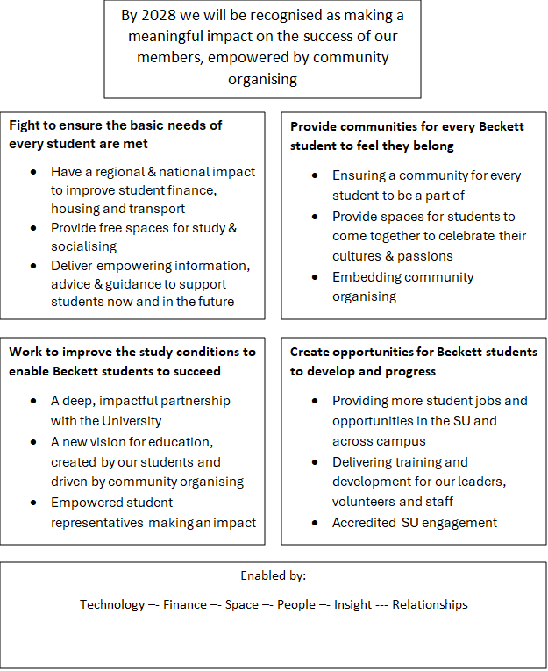

Slide 11
THEORY OF CHANGE
Missions provide the ‘what?’
Organisational clarity for decision making – if it doesn’t fit the missions, we aren’t doing it
But, this doesn’t change the how… and the how was the problem that the students told us about
So the answer became COMMUNITY ORGANISING at scale, in all areas

Slide 12
Why community organising?
Can be applied across the missions
Builds community power – lack of social capital is not a problem, it is an opportunity
Aligns community building and change making
Refocuses our attention to create change beyond the University
Allows us to build a regional network and impact

Slide 13
What is a whole SU approach?
Community organising is not a bolt on to existing work or methods
The techniques and practice are now the foundation of all of our engagement work
This requires rethinking some of the core elements of the way we have run students’ unions in the UK, and constantly challenging our ways of working

Slide 14
Leadership, training & development
Must come from the top – I am like a broken record or trying to step up a cult…
When we say all staff, we mean all staff – September 12th all staff will have a training session on community organising
Why not have bar staff using organising techniques?
Our student staff need to be a full part of our team, not a bolt on
Money, time and expertise

Slide 15
Academic Representation
We still have Course Reps, but they are trained in Community Organising methods, such as holding relational 1-1s and house meetings with their peers (I will talk a bit about this will work at course level, across study-levels, and at School level)
Encourages community building across different levels, and different courses within subject areas
Course Reps identified as likely leaders of Core Communities
Refocus of ‘School Forums’ towards ‘Assemblies’, where more specific ‘asks’ can be discussed with power holders, rather than the raising of very individualised pieces of feedback
Insight gathered will inform the Union’s campaign cycle

Slide 16
Clubs & Societies
Creation of ‘Core Communities’ to ensure that every student can find a community related to their studies, their nationality, their faith, or their identification with a liberation or equality group
How is this different? We won’t wait for students to approach us to set these up, we will divert our resources to creating the foundations for these communities to exist
Core Communities will serve both a social purpose, providing opportunities for like-minded individuals to meet, and also provide a defined set of Communities for our Student Community Organisers to engage directly with
What have been traditionally hobby or interest-based societies will still be supported by the SU to promote themselves and grow their membership, but funding and staff resource will be heavily weighted towards Core Communities
Insight gathered will inform the Union’s campaign cycle

Slide 17
Democracy
Rejection of the idea that our direction can be determined by whoever can fill a room on a given day
Core Communities will be given democratic power to set our priorities each year and shape our campaign cycle
Five Steps to Social Change cycle

Slide 18
Advice
Work still to do and our thinking developing (can’t break it and can’t stop!)
Ensuring our advice service is a proactive part of wider representation
Beyond triage – how can our organising learn from casework and empower students?
Housing the team within organising, using an assumption of community empowerment and strength, rather than an individualised, paternalistic model
Developing a public affairs function will be vital to impact

Slide 19
Officers
Big thinking to be done this year…
Do they fit with the model? Are we just shoehorning them in – which is exactly what we said we would stop doing!
Training them alongside our student community organisers
Using organising feedback to build executive committee agendas
Using the organising cycle to renew accountability
How prescriptive can we be based on listening? Do representative elections fit the model at all?
Uni is clear they want them, students seem to respond to them, we are seeking a way to make them add to the model

Slide 20
Early success and encouraging signs
We used Community Organising methods to engage students in the review, and had some of the best turnout we’ve seen in years
1
Pilot year working with Citizens UK, having a Core Team made up of Officers & Student Community Organisers has led to us becoming a principle partner in CUK
2
Four key campaign areas identified (timetabling, public transport, faith spaces, part-time jobs)
3
Hosted the West Yorkshire Citizens Assembly where commitments in the above areas where made by mayoral election candidates
4
First successes starting to materialise with the bus campaign in Leeds, which has been influenced by our work on public transport
5

Slide 21
Challenges and considerations
To what extent can/should we pre-determine our Core Communities, for example what is our approach to nations and faiths that very small numbers identify with?
Putting complete faith in student staff to deliver what may previously have been the work of a career staff member, and the challenges this presents
How quickly could the ground shift under us again? Will there be another big shift?
Pace of change - strategic capacity is a challenge currently
Officers and their impact on the model

Slide 22
Building our movement
We will share any and all of our work, documents, research, just ask!
We used external consultants, and had clear reasons for this, you don’t have to…
Follow up session planned at Strategy Exchange
If this works we will be hosting a conference in 2025 (we can’t handle any more visits!)

