Slide 1
Keeping Student Reps engaged in times of declining engagement
Ausrine Naujalyte
Emma Hollenberg
Krystyna Drewenska
Notes:
EH

Slide 2
Room shuffling and ice breaker
What 3 things have you taken away from the conference?
Notes:
KD

Slide 3
Rep Structure
HUMS Exec Officer FBMH Exec Officer
FSE Exec Officer Research Exec Officer
Education Exec Officer
School Rep
School Rep
Student Rep
Course Rep
Pre 2022
Academic year 23/24
Notes:
AN

Slide 4
Rep Structure
HUMS Exec Officer FBMH Exec Officer
FSE Exec Officer Research Exec Officer
New training for reps – different delivery methods
Sign-up method, no elections*
School Rep
Focus on developing sense of belonging – School Reps
Academic Rep
Academic year 23/24
*Some funky programmes
Notes:
AN

Slide 5
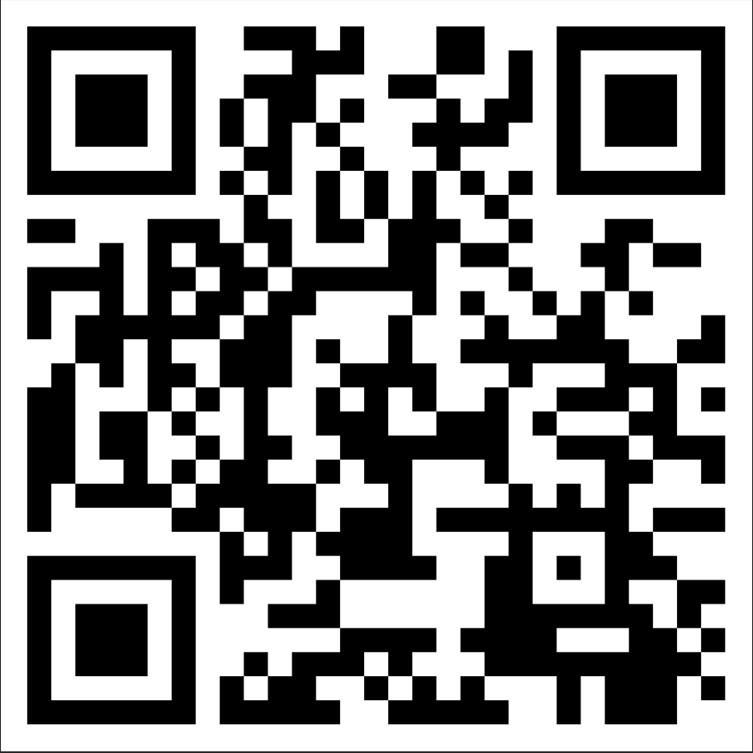
Provocation
How do you stop students from engaging?
Notes:
KD https://padlet.com/krystynadrewenska/how-to-keep-reps-disengaged-5d0yci54trc6fznz

Slide 6
What can we do instead?
Notes:
KD

Slide 7
3 Pillars of Engagement
Build
How do you make students care about their academic matters?
How can we adapt rep training?
Maintain
How can we keep reps engaged?
What events work best?
Recognise
How can we recognise contributions and celebrate achievements?
How can we ensure that reps continue to be reps in the next academic year?
How can we build a sense of belonging among reps?
What communication methods work best?
Notes:
EH

Slide 8
If you had unlimited resources, how would you...
Build
How do you make students care about their academic matters?
How can we adapt rep training?
Maintain
How can we keep reps engaged?
What events work best?
Recognise
How can we recognise contributions and celebrate achievements?
How can we ensure that reps continue to be reps in the next academic year?
How can we build a sense of belonging among reps?
What communication methods work best?
Notes:
EH
https://padlet.com/krystynadrewenska/if-you-had-unlimited-recourses-how-would-you-313wma9kjnq6vid

Slide 9
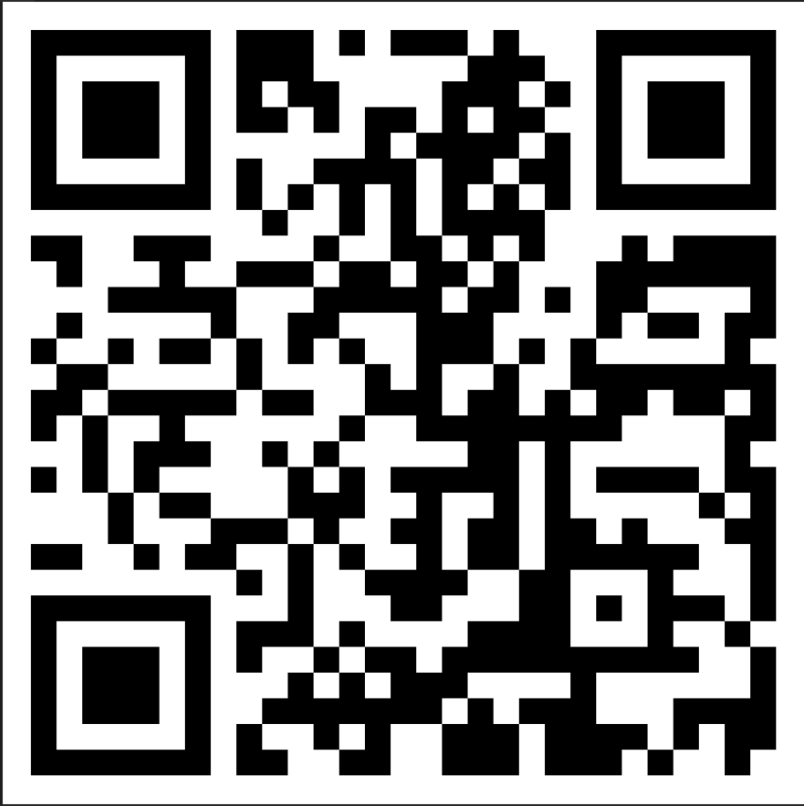
Notes:
KD

Slide 10
If you had unlimited resources how would you...
Build
How do you make students care about their academic matters?
How can we adapt rep training?
Maintain
How can we keep reps engaged?
What events work best?
Recognise
How can we recognise contributions and celebrate achievements?
How can we ensure that reps continue to be reps in the next academic year?
How can we build a sense of belonging among reps?
What communication methods work best?
Notes:
EH
https://padlet.com/krystynadrewenska/if-you-had-unlimited-recourses-how-would-you-313wma9kjnq6vid

Slide 11
With the resources you have, what can you focus on?
Build
How do you make students care about their academic matters?
How can we adapt rep training?
Maintain
How can we keep reps engaged?
What events work best?
Recognise
How can we recognise contributions and celebrate achievements?
How can we ensure that reps continue to be reps in the next academic year?
How can we build a sense of belonging among reps?
What communication methods work best?
Notes:
AN

Slide 12
Thank you!
studentreps@manchester.ac.uk

