Slide 1
Have we forgotten how to lobby people that might actually listen? (or the tyranny of nostalgia and why things are harder than you expect)
James Coe | Associate Editor for Research and Innovation, Senior Partner Counterculture, friend to all | WONKHE
@James_Coe1 | james@wonkhe.com

Slide 2
What is it we can solve locally that fixes issues nationally AND helps the region and its leaders look good AND it is good for students AND it is possible to do

Slide 3
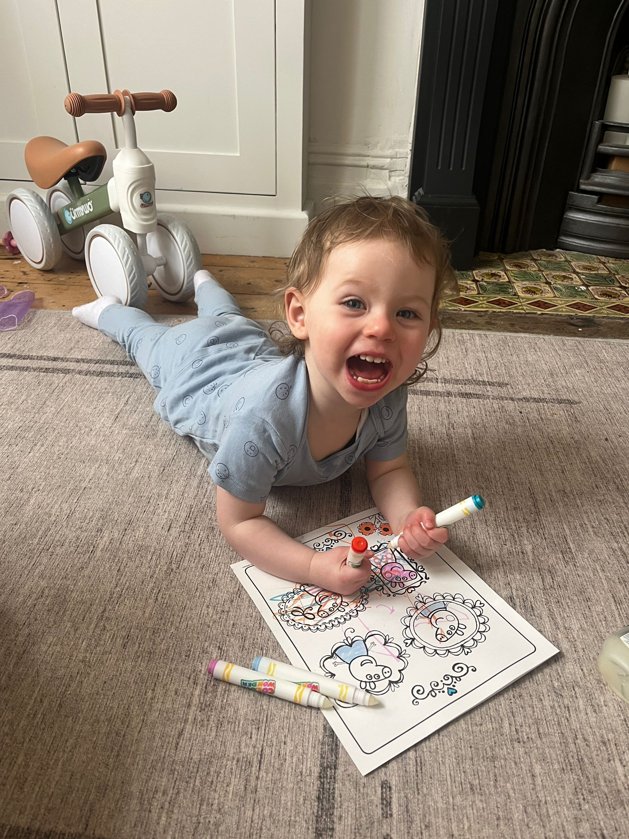
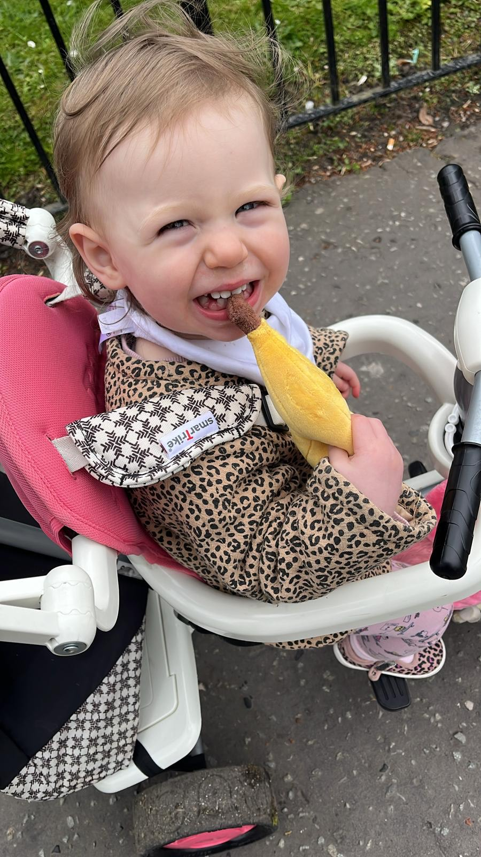
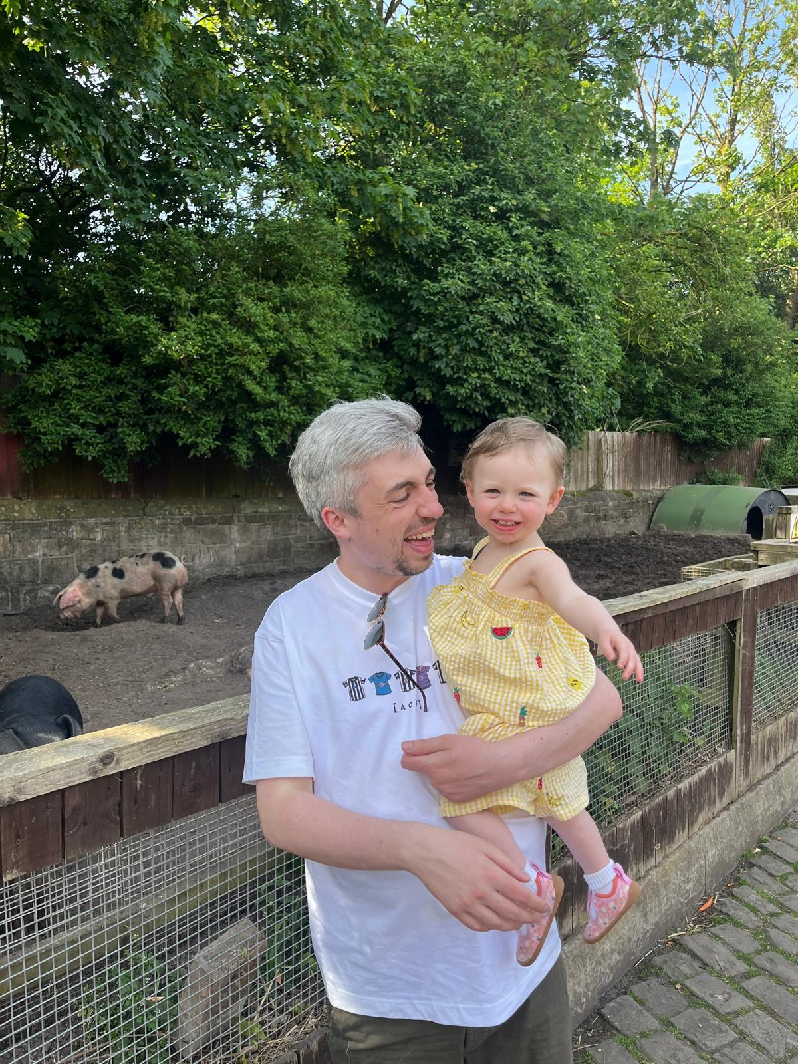
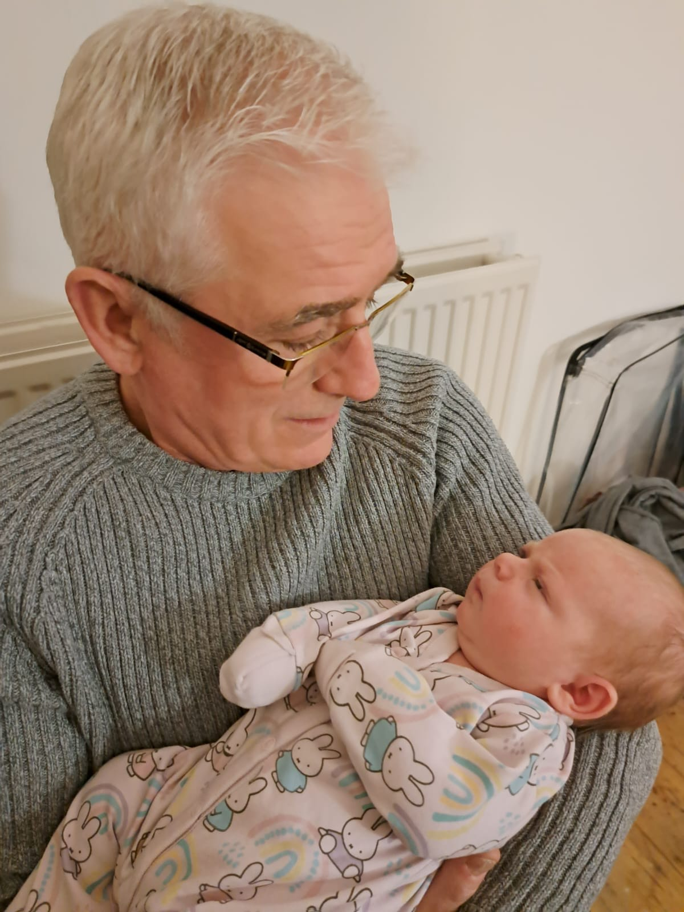

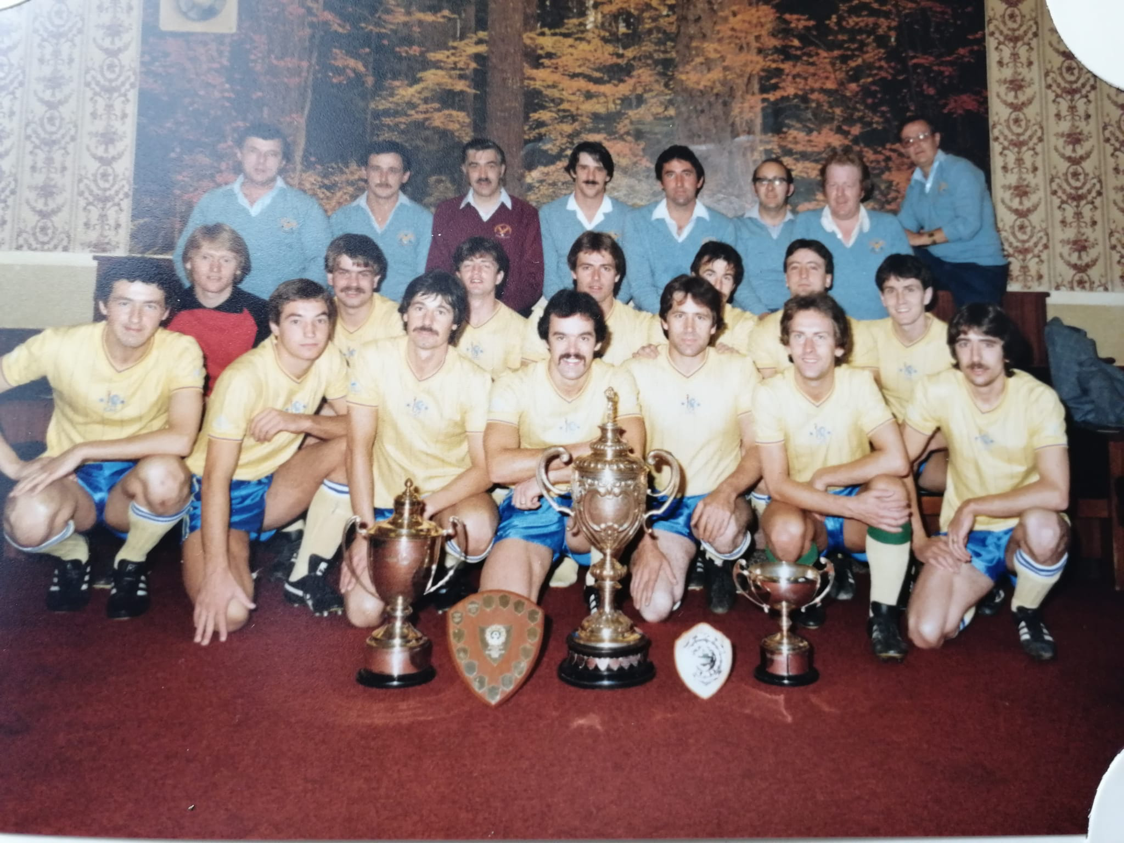

Hiya

Slide 4
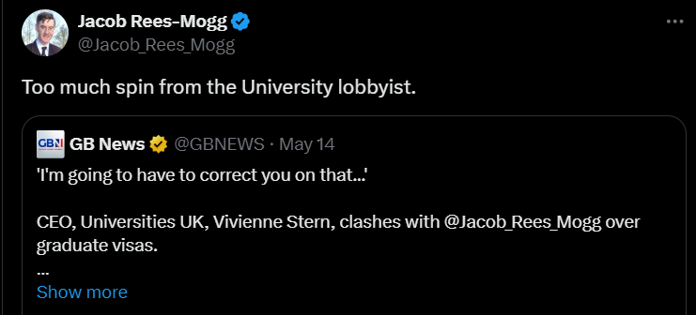
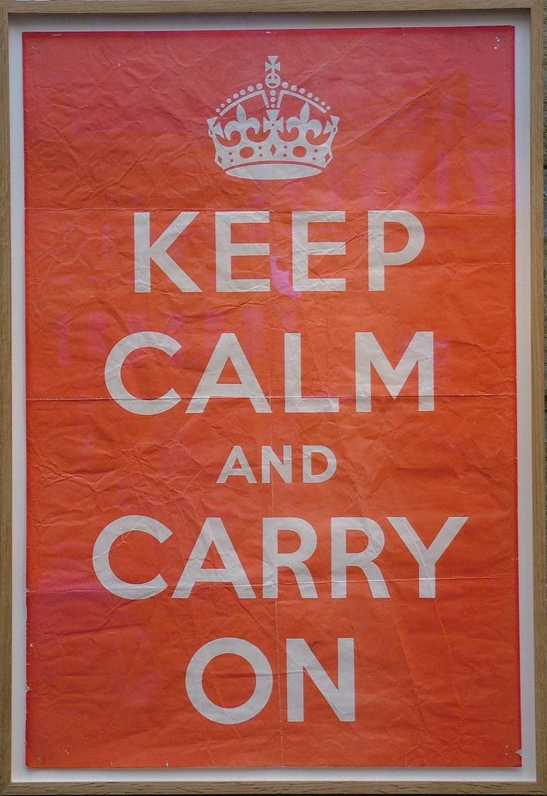
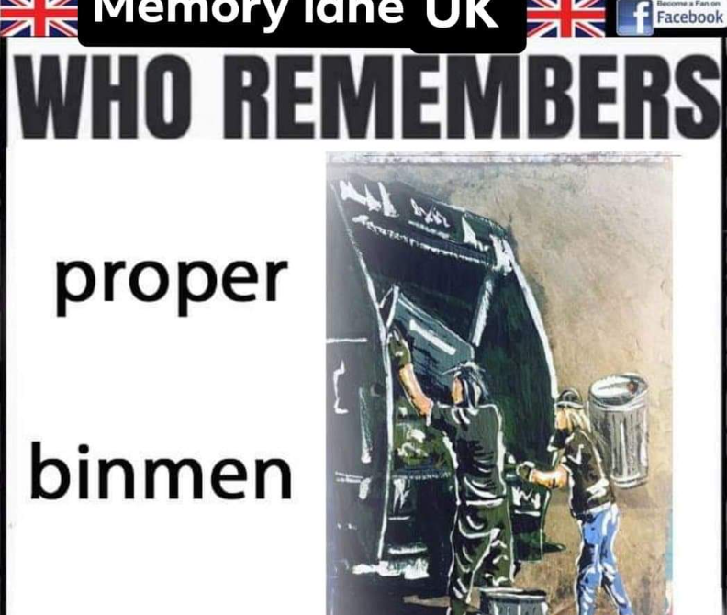
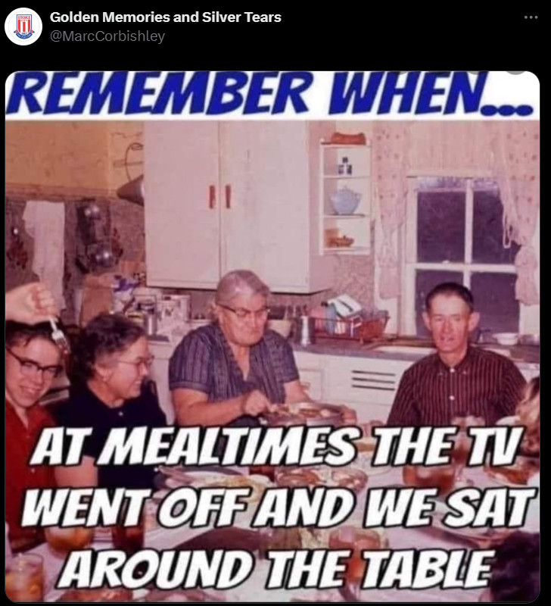
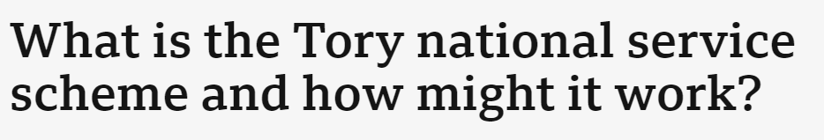

Slide 5
Choosing to do nothing is a choice

Slide 6
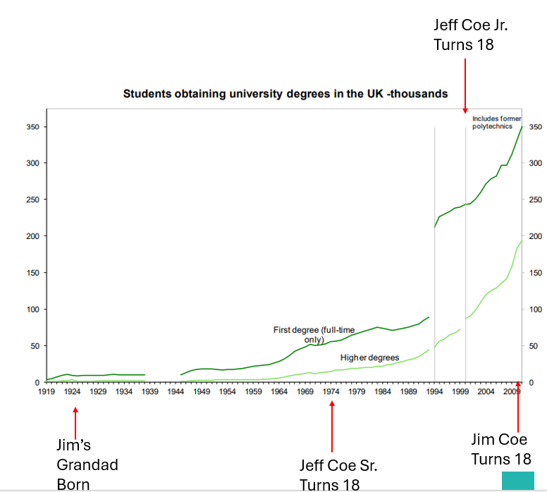
The demographic case
Students
Higher education has grown and will continue to grow.
This is not only because of demographics but because of an economic reality
The challenge is who do we let in, how, and to do what.

Slide 7
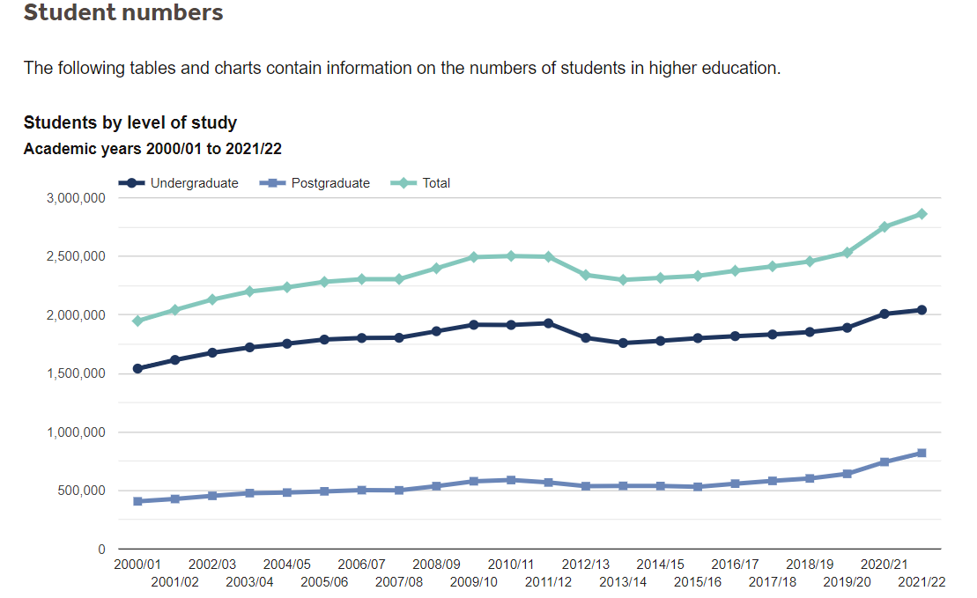
The demographic case
Students
Applications rates are still high by historical standards
There is still a significant proportion of students that could go to university but do not

Slide 8
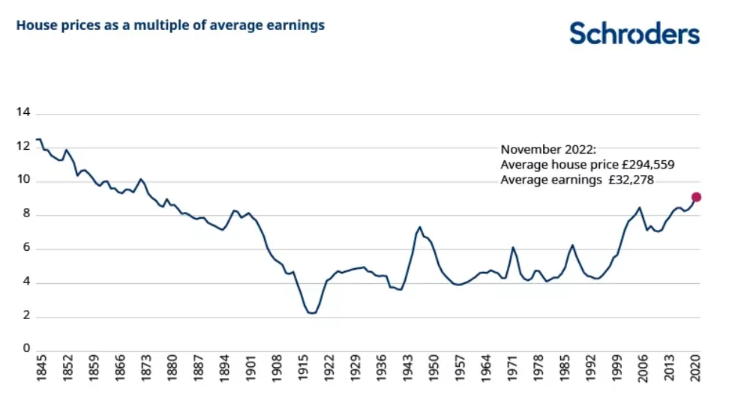
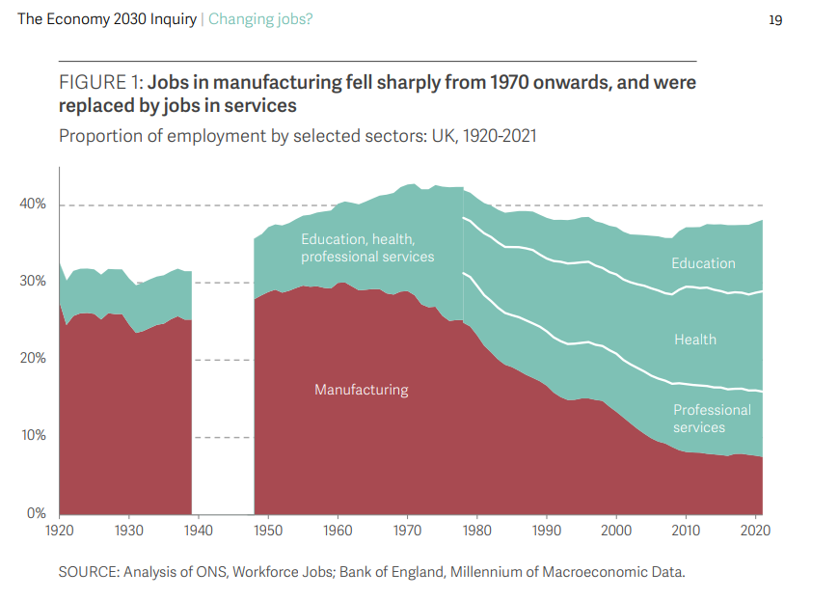
Good Jobs

Slide 9
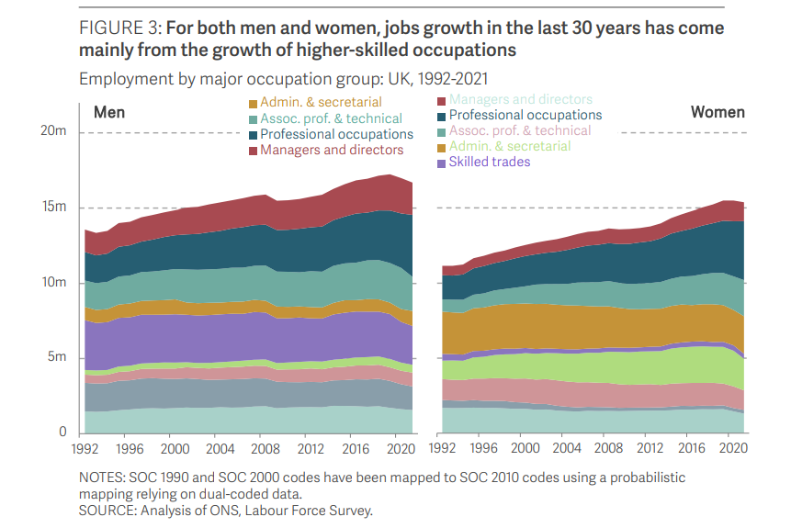
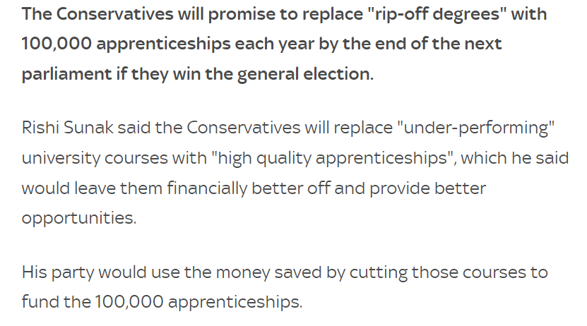
Good Jobs

Slide 10
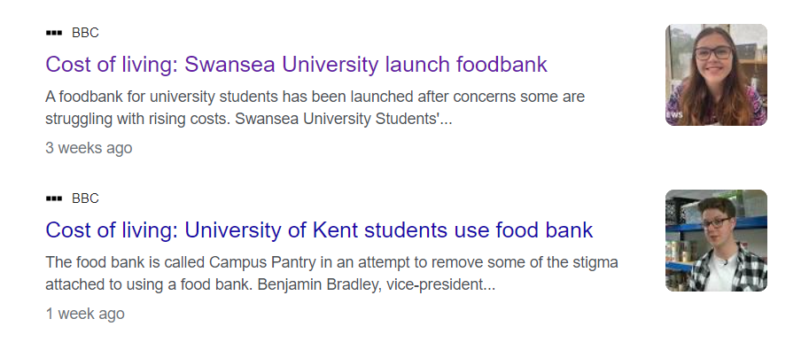
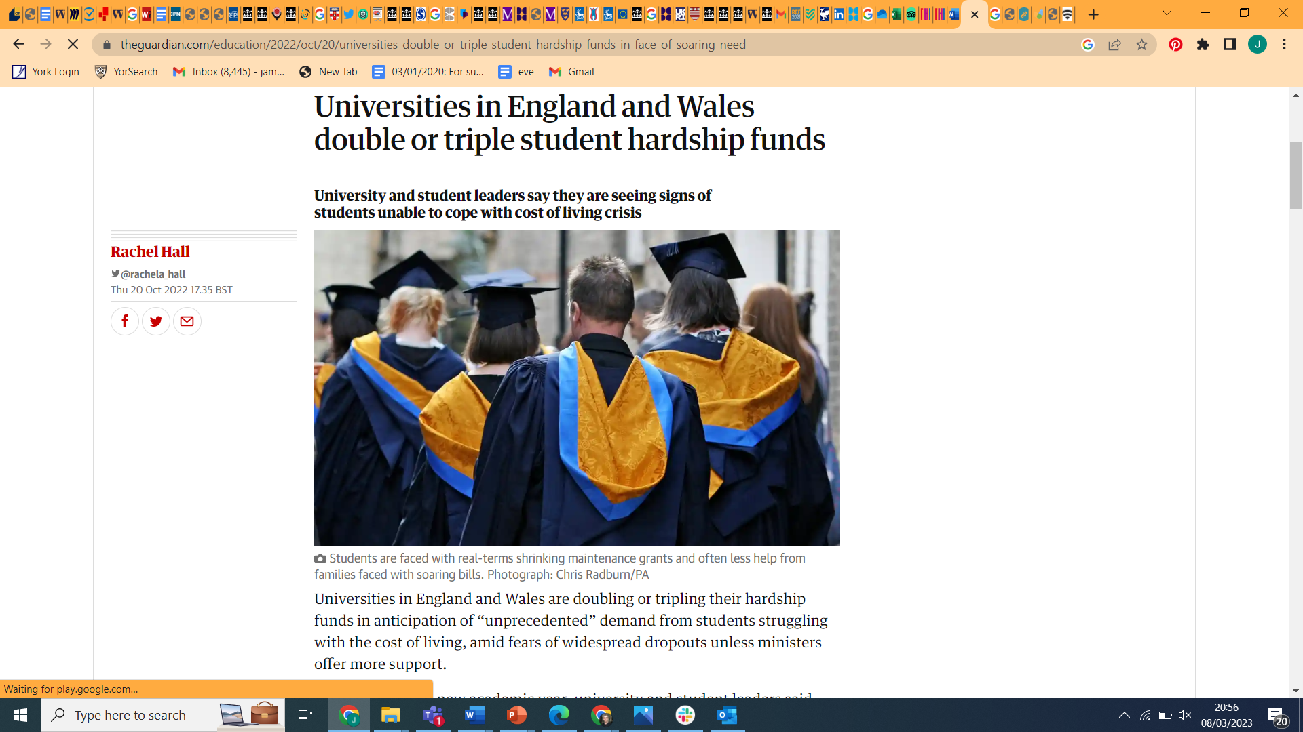
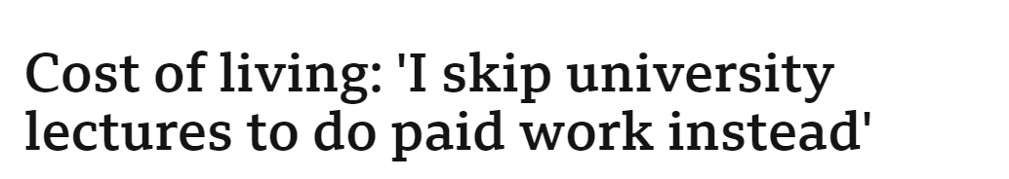
Structural funding crisis?

Slide 11
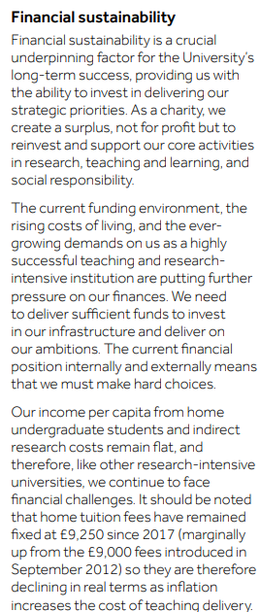
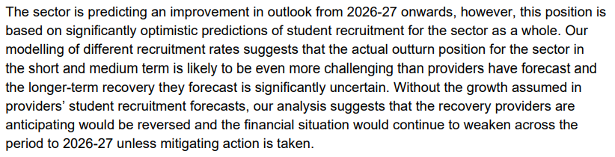
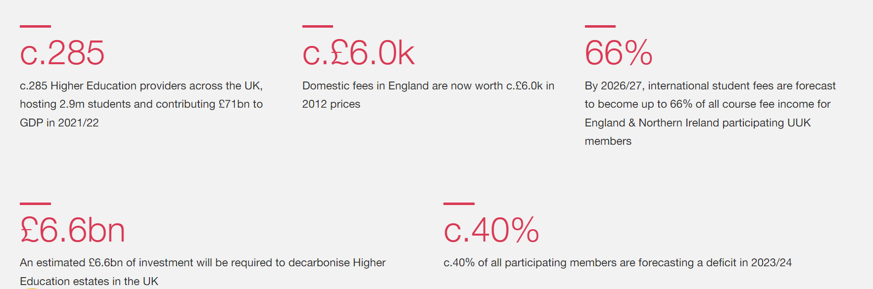
The financial picture

Slide 12
Political Outlook

Slide 13
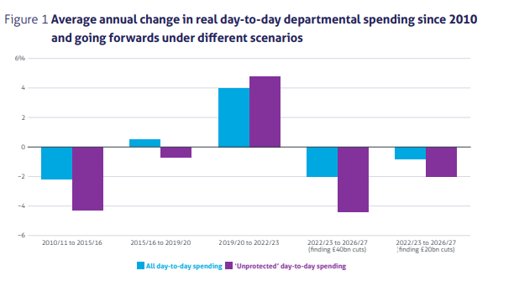
Institute for Government 2022

Slide 14
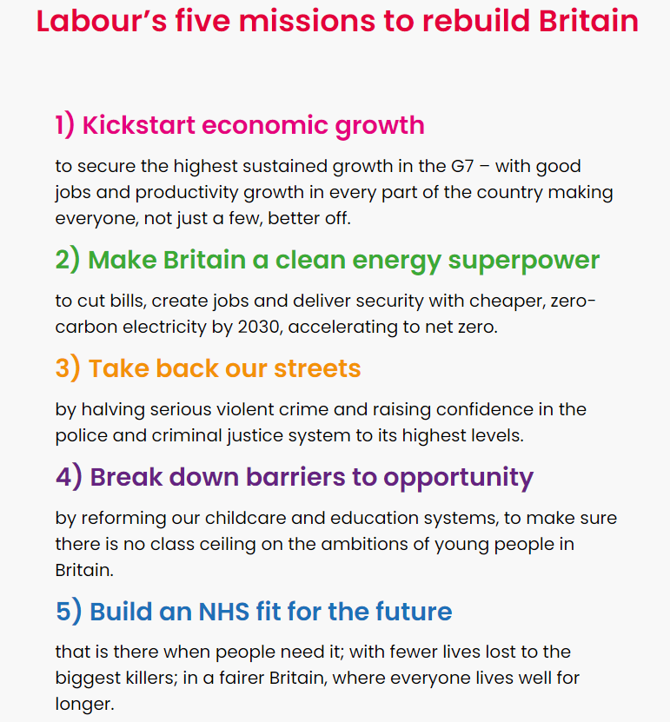
Institute for Government 2022

Slide 15
Labour’s inheritance
Low productivity
War in Europe and the Middle East
Brexit and its outcomes
Far right on the streets
Little fiscal headroom
Multiple structural crisis
Institute for Government 2022

Slide 16
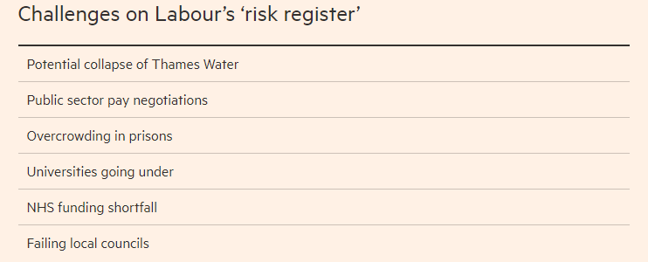
Institute for Government 2022

Slide 17
Possible higher education futures

Slide 18


Slide 19
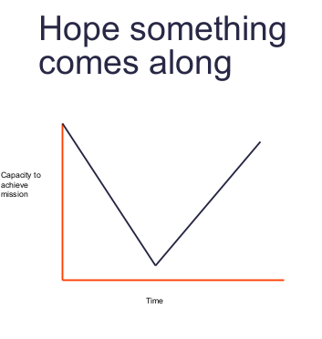
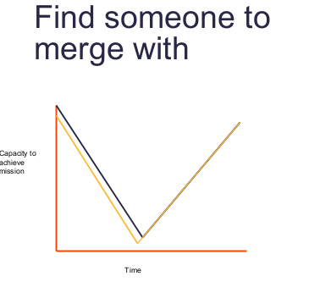
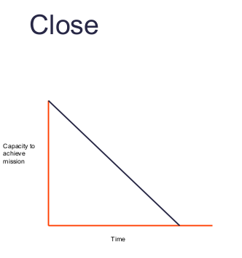
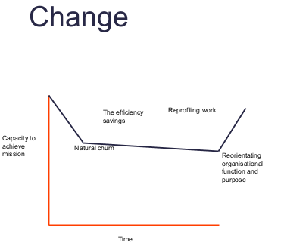
THERE IS NO PLAN

Slide 20
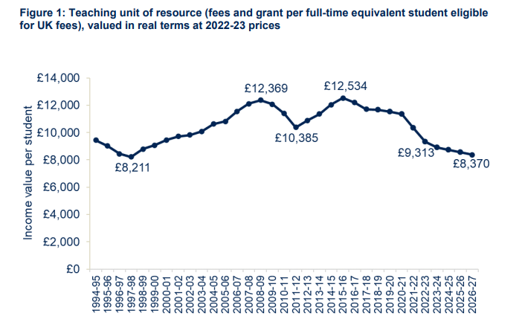
Increase unit of resource
Massive cost reduction
Increase the grant element
Grow student numbers even more(?)
Raise taxes

Slide 21
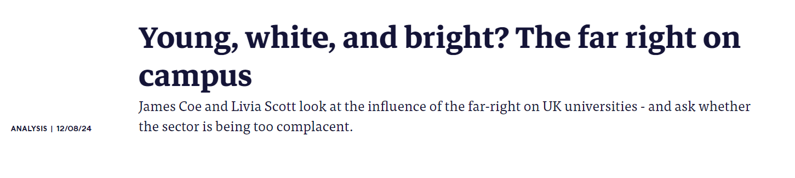

Slide 22
Things are politically contentious, or students aren’t engaging
Let’s mediate it through structures
Let’s go to consensus decision making

Slide 23
Ok now what

Slide 24
Local government
Regional government
Westminster Government

Slide 25
Some form of policy making
Local democratic groups and policy forums
Elected representatives
Events

Slide 26
Local councillors for the very local
Regional mayors for the very regional
MPs for Westminster and lobbying
Assorted power groups

