Slide 1

Academic Integrity:
Making Meaningful Change

Slide 2
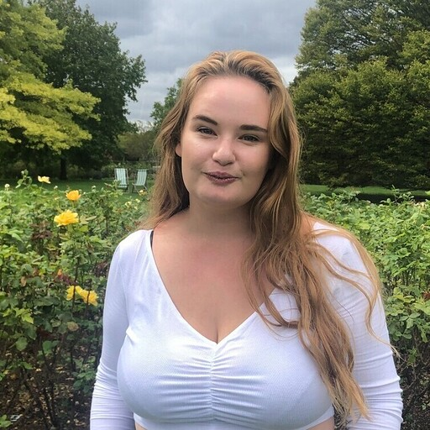
Hannah
Principal Advice Caseworker
(she/they)

Slide 3

Alkhemy - who are we?
Social Impact Company
Support the ORS and HE sectors
Not quite a consultancy…
A team from the SU world: sabbs; student voice; advice; and more
We believe in radical disruption
Our specialities: Interim Capacity; Democracy Reviews and more

Slide 4
Academic Misconduct
Key Groups and Challenges
Today’s Session
Your Experience
Collective Representation
Common Challenges
Trends and Your Context
Who? What? Why?
Best Practice and Shared Challenges
Working with Student Voice and Officers
Building a National Picture

Slide 5
Academic Misconduct
Trends and your Context

Slide 6
Activity
We’ll start by exploring the trends that you see with Academic Misconduct at your organisation.
If you have a phone/laptop, you can take part using the following link: www.menti.com
Then input the code that will appear on the screen.

Slide 7
Academic Misconduct Trends
Mature
International

Slide 8
Key Groups and Challenges
Who? What? Why?

Slide 9
International Students
May not understand policy
International PG students:
  Often only receive guidance at UG level
  If UG was completed in another country, may not have received guidance on policy in the UK
Language used in policy may not be clear, or confusing
Cultural differences may cause challenges in seeking support, or being open about external pressures

Slide 10
Mature Students
Time away from studying can cause difficulty
Pressure of being an older student and being expected to know what to do
Can be faced with complex external challenges relating to family, finances (e.g. mortgages)

Slide 11
Your Experience
Best Practice and Shared Challenges

Slide 12
Activity
In small groups:
Discuss how you current support your students with Academic Misconduct.
How do our current practices reflect the challenges we are experiencing?

Slide 13

Current Challenges
Share your groups discussions with the room:
How can the challenges we faced be addressed within advice teams?
Which of our challenges are rooted in institutional policy, approach, and practice?

Slide 14
Collective Representation
Working with Student Voice and Officers

Slide 15

Collective Representation
Thinking about our colleagues in Student Voice, and our Sabbatical Officers:
How does your advice team already work with these teams?
How can these teams help us to identify and dig down into trends we see in advice?
What techniques are available to these teams to assist us?

Slide 16
Collective Representation
Internal Surveys
GOATing and GOALing
Drop-ins
Manifestos
Student Reps
National Trends
Advice-related queries often appear organically in SV-led surveys
Your student officers can go out and talk/listen to students more generally to hear their concerns
Your officers may hold drop-ins for students, which could be themed on particular topics
Were your officers elected on manifesto pledges relating to trends?
Student reps are often the front line for student concerns
Your officers will be networking with other officers around the country

Slide 17
How are you sharing your data with SV / Officers?
How do you get info from SV / Officers?
Key Considerations
Can you work with SV / Officers to get additional insight?
How do officers take your data to senior committees?

Slide 18
Common Challenges
Building a National Picture

Slide 19
Common Challenges
As a whole group:
Thinking back across today’s discussions, can we identify those challenges which are broadly applicable to many/all of us?
On a national scale: what can we do, as advice teams within our sector, to combat these challenges and the narrative.
I.e. thinking about international students, how do we combat the rhetoric around this community?

Slide 20
Thank You
hannah@alkhemy.org.uk

