Slide 1
CONFLICT RESOLUTION: USING NON-VIOLENT COMMUNICATION (NVC)
Gemma Perella, gemma@thesli.co.uk

Slide 2
ABOUT THIS SESSION
Learn the essential steps of Non Violent Communication (NVC)
Learn 4 steps for talking about conflict diplomatically and empathetically
Practice drawing out and expressing the underlying needs of a conflict – using your own example
Learn how to use NVC to work towards constructive solutions
Notes:
2

Slide 3
ABOUT ME
Personal Development Trainer
Creating confident, resilient and emotionally intelligent young leaders.
Providing training courses using a mixture of coaching, instruction and activity based learning.

Slide 4
YOUR EXAMPLE
Identify a conflict in your life
0-4 in difficulty out of 10
Something you can talk about
Does NOT involve the person sitting next to you
OK if it was resolved or unresolved
OK if it is work, study or personal
Notes:
4

Slide 5
CONFLICT RESOLUTION
Active listening
Assertiveness
Structuring a difficult conversation
Negotiation skills
Looking for collaborative solutions
Understanding conflict drivers
Non Violent communication
Notes:
5

Slide 6
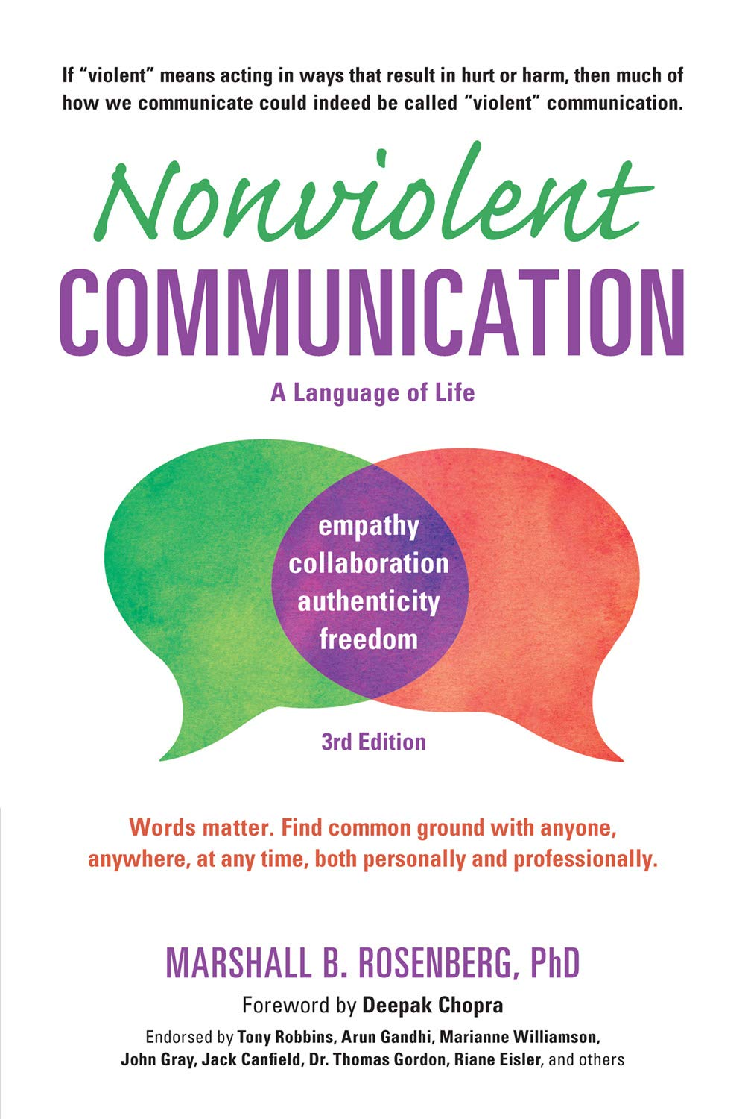
NONVIOLENT COMMUNICATION
Nonviolent Communication: A Language of Life – Marshall B. Rosenberg
State the situation as an observation
Identify the feelings
Identify what needs are not being met
Request a solution or state the boundary
Notes:
6

Slide 7
1) MAKE OBSERVATIONS
Judgements are our opinions, interpretations, assumptions, exaggerations, guesses and even ‘spin’
Observations are the things we can see as definitely true – like we are watching the scenario on a video recording.
Notes:
7

Slide 8
1) MAKE OBSERVATIONS
A colleague waltzed by my desk on Friday afternoon and pressured me into doing last minute social media for their campaign - and I gave in to them.
A colleague waltzed by my desk on Friday afternoon and pressured me into doing last minute social media for their campaign - and I gave in to them.
A colleague came to my desk at 3.30pm on Friday afternoon and said “This campaign needs a final push before 5.30pm and I have too much to do. You are really good at communications, you should do it.”
Even though I knew I was busy I agreed to take on the work.
Notes:
8

Slide 9
1) MAKE OBSERVATIONS
You derailed our meeting into talking about your latest fad project so that you could justify some extra resources.
You derailed our meeting into talking about your latest fad project so that you could justify some extra resources.
In our last team meeting you raised a point that was not on our agenda. We spent 20 minutes talking about a new project you are running and you asked for extra resources.
Notes:
9

Slide 10
YOUR EXAMPLE
Think about your conflict example.
State the situation as an observation
Factually, what happened?
Notes:
10

Slide 11
2) IDENTIFY FEELINGS
Afraid Agitated Angry Annoyed Anxious Aversion Bored Confused Depressed Disconnected Dislike
Embarrassed Enraged Envious Exhausted Fatigue Frustrated Guilty Hate Helpless Hopeless Hurt
Impatient
Insecure
Jealous
Lonely
Lost
Nervous
Outraged
Pain
Puzzled
Restless
Sad
Self conscious
Sensitive
Suspicious
Tense
Tired
Vulnerable
Withdrawn
Worried
Yearning
Notes:
11

Slide 12
3) IDENTIFY NEEDS
Notes:
12

Slide 13
3) IDENTIFY NEEDS
CONNECTION
acceptance
affection
appreciation
attention
belonging
care
comfort
communication
community
companionship
compassion
consideration
consistency
cooperation
empathy
inclusion
intimacy
kindness
love
mutuality
nurturing
respect/self-respect
safety / security
stability
support
to know and be known
to see and be seen
trust
warmth
HONESTY
authenticity
integrity
presence
trust
PHYSICAL WELL-BEING
air
food
health
movement/exercise
rest/sleep
sexual expression
safety
shelter
touch
water
PLAY
celebration
creativity
humour
joy
Leisure
PEACE
beauty
ease
equality
faith
harmony
healing
inspiration
transcendence
AUTONOMY
choice
dignity
freedom
independence
power
space
spontaneity
MEANING
awareness
challenge
clarity
competence
consciousness
contribution
discovery
growth
hope
inspiration
learning
mourning
order / structure
participation
purpose
self-expression
understanding
Notes:
13

Slide 14
I STATEMENTS
I feel ____ because I needed ____.
I am ____ because I value ____.
I was ____ because ____ is important to me.
I was irritated because I need the consistency of sticking to an agreed agenda.
I feel overwhelmed. I already have a lot of work and need the space to complete those tasks before taking on more.
Notes:
14

Slide 15
YOUR EXAMPLE
2 & 3) Identify feelings and needs
What were you feeling in your situation?
What were your unmet needs?
Use an I statement
Empathise with the feelings and needs of the other person
Notes:
15

Slide 16
4) REQUEST A SOLUTION
Use your understanding of your needs (and theirs) to move forwards
Requests:
Statements:
Would we be able to…
Could we try…
Would you be willing to…
It would help me if…
I need / want / would like…
I will / will not…
I am going to…
When --- then I will…
If --- then …
I have the right to...
Notes:
16

Slide 17
YOUR EXAMPLE
4) Request a solution OR state a boundary
What do you (both) need that would support the situation?
Be specific
Be positive
Ask, don’t demand
Notes:
17

Slide 18
NVC
State the situation as an observation
Identify the feelings
Identify what needs are not being met
Request a solution OR state the boundary
On Friday at 3.30pm you asked me to help you do a final push on your social media campaign. Even though I knew I was busy I agreed to take on the work.
I felt frustrated with myself.
Belonging is important to me so I took on too many tasks and put myself under pressure.
It would help me if I had at least two days notice for tasks so that I can plan my work flow.
Notes:
18

Slide 19
NVC
State the situation as an observation
Identify the feelings
Identify what needs are not being met
Request a solution OR state the boundary
In our last team meeting you raised a point that was not on our agenda. We spent 20 minutes talking about a new project you are running and you asked for extra resources.
I felt annoyed
Because I value structure and fairness – and I wanted to discuss an agreed agenda point.
When you have suggestions please submit them in advance or wait until ‘AOB’ so that we can keep to our agenda.
Notes:
19

Slide 20
WRAPPING UP
Learned the 4 step NVC model for discussing conflict
Practiced articulating what you need to find a solution
Conflict resolution skills take time, practice and complimentary skills
Notes:
20

Slide 21
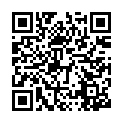
FURTHER SUPPORT
NVC resource sheet
Notes:
21

Slide 22
www.thesli.co.uk
Training programmes
Coaching
Resources and blogs
Mailing list
CONFLICT RESOLUTION: USING NON-VIOLENT COMMUNICATION (NVC)
Gemma Perella, gemma@thesli.co.uk

