Slide 1



Elections 2024
Playback
Notes:
Elections Playback 2024.
Wednesday 14th August.
11:00am - 11:50am.
50 min presentation.

Slide 2
Content
Big SU Survey: SU Election Report 2024
RO recommendations
Case studies
Turnout
Key survey insights
Key candidate demographics insights
Notes:
2 - 3 mins to talk through presentation content

Slide 3
Our Support in 2023/24
  Returning Officer for 107 SUs over 150 elections
  34 in Autumn 2023 & 116 Spring 2024
  Development webinars in December/January
  Daily drop-in triage over peak period in March
  73 SUs completed the Elections Survey
  15 SUs used the Candidate Demographic Survey
(162 candidates) & more data collected
Notes:
5 mins to talk through support more widely
- Development Webinars. Were in December/January, we'll move earlier based on feedback
- 15 SUs used Candidate Demographic Survey but we also asked SUs for their data, come back to that exciting update later

Slide 4

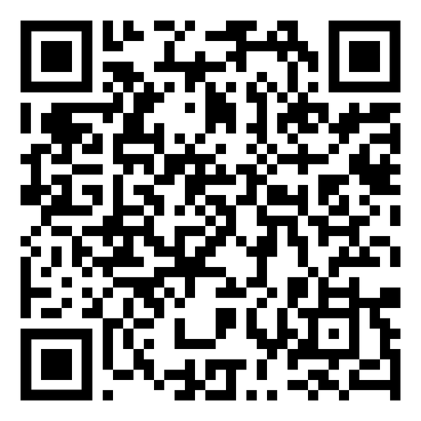
Big SU Survey:
SU Election Report 2024
  Annual report
  Informed by the Elections Survey,
shared in Spring 2024
  73 SUs contributed
  SUs from across the UK
Notes:
5 mins to talk about the report
- Annual, older reports up on Connect
- Informed by Elections Survey, thanks to those for completing
- SUs to do & don't use the RO service contributed to survey
- 73 completed this year, similar to most year's feedback
- SUs from across our 4 nations and from a range of SU sizes contributed

Slide 5
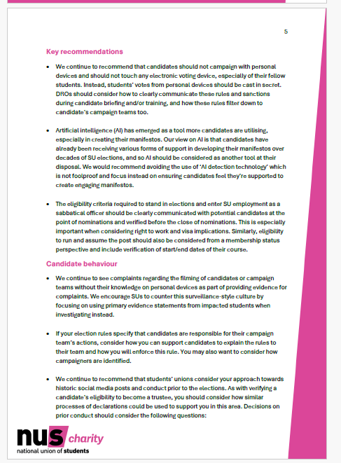
Returning Officer’s
Recommendations
  From Peter Roberston, NUS Charity Director & national Returning Officer
  Updated annually to reflect the common complaints & issues
  Covers: candidate behaviour, rules
and regulations, complaints & more
Notes:
5 mins to talk about RO recommendations
- Updated each year
- Reflect current SU issues with elections
- Informed by drop ins, complaints & appeals too
- Themed in sections, have a read of what's most relevant to your SU
- Pages 4 - 7 on report

Slide 6
Top 2024 Recommendations
  Candidates should not campaign with personal devices and should not touch any electronic voting device, especially of their fellow students. DROs should consider how to clearly communicate these rules during candidate briefing and/or training.
  Artificial intelligence (AI) has emerged as a tool more candidates are utilising. Candidates have already been receiving various forms of support in developing their manifestos over decades of SU elections, and so AI should be considered as another tool at their disposal.
  The eligibility criteria required to stand in elections and SU employment as an officer should be clearly communicated with candidates at the point of nominations, especially important when considering right to work and visa implications.
Notes:
5 mins to talk about RO recommendations
- Top recommendations this year
- Pages 4 - 7 on report

Slide 7
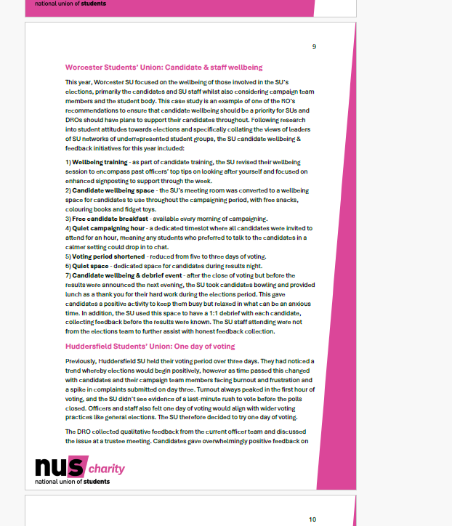
Case Studies
  x6 case studies from SUs
  Qualitative examples to accompany the quantitative data from the survey
  Worcester SU created a debrief event with candidate wellbeing in mind
  Huddersfield SU moved to a one day voting period & used lanyards to denote campaign team members
  University of Nottingham’s SU focused on supporting student media and swapping QR codes for NFC tags
  King’s College London SU embedded their elections in a wider student leadership journey
Notes:
5 mins to talk about the case studies
- Wanted more qualitative examples to accompany the stats from coming from the survey
- Includes x6 case studies from x4 SUs
- Range of topics included
- We'd encourage people to read to discover different approaches plus please continue to share examples of good practice via Workplace or via the CoP
- Pages 8 - 11 on report

Slide 8
Survey & report
highlights
Notes:
- I'll now cover some some key highlights, loads more detail in the report and of course email if you have any questions

Slide 9
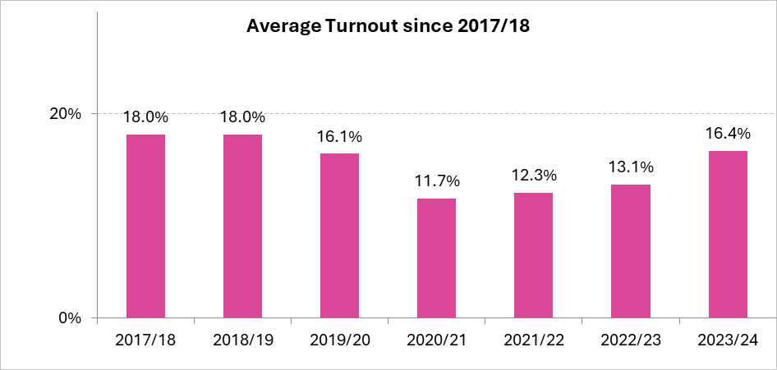
Turnout
  National turnout up to 16.4%, up 3.3% from last year.
Notes:
- 16.4% this year
- 3.3% increase (biggest post-Covid jump in recovery)
- Increase really consistent considering size of SU too. Looked at SUs of different sizes in 4 categories and all were over 16%
(4 categories are: fewer than 10k, 10-20k, 20-30k and more than 30k)

Slide 10
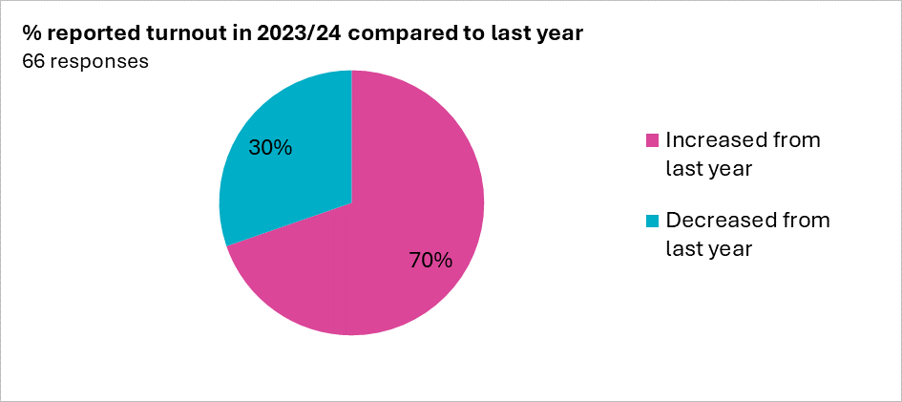
Turnout
  70% of SUs saw increased turnout from last year
Notes:
- Considering the overall national turnout, we looked at individual SUs. 70% managed to increase their turnout this year.

Slide 11
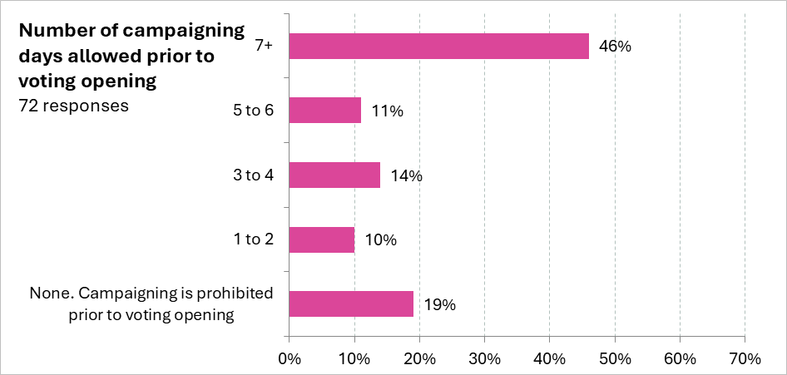
Nomination & Voting Periods
  Nomination periods are getting longer.
  In 2022/23, 26.3% of SU’s nomination periods were open for 29 days or longer, which has increased to 40% this year, a jump of 13.7%.

Slide 12
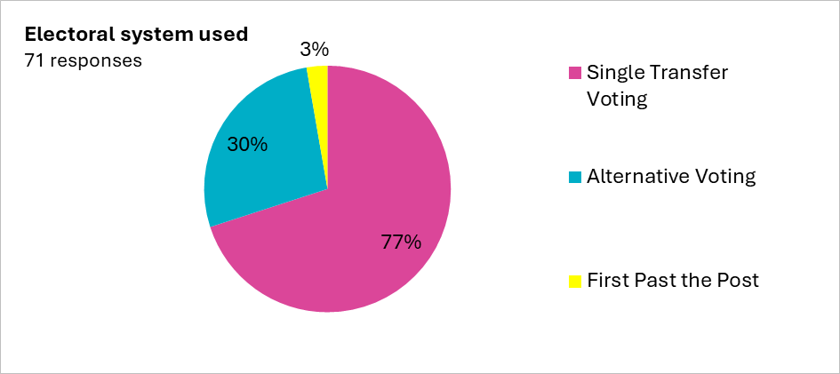
Voting Systems
  The amount of SUs that use the single transferable vote (STV) method has increased in these recent elections, with 77% of using the system, up 22.6% from last year’s 54.4% of SUs.
Notes:
Bonus stat: no SUs use paper votes only, vast majority (93%) use just online, other 7% use both electronic and paper votes. More info in report appendix

Slide 13
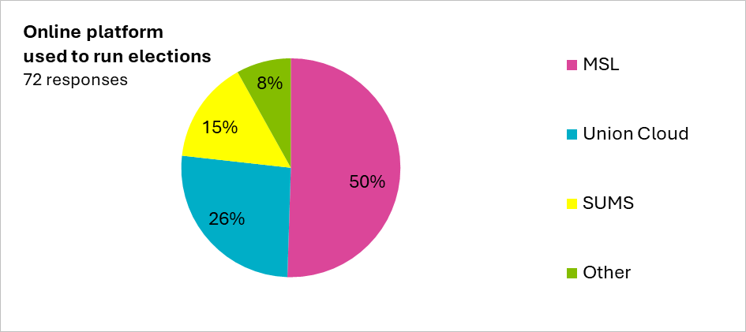
Voting Platforms
  Exactly half of SUs use MSL as their voting platform (36 SUs). Another 26% used Union Cloud to run their elections.

Slide 14
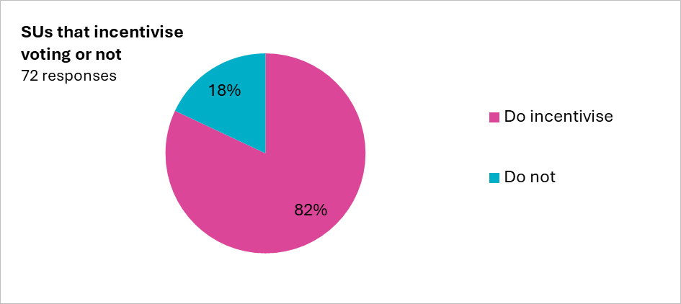
Voter Incentives
  The use of incentives continues to rise in SU elections, with 82% of SUs reporting that they use some form of incentives in their elections.

Slide 15
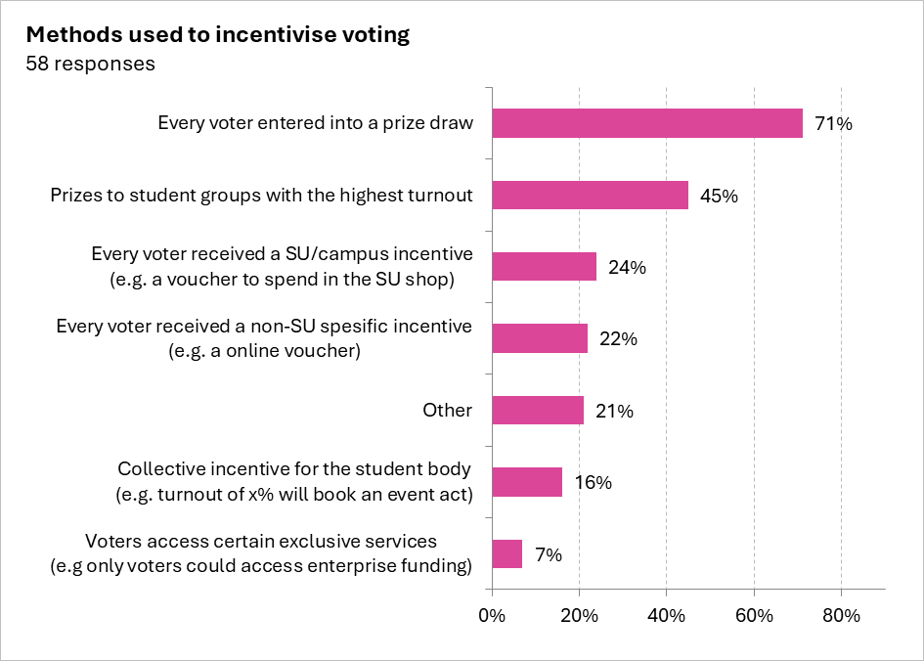
Voter Incentives

Slide 16
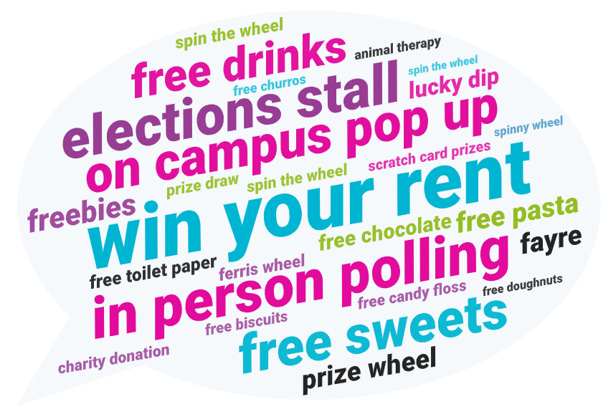
Voter Incentives
  Increase in SUs using prize draws, spinning wheels and lucky dips.
  Many incentives
remain food focused.

Slide 17
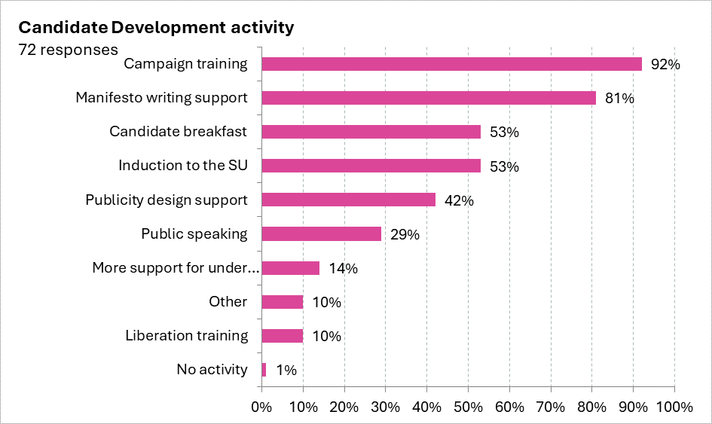
Candidate
Support

Slide 18
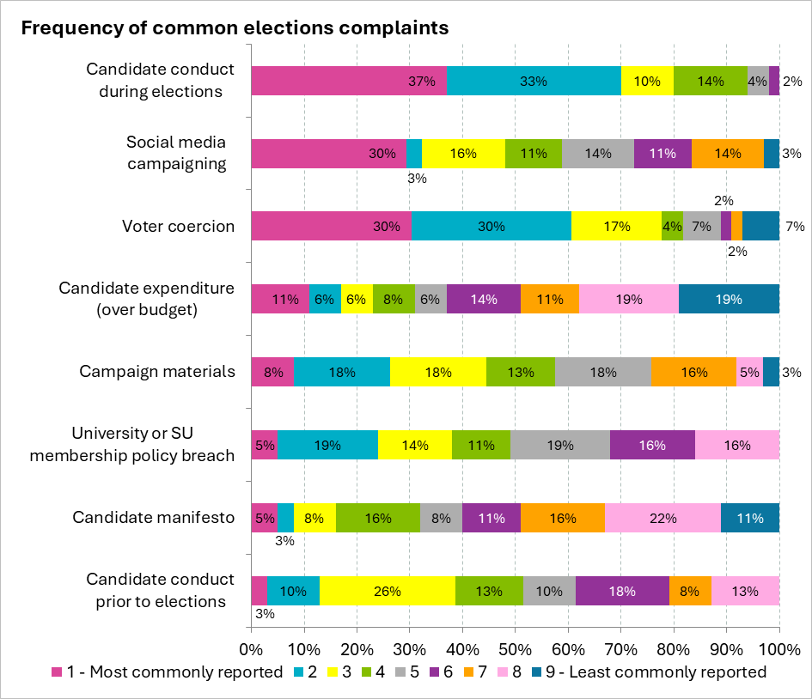
Complaints &
Conduct
  Vast majority of complaints still surround candidate behaviour (in personal and social media conduct) and voter coercion.
  Least reported complaints around expenditure (overspending budget).

Slide 19
Candidate
Demographic Data
Notes:
- Highlight new approach to candidate demographics this year
- Still have the CD survey (15 SUs used, representing 162 candidates)
- However we also asked SUs to provide their data, so we have LOADS more data for 7 key candidate demographic data

Slide 20
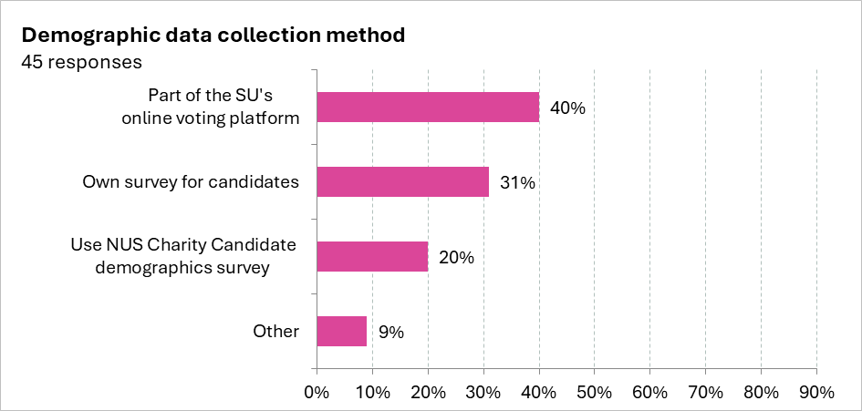
Collecting Candidate Demographic Data
  63% of SUs who responded to our elections survey confirmed that they do collect data to better understand their candidates’ demographics.

Slide 21
Collecting Candidate Demographic Data
  New approach this year, we combined data from the Candidate Demographic Survey and the Elections Survey.
  Resulted in significantly more data for 7 key demographic questions.
  Between 380 - 3,300 candidate responses per question.

Slide 22
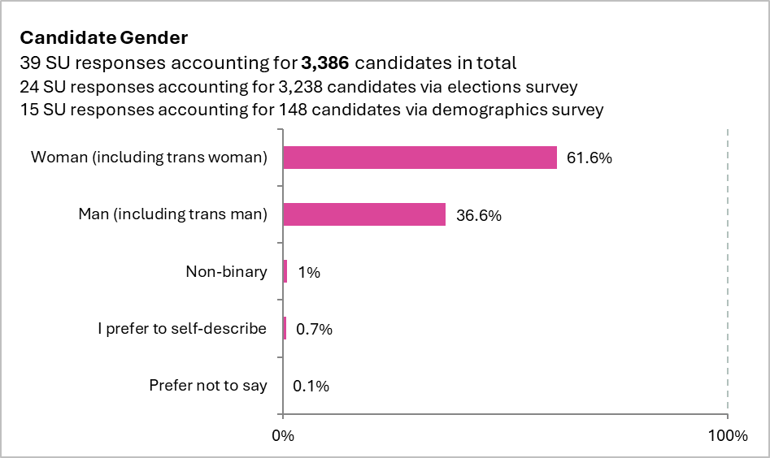
Candidate Gender

Slide 23
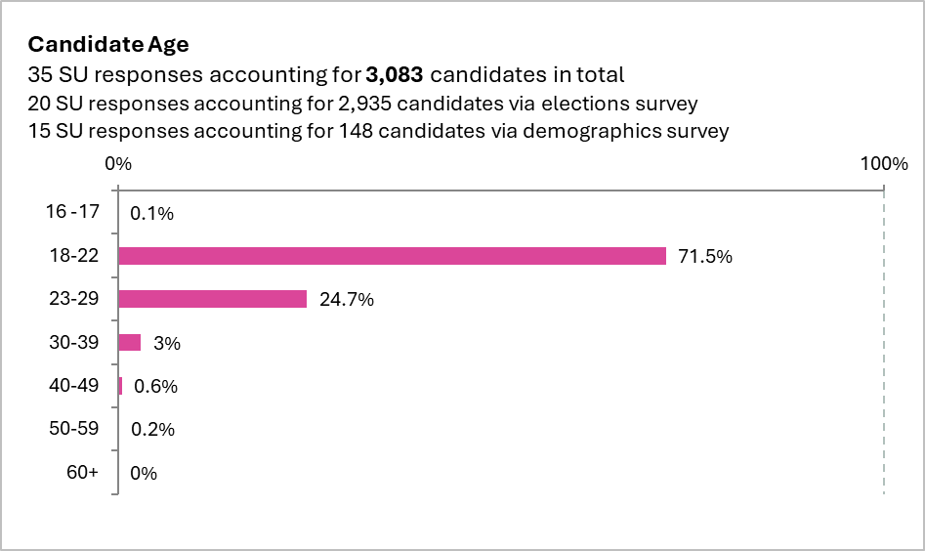
Candidate Age

Slide 24
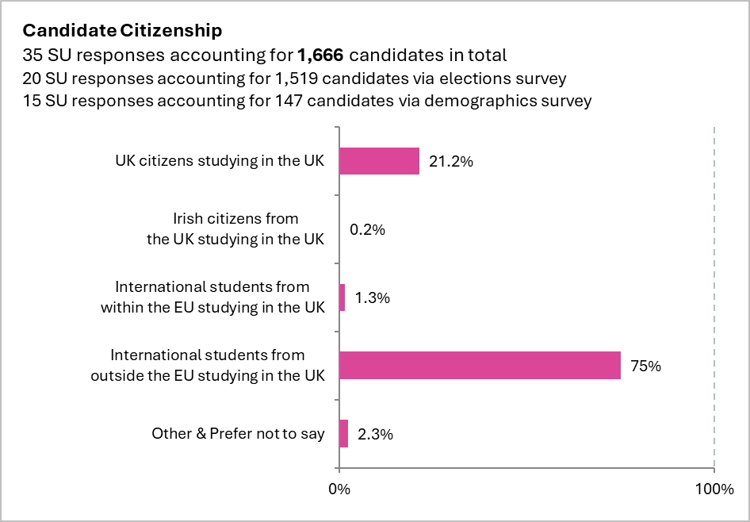
Candidate Citizenship

Slide 25
More Candidate Demographic
Data in report
  Gender
  Age
  Citizenship
  Sexual Orientation
  Religion, Faith or Belief
  Ethnic Group
  Disability
Notes:
- We've highlighted x3 questions surrounding candidate demographic data in this presentation
- We have more data! These are all in the report

Slide 26
Q&A
Challenges & opportunities
from this year
Notes:
Wrap up presentation and any questions by 11:50am

Slide 27
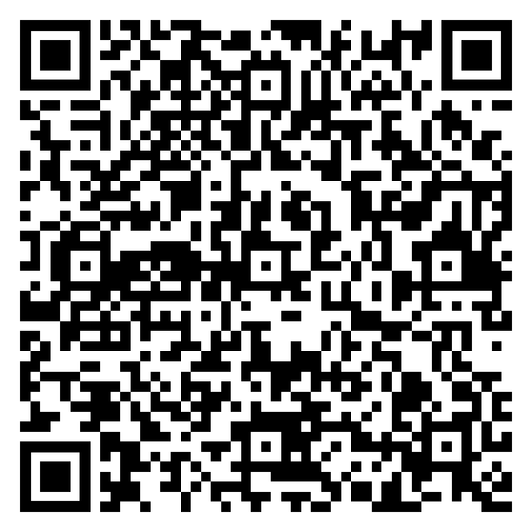
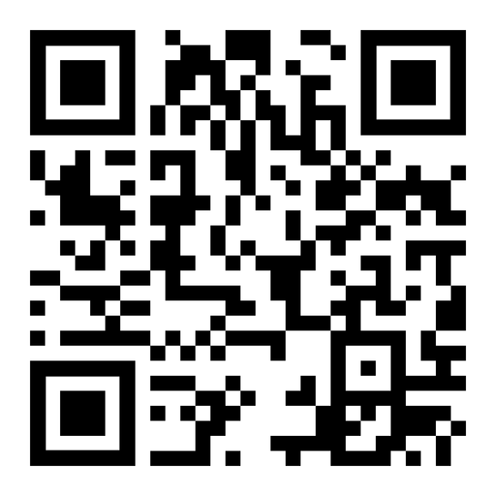
Handy Links
SU Elections Report 2024
Election Service webpages on NUS Connect
Workplace DRO Group
Notes:
1 - 2 mins to show QR codes, let people scan then whilst chatting through these
Shoutout DRO Workplace as handy place for collaboration if not mentioned already

Slide 28
Thank you!
elections@nus.org.uk
Notes:
Wrap up presentation and any questions by 11:50am

