Slide 1
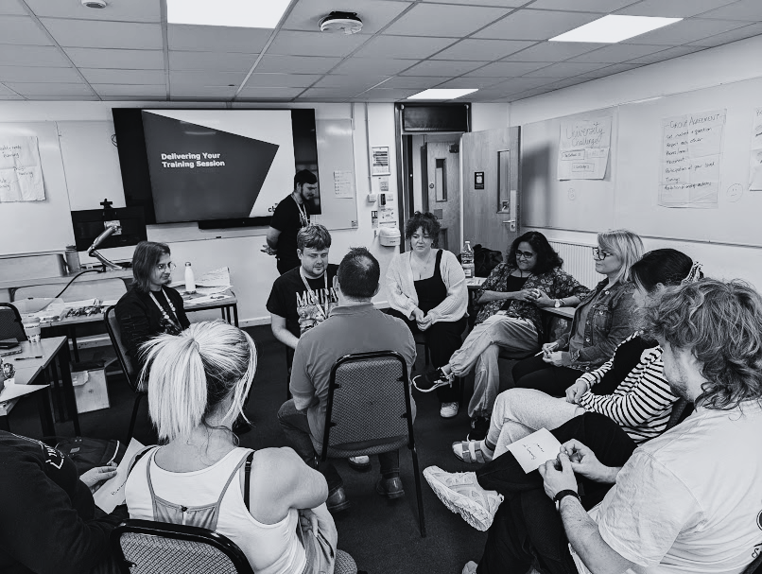


Inclusive
training practice
Rosie Hunnam - Organised Fun
Emily Clarkson - NUS Charity

Slide 2
Today’s session
We’re going to be focusing on how we can make our training more inclusive, through practical action and thoughtful consideration.
  What do we mean by ‘inclusive training’?
  How can we make our training spaces (online and in person) more inclusive?
  Top tips for before, during and after training that can make your training more inclusive

Slide 3
Today’s session
  Develop an understanding of how to ensure training is inclusive and accessible
  Consider what makes in-person and digital training less engaging or inaccessible
  Explore ways to prepare and delivery accessible and inclusive training

Slide 4
What do we mean by inclusive?
What do we mean by accessible?

Slide 5
Defining our terms
Inclusive
Including everyone, safe, welcoming, helping people to access the learning, feeling comfortable
Accessible
Easy to approach, engage with, understand, empowering

Slide 6
Activity time!

Slide 7
Pairs communication exercise
  Sit back-to-back with somebody
  One of you has a drawing, the other has drawing implements
  Without looking at what the other person is doing, the person with the drawing (the describer) will tell the drawer what to draw.
  Only the person with the drawing (the describer) can talk or communicate. They cannot look at the drawer’s picture whilst the activity is taking place.
  You have 5 minutes for this activity.

Slide 8
How did you find that?

Slide 9
Communication
Why was that difficult?
  Cannot ask a question to resolve ambiguity or clarify instructions
  Cannot give feedback that the other is doing it correctly
  As learners we access different senses to decode communication – therefore struggle with interpreting the information we only receive by hearing and are filtering through our own experiences/preferences.

Slide 10
Good communication
Is reciprocal and builds trust and relationships…
It requires the following steps:
  What I mean
  What I say
  What they hear
  What they understand

Slide 11
How can we make our training spaces more inclusive?

Slide 12
Activity: sharing experiences
  Discuss any experiences you’ve had where the training has felt uncomfortable, difficult, or inaccessible, either for you, or someone in the training.
  Discuss in pairs and choose one example to note down on a post-it note (5 minutes)
  Then pass on your post-it note to to a different group.

Slide 13
Activity: Making training more accessible & inclusive
  Generate ideas in your pairs to identify things that you could do as the trainer; before, during and after training, to avoid that situation in the future (5 mins)
  Write these ideas on post it notes and we’ll map the idea’s as a group.

Slide 14

Exclusive training environments exploration exercise

Slide 15
Feeding back

Slide 16

Top tips - before training
  Designing a range of activities
  Making time - not rushing
  Joining instructions (setting expectations)
  Get access requirements
(you can’t know if you don’t ask)
  Training materials

Slide 17

Top tips - during training
  Training environment
  Equipment
  Group agreement
  Training culture (creating space for things
that are important for trainees)

Slide 18

Top tips - after training
  Feedback
  Review

Slide 19
Train the Trainer
  The course provides an opportunity for you to learn and develop the skills, knowledge, and techniques to be an effective trainer. This is also acts as a great refresher course for those who have been training for a couple of years.
  We’re running a mixed cohort of Train the Trainer in Autumn-Winter 24, where you can book individual delegates places.
  Email learningdevelopment@nus.org.uk to be added to the waiting list for info. More details coming soon!

Slide 20
Thank You
Rosie Hunnam (Organised Fun) - rosie@organised.fun
Emily Clarkson (NUS Charity) - emily.clarkson@nus.org.uk

