Slide 1



The new SU
Governance Code
Charlotte Britton-Stevens - NUS Charity
Laura Moss - Wrigleys Solicitors

Slide 2
Today’s session
  History of the Code and its SU adaptation
  Areas of consultation
  Governance challenges
  Breakout discussion on governance challenges in your SU
  Feedback and Q&A
  Next steps for the consultation

Slide 3
The Charity Governance Code

Slide 4
Charity governance code
  Steering group:
    ACEVO: Charity Leaders Network
    Association of Chairs
    The Chartered Governance Institute
    NCVO: National Council for Voluntary Organisations
    WCVA: Wales Council for Voluntary Action.
    The Charity Commission is an observer on the group.
  Created for charities in England and Wales with feedback from over 200 charities/organisations in 2017
  Refresh in 2020
Notes:
Scottish Third Sector Forum have a Governance Code too, most recently updated in 2023. It has 5 principles and isn't bad, but doesn't have any recommended practice so I prefer the Eng/Wales one. They are both based on principles so there's nothing stopping anyone using one over the other.

Slide 5
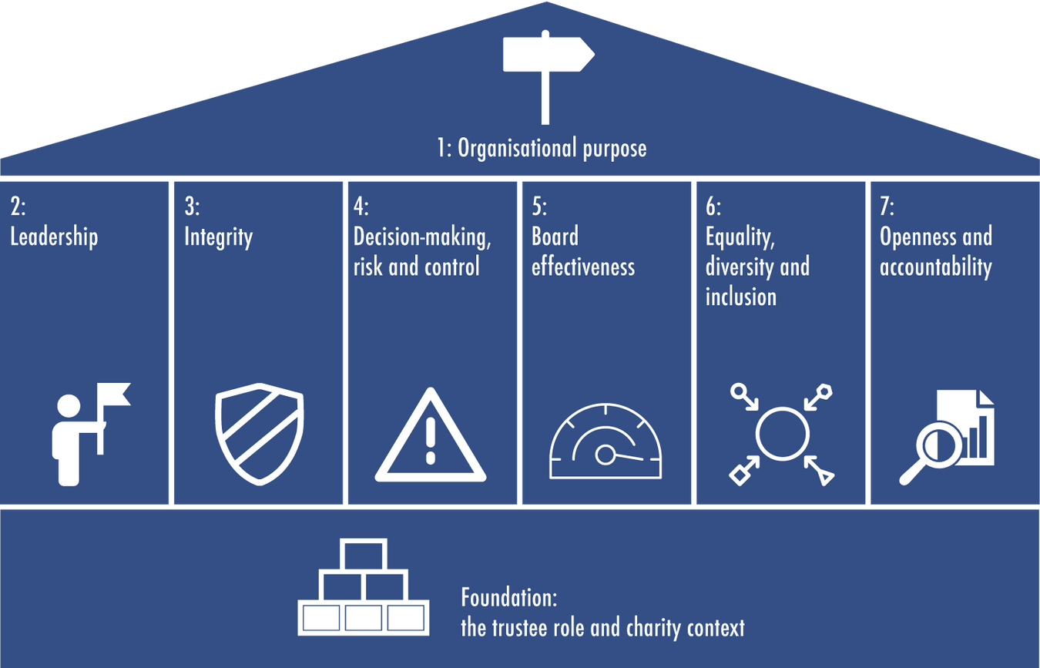
Charity governance code

Slide 6
SU governance code

Slide 7

Adaptations and changes
Task group of SUs from across England, Wales and Scotland.
The key changes were:
  Weaving democratic principles throughout the code
  Changing terminology so language was much more familiar to an SU audience, e.g. “charity” to “union” and “beneficiaries” to “members”
  Framing the code so unions can demonstrate desirable practice and outcomes
  Making sure the Code was applicable across the nations - especially making sure it was all good with OSCR regulation.
  We did a refresh with SUs in 2021 looking at integrity, EDI and accessibility of language

Slide 8
Consultation on the
Charity Governance Code

Slide 9
Consultation
  User-friendliness
    Language
    Size of charity
    Barriers and obstacles
  Structure and content
  Potential new areas of focus

Slide 10
Consultation
  User-friendliness
    Language
    Size of charity
    Barriers and obstacles
  Structure and content
  Potential new areas for inclusion:
  Artificial intelligence (usage and application)
  Boardroom behaviours
  Cybersecurity and cyber risk
  Climate change and environmental issues
  Engaging with issues of cultural significance
  Financial resilience
  Fraud
  Investments and their management
  Lobbying and campaigning
  Political engagement
  Risk management
  Senior staff pay
  Technology and data
  Trustee succession planning

Slide 11
Governance challenges

Slide 12
Governance challenges

Slide 13
Governance challenges

Slide 14
Feedback
Q&A

Slide 15
Next steps
  NUS Charity will continue discussions with the Charity Code steering group
  We’ll keep interested SUs in the loop - join our governance group on Workplace!
  CGC timeline is a paper in autumn and an updated Code in early 2025
  NUS Charity will look to review the SU Governance Code in 2025.

Slide 16

Thanks!
Charlotte Britton-Stevens - NUS Charity
uniondevelopment@nus.org.uk
Laura Moss - Wrigleys Solicitors
laura.moss@wrigleys.co.uk

