Slide 1

Academic Misconduct: A Holistic Approach
Christabel Carter: SU Advice Manager

Slide 2

What was the problem and why do anything?
Rising Academic Misconduct cases
Types of Academic Misconduct cases
The Skills and Post-16 Education Act 2022 making Essay Mills illegal entities
University and usual methods failing.

Slide 3
Key People In The Room?
SU Advice
SU Comms
SU Officer- Education
Quality
Academic/ Professor
University Support

Slide 4

SU Academic Miscoduct Campaign Group
Role and Responsibilities of the Group:
As outlined in the Terms of Reference, this group will:
Develop creative strategies to raise awareness of good academic practice
Deliver regular comms on academic misconduct to students at key points in the academic year.
Keep up to date with relevant City policy and wider sector policy changes
Actively identify and target students at risk of academic misconduct and in need of support.
Ensure comms factor in students from different demographics and experiences.
Make recommendations to Schools on how to effectively communicate the importance of academic integrity to students.
Identify best practice in the sector and beyond to reduce academic misconduct cases.
Focus on preventative measures to deter academic misconduct rather than amending City’s Academic Integrity & Misconduct policy.

Slide 5

Previous Actions?
Audio Case Studies
Short Video Clips by City Academics
Freshers Stalls Awareness

Slide 6
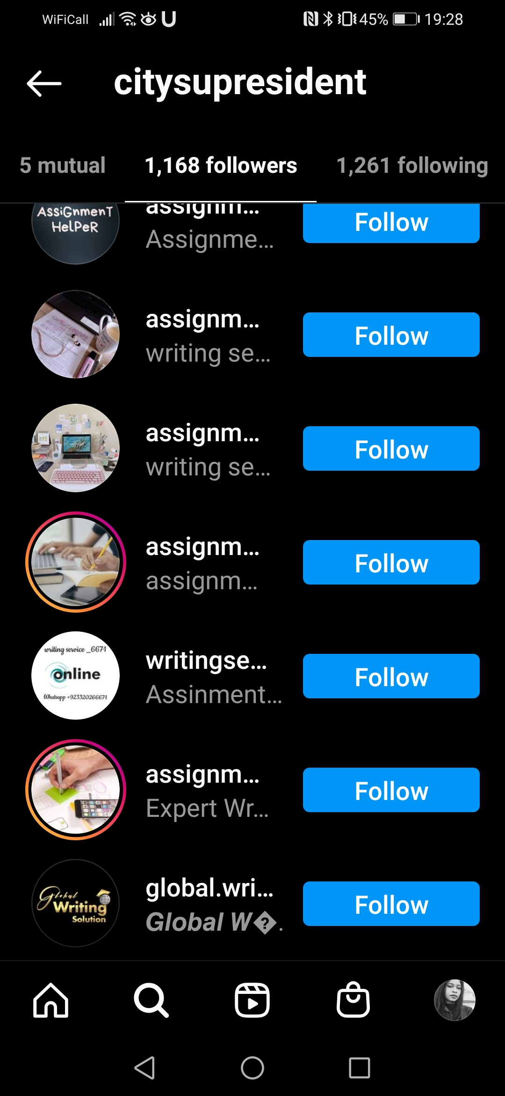
Social Media Police
BLOCK!
DELETE!
REPORT!

Slide 7
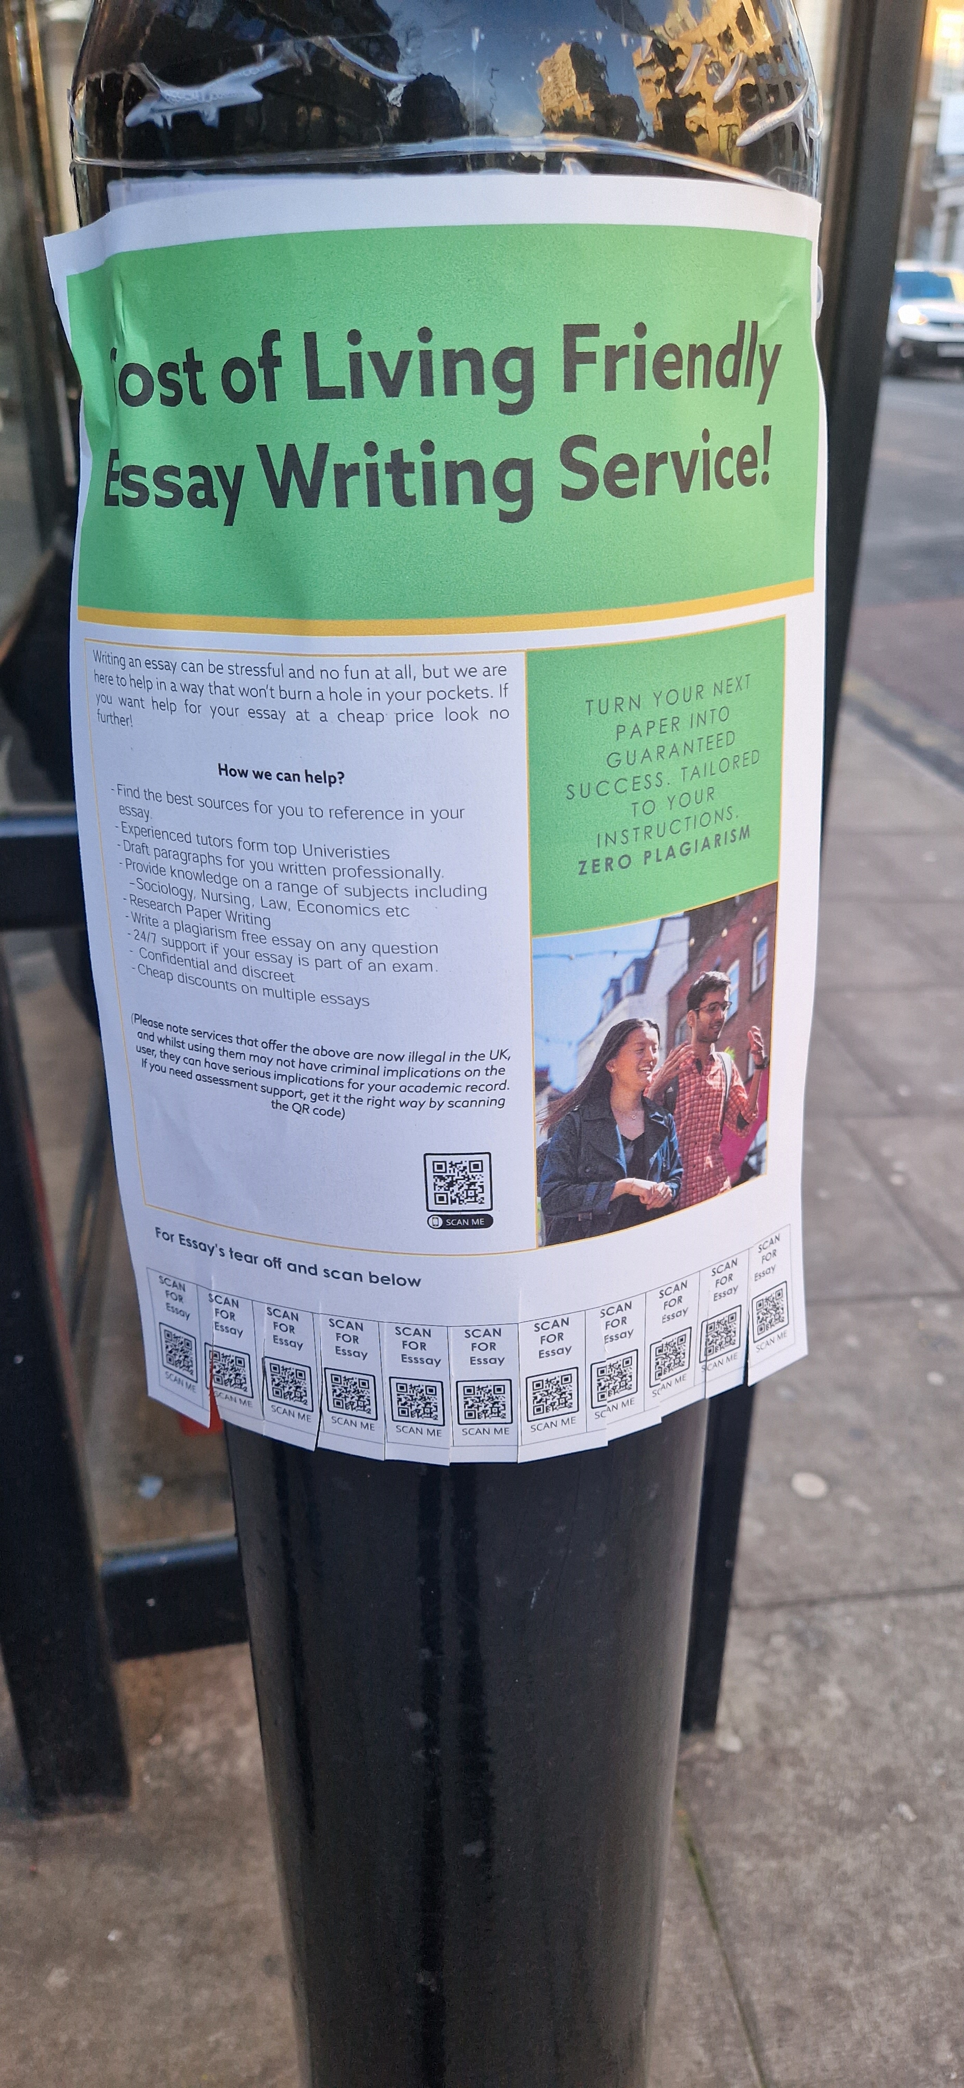
TOP SECRET FAKE ESSAY MILL SERVICE….
The aim of students who were thinking of pursing the fake service instead being provided with the appropriate support
We included text on the poster which lets students know that these services are illegal, and they can scan a QR code which will take them to the SU Academic Integrity & Misconduct Campaign support page.
However…
if students chose to ignore this and decided to tear off the ‘scan for essay’ QR code bit, they were directed to a Hidden WARNING PAGE..

Slide 8

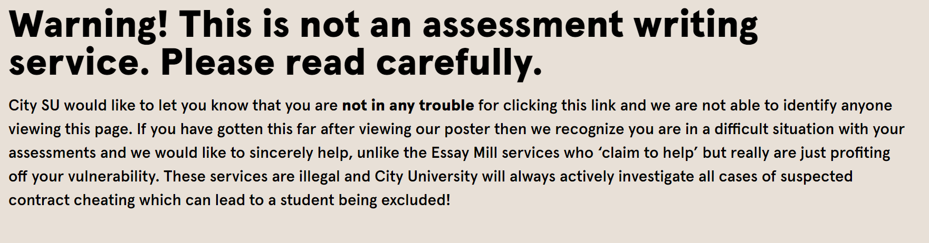

Slide 9
Assessing Risk
Students feeling a sense of increased anxiety when the click on the webpage. We agreed that students going on the webpage is their own choice as they would have chosen to read the poster and tear off the link. The webpage will make it very clear that nobody will know they have accessed the page and there are no real academic consequences for accessing it.
Staff and students pulling the posters down. If this happens then this is a good thing, and demonstrates students are aware these services are not appropriate. It was agreed City staff from the City AIM working group which includes ADE’s would be informed of the initiative and a proposal was shared before going ahead .
Financial costs: Usually these posters from Essay Mill companies are very basic and on normal paper, so we can just print these normally without using a professional printing service. We want them to look authentic. When taken down we can always reprint or create new ones.

Slide 10

Make Academic Misconduct Relevant…Well Sort Of!

Slide 11


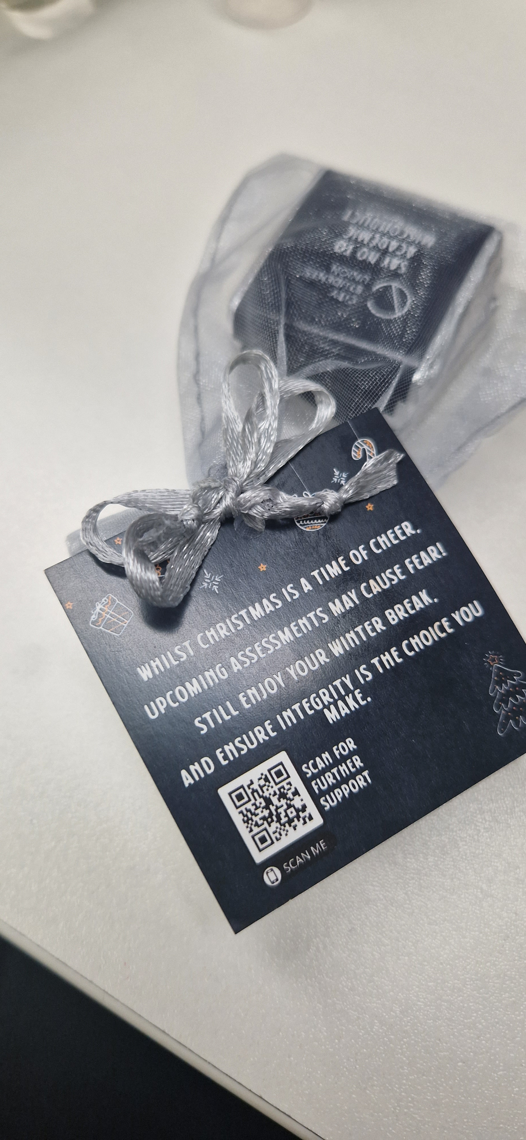
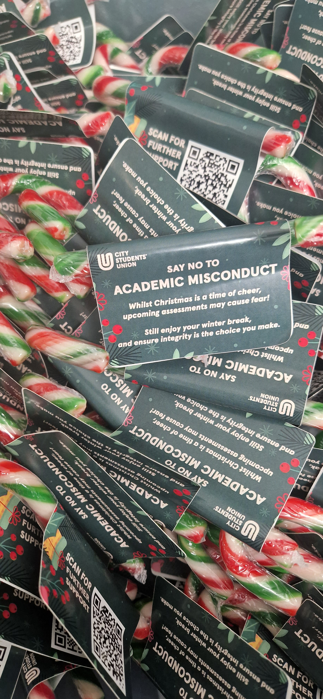
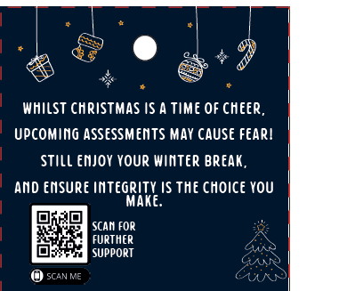
Winter Festival

Slide 12
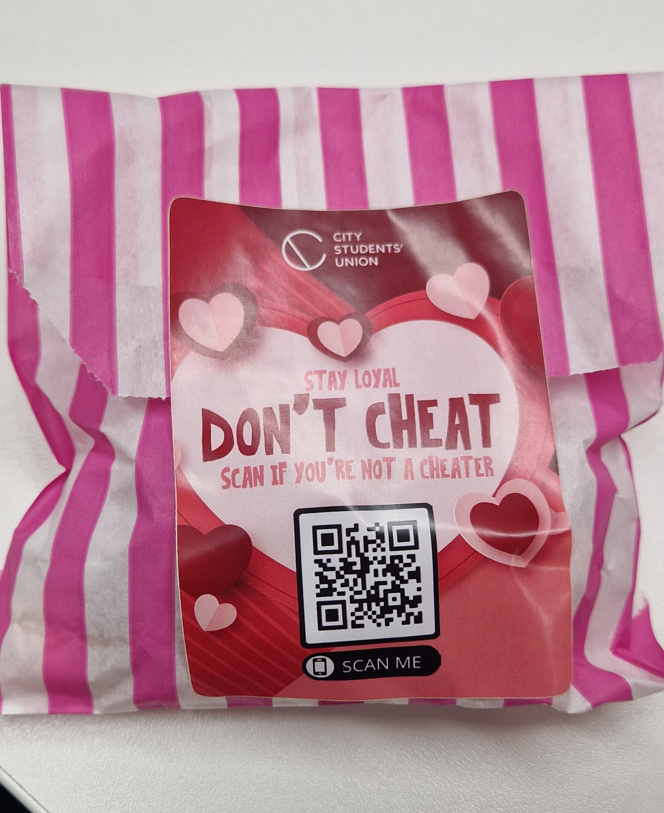
Valentines Day

Slide 13

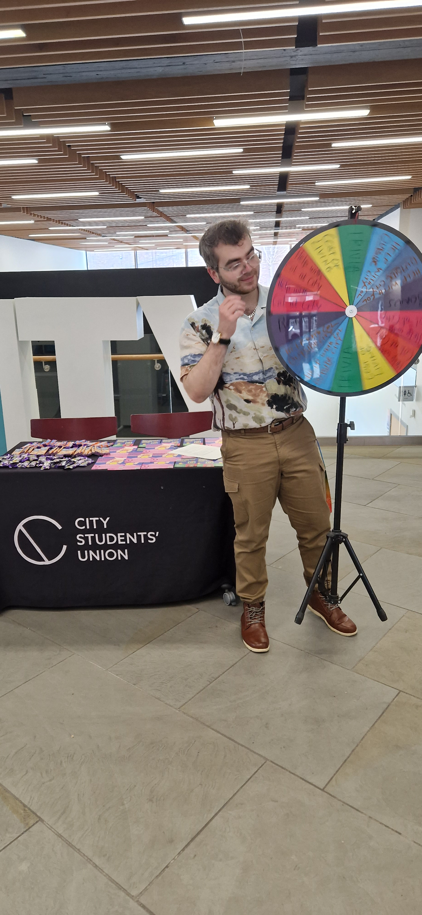
Can Academic Integrity Workshops Actually Work?
Promo
Incentive
Expert Speakers
Content

Slide 14
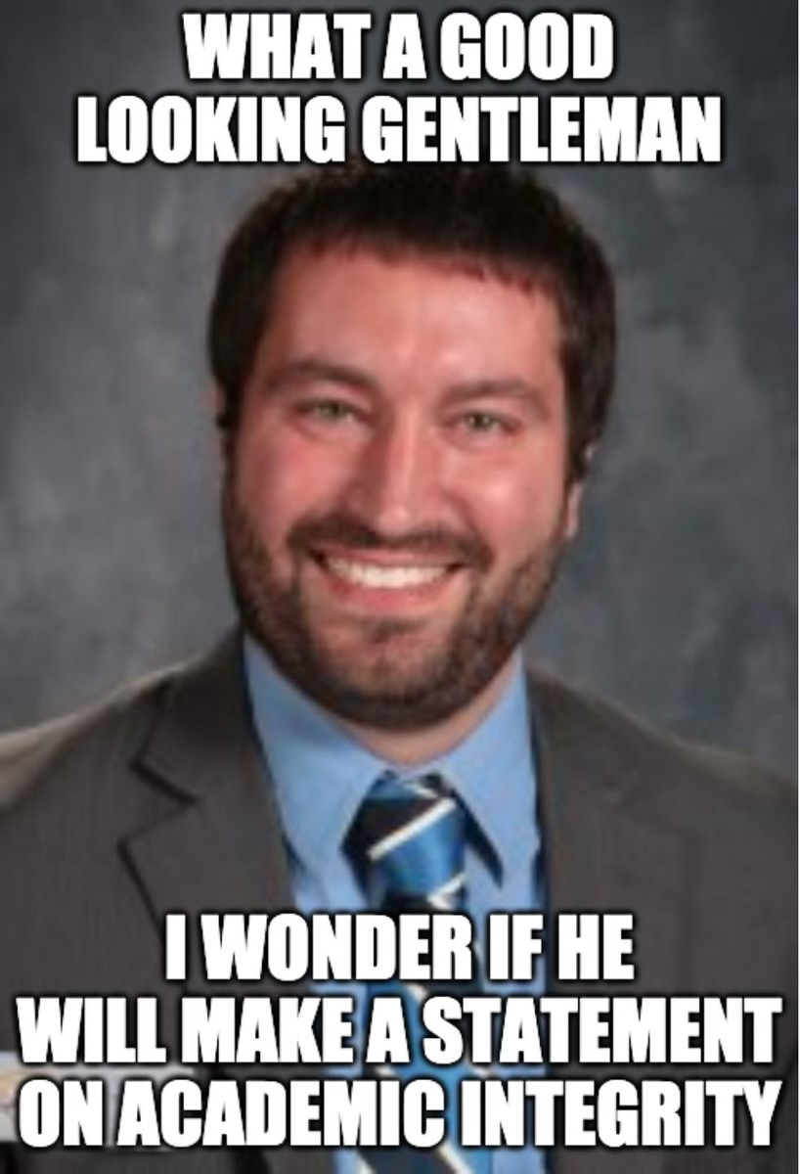
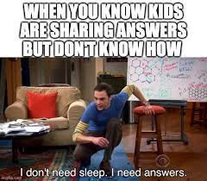
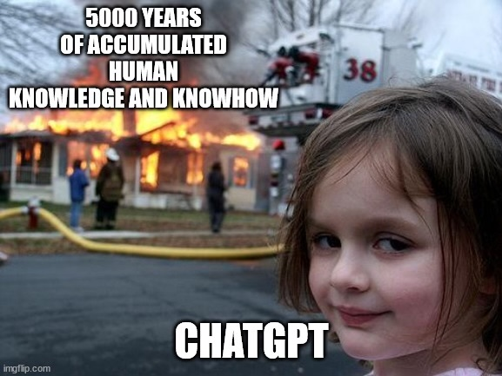
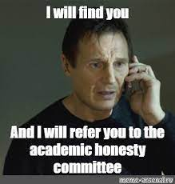
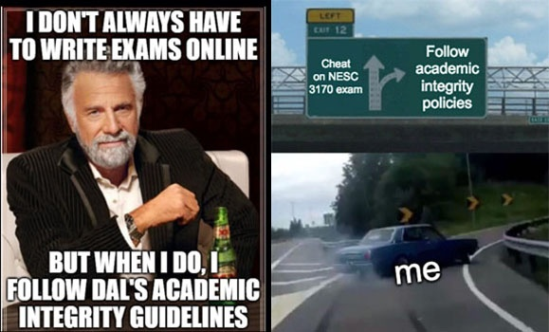
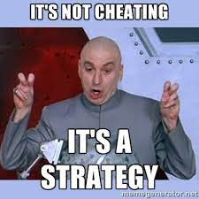
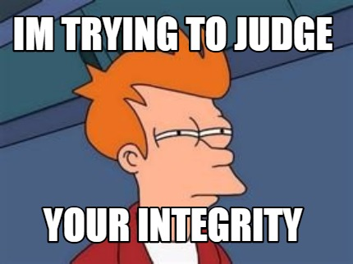
Micro Placement Student Project

Slide 15

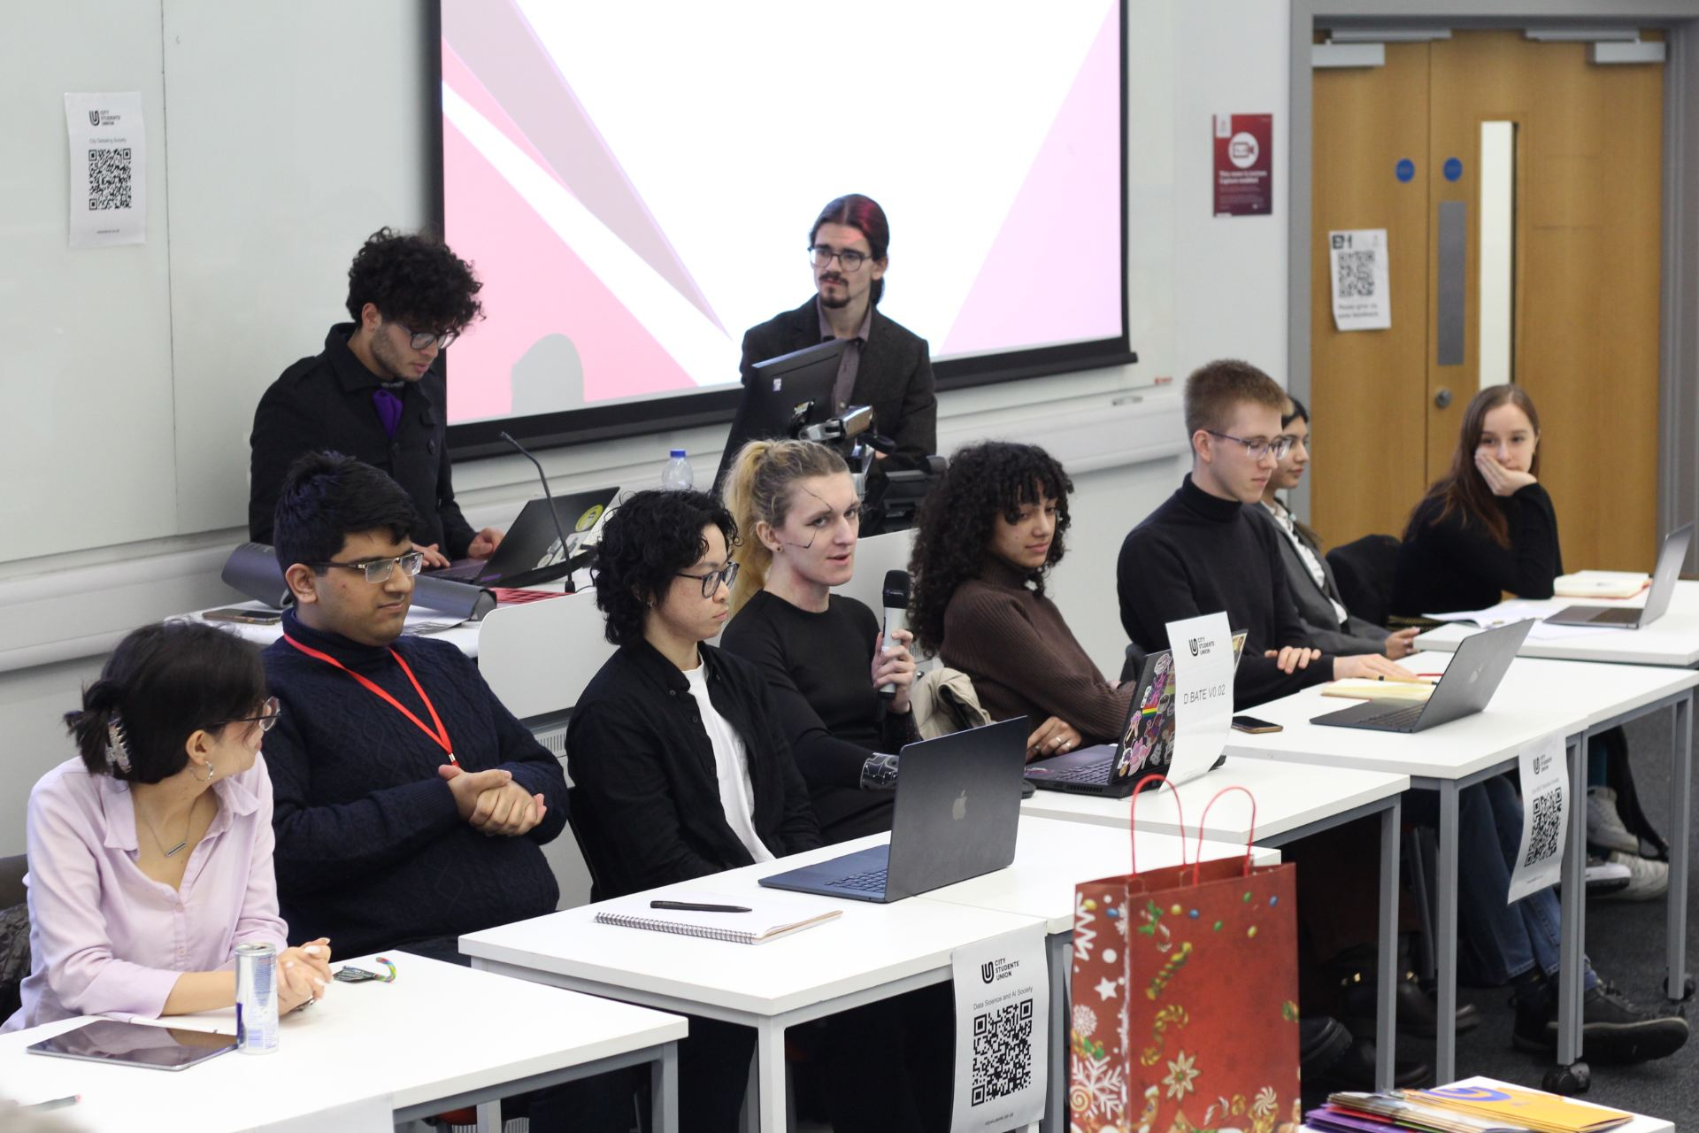
Moving With The Times…Generative AI!
The Great Student AI Debate >>>
What place does AI have in Education?

Slide 16
Get Creative.…This Is A Safe Space!
How can you make an event, celebration or activity at your SU relevant to Academic Misconduct?

Slide 17
Business as Usual
Policy intervention and amendments
Feedback on cases/ reports
Regular catch ups with Quality Departments
All schools having templates – clear allegations outlined
AI declaration form
Delivering part of training to University AM- on what the SU can deliver
Targeted Induction talks

Slide 18


What Next?
Academic Integrity Fair
Revamp contract cheating poster to AI detection free software service
Clearer boundaries on AI use in assessments including proof reading tools
Lobby for sanctions to include learning requirements following poor academic practice
Opportunities post merger

Slide 19
Questions?
Thank you ☺
Christabel.carter@city.ac.uk

