Slide 1
Instructions for the instructor
KUPLA tutor training 4/6. Version 2.1, published 30.6.2021, improvements to the accessibility of the presentation.
The instructions for the instructor can be found in the notes of the slides (speaker notes). You can share the presentation in PDF format with the tutors in the training.
The material is not intended as self-learning material for tutors, although as a tutor you can certainly browse and find inspiration from the material. The exercise book for student tutors can be found here.
Other KUPLA materials can be found at www.ehyt.fi/universities

Slide 2
Acknowledging diversity and inclusiveness in tutoring
Notes:
(Version 2.1, published 30 June 2021)
This is a training on acknowledging diversity and inclusiveness in tutoring It is a live training, but with minor modifications the material can also be used in webinar training on electronic platforms where tutors can be divided into small groups for discussion. This training has been developed by the KUPLA project of EHYT ry and Nyyti ry (2018–2020). The aim of the project was to support the well-being and learning abilities of university students. ​
​​
Duration: 75 min Times for the outline and the total duration of the training are estimated. The use of time depends on the instructor, the size of the groups and the duration of group discussions.
​
The training instructor makes sure that the tutors change small groups after each exercise. The instructor manages the exchange of groups and how the groups are formed. ​ This way no one is left without a group and it is easier for tutors to get to know each other during the training.
The contents of the training and the tutor’s exercise book overlap. If desired, the tutor can also write down the discussions held during the training in the tutor's exercise book or the tutoring plan.
Explain that before each pair/group assignment, the tutors introduce themselves to each other by the name they want to call themselves. This way they will get to know each other.
​In this section you will need A remote control to change the slides of your presentation (better flow) ​Clock ​Pens and paper
Explanations of the symbols used in the slides
The nut symbol indicates a task.
​F = You can do this exercise with freshers.
Training frame
Start, 10 min​
Student diversity, prejudices, and inclusion, incl. exercise, 20 min​
Exercises, 40 min​
Summary, 5 min

Slide 3
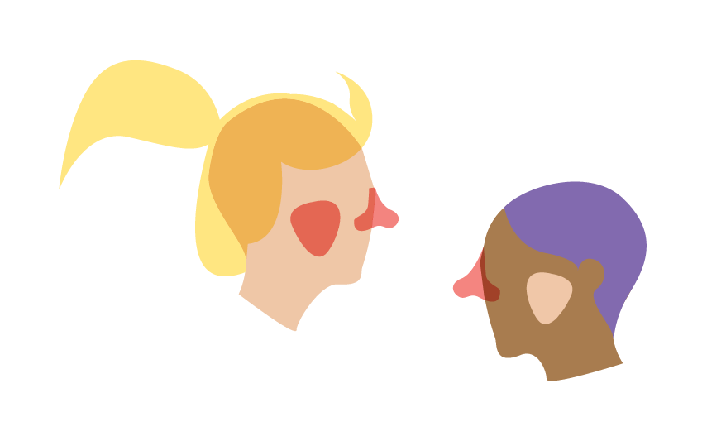
What might a fresher be thinking in the beginning of their studies?
There is a lot of competition here!
I fear that my gender will be assumed
I want to participate but not speak
Unlike with others, people only speak English to me even though I am Finnish
I want to get to know others even though I am older
No-one intervened with the n-word used at the lecture
I am not always invited because I don’t use alcohol
I cannot participate because the get-together is in a non-accessible space
Notes:
What might a fresher be thinking in the beginning of their studies? Here are some examples. How would you address the concerns and fears of freshers in the beginning of their studies?

Slide 4
Training objective
Get to know stereotypes and our own prejudices.
Learn how to plan tutoring to be inclusive ( = to include everyone and acknowledge diversity).
Learn how to plan familiarization activities that fit all freshers.
The fresher feels welcome

Slide 5
Training topics
Prejudices and stereotypes
Planning inclusive activities

Slide 6
Prejudices and stereotypes

Slide 7
Prejudices and stereotypes
Prejudice refers to an unfounded (favourable or unfavourable) preconceived idea.
Becoming free of prejudices requires first recognising them and becoming aware of them. An open conversation can help: it makes generalisations visible and their necessity and accuracy can be examined and questioned
Stereotypes are simplified and generalizing conceptions that are often unconscious. Stereotypes are linked to expectations and assumptions about different characteristics or behaviour.
Source: The Finnish Association of Adult Education Centres
Notes:
Everyone has prejudices, preconceptions and stereotypes about other people and groups of people. They make complex phenomena simple.
Stereotype: All students are young and attend a lot of student parties. Prejudice: A student who does not use alcohol is boring. (So we’re a really boring bunch most of our time, if that were the case. Here, too, quite a tiringly boring gang, all of us.) Prejudice: A student who uses alcohol is fun to be with. (This is not true all the time and in all cases. Sometimes it might be, but quite often being too drunk is anything but fun to watch.) How often have you actually been less fun to hang out with when drunk?
Source: https://peda.net/kol/foorumi/m/mkk/t2kk/ejs

Slide 8
Stereotype: All students go to student parties
Out of first-year students, 17% did not participate in any student events. Most common reasons:
lack of time (mainly due to working)
“not interested (in partying)”
alcohol usage plays an overly dominant role.
Other reasons: (social) anxiety, not having anyone to go with, fear of humiliation, not having been informed about the event, too expensive, children/family...
→ Student events can be exclusive
Source: Nyyti ry, 2016
Notes:
The reasons for opting out may be the same as the reasons for opting out of tutoring (activities organised for freshers).
Tutors often organise events (and meetings), so it is a good idea for the tutor to think in advance about how the diversity of freshers is taken into account.
Not everyone is interested in the same things and for many, meeting new people is a cause of anxiety.

Slide 9
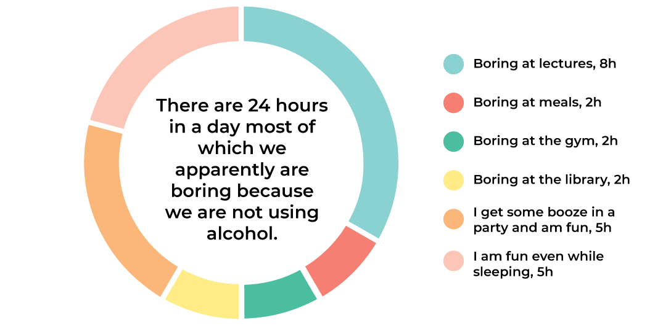
Prejudice: “You are boring when you don’t drink”
Notes:
Here’s an example of one common prejudice, the remark that someone is boring if they don’t use alcohol.
The example day divides the activity into non-alcoholic and alcoholic activities. The image can be used to reflect the prejudice.

Slide 10
Diversity and prejudices
Exercise
Which things cause prejudices when you tell about yourself?
Every time I tell X, people assume that...
E.g. “every time I tell that I am a teetotaller (I don´t drink) people assume that I am an athlete”
Notes:
Exercise: A discussion in pairs/small groups. The purpose of the exercise is to make prejudices and expectations related to people’s characteristics visible.
Instruct participants to divide into groups of four. Give instructions and an example if necessary: "When I tell I love computer games, people always assume that I am a quirky super geek".
Can be processed quickly by asking groups their feelings and thoughts with the following questions:
- What assumptions have you encountered?
- How do you feel when people assume things that may not be true?
- Has it ever felt like a person characterises you as a person with only one characteristic?
- How did it feel to do the exercise?

Slide 11
Inclusivity
Inclusivity means getting people involved and including them. In this training, inclusivity also means enabling involvement and participation. ​
The idea of understanding diversity: no-one is a mistake or a disturbance. It is more socially sustainable to be inclusive than exclusive. All kinds of people are needed.
Everyone has an equal right to belong to a study community.
Notes:
Sources: Huomioi helposti, inklusiivisempaa larppausta, https://turvallisempaa.files.wordpress.com/2018/07/inklusiivisempaa-larppausta_v1-0.pdf
Wiktionary: https://fi.wiktionary.org/wiki/inklusiivinen

Slide 12
Inclusivity means acknowledging diversity
Each person has a different identity and characteristics. Diversity is in all of us.
Acknowledging diversity means respecting everyone's identity and characteristics in a positive sense and in a safe environment so that everyone feels welcome as they are without fear of discrimination.
Processing and identifying your own prejudices/stereotypes can help you plan tutoring.
Source: Culture for All service
Notes:
Inclusiveness also means promoting equality.
Diversity is related to age, gender, sexual orientation, socioeconomic status, physical and mental characteristics, disability, health status, skin colour, appearance, religion, language, culture, ethnicity, nationality, political views, and different ideologies and beliefs.
Source: Culture for All service, Avaus moninaisuustietopaketti, http://www.kulttuuriakaikille.fi/doc/Avaus/Avaus_Suomi_Online.pdf

Slide 13
Planning inclusive activities

Slide 14
Case Vilkka
Exercise
Consider the following situation with a partner:
As a tutor, you would like the freshers to play the Pony game on the first day. In this game, the participants sing and move around “rubbing” first their cheeks, then their sides and then their bottoms together with another group member. After the game Vilkka, one of the freshers, tells you that the idea of not participating felt embarrassing even though they did not want to want to participate because the physicality of the game felt uncomfortable.
How do you discuss this with Vilkka? How do you receive feedback?
How can you tailor your activity to your target group? Which exercise would you do instead of the Pony game?
Notes:
Exercise: Pair/small group exercise.
Duration: 3 min
Review with pairs/small groups their answers first to the first question and then to the second.
The purpose of the exercise is to consider: - How does the exercise fit the target group?
Getting to know each other does not require touching others. - What is the goal of the exercise? - How do you receive feedback as a tutor? - How do you face the fresher in this situation?
Receive feedback and thank Vilkka for telling how they feel. Apologise that they have been in an awkward situation.

Slide 15
Prepare in advance
Consider in advance
activities with a goal.
different ways of carrying out the activity.
how to adapt the activity when necessary.
If you have the time and the opportunity, read feedback given about tutoring in previous years. What were things that people hoped would be considered/improved?
What tips can previous tutors give you? Which situations came as a surprise and how did they alter the planned activities?
Even though every fresher is a unique individual it pays off to consider in advance what kind of wishes different people might have for tutoring. E.g. what might a fresher with some bad group experiences expect from you as tutor?

Slide 16
Activities for a diverse group
Exercise
Find online/brainstorm 1–3 familiarization exercises. Assess how they fit the fictional student characters:
A. a student in a wheelchair
B. a 45-year-old student
C. a student who feels anxious about social situations
D. a student who does not want to perform or speak
E. a student who has bad experiences about groups
F. a student whose native language is not Finnish
G. a student who would like to maintain physical distance
Only use exercises that can be adapted for everyone to take part easily.
Notes:
Exercise: Pair/small group exercise. Duration: 4 min
This task uses stereotypical student characters to help plan activities. This way, the exercises are better designed for different freshers.
The task of the tutors is to choose in pairs or in small groups of 1–3 exercises that are familiar to them. After this, each pair/group considers the suitability of the exercises for the example students A–G. How could the exercise be modified to suit all students in the example? If the exercise is not suitable for just about anyone, should it be omitted?
Go through the group discussions/notes together and discuss how the different target groups could be better taken into account in advance in each exercise. Also discuss how the exercise felt. How did your own prejudices affect during the task? Remind participants that each student is an individual despite this pre-arranged practice, meaning it is always a good idea to ask participants how it is easiest for them to participate in the activity.
Say: Develop a lot of different exercises/discussion assignments/visits/activities with your tutor pair and then discuss their suitability from a diversity perspective. This way you build an “action bank” to use during the first week of tutoring and beyond.

Slide 17
Spending an evening together with the freshers – checklist
Exercise
When you plan the meetings/activities with the group of fresher, note if the ideas fulfil at least some of the following conditions: [ ] People get to know each other​
[ ] You would participate yourself
[ ] Everyone feels welcome as they are
[ ] Alcohol does not further participation/drinking alcohol is not assumed​
[ ] Touching other people is not assumed
[ ] There is a clear idea of what the activity includes and what its goal is
Notes:
Exercise: A discussion task in pairs/small groups.
How do you come up with different activities for a fresher group?
The small group/pair reflects on the tutoring plan they have already made, or recalls how the activities organised for them as they were freshers corresponded to the given conditions. The goal is to plan activities that would be easy for all freshers to participate in.

Slide 18
Summary
Everyone has prejudices about other people. Recognize your own prejudices and use the activities to process prejudices the freshers have regarding studying and the study community.
Be careful not to convey to the freshers that there is only one way of being a student.
Do not force, pressure or coerce anyone to participate for any reason (“traditions” or “everyone else does it” etc.)
Diversity is in all of us: ask how will the activities be the easiest for everyone to participate.
Intervene and remind the freshers to always intervene in inappropriate and disruptive behaviour and treatment.
Make sure the freshers feel welcome.

Slide 19
KUPLA – Students reforming substance use culture
The training has been developed by KUPLA – “Students reforming substance use culture”, a joint project by EHYT ry and Nyyti ry. The project was ongoing from 2018 to 2020.
National partners in the programme included the National Union of University Students in Finland (SYL), University of Applied Sciences Students in Finland (SAMOK), Finnish Student Sports Federation (OLL) and the Finnish Student Health Service (FSHS).
This work is licensed under a Creative Commons Attribution 4.0 International License. Read more about the license on Creative Commons website.
This training may be used, shared and modified freely with a reference to KUPLA as the original author.
Other materials for the KUPLA project can be found on EHYT's website, www.ehyt.fi
Notes:
This work is licensed under a Creative Commons Attribution 4.0 International License. See the license at http://creativecommons.org/licenses/by/4.0/
The sources and inspiration for tutor training have been:
Tutor training materials of Student Union COPSA of Centria University of Applied Sciences 2018
Tutor training materials of Student Union OSAKO of Oulu University of Applied Sciences 2018
Eeva Vissel, Elina Ylönen, 2018. Turvallinen tuutori, vertaistuutorin käsikirja, Student Union KAAKKO https://www.theseus.fi/bitstream/handle/10024/145772/VisseljaYlonen.pdf?sequence=1&isAllowed=y

