Slide 1
ACTIVISM 101

Slide 3
WHAT IS AN ACTIVIST? How can people be activists?
Physical Activism
Media Activism
Audio Activism
Notes:
the policy or action of using vigorous campaigning to bring about political or social change.
Physical Activism – Going out there to Marches, Organising protests and compiling signatures for petition, signing a post card to send to your MP on a certain issue
Media Activism – Sharing posts, lobbying people in power over social media
Audio activism – taking part in phone lobbying – ringing up people to ask for their support, ringing in to tv/radio debates

Slide 4
What does the perfect activist look like?
Notes:
5-10 minutes to draw the perfect activist

Slide 5
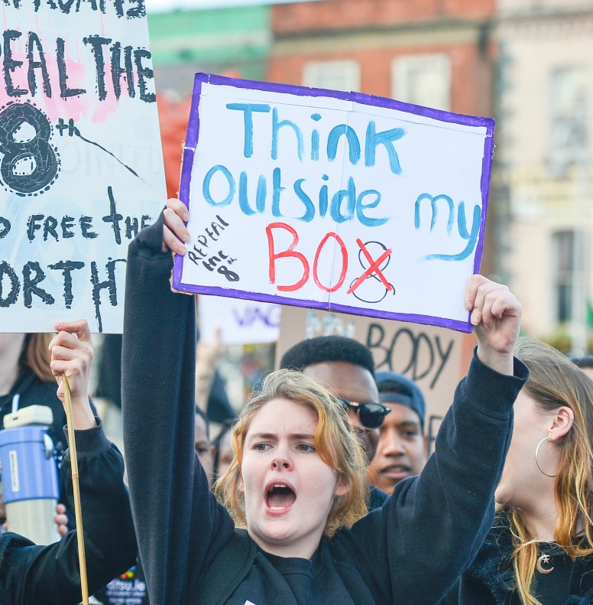
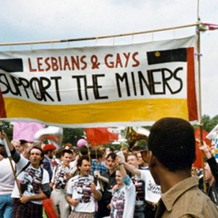
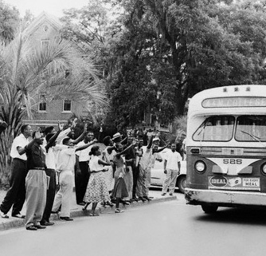
WHAT DO THESE CAMPAIGNS HAVE IN COMMON?
Notes:
LGSM
Montgomery Bus Boycott
Repeal the 8th

Slide 6
Notes:
LGSM
Montgomery Bus Boycott
Suffragette Movement
Anti Gun Protests

Slide 7
EDUCATE
Notes:
Firstly, you need to question whether you know the ins and outs of this issue.
It is no good simply knowing the side that is in your favour, in fact it is more important to know the arguments that will stand in your way and how you will respond to those.
As a Law Graduate – my priority in any campaign has been to find the arguments against me before I even look at the arguments in my favour. We need to be more of an expert on the against arguments then those on that side.
But then you need to educate those around you on the issue .

Slide 8
ORGANISE
Notes:
Who are the key players in this issue?
What skills are available in your campaign community?
What resources do you have at your disposal to use?

Slide 9
AGITATE
Notes:
Start talking and creating movement in the campaign – take people on the journey with you.
Use the apathy staircase

Slide 10
The Apathy Staircase
Action
Belief
Injustice
Experience
Notes:
Ask people about their experience – people love to talk about their lived experiences and it helps you to shape your conversation.
Inject the injustice – get people to think about good standards, comparison is an effective tool – compare their handbook/prospectus to their lived experience.
Make the wrong a right – Look at the Student Charter, contract, handbook, other universities sometimes basic rights and make clear the standard.
Then ask them to act – sometimes we get so focused on this part that we forget about the other steps.
Example; Freezing Exam Halls – Speak to students about their exam experience, ask questions about the environment - Inject the injustice ‘you mean you have to wear 3 jumpers and you are still cold in the exam hall despite paying at least 9,250 in fees? In other universities they bring in heaters or move the exams to another space with adequate heating . Make the wrong a right – wow the Health and Safety Executive would be less than impressed if they knew that was happening in a work place its even worse when you are paying for it. We have a right to adequate heating all the time especially when we have to concentrate in order to get amazing degrees which we are paying for. Then we bring in the action, sure if you could use the ipad I brought and vote yes on this big idea we can take this forward as a mandate to sort this.

Slide 12
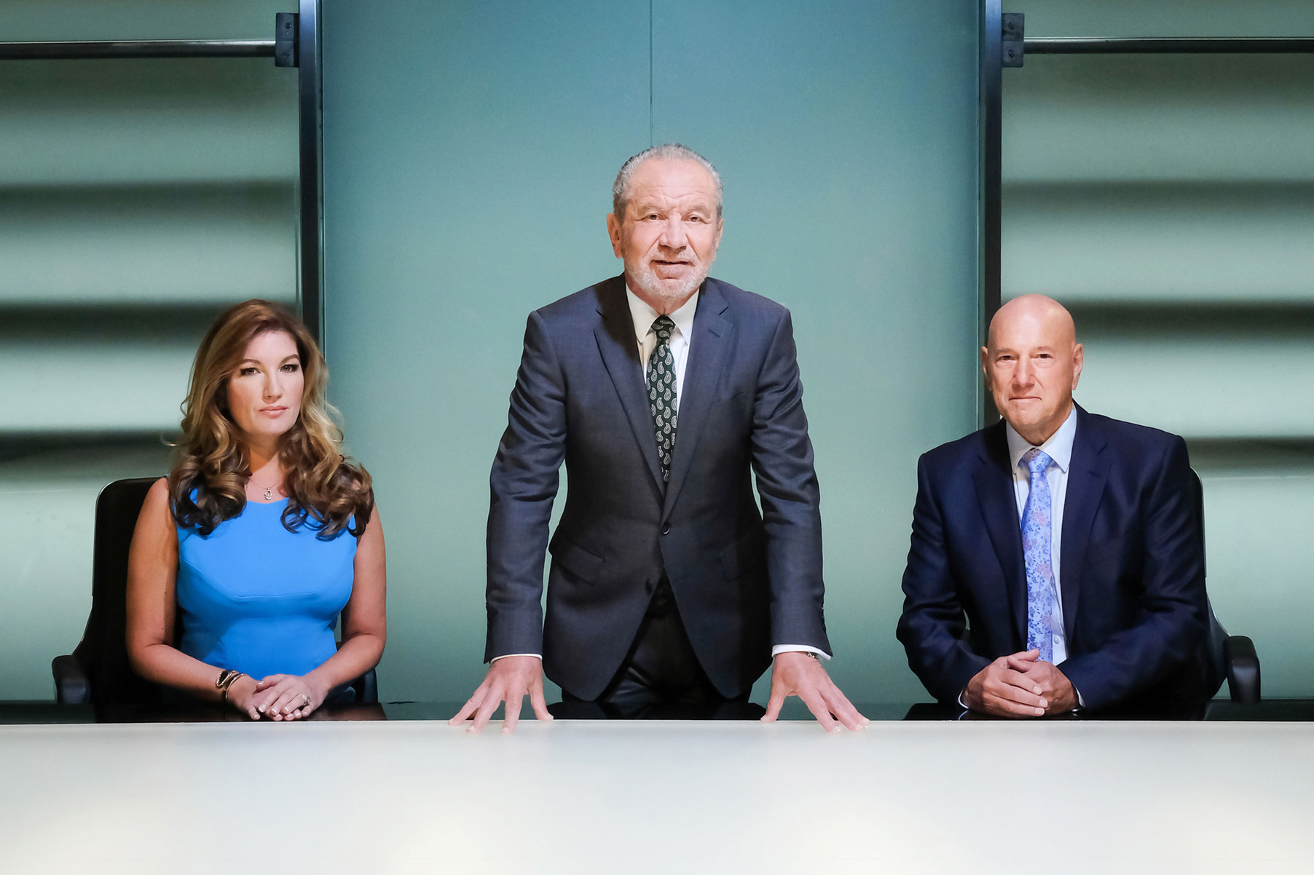
Challenge
Get your campaign on
Notes:
30 minutes to find a university issue
Educate, Organise and Agitate using the apathy staircase

Slide 13
Reflection

Slide 14
Key Tips to remember
Be specific in the objectives of the campaign.
Get nerdy on that issue
Ensure the spaces are accessible.
Be mindful that the right voices are given the opportunities to be heard.
Be willing to reflect and learn.
Don’t give up fighting once your specific need is met.
Remember to protest the policy not the person (unless you are protesting a person)

Slide 15
How do we create change as a Union?
Submit a Big Idea
Join a society that does campaign work
Take part in our volunteering opportunities
Join our Student Media Platform
Speak to your elected officers

Slide 17
Go out there and change the freaking world!
Stephanie Lomas
VP Education
sueducation@uclan.ac.uk
01772 894899
Big Idea? Email YourUnion@uclan.ac.uk
Stand for Election – uclansuelections.co.uk

