Slide 1
How would you behave if….

Slide 2
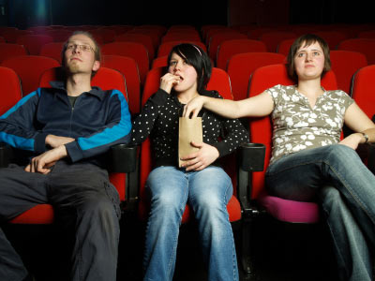
You are in the cinema and some people in front of you are talking very loudly and giggling. You can’t hear the film properly and you are starting to feel cross

Slide 3
Would you…
Tap them on the shoulder, smile sweetly and say very politely
‘please could you be quieter because I can’t hear the film’

Slide 4
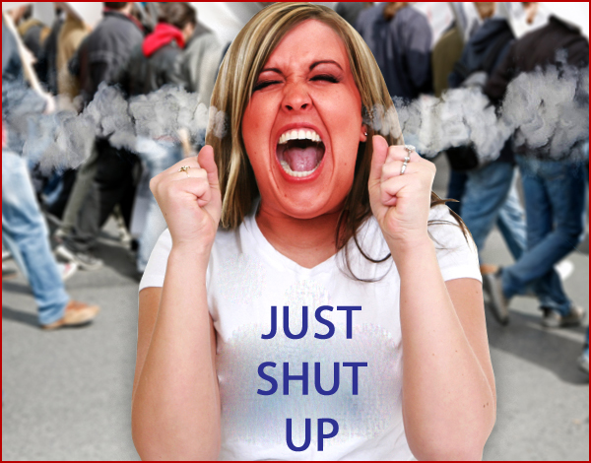
Or…..
Get angry and say loudly….SHUT UP!

Slide 5
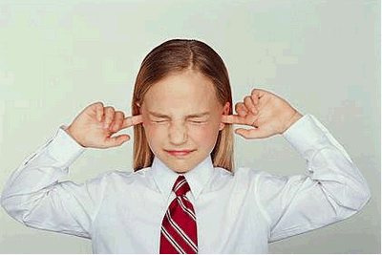
Or…..
Try and ignore the racket they are making even though it would spoil the film for you

Slide 6
You can choose to respond in one of 3 ways
You can respond ASSERTIVELY

Slide 7
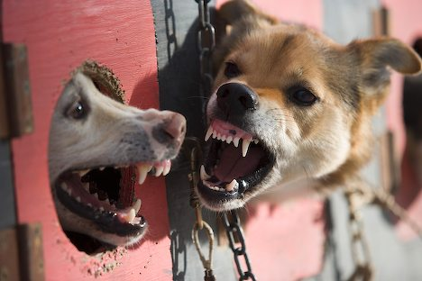
You can respond AGGRESSIVELY

Slide 8
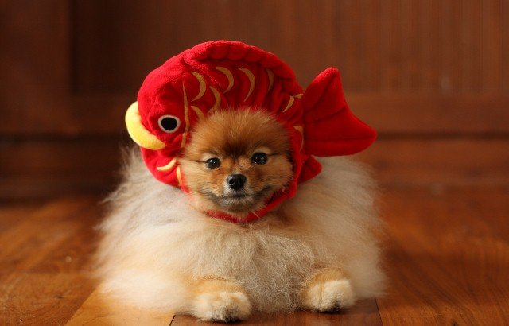
You can respond PASSIVELY

Slide 9
Which type of response is the best?
Aggressive
Assertive
Passive

Slide 10
Write down
An assertive response
An aggressive response
A passive response
To each of the following scenarios

Slide 11
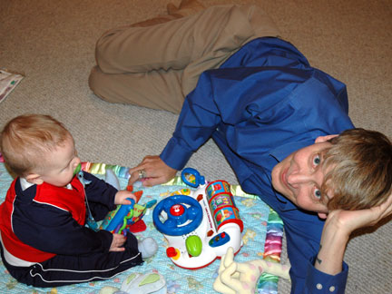
Scenario 1
Your mum is hassling you to babysit for your little brother. She knows you had already arranged to go out with your friends and you don’t want to let them down. What would you say to her?

Slide 12
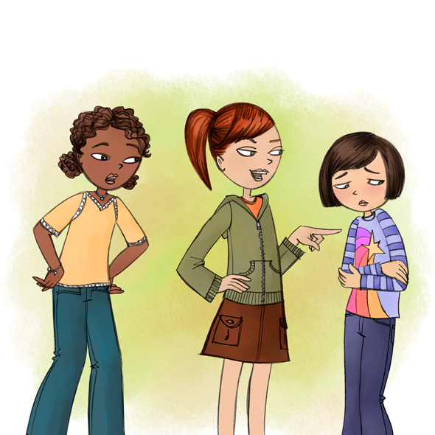
Scenario 2
You’re being bullied at school and a group of girls keep pushing you and calling you names. You are worried and afraid. What would you do about it?

Slide 13
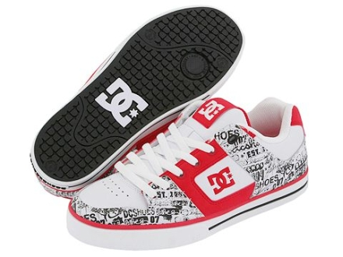
Scenario 3
You’re best friend buys exactly the same pair of designer shoes as you. You like to be original and hate to be copied. What would you do/

Slide 14
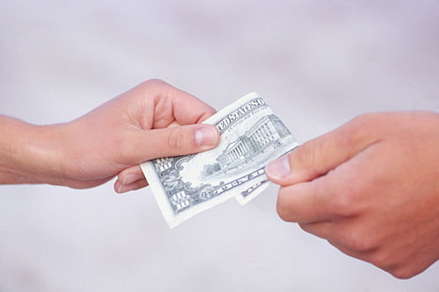
Scenario 4
A friend has borrowed £10 from you. It was 4 weeks ago and you really need it back. What would you do?

Slide 15
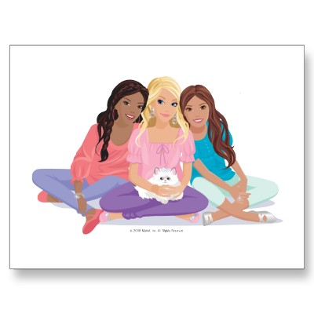
Scenario 5
Three of your close friends have gone to the cinema without asking you. You feel very left out and quite down! What would you do?

Slide 16
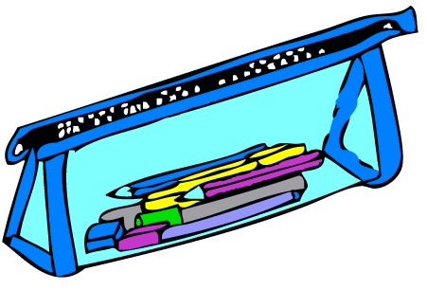
Scenario 6
A classmate keeps going into your pencil case and borrowing pencils without asking. You are getting annoyed because he often never returns things that he has borrowed. What would you do?

Slide 17
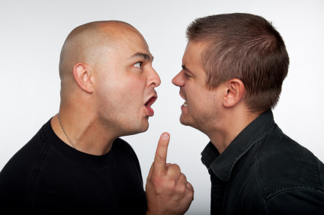

Slide 18
Assertive behaviour ?
Aggressive behaviour ?
Passive behaviour ?

Slide 19
Why do you think Assertive behaviour is best

Slide 20
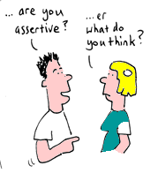
What is Assertiveness
Behaviour
Direct and honest
Respect others
Stand up for your rights in helpful ways

Slide 21
Feelings
Improved self esteem
Improved self confidence
Control
Respect for self and others

Slide 22
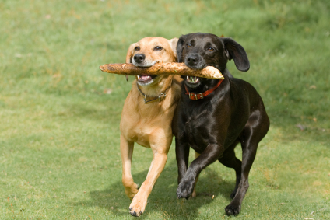
Outcomes
Good result without feeling angry or hurt
Gain self respect
Respect your rights and rights of others

Slide 23
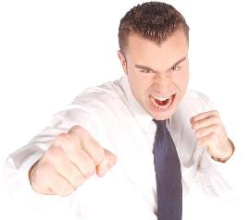
What is Aggressiveness
Behaviour
Blaming
Threatening
Fighting
Stand up for your rights but in unhelpful ways

Slide 24
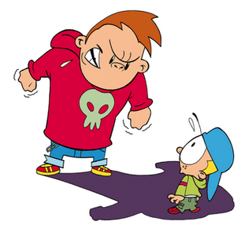
Feelings
Anger
Frustration
Bitterness
Guilt
Lonliness

Slide 25
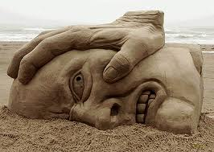
Outcomes
Domination
Humiliation
Win at the expense of others
Force others to lose

Slide 26
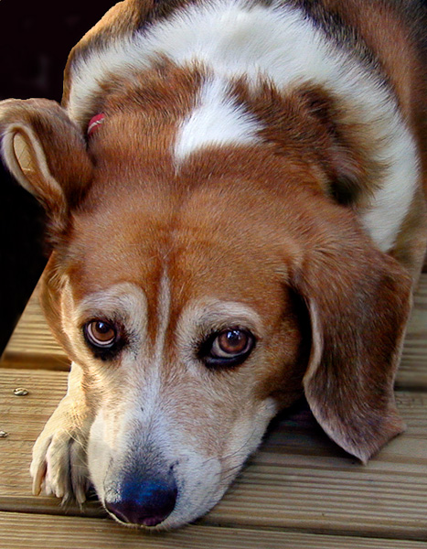
What is Passiveness
Behaviour
Be apologetic
Give up your right by not being honest
Do what you’re told regardless of how you feel

Slide 27
Feelings
Helpless
Anxious
Resentful
Disappointment

Slide 28
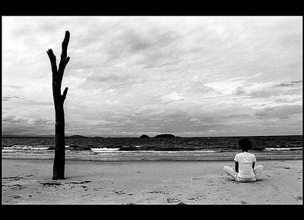
Outcomes
Don’t get what you want
Anger builds up
Rights violated
Loneliness and isolation

Slide 29
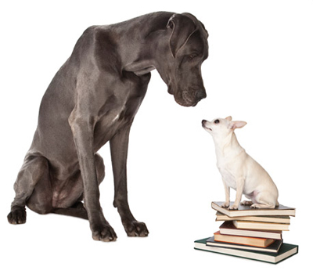
Passive
You are more important than me

Slide 30
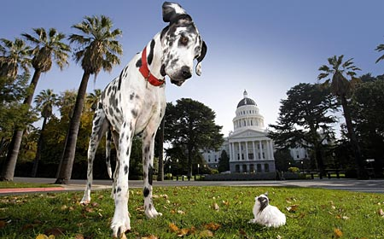
Aggressive
I’m more important than you

Slide 31
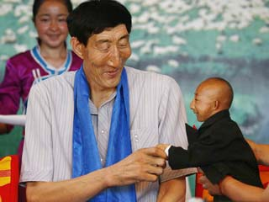
Assertive
We are equal

Slide 32
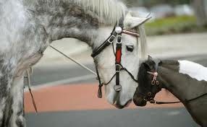
Guidelines for good communication
Know what you want
Look at the other person directly
Listen to the other person
Have a clear, firm voice
Say no and don’t make excuses
Use clear body language
Say what you want
Repeat what you want
Suggest reasonable alternatives
click here for a short video

Slide 33
Key Messages
You can behave assertively, aggressively or passively towards others
Assertive behaviour is the most proactive type and achieves the most positive outcome

