Slide 1
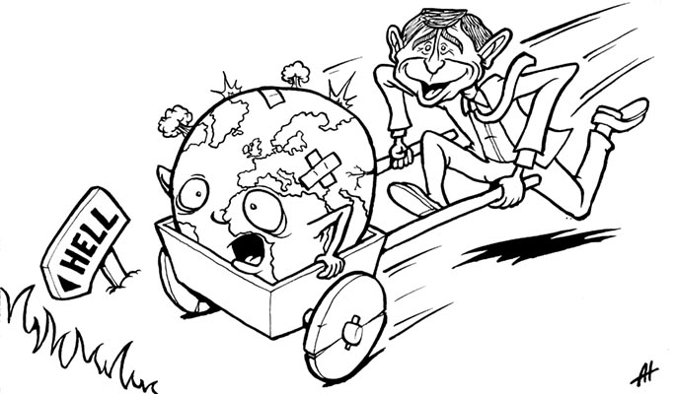
Righting the wrongs

Slide 2
Goals!
Money Goals Something that specific that some people get at a specific point in time Installing three microwaves on campus | Salary Goals Something that people will get regularly Agreeing that this is a campus that now offers facilities to warm up food- so MWs repaired | Approach goals Agreeing the basis on which people should get things, and why Agreeing a “healthy campus” policy that has an ambition of all students being able to access healthy and hot food
Rights

Slide 3
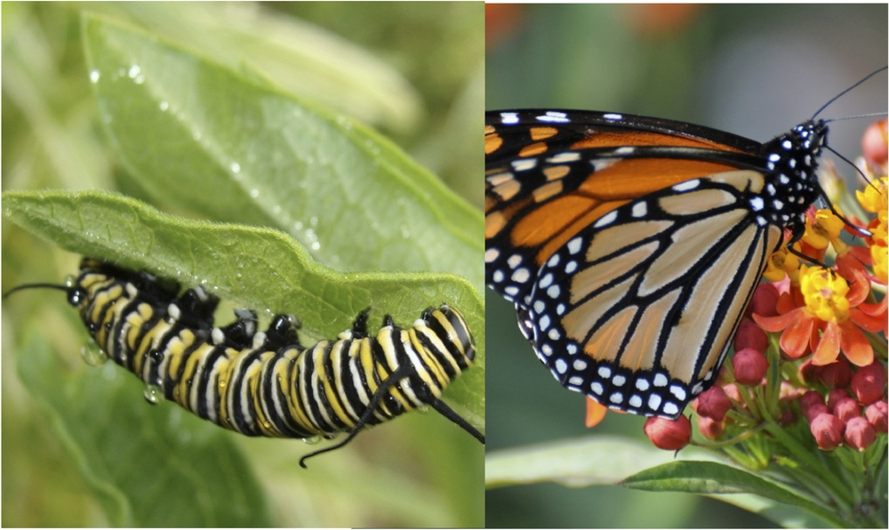
Righting wrongs
Identify the moan
Flip it
Is this convertible into a “right”? State it:
“All students have the right to safe housing”
Source it
Who would own it? Govt? Uni? Dept?
Do students currently have this right in theory?
Where is it written down?
Do they currently have it in practice?
ie active dissatisfaction on NSS
Are there differences between students?
What can you do about it?

Slide 4
Rights
Discovery | Establishment | Extension
Enforce | Defend | Promote

Slide 5
Check the policy
What are the rights implied here?
Any bits you’d make more specific?
Any extensions you would make (better, faster, etc)
Is implementation in there?
Is monitoring/performance built in? Does it work?

Slide 7
Solutions
Equal slices
Wants assessment
Calorific needs assessment
FCFS
Cake as reward for achievement
Destroy the cake/give to charity
Arbitrary rank (ie age)9
Desire assessment
Birthday boy

Slide 8
Ladder
Reflexive emotional individual consumer
Empowered individual consumer
Individual advocate
Collective generalist rep
Targetted rep
Collective advocate
Targetted advocate
Stakeholder
Policy Actor
Partner
Cheerleader
Sellout

Slide 9
Thank you

