Slide 1
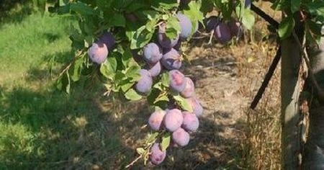
I just picked me a plum
Why some student officers’ social media works (and some doesn’t)

Slide 2
Pick an SU
Twitter, Blogs, Insta, Facebook & TikTok
How easy was it all to find?
Do you know what they’re doing
Do you know what they’re achieving?
Do you know what they think about things?
Do you know how they’re handling things?
General reflections

Slide 3
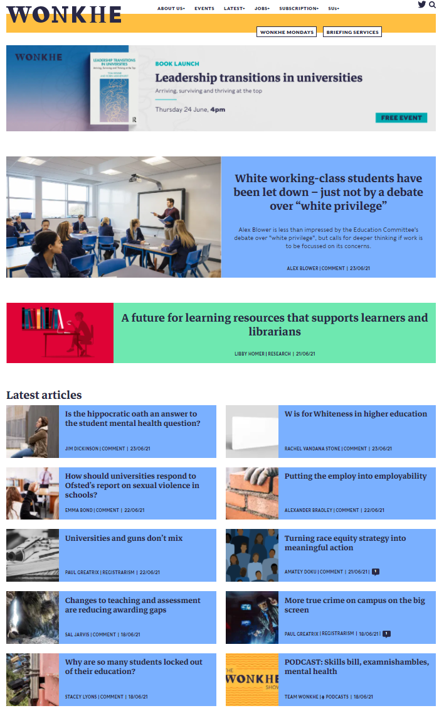
Context…
We spend a lot of time looking at political comms inc MPs and ministers (and VCs and uni SMTs…)
SU officers' social media - some dry, some exciting, some "on brand", some painfully off-brand…
Some barely post, and others overshare in a way that's genuinely upsetting.
Emerging theory on political effectiveness
What can officers (and staff that support them) do to build an effective and engaging presence online that builds profile, increases engagement and enhances accountability?

Slide 4
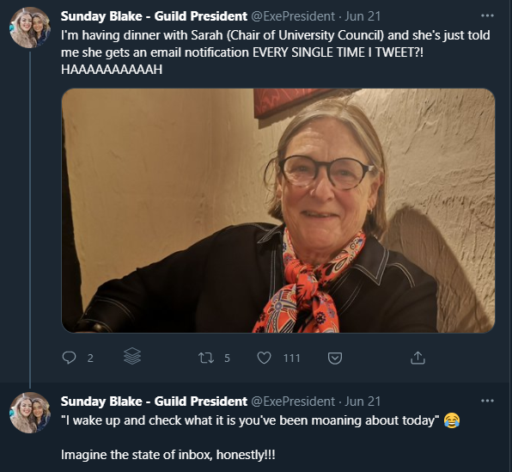
About this session
This isn’t a session about building a following or creating engaging content or staying out of trouble or being on brand or handling pile-ons
This is a session that anchors the output of student officers to their student (political) leadership role
That involves leading a group of people (and its sub groups) and influencing others
It’s also about being a “player” in the community
Platforms: Principally about Twitter and Blogs (with some Facebook)
That’s not to say that political comms are impossible on TikTok and Insta, but…

Slide 5
About this session
This isn’t a session about building a following or creating engaging content or staying out of trouble or being on brand or handling pile-ons
This is a session that anchors the output of student officers to their student (political) leadership role
That involves leading a group of people (and its sub groups) and influencing others
It’s also about being a “player” in the community
Platforms: Principally about Twitter and Blogs (with some Facebook)
That’s not to say that political comms are impossible on TikTok and Insta, but…

Slide 6
Officers as embodiment
SUs as organisations that reflect students
SUs as organisations led by students – mutuals
SUs as organisations that agitate for change (positively)
SUs that make students’ lives better
SUs that make students feel more powerful

Slide 7
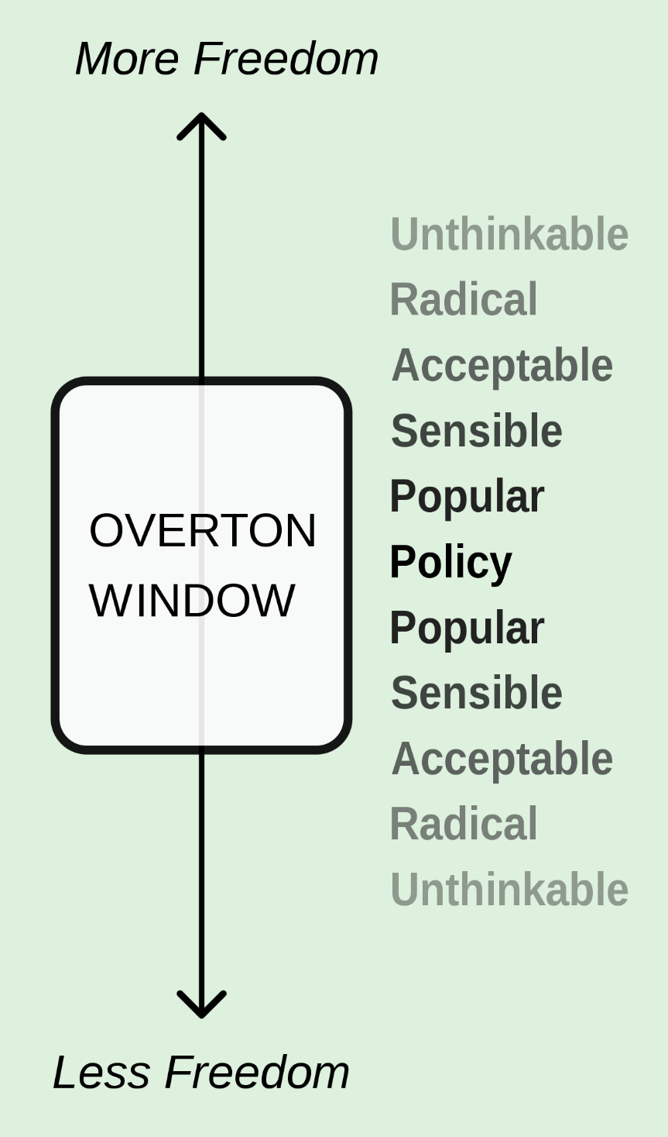
They use it to help shift the overton window

Slide 8
They provide highlights of a day - with angles

Slide 9
They influence the norms on campus

Slide 10
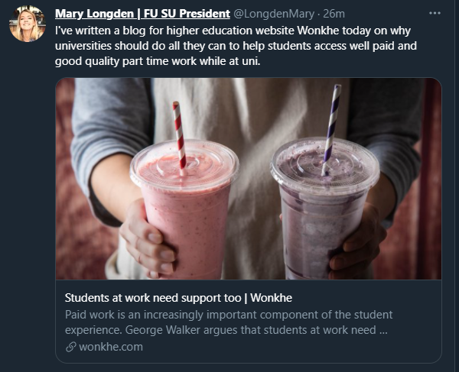
They bring the national to local and fill in the blanks

Slide 11
They talk about wants as well as wins

Slide 12
They make hidden students visible and build solidarity with them

Slide 13
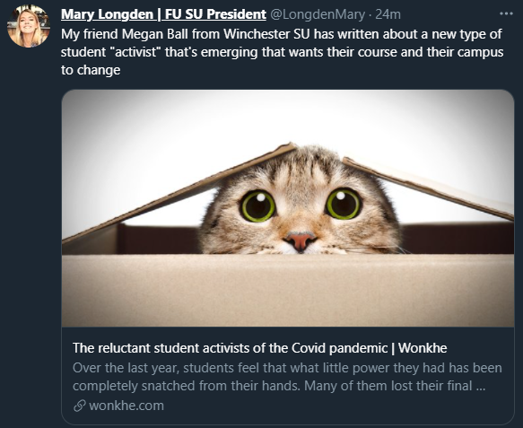
They promote their own stuff and other officers’ stuff

Slide 14
They channel anger

Slide 15
They love their own members - all of them

Slide 16
They take followers on a learning journey

Slide 17
They have things to say about the student condition

Slide 18
They create pace and positivity around their activities

Slide 19
They defend their own members when attacked

Slide 20
They explain the choices being faced by universities

Slide 21
They provide mind reading

Slide 22
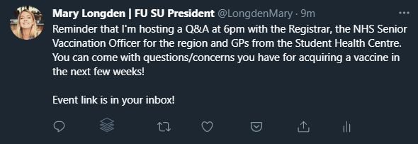
They update on events

Slide 23
They reframe controversy

Slide 24
I just picked me a plum
Why some student officers’ social media works (and some doesn’t)

