Slide 1
It’s all coming up
What will happen in the year ahead and why (and how) should SUs respond?

Slide 2
Representing students
Representing students/winning for students/achieving change/promoting, defending & rights of students
All involve strengths and weaknesses approach (manifesto, lobbying/campaigning/outcome – “hunting”)
All can involve opportunities and threats approach (events, reviews, initiatives, bandwagons – “fishing”)
Forecasting v Planning

Slide 3
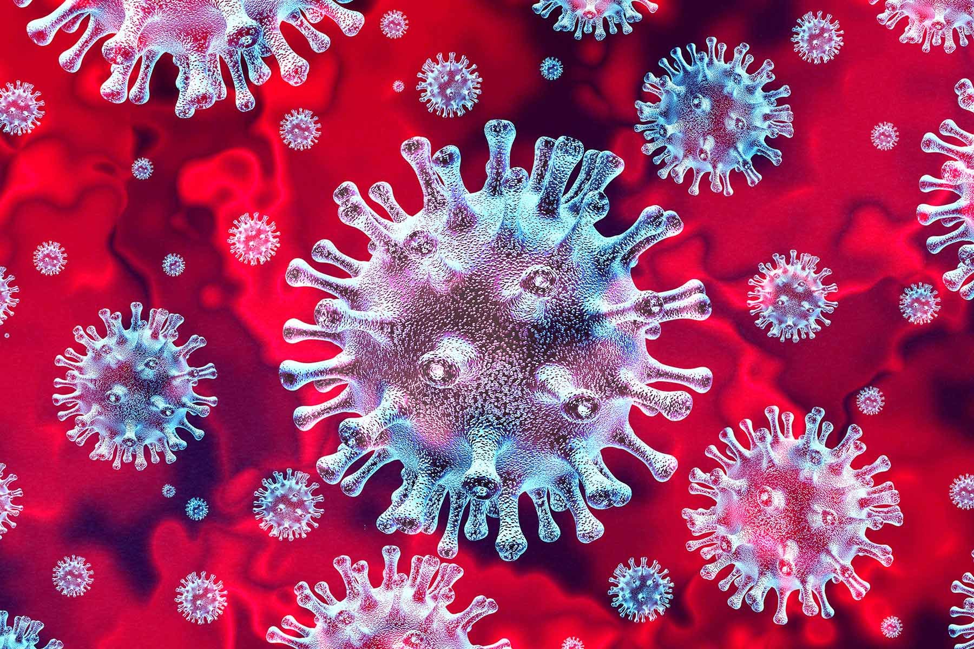
Change
Change is in the air
For the first time ever in this situation (some of) our parents (institutions) aren’t ready.
Students, Students’ Unions and Education are all going through rapid change.
We ought to be interested in change (but not for its own sake).

Slide 4
And now the problem is
Nobody has done this before
Higher education is highly “mimetic” and generally conservative
Covid (and recovery from it) requires all sorts of skills and smarts that have not previously been necessary or even desirable
Previous focus on incremental performance rather than innovation
And everyone’s knackered

Slide 5
Students
Underpinning assumptions (Harry Potter and Nurses)
Government capacity in HE part of DfE
Responsibility dumping on universities
Departmental dumping on DfE (DHSC? DWP?)
Only deal with issue once a crisis, only advise once solved, only fund once money runs out
Students not flagged as vulnerable
Higher education already very expensive

Slide 6
Medium issues
Busyness with the small – comforting
Busyness with the massive – exciting
Both a way to avoid accountability
Creativity rather than theft required?

Slide 7
1. The TEF will happen
Gold, silver, bronze
Student written submission
Pressure on SUs – pressure back?
Embedding voice and leveraging
Are you ready to maximise opportunity for SU and for students?

Slide 8
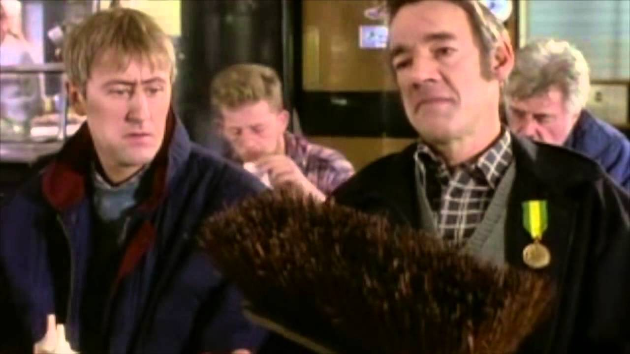
2. Money will get very tight
Unit of resource frozen, plus inflation
Prospect of SNCs for “low value subjects” and “low value students”
Failure to match demand to supply over 3 years, and moves around the market
Redundancy schemes
Couse closures
Trigger’s broom and student protection
Are you across the university’s finances?
Are you confident that students will be protected?

Slide 9
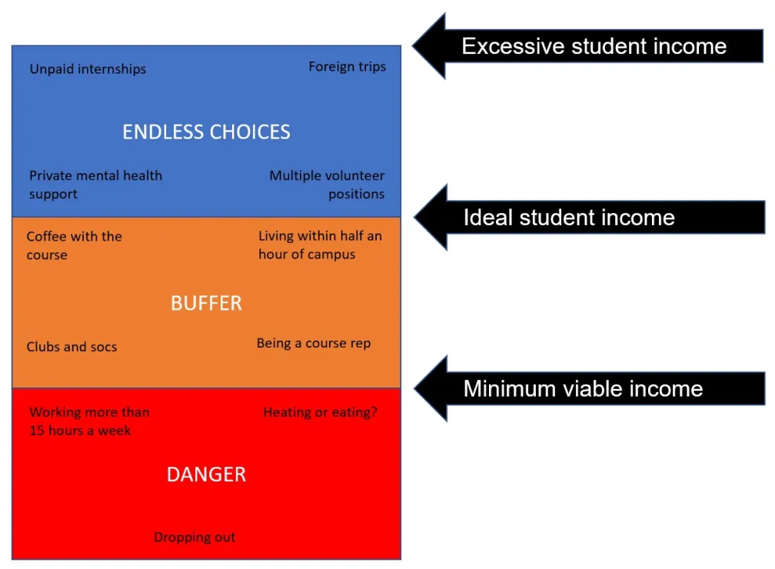
3. Money will get very tight
Bursaries and scholarships
International students
Home students – threshold and value
The student experience buffer
Are you confident in the
university’s arrangements?

Slide 10
4. There will be major housing reform
Standards, pets and some other bits
6 or 12 month fixed term tenancies banned
Cancel on 2 months notice
Right to stay
Signing early will be pointless
International students might find difficulties
Landlords may discriminate against students

Slide 11
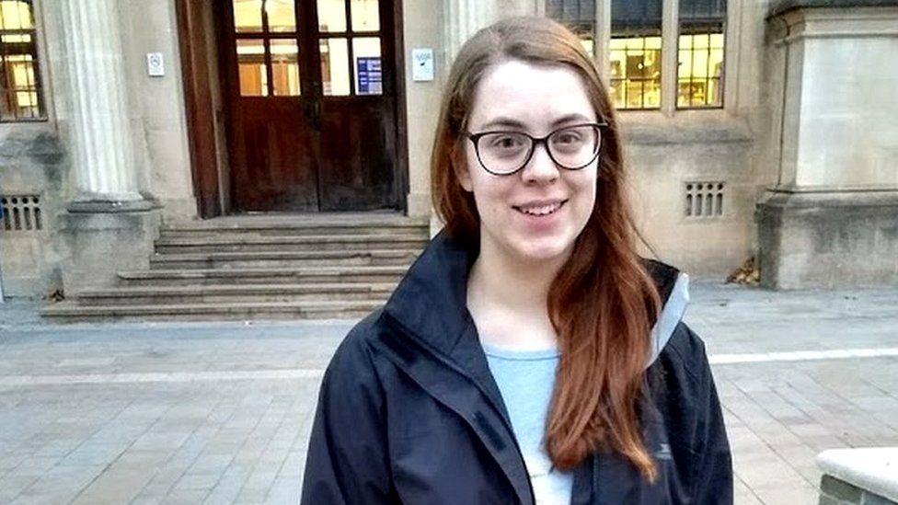
5. Big issues around Disability and M/H
Abrahart case – appeal or not?
Process of “becoming” Disabled
Assessment adjustments
Challenges to the SU model
Do you know what the
university is doing?

Slide 12
6. Free speech bill
As a reminder…
Toughening of existing duty – becomes something to promote and more than external speakers and room bookings
New DoAFaFoS on the OfS appointed by SoS
Will operate an ombuds scheme (relationship with OIAHE)
Freedom of speech within the law BUT reasonably practicable wording and balancing with other duties
Students’ unions directly regulated UNLESS an SU of an Oxbridge College
New legal tort if a person is impacted by a failure re the duty

Slide 13
6. Free speech bill
Copy and paste emphatically rejected in the Senedd yesterday
Report stage
Foreign funding (free speech or security?)
Security costs (will this work?)
Academic freedom definition addressed (expertise…)
NDA ban defeated (MD very strong on OfS regulation and what it will achieve)
Harassment and a free speech defence amendment defeated (existing balance left intact, OfS will issue guidance)
Labour amendments on political neutrality of the DoAFaFoS and a sunset clause both obviously defeated

Slide 14
6. Free speech bill
To the Lords!
To what extent will definitional/interpretation issues be left to OfS?
Interaction with other legislation (inc online harms bill and human rights proposals)
Problems with direct SU regulation when SUs already regulated by university and charity commission
Which SUs regulated and how?
Interaction with the OIA
OfS implementation – Quality and standards?!
Bill of rights – Raab – free speech and public authority overreach

Slide 15
7. Harassment and sexual misconduct
New OfS statement
High hopes from Michelle Donelan on NDAs
Will it make a difference?
Bartlett School of Architecture
Acting in and acting out tensions…
Is the union ready when the SoE kicks in?
NDA approach?

Slide 16
8. Quality arrangements
B Conditions
B3 Bear and outcomes
Other B Conditions
Investigations…
Changes to quality policies and arrangements – course reps etc
Are you ready to take advantage of (see off threats from) the changes?

Slide 17
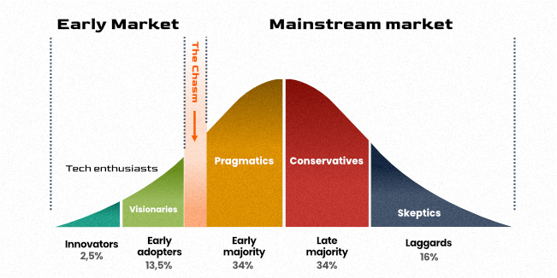
9. Decol will hit the buffers
Ministerial opposition
Change in “faces” and harassment handling?
What about the laggards?

Slide 18
10. A new deal for PGRs
Space
Funding
Supervision
Staff?
SU effectiveness at voicing or working on these?

Slide 19
Plus…
Ongoing blended tensions
A crisis in assessment
Essays and AI
Exams and proctoring
Authentic assessment – scale and discrimination
Academic integrity
Labour and fees
Universities will “fill up” again (what does full mean)
Grade inflation panic will continue

