Slide 1
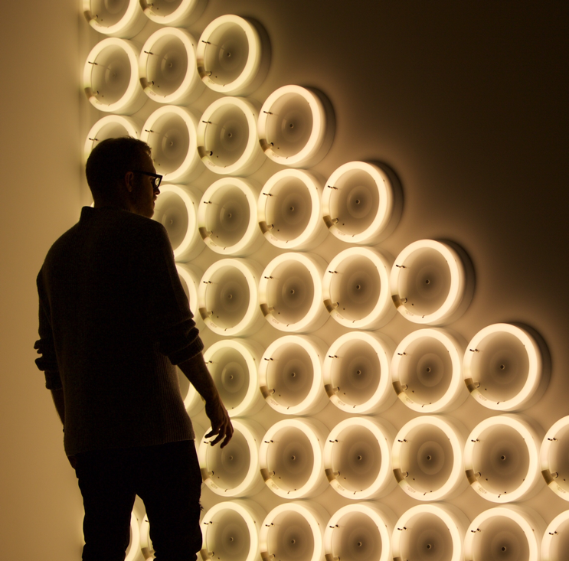
Student Staff Roles as Co-curricular Activities and Student Development
Alan Roberts- Counterculture
Frank Longdon – Lancaster SU

Slide 2
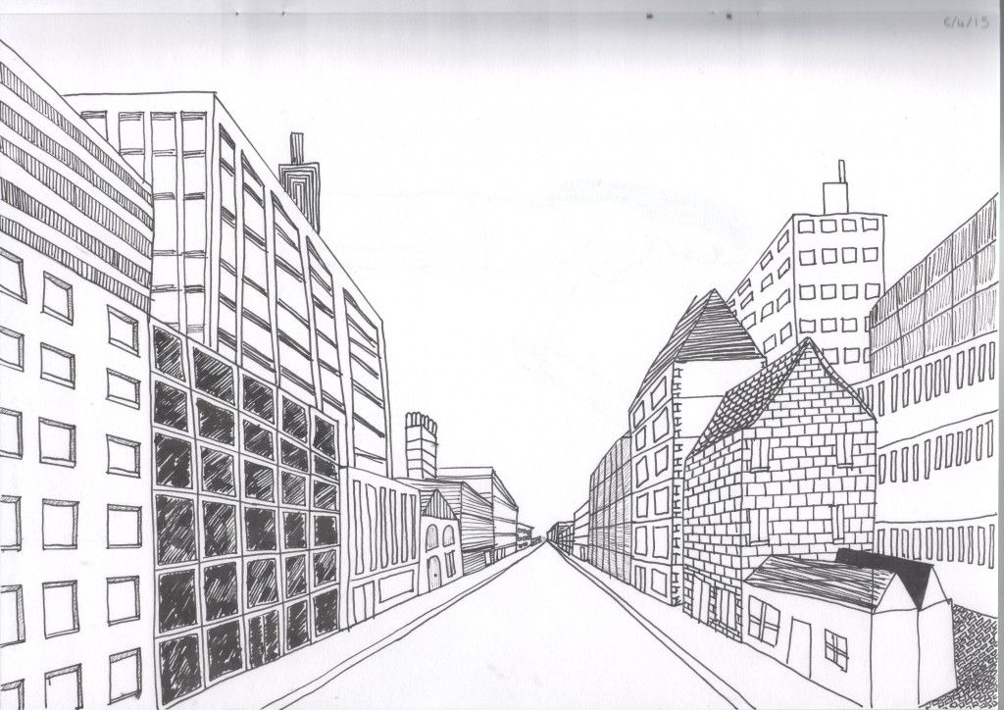
Two discussions
Understanding the US research around supporting and developing student staff
Discussing the opportunities, risks and solutions to employing more students.

Slide 3

The US research…the Before Times
Unions conducted performance evaluations, but…
  They weren’t based on learning outcomes
  They weren’t consistent across service areas in the Union and University

Slide 4
Program Overview
Goal
  To create a comprehensive student staff and leader experience by the development of outcomes, assessment, on and off boarding, training recognition, and other interventions
Accomplished
  The development of the learning outcomes, development plan, and performance evaluation for undergraduate student staff
  The development of learning outcomes and performance evaluation for graduate student staff
In Progress
  The measurement of the success of the program
  Making small adjustments based on supervisor feedback to streamline use

Slide 5

Research and Development
Professional Associations
  NACE Competencies
Student Centered
  First, what do we want our students to learn?
  Open to change
Healthy Debate
  Reasonable expectations
  Measurable

Slide 6
Learning Outcomes
NACE Competencies
Career and Self Development
Communication
Critical thinking
Equity and Inclusion
Leadership
Professionalism
Teamwork
Technology
DOSA Learning Domains
Communication
Critical Thinking
Problem Solving
Personal Development
Integrative Learning
Intercultural Fluency
Civic Engagement
RISE Learning Outcomes
Communication
Critical Thinking
Digital Technology
Interpersonal Skills
Accountability, Professionalism, Work Ethic
Intercultural Fluency
Career Readiness
Leadership: Year 2+

Slide 7
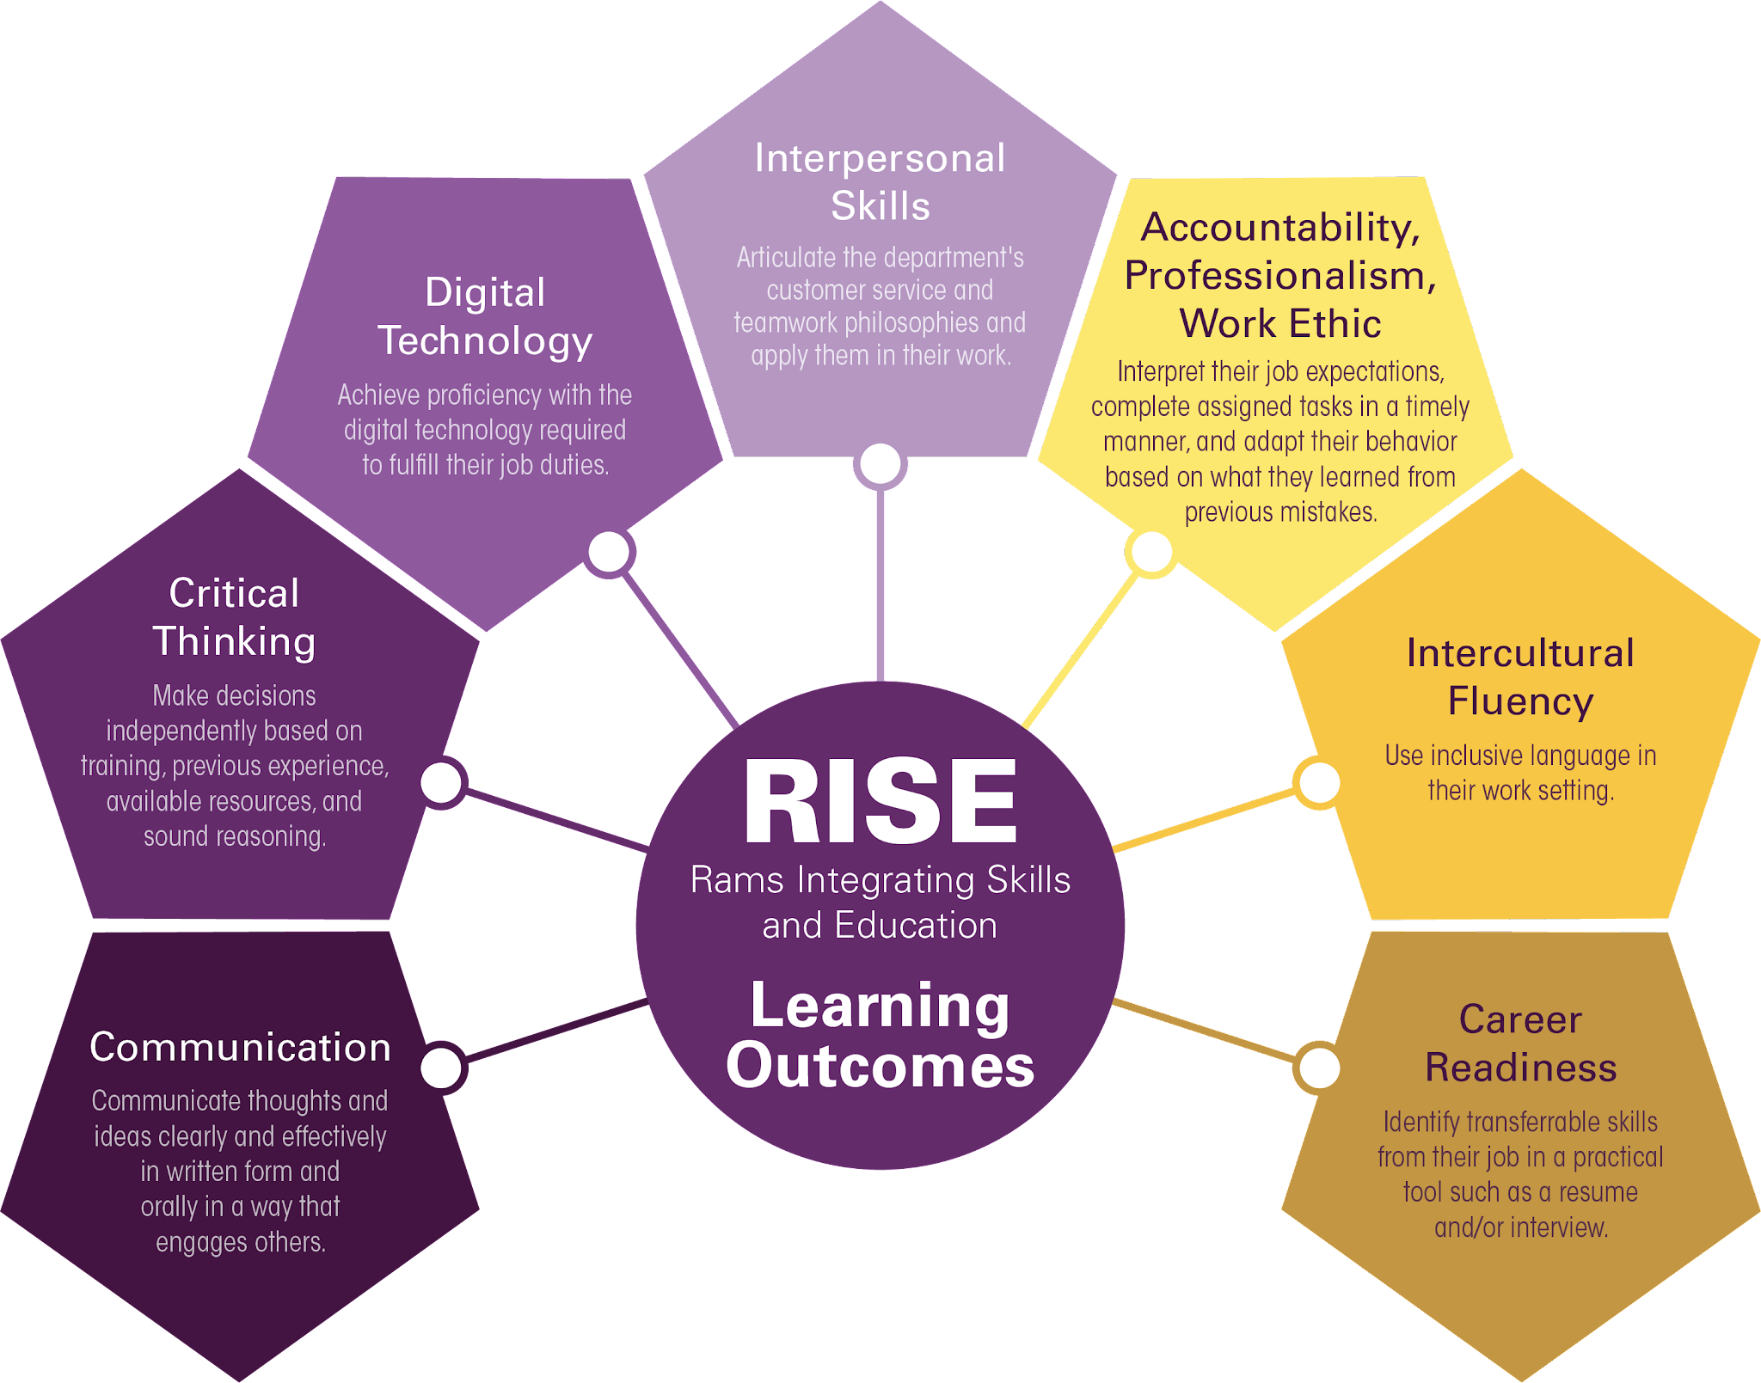

Slide 8
In Your Hands
Performance Evaluation
  Students use the performance evaluation rubrics to self-evaluate at least three times a year.
Development Plan
  A tool to provide the supervisor and student with a snapshot of their growth and progress throughout the year. The supervisor reviews each student's self-evaluation, adds their own score and comments, and records averages.
The Key
  This document supports supervisors in the performance evaluation process. Instructions are given on how to input information into the corresponding development plan.

Slide 9



Performance
Evaluations

Slide 10

Methods of Evaluation
Student-Focused Language
Types of assessment
Delivery

Slide 11
Timeline
Autumn Mid-Semester
Check-In
End of Semester 1 Evaluation
Spring Mid-Semester Check-In
End of Year Evaluation

Slide 12

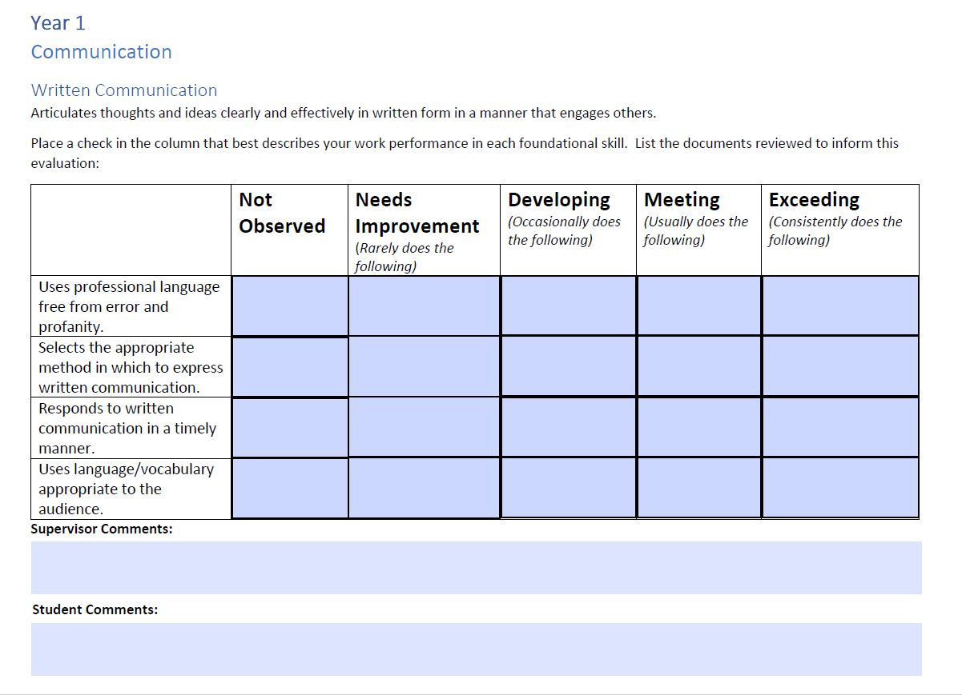


Slide 13
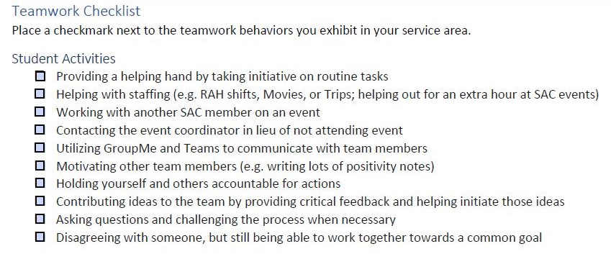

Slide 14
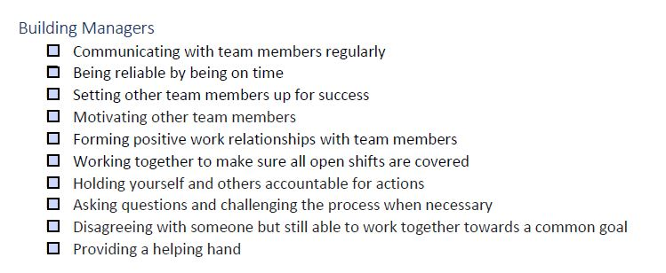

Slide 15
Development Plan
Notes:
*Ed Session Presenters* - please include the provided Land Acknowledgement on your title slide so that attendees can read it as they enter the room.

Slide 16

What is It?
Summarises performance evaluations
Tracks students’ progress throughout the year
Is a tool for the supervisor & the student

Slide 17
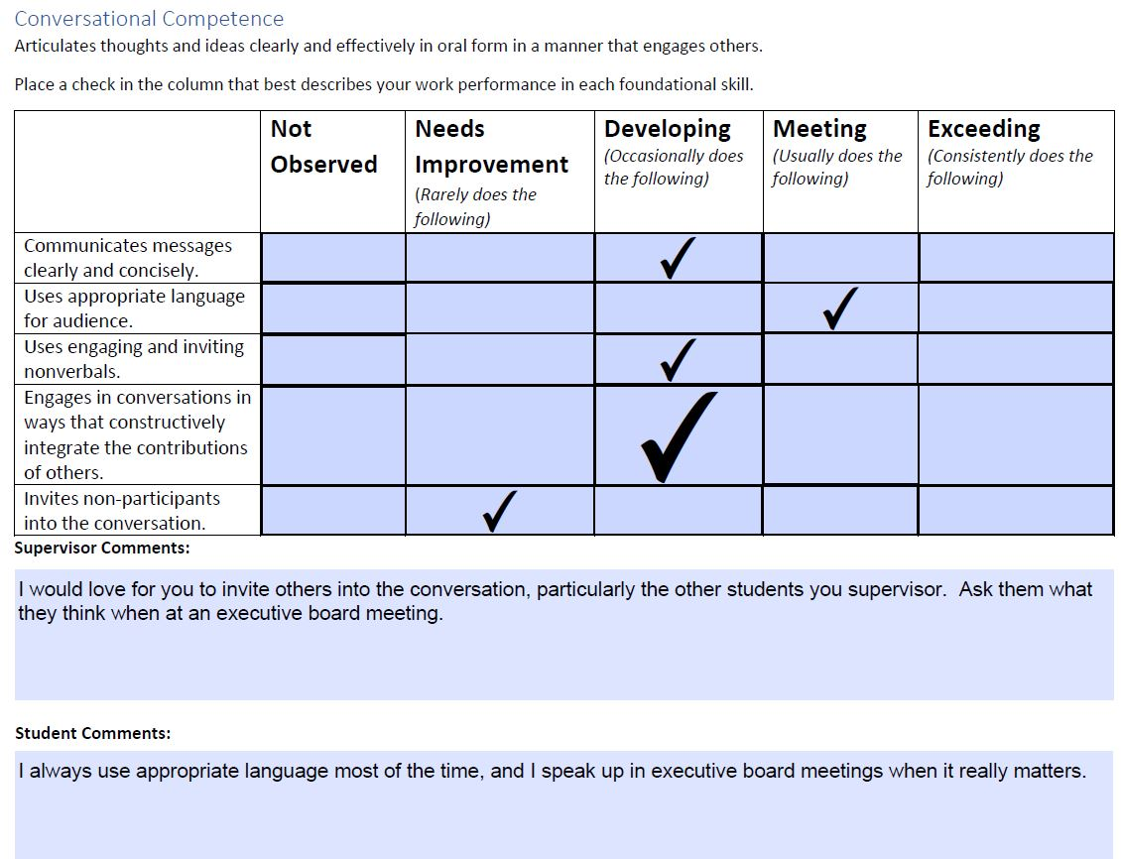

Slide 18
2nd Year of the programme
Experiential Learning
  Students can use internship, conferences, field placements, study abroad, research, co-curricular programs, etc.
Co-Curricular Programs
  More out-of-the-classroom educational opportunities packaged into a co-curricular transcript.
Assessment
  Supervisors can utilise this assessment of the 2nd Year experience to further develop areas of growth for students. For example, students who need to grow in written communication will be asked to write a one-page reflection.

Slide 19
Programme Assessment 2022-2023
74% (17/23) student staff grew in at least 70% of the learning outcomes.
  The strongest learning outcomes, meaning the ones with the greatest number of students who either grew or started at the highest level and stayed the same, were career readiness, intercultural fluency, digital technology, and teamwork.
  Critical thinking, digital technology, and conversational competence were the learning outcome with the greatest number of students who showed growth.
  The greatest number of students showing progression occurred in the critical thinking learning outcome.
Off campus student retention significantly improved.

Slide 20
On the Horizon
Ongoing Assessment
Facilitation Guides
  1:1 Conversations
  Goal setting
Supervisor Development

Slide 21
Lancaster time!

