Slide 1


A Campaign for Basic Needs
Alan Roberts, Counterculture
Phillip Smith, Rutgers University

Slide 2

What are Basic Needs?
Basic needs encompass more than just food; they include housing, health, financial stability, and transportation.
Addressing these needs holistically is crucial for students’ academic success and their overall wellbeing.
Responding to the interconnectedness between the different basic needs is what typically would describe a basic needs approach.

Slide 3
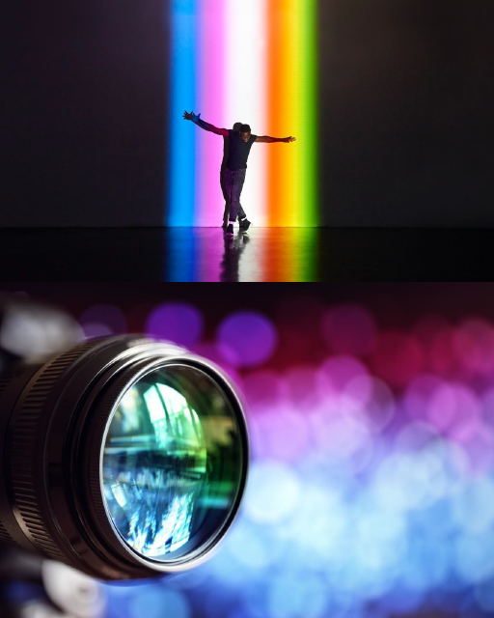
US Institutions are increasingly developing integrated support systems that centralise services such as food pantries, housing assistance, and mental health resources.
These models are increasingly data-driven, allowing for continuous adaptation to meet evolving student needs, ensuring an holistic support system
The US Model: A comprehensive and integrated approach

Slide 4

The UK Approach: Emerging strategies and focus on immediate needs
The UK is still developing a comprehensive approach to basic needs, with a primary focus on immediate issues like food insecurity and cost of living.
Nottingham Students' Union: Conducts research on food poverty and advocates for more integrated approaches to student support​.
Strathclyde University Students' Union: Offers mental health and wellbeing programs, including massage therapy, safe spaces, and urgent care packages.
Lincoln Students' Union: Focuses on cost-of-living support with emergency funds, food banks, and financial advice, along with extensive mental health support​.
Leeds University Union: Provides a comprehensive range of basic needs services, including food pantries, housing assistance, and mental health services​.

Slide 5
Learning from each other: Integrating approaches
Sharing challenges and different strategies.
The US has developed a mature, collective model of support, while the UK is beginning to adopt more integrated strategies, particularly in response to rising student demands for comprehensive support​.
The workshop today will explore how UK institutions can adapt and learn from US models while building on their strengths, particularly in community-driven and place-based initiatives.

