Slide 1

The housing problem

Slide 2


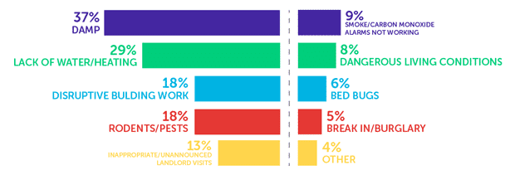



Introduction:

Slide 3






Introduction:

Slide 4
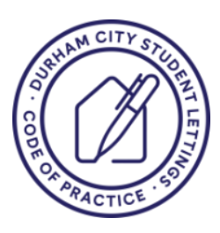
Durham University’s Responsibility
Denial
Collaboration

Slide 5
Misery Olympics (Housing edition)
57.50% of respondents said that they faced mould.
36.25% of respondents said that they faced condensation.
33.75% of respondents said that they faced draughty windows/doors.
25.00% of respondents said that they faced slugs/mice or other infestation.
16.88% of respondents said that they faced leaking roof/windows.
12.50% of respondents said that they faced lack of heating.
10.00% of respondents said that they faced electrical safety hazards (e.g., exposed wiring, faulty appliances).
8.75% of respondents said that they faced lack of hot water.

Slide 6







Role of Student Unions: Advocacy

Slide 7




Role of Student Unions: Durham SU initiatives, campaigns, and collaborations
Housing training
Annual Housing quality and affordability survey

Slide 8
Durham SU next steps
Renter Reform Bill (evolution)
Rate Your Landlord
Co-ops (they are the future)
Additional licensing scheme or accreditation scheme: Student living agreement.
Rent controls
Rome was not built in a day!

