Slide 1
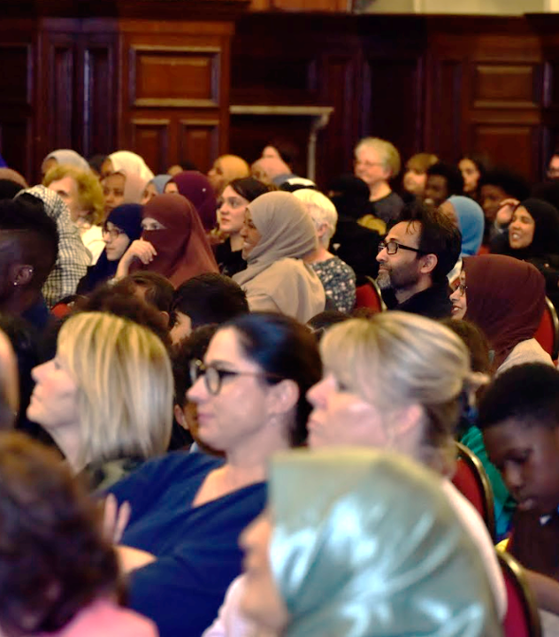
Community Organising Campaigns
A rushed primer for
NUS Membership Services 2024

Slide 2
Key Questions
How do you move beyond the ‘standard’ campaign playbook to do something unique but impactful?
How do you build campaigns that focus on leadership development and building community power? So that once the campaign is won, you’re in a better place for the next one?
How can you transform some normal activity like voter registration into a key campaigning tool?

Slide 3
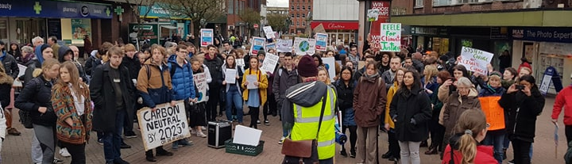
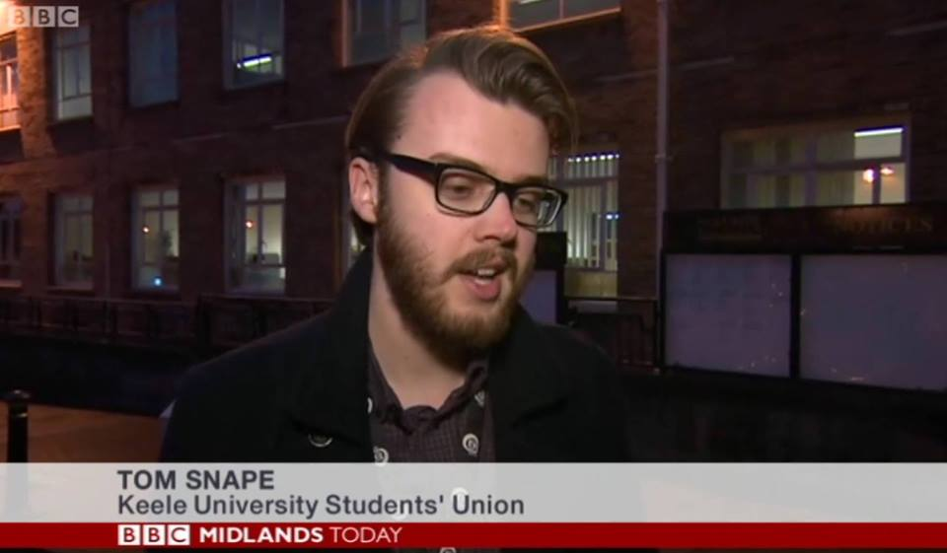
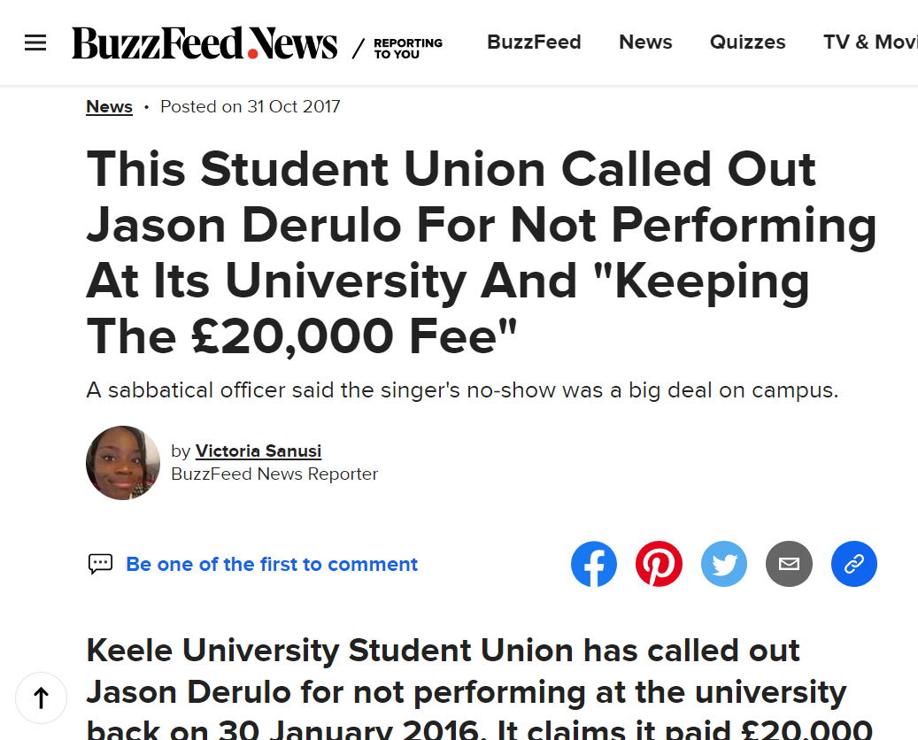
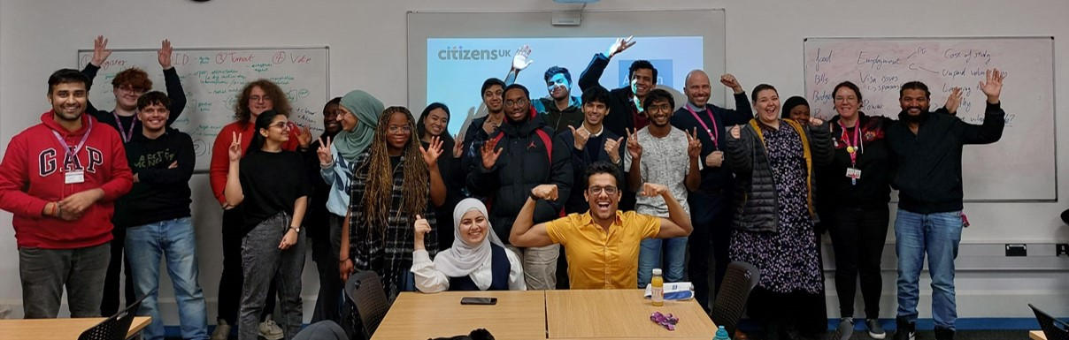
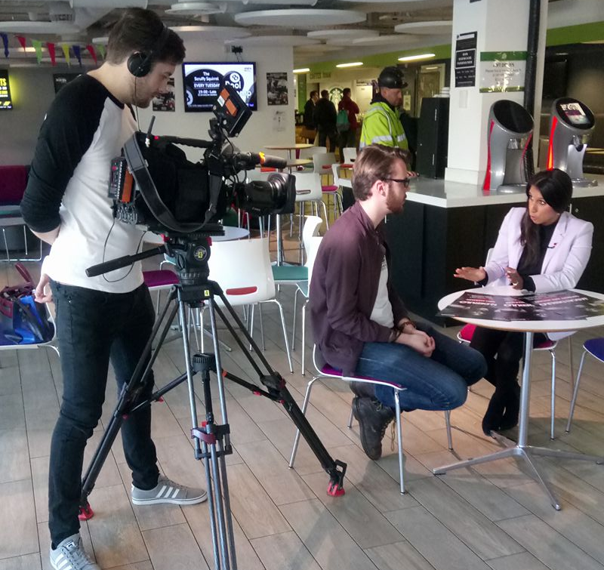
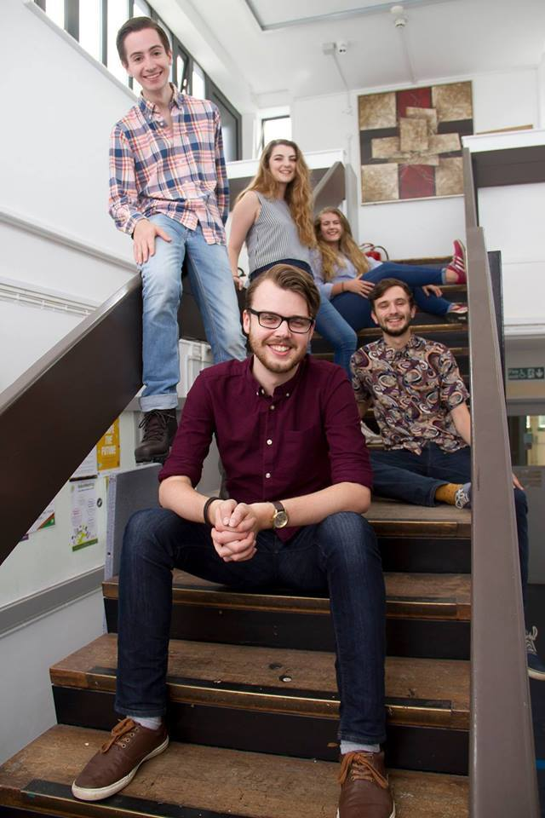

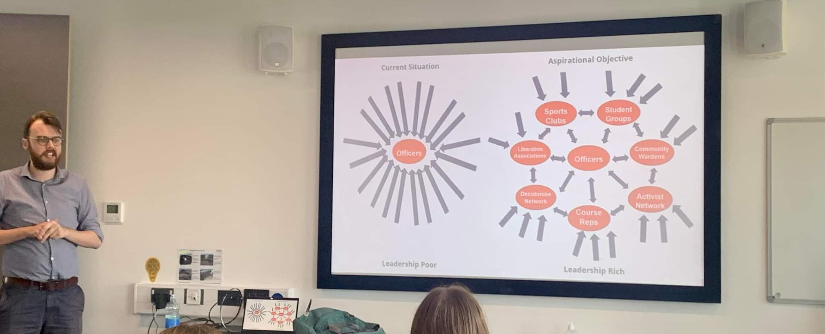
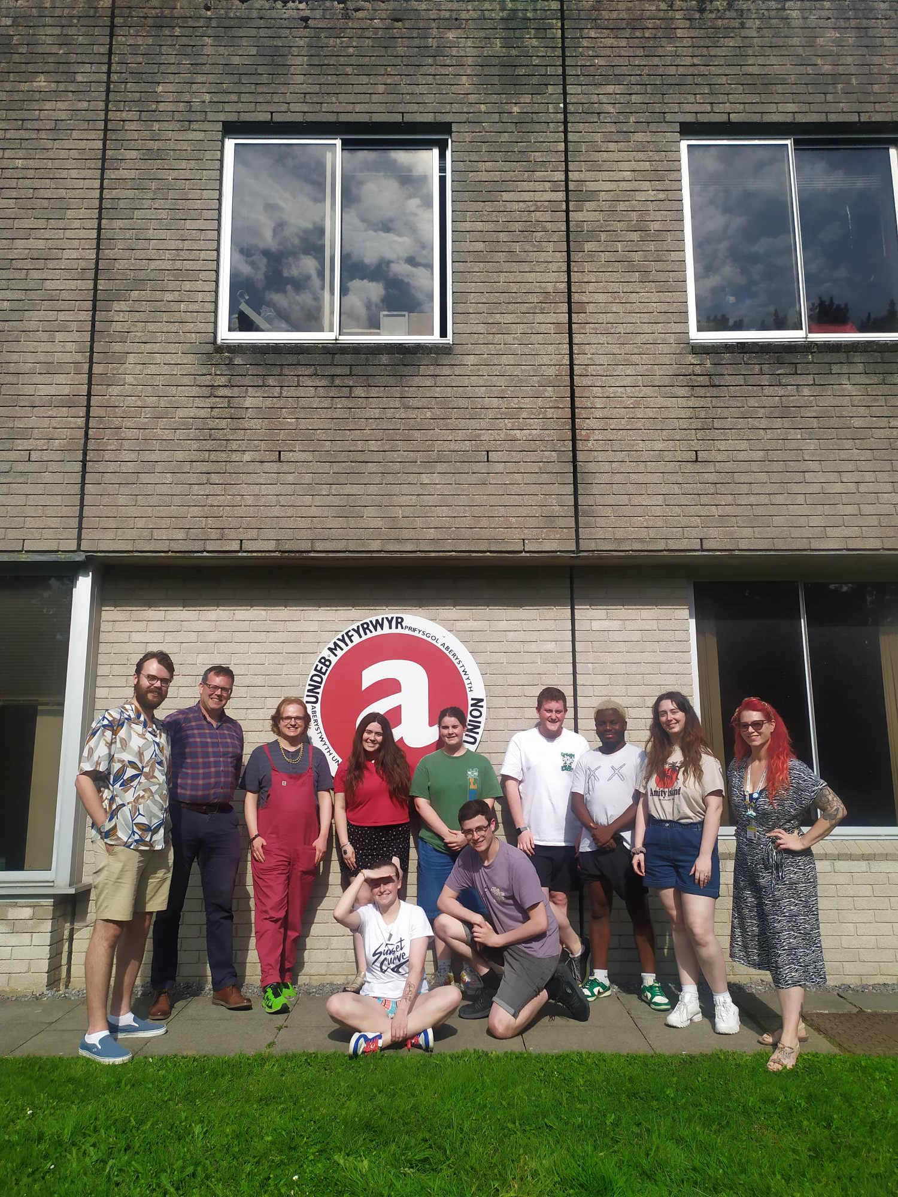
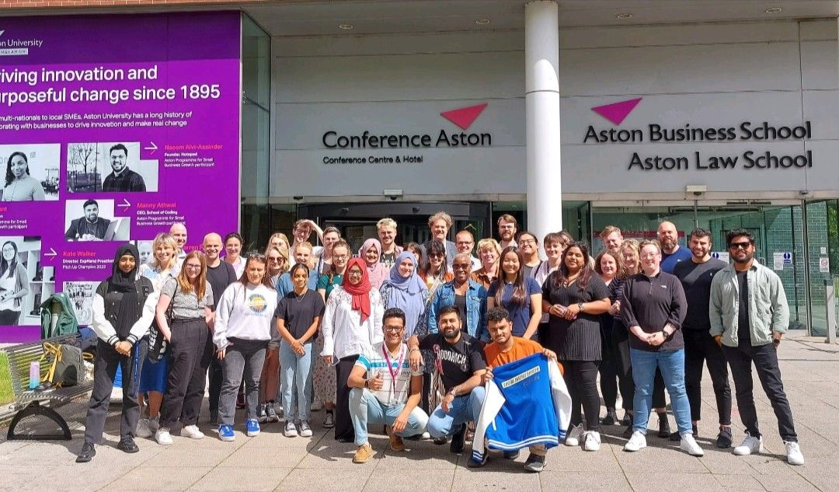
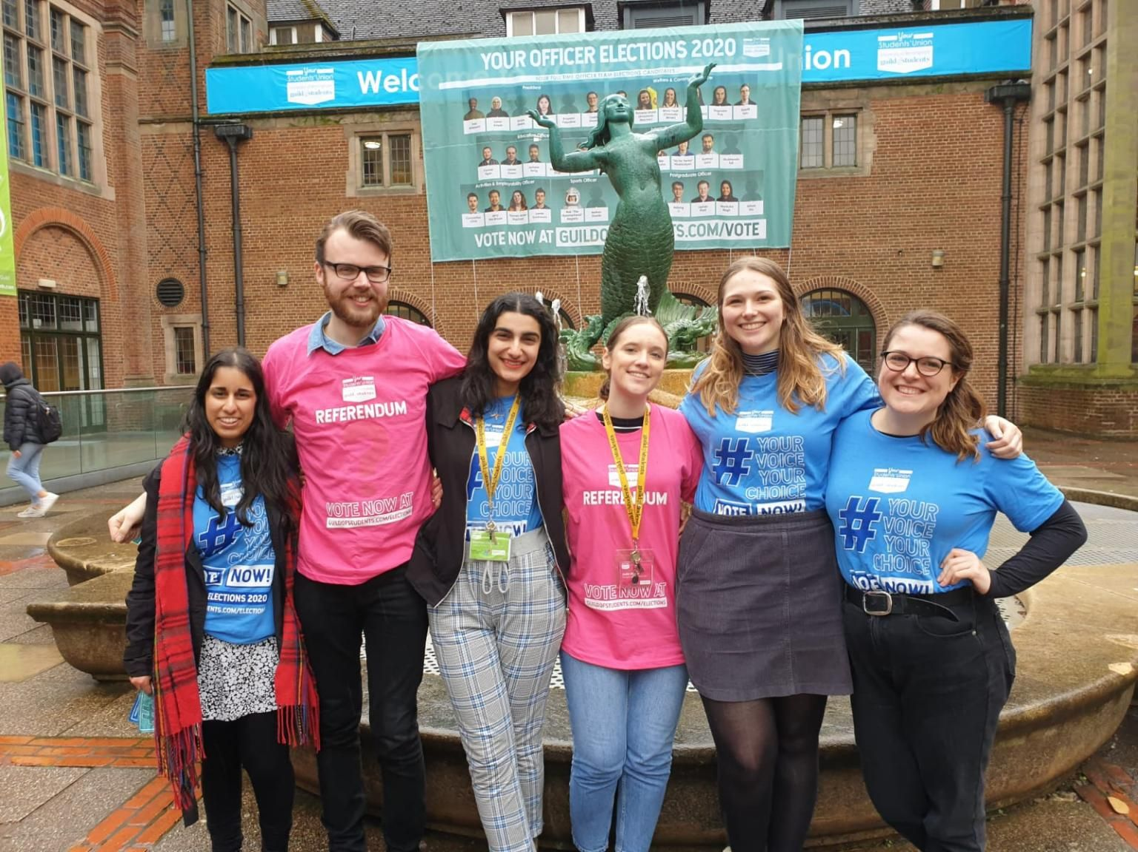

Slide 4
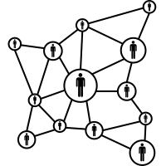


Lone Wolf
Mobilisers
Organisers

Slide 5
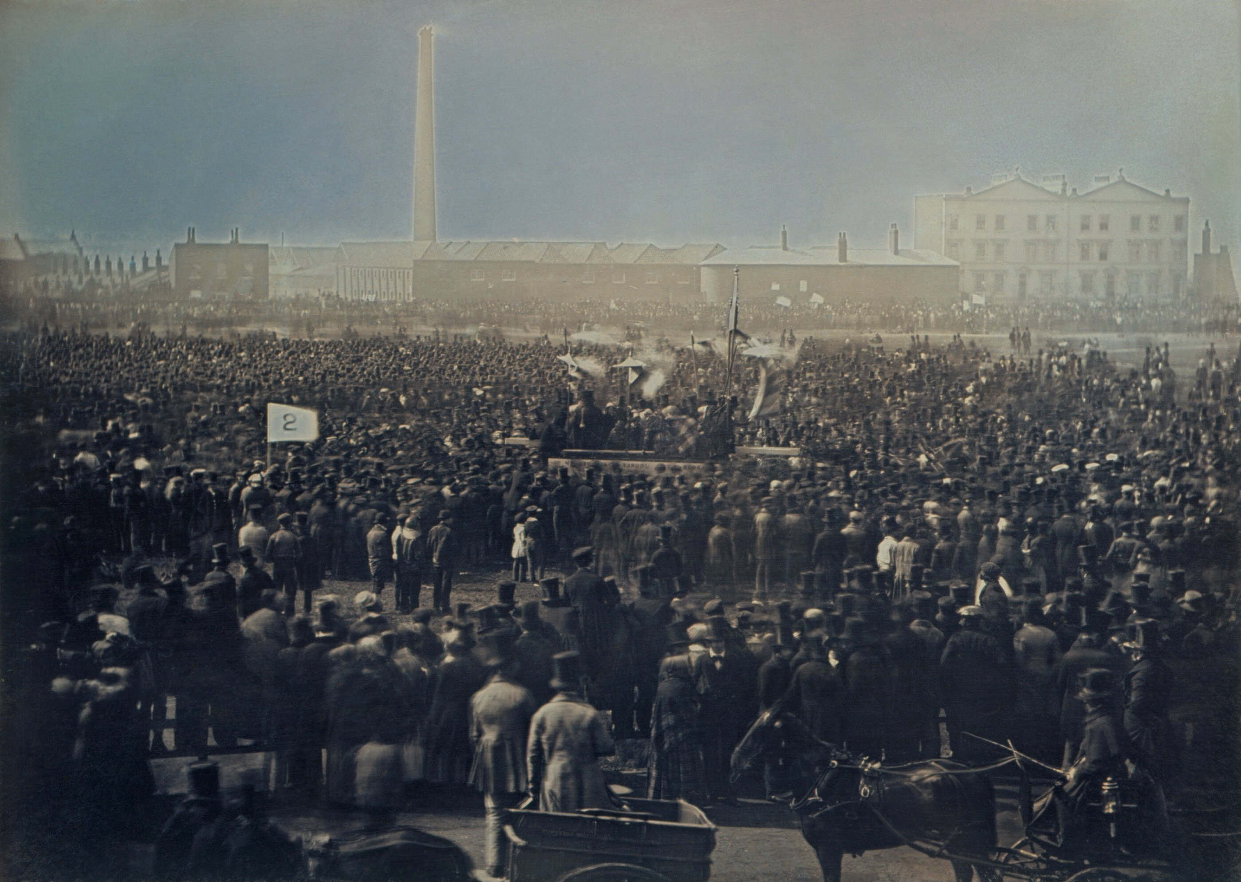
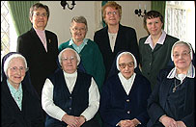
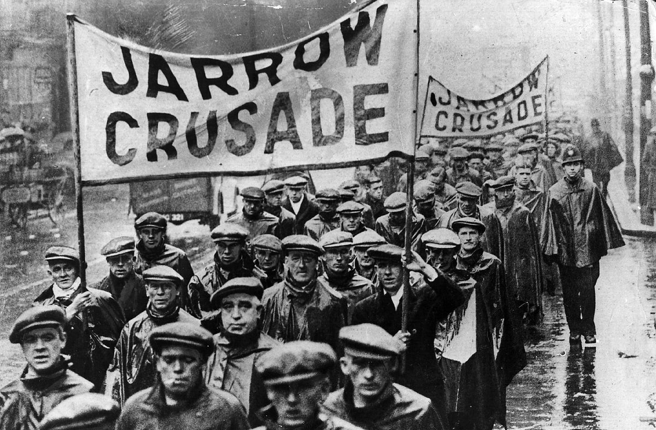
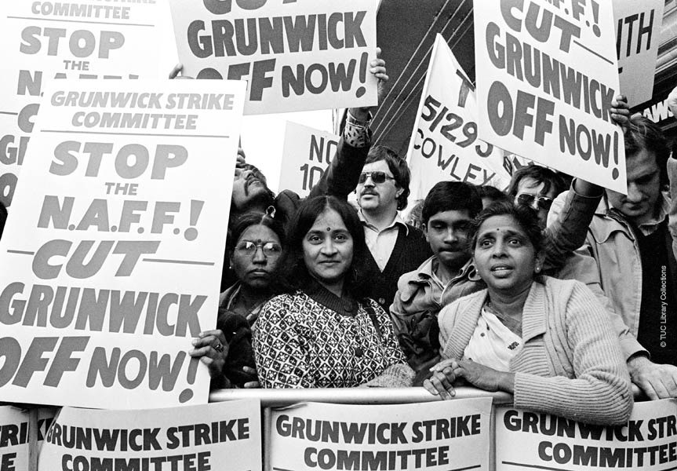
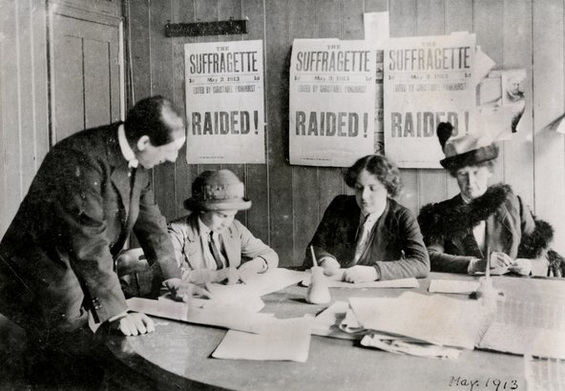

Slide 6
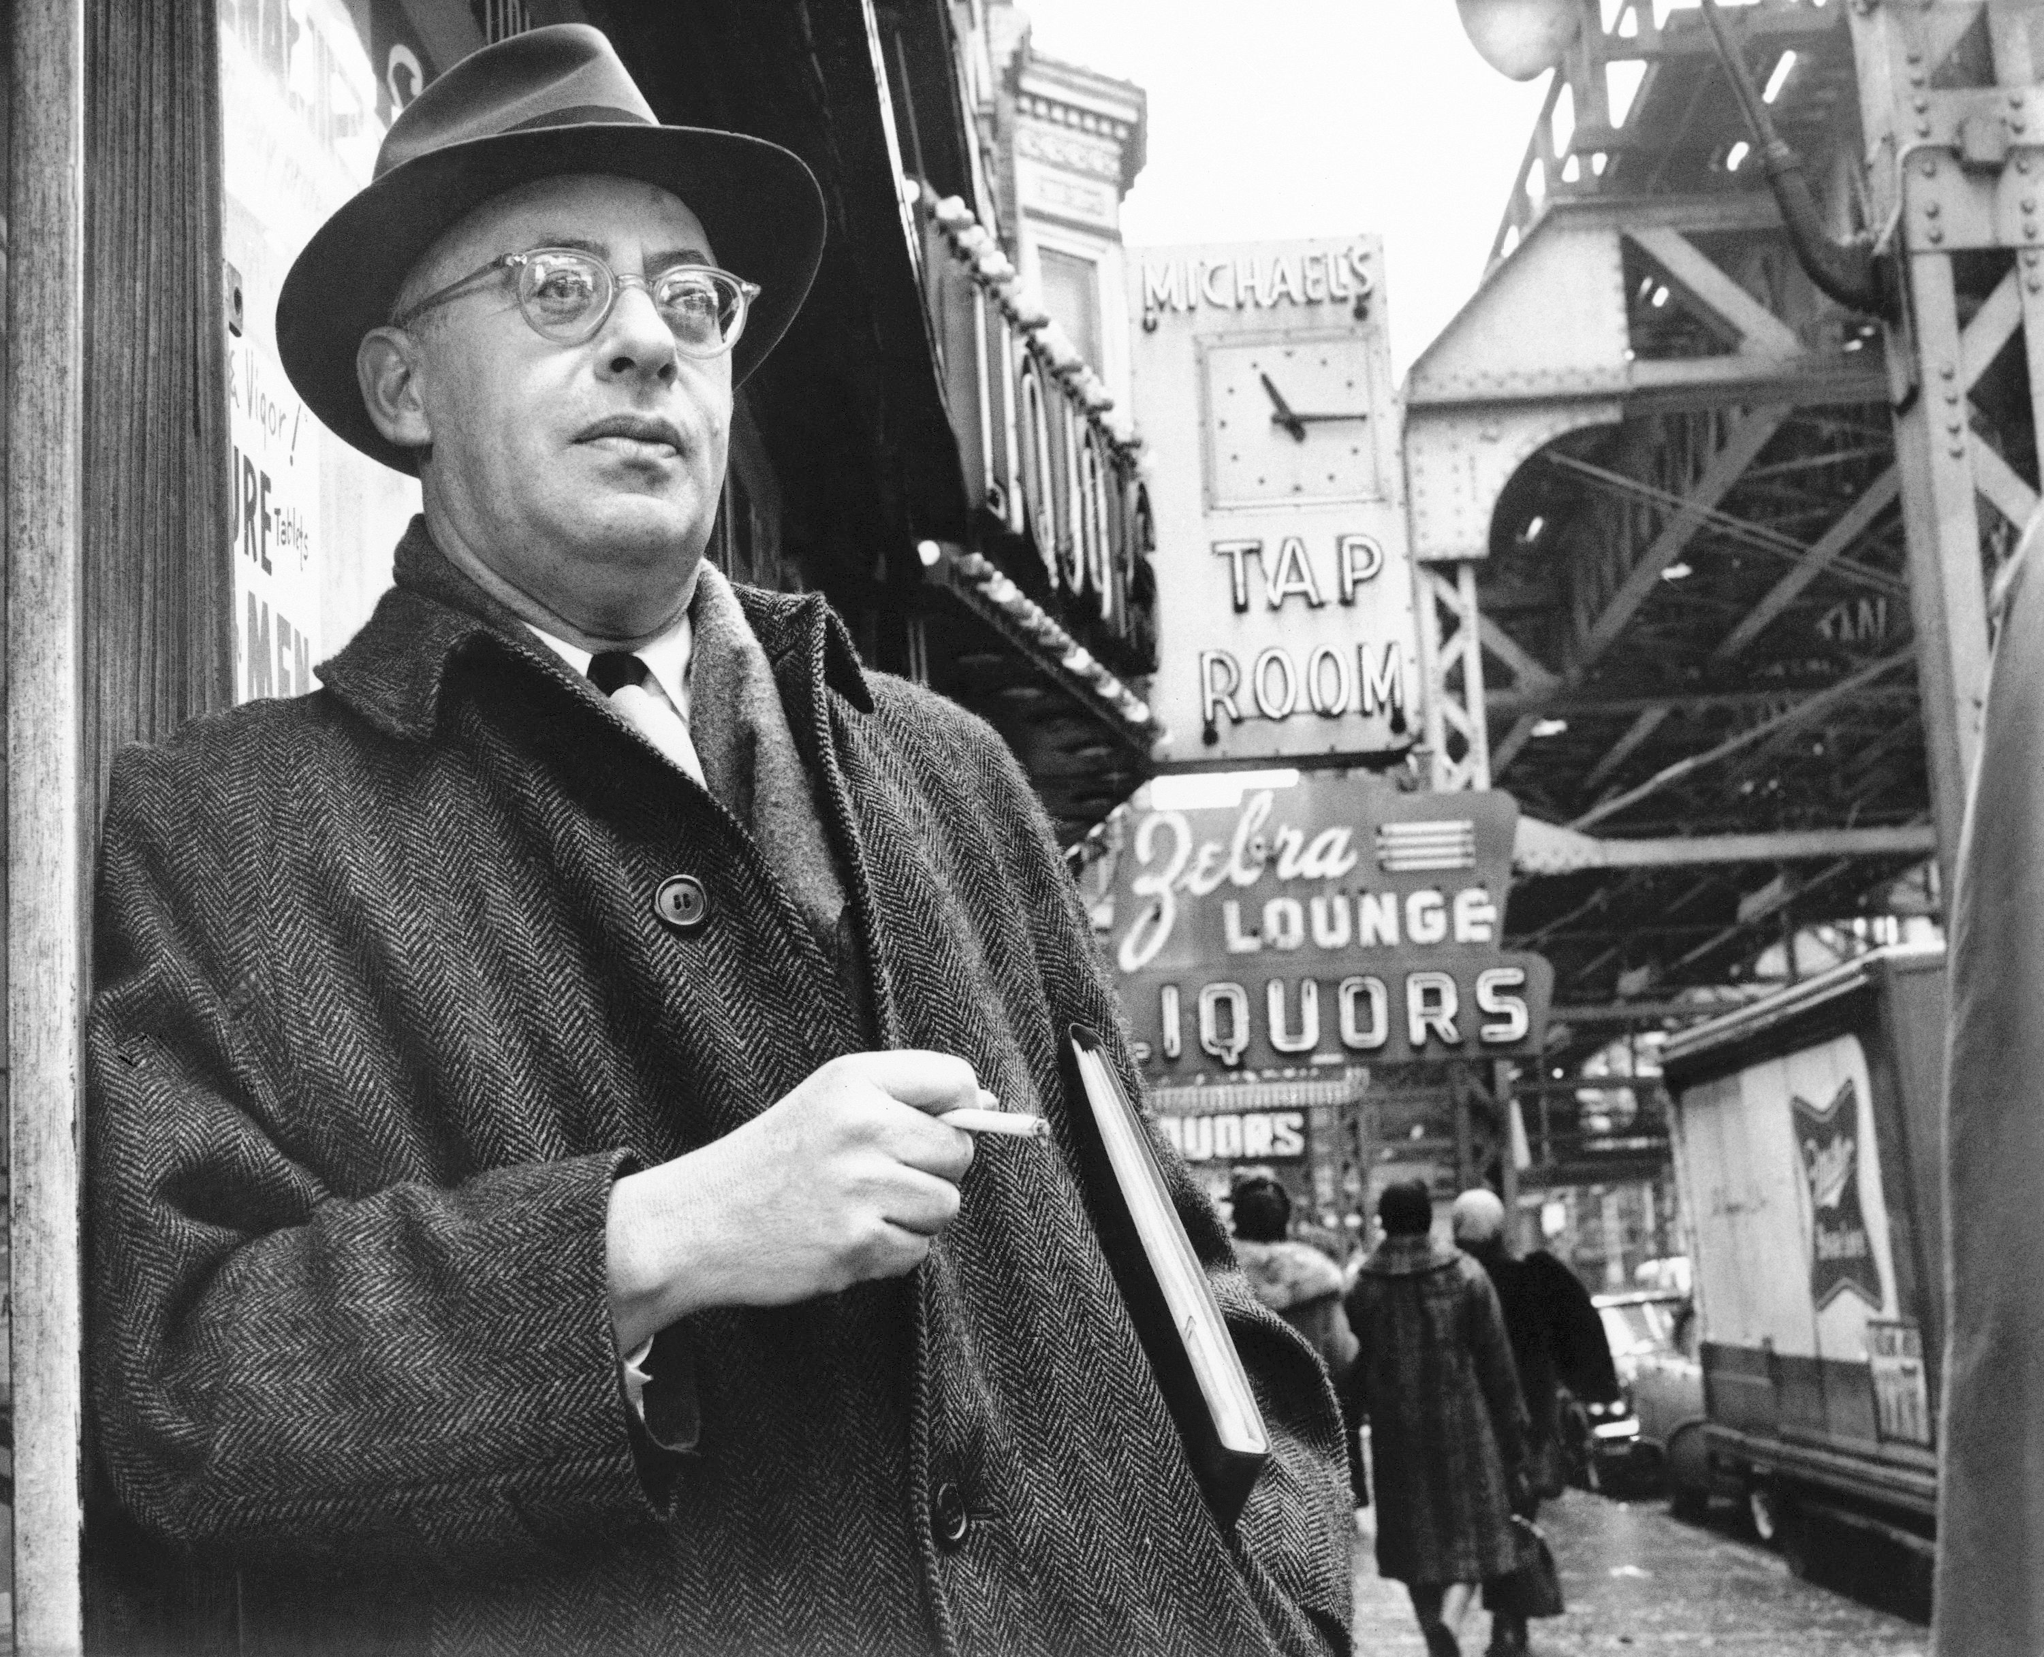
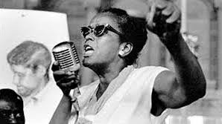
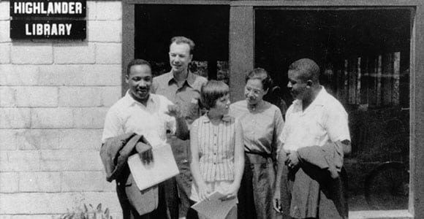
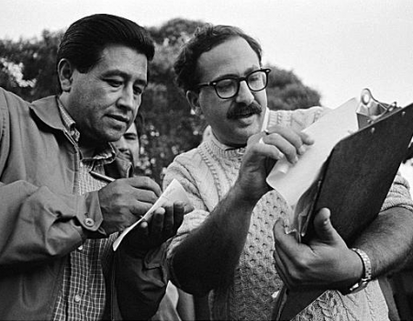

Slide 7
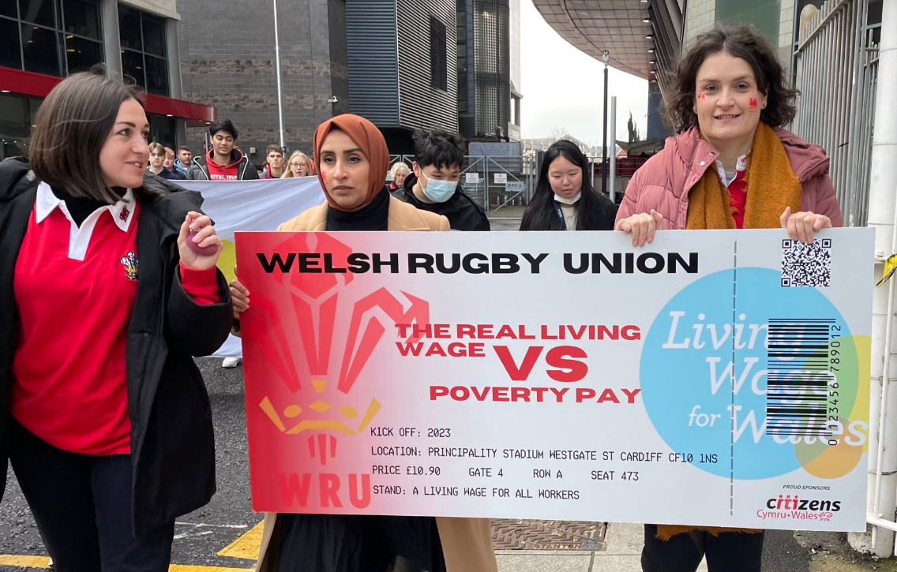
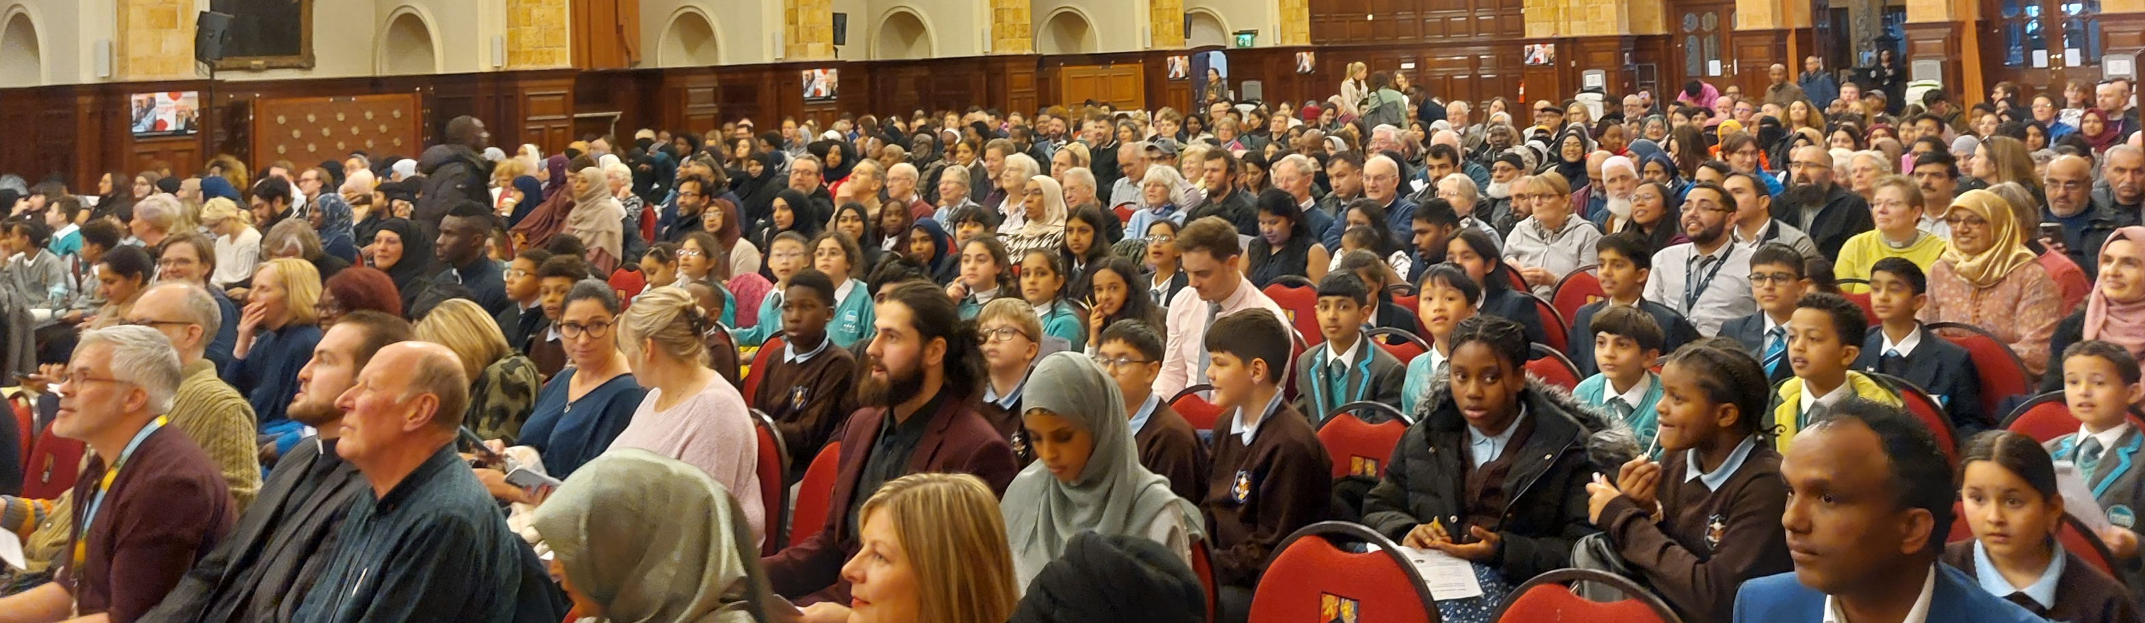
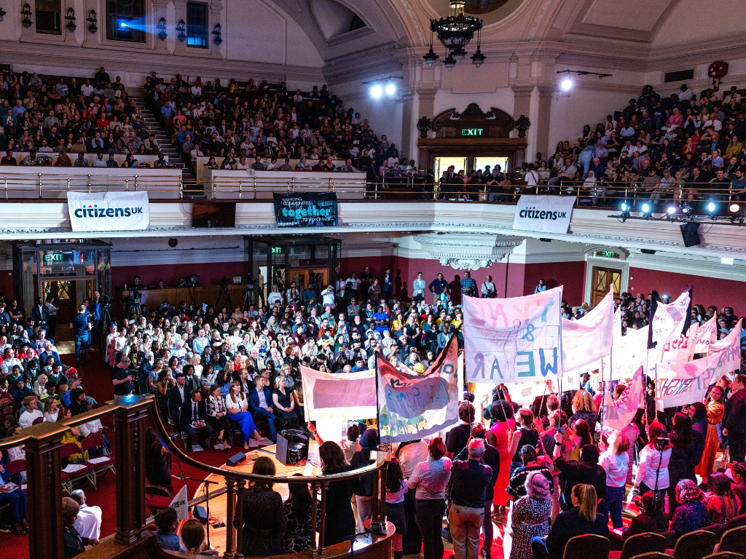
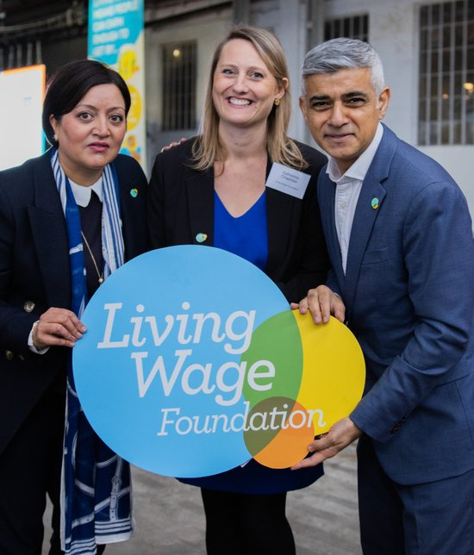
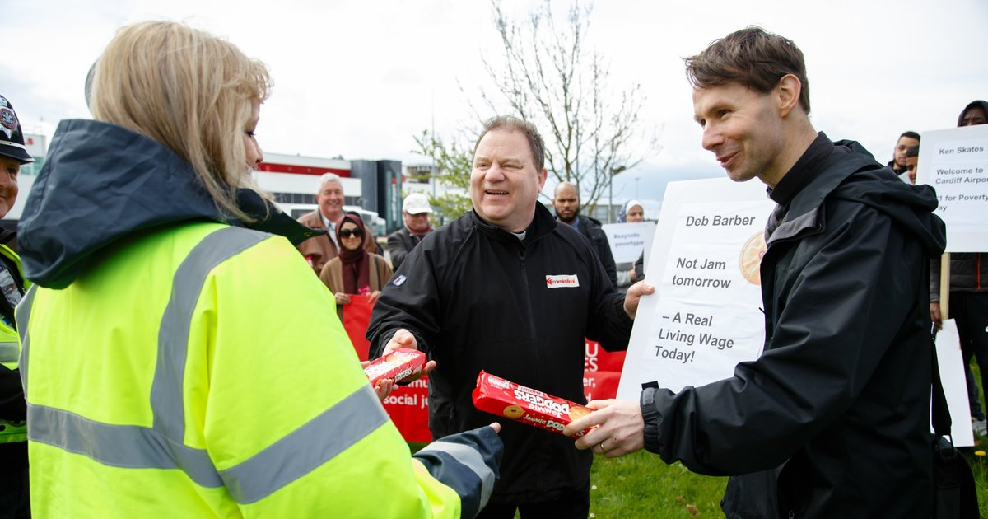
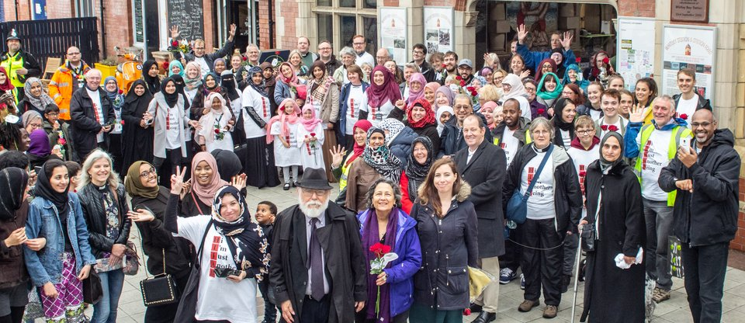

Slide 8
This is an argument!
Notes:
How do we stop everything falling over at the end of every year?

Slide 9
Key Concepts
Power - Positional Power / Relational Power. Like it or not, we need to understand power to win.
Self Interest - People act on interests rooted in their context, story, and sense of self. We need to understand this to move people to action.
Leadership – Identifying leaders, nurturing their development, allows for scale, reach and impact.

Slide 12
The Iron Rule of Community Organising: Never do for others, something that they can do for themselves.
Why is this rule important? What happens when you break it?

Slide 13
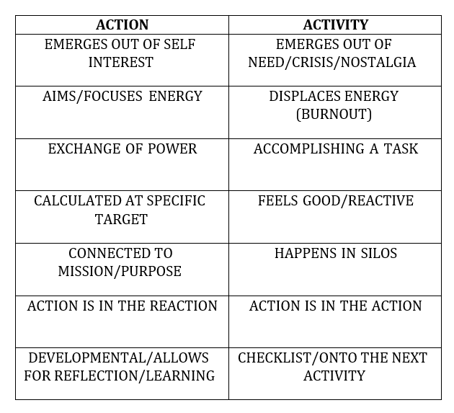
“Action is to organisations, as oxygen is to the body”
“The Action is in the Reaction”
Notes:
How do we stop everything falling over at the end of every year?

Slide 14
Who’s in your team?
What diverse skills and experiences can you draw on?
Ideally a core should have some kind of training.
Organise
Listen
Plan
Action
Negotiate
Aim is to build accountable relationship (and win)
What will you compromise on?
Listen to your community.
Find Relational Leaders and grow your team.
Identify key issues.
Take public action
“The Action is in the Reaction”
Demonstrate relational power
Problem -> Issue -> Solution
Worthwhile & Winnable
Who can say yes?

Slide 15
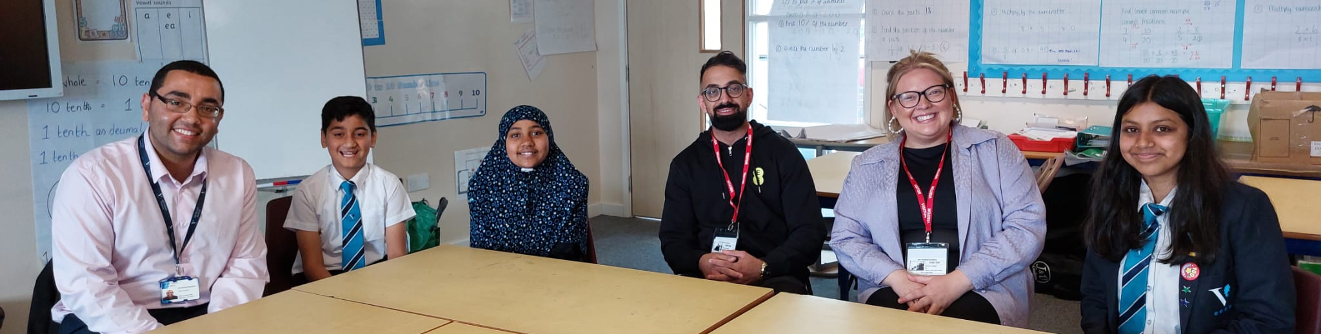
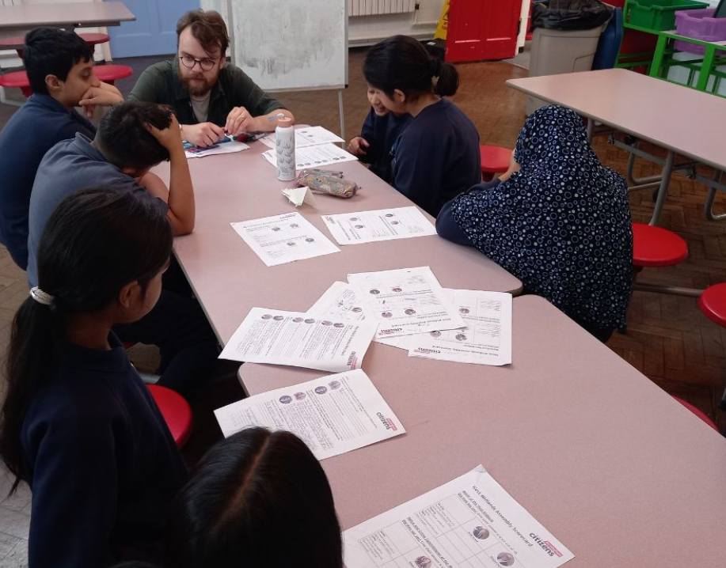
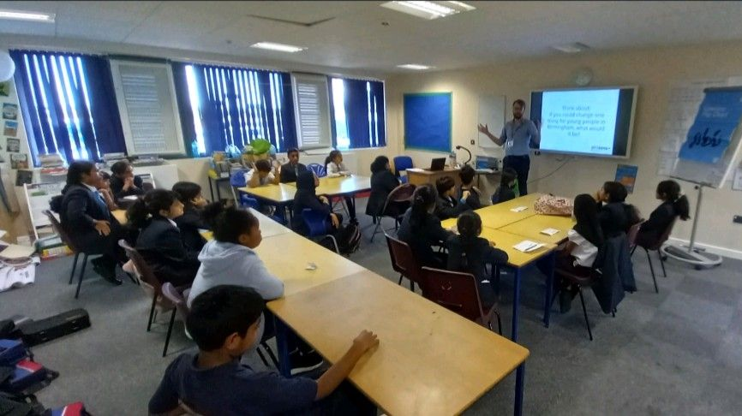
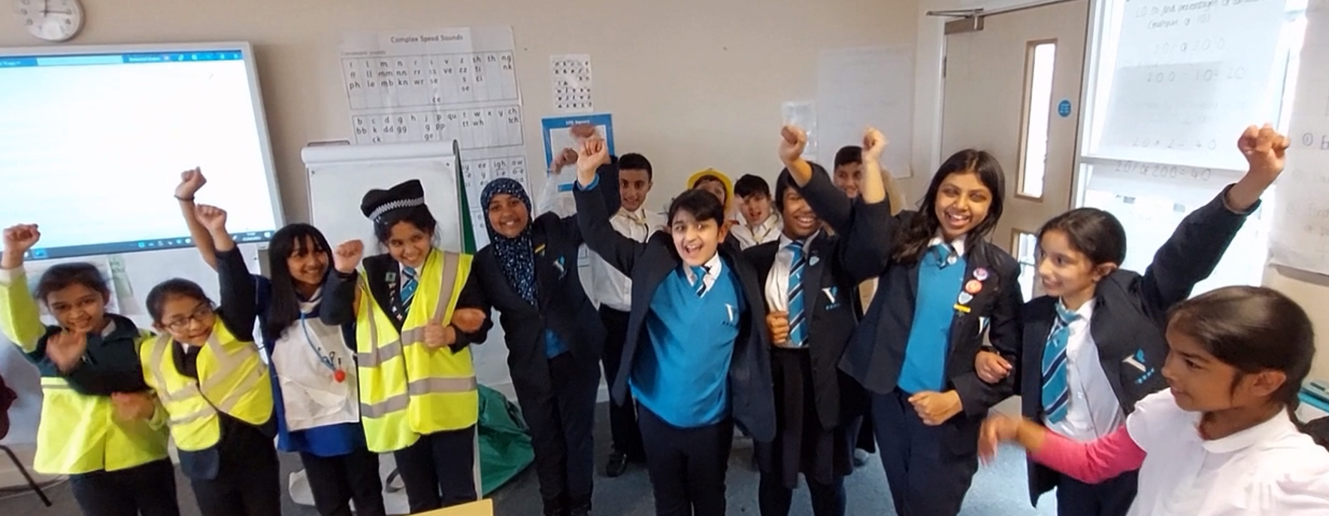
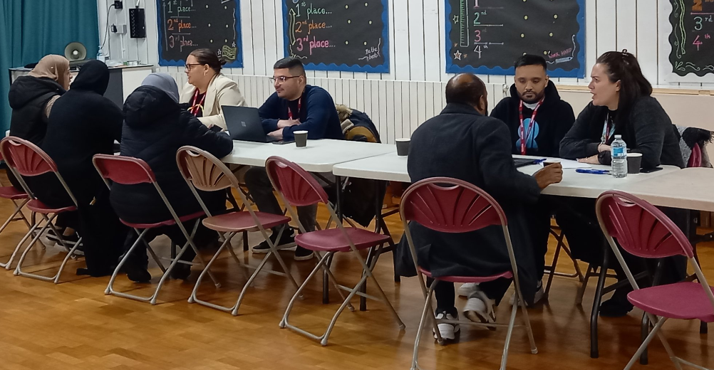

Slide 16
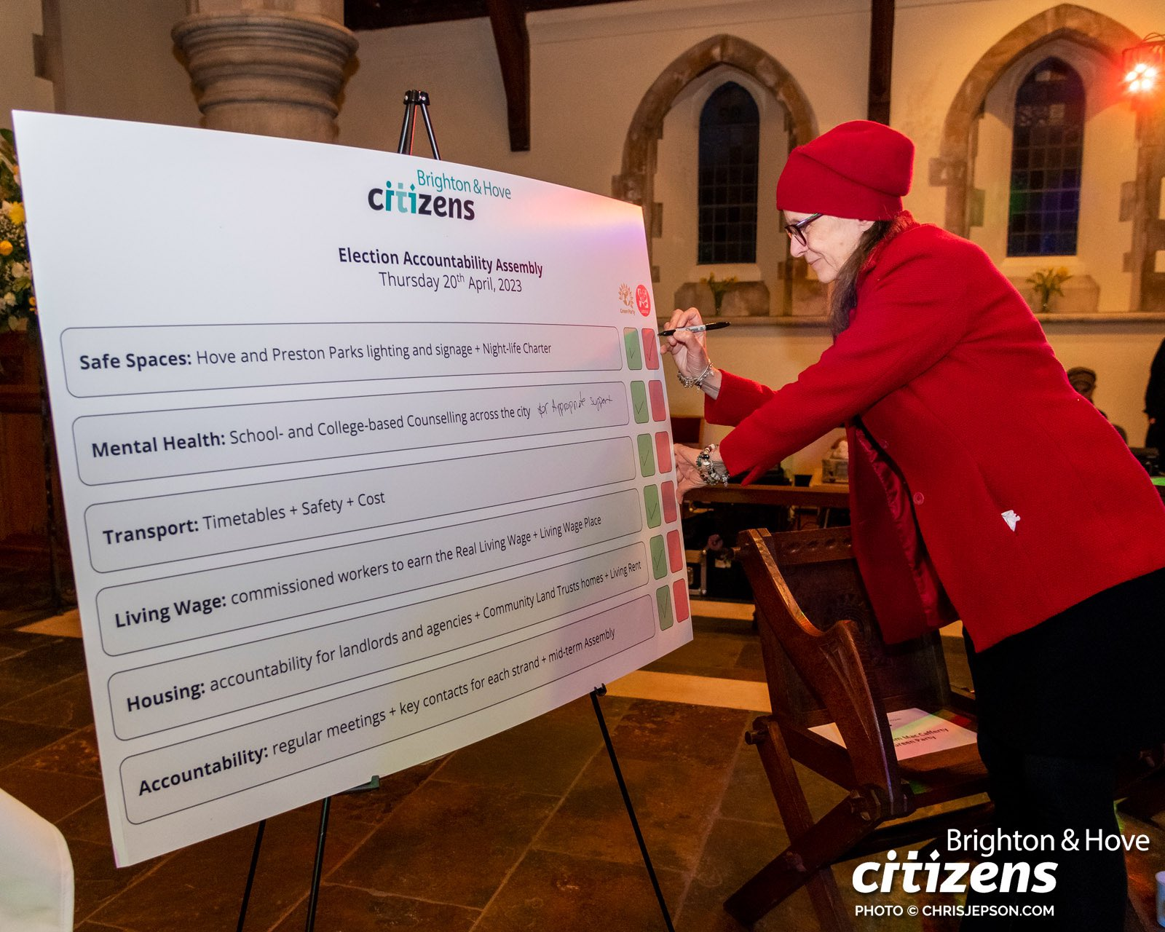
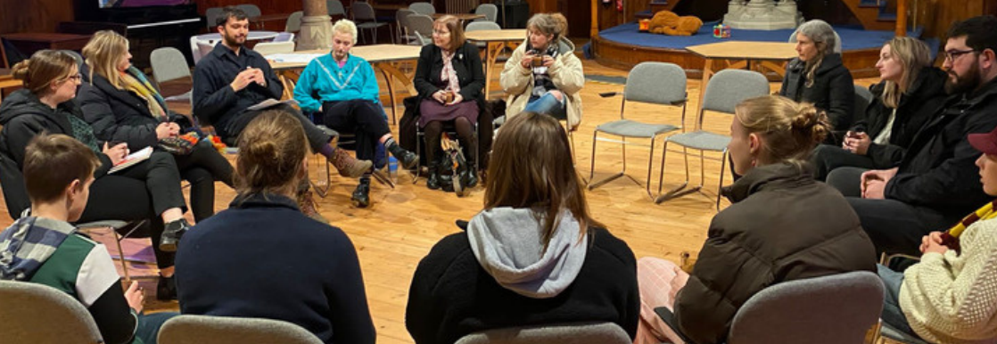
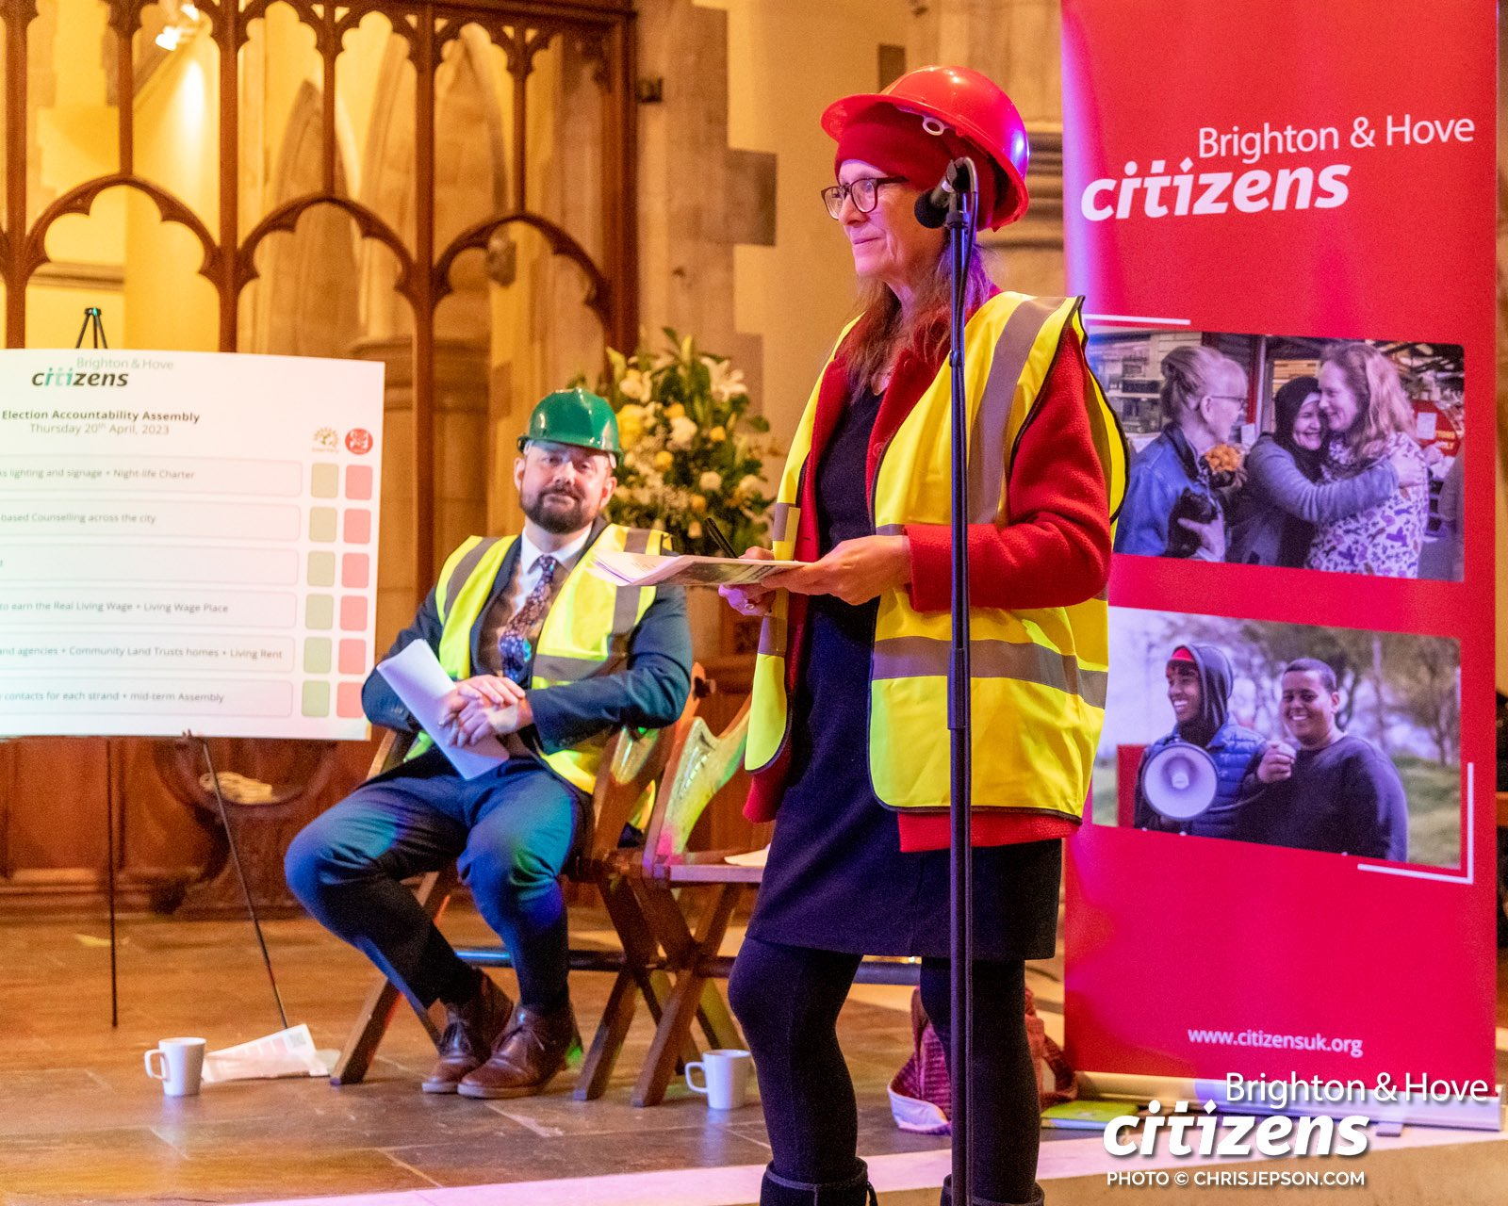
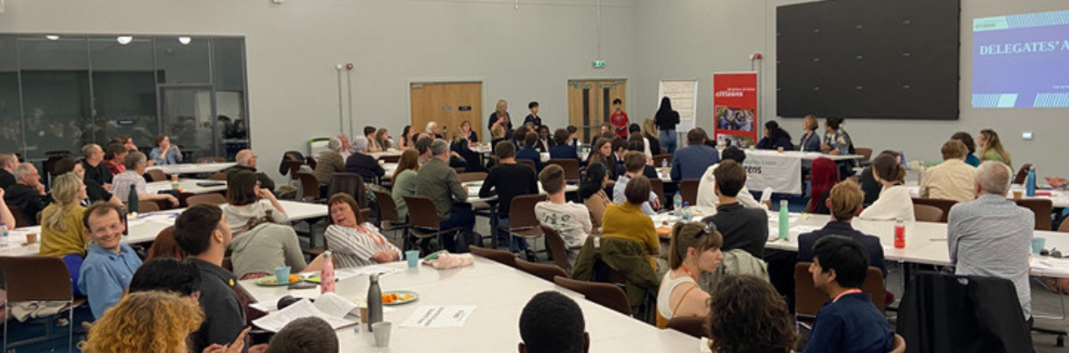

Slide 17
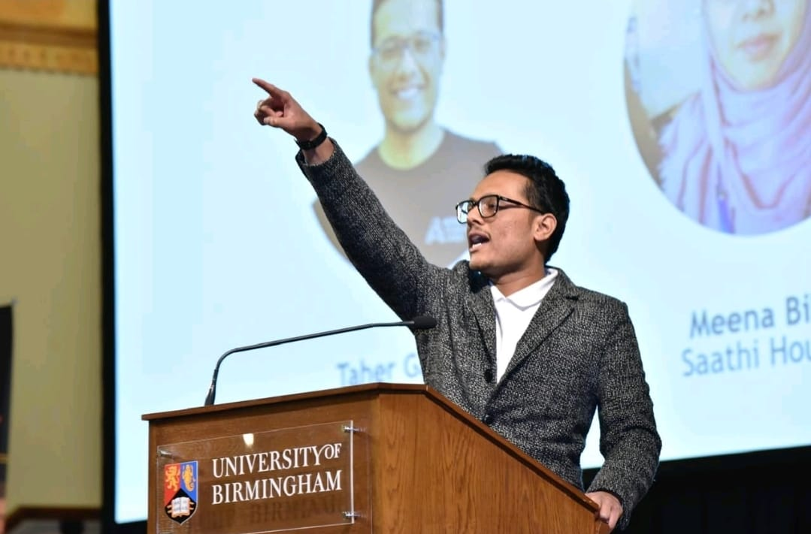
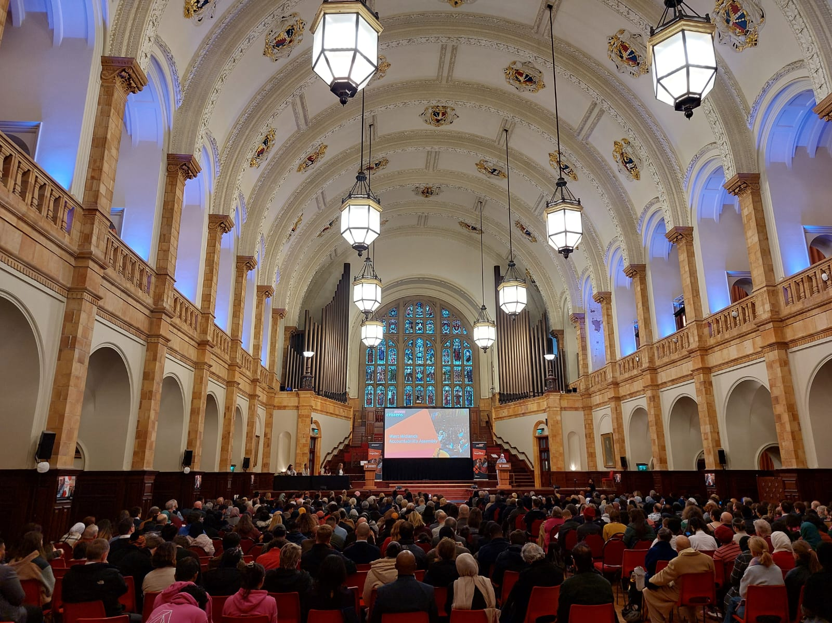
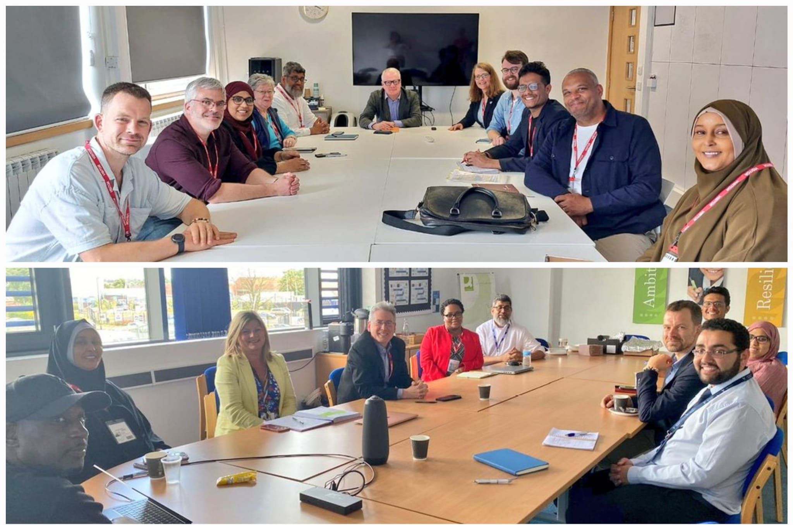

Slide 18
4 Tests
Do we have actual stories of people affected by this issue in our member institutions?
Do we have member institutions who agree this is a top issue for them and will agree to act committing turn-out/resources?
Is there a specific demand which is achievable?
Will it grow new leaders?

Slide 19
Getting Started
Focus on deep listening.
Identify leaders, give them ownership of the work.
Have a cleareyed understanding of power, who has it (what is their name!), and how much you need.
Find unconventional allies.
Focus campaign activity on power holders, otherwise what is it for?
If you do this right – it’s not wasted effort to lose!

Slide 20

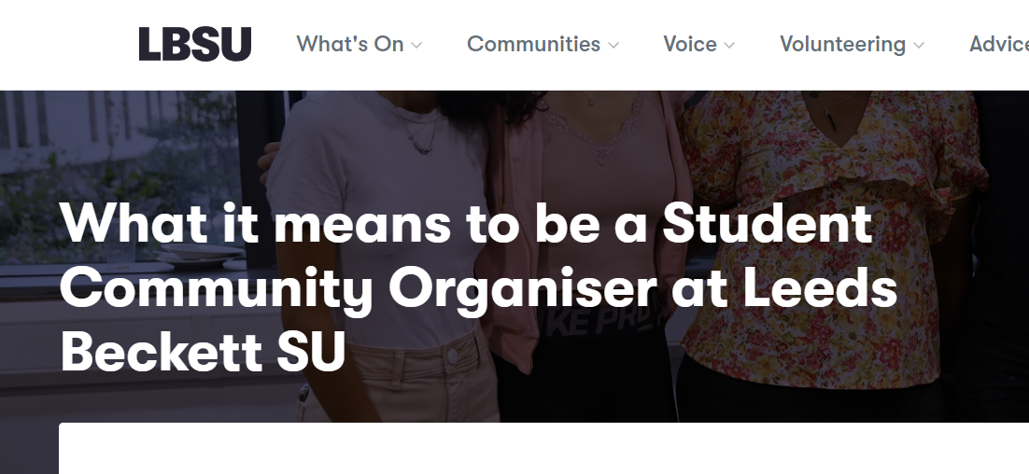
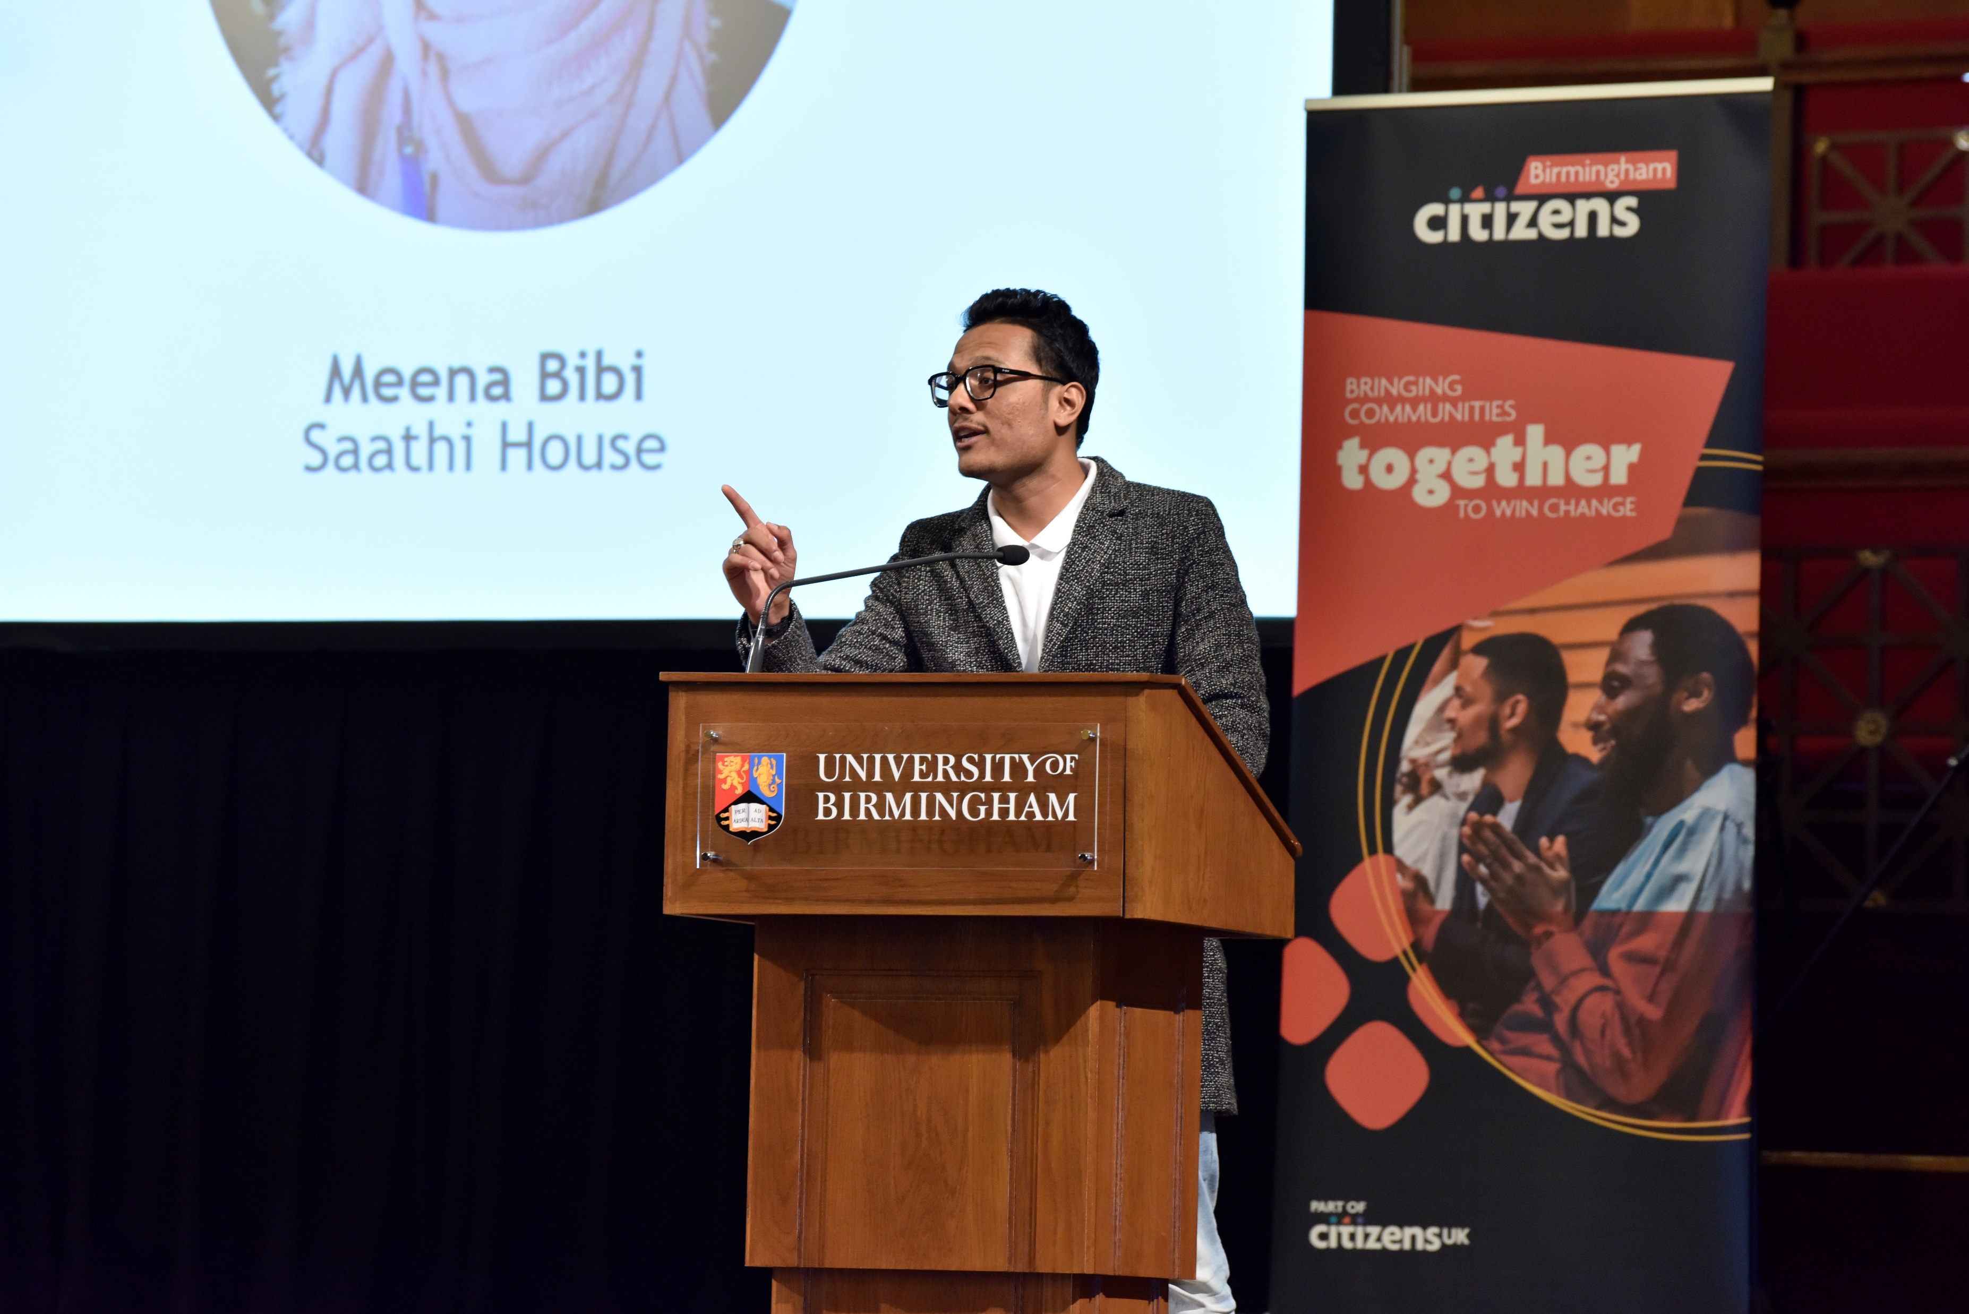
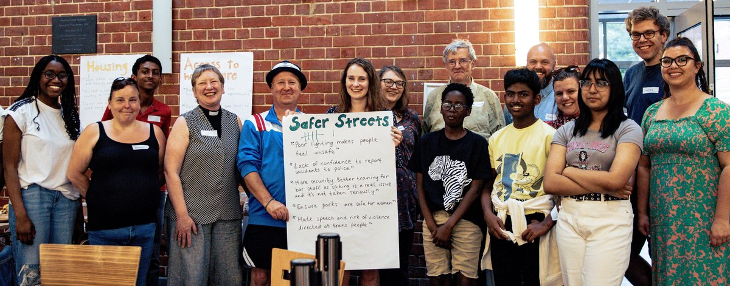
What have we been up to do with the Student Movement?
A few other things cooking too!

Slide 21



Self-Learning
How to Resist – Matthew Bolton
Roots for Radicals – Edward Chambers
How Organisations Develop Activists – Hahri Han
No Shortcuts - Jane Mcalevey (and watch her videos online)
The Purpose of Power - Alicia Garza
Public Narrative lectures – Marshall Ganz
I've Got the Light of Freedom by Charles M. Payne
How can we help?
Contact your local chapter (if we have one)
Do you want some training?
Drop me an email tom.snape@citizensuk.org
Let’s have a chat!
Connect on LinkedIn
Join the highly infrequent mailing list!

