Slide 1

Telling Complex Stories
Cerys Evans, LUSU President (23/24 & 24/25)
Frank Longdon, LUSU Student Insight & Voice Manager

Slide 2

Telling Complex Stories
Notes:
At Lancaster we are blessed with a hip, young University Council who are deeply in-touch with the lives and experiences of students today.

Slide 3
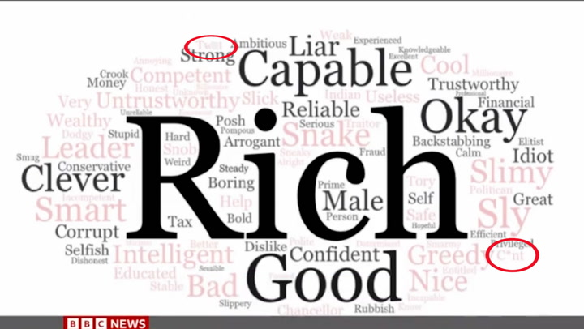
The sector problem: death by bar chart
Continual use of quantitative methods that has produced repetitive reports saying the same thing, in the same way: students are poor, rents are too high, maintenance is too low.
Where are we going wrong?
Telling Complex Stories
Notes:
Comes from a lack of self-assuredness on what counts as data.
You've asked some multiple-choice questions, thrown in a likert or two, and inputted some free text comments into freewordcloudgenerator.com because it is all definitely data. Yes very good, well done. But what does it actually tell us?

Slide 4
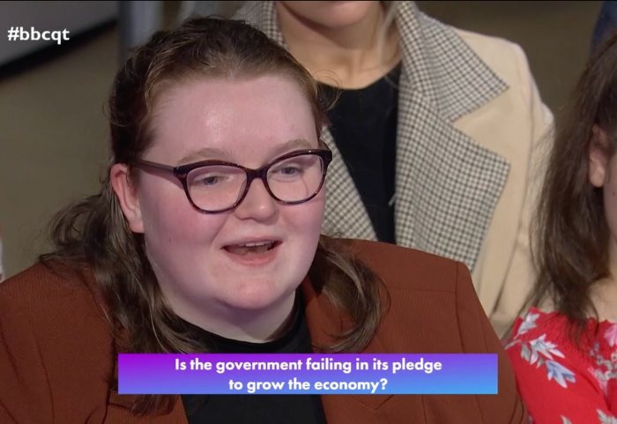
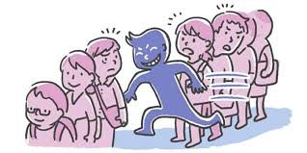
Cutting through
Telling Complex Stories
Notes:
Christmas wish lists
National data
QoftheW
Supperclub data
Cerys on BBCQT
Josh on ITV
What cut through? Extent of utility of each

Slide 5
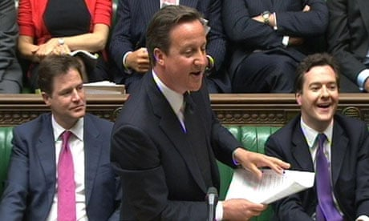
David Cameron
Telling Complex Stories

Slide 6

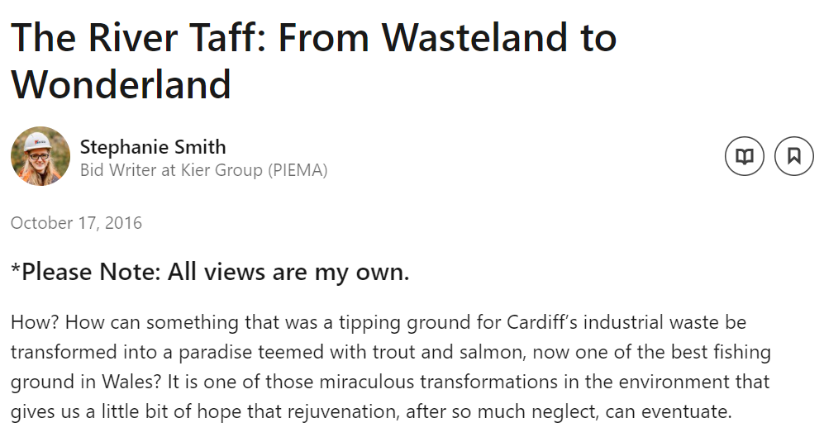

A.I.D. model for Rep Feedback
ACTION IMPACT DO SOMETHING
Telling Complex Stories
Notes:
The world is constantly changing. Some changes happen quietly.
When the Taff was bring cleaned it was very hard to explain the impact to the local community. Not since before the industrial revolution had it been clean enough for any wildlife. Noone had swam in it in living memory. The process of regeneration was a quiet change.
The (post-Brexit) process of increasing level of sewages is a loud change. It has multiple points of IMPACT: drops in fishing stocks, swimming in shit, less sighting of Otters, etc.
In both instances the ACTION is broadly the same: filling the river with shit.

Slide 7

Telling Complex Stories

Slide 8
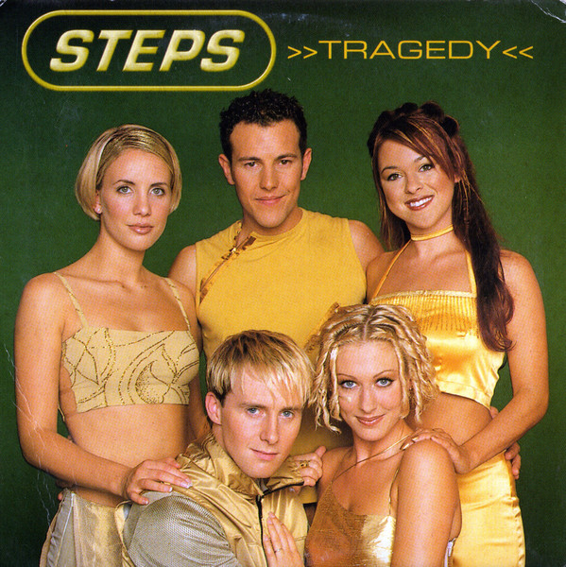
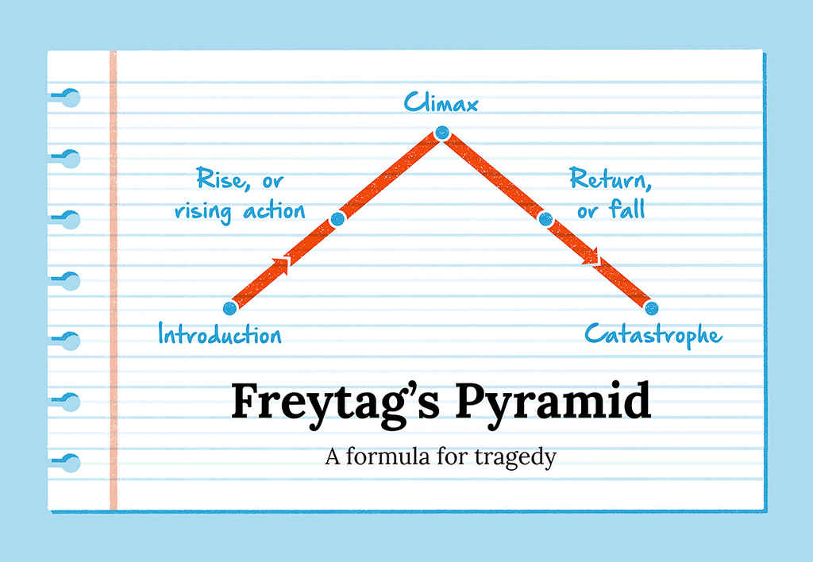
Freytag's Pyramid
Telling Complex Stories
Notes:
Introduction. The status quo is established; an inciting incident occurs.
Rise, or rising action. The protagonist actively pursues their goal. The stakes heighten.
Climax. A point of no return, from which the protagonist can no longer go back to the status quo.
Return, or fall. In the aftermath of the climax, tension builds, and the story heads inevitably towards...
Catastrophe. The protagonist is brought to their lowest point. Their greatest fears have come true.

Slide 9
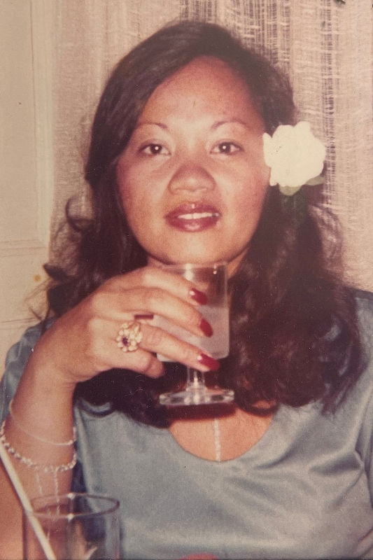
AgeUK: Gwen’s Story
Loneliness and isolation amongst older people.
“Gwen loves it when the birds appear in her garden. She saw a goldfinch recently. With its brilliant yellow wings and red head, it was an unusual sight and provided a flash of difference in an otherwise monotonous day”
https://www.ageuk.org.uk/discover/2023/november/gwens-story/
Telling Complex Stories

Slide 10
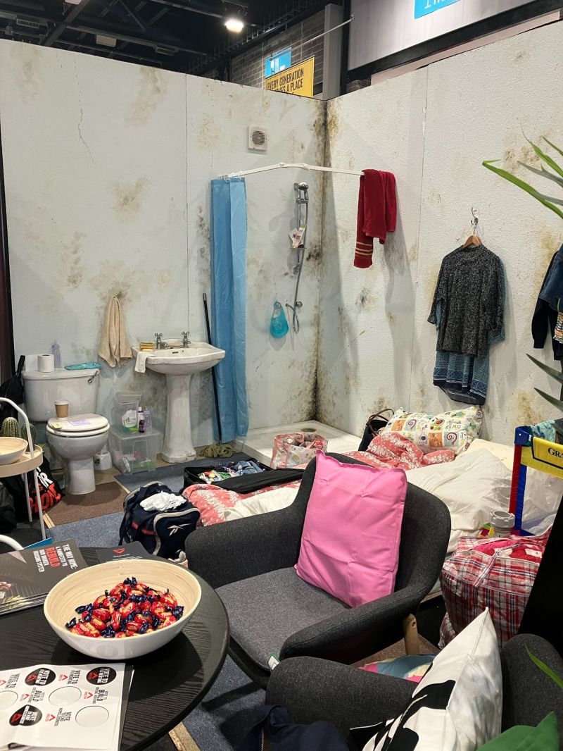
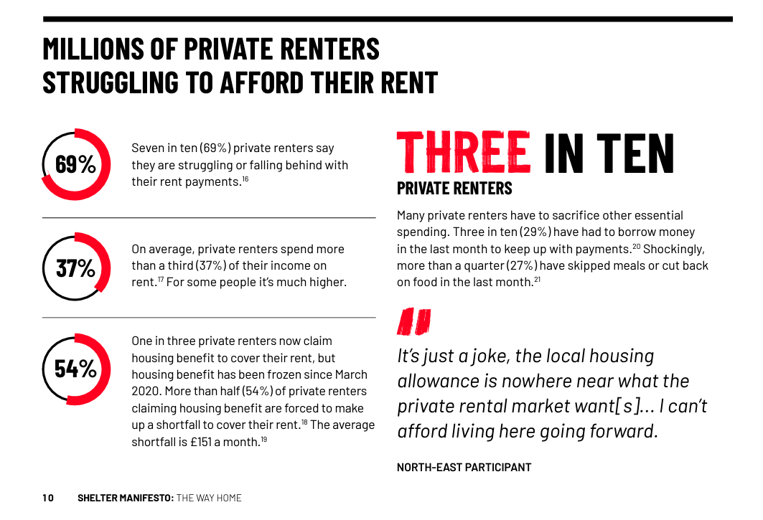
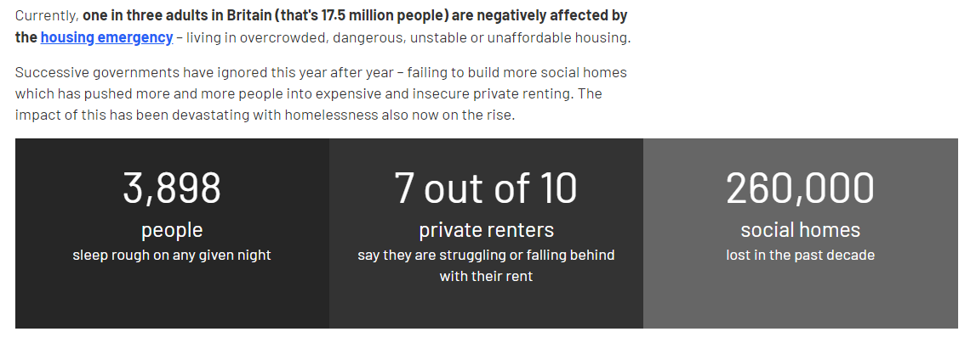
Shelter: Conditions of Rental Properties
In 2023, Shelter published The Way Home: a Manifesto to Rebuild Our Broken Housing System (https://downloads.ctfassets.net/6sxvmndnpn0s/1kvusq1hw6ca5PbHgXv7We/a3d2c75c210818107615194cab668921/Shelter_Manifesto_2023.pdf)
https://england.shelter.org.uk/support_us/campaigns/general_election
https://www.linkedin.com/posts/famouscampaigns_ok-heres-an-impactful-use-of-a-conference-activity-7117720201118236672-9LI-/
Telling Complex Stories

Slide 11
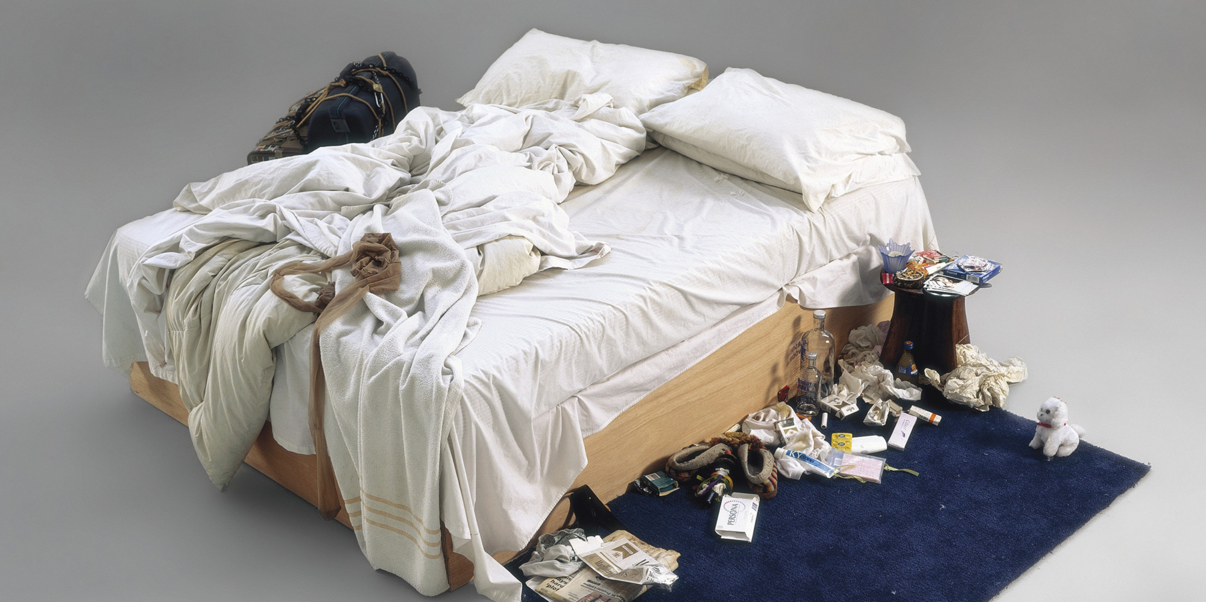
Tracey Emin, My Bed, 1998
"Well, they didn't, did they? No one had ever done that before."
Telling Complex Stories
Notes:
How could Tracey Emin tell you about a depressive period in her life, a time when she spent four days in bed drinking alcohol?
Media reaction

Slide 12


Children’s Society: Our Impact / Leila’s Story
https://www.childrenssociety.org.uk/what-we-do/our-impact
https://www.childrenssociety.org.uk/what-we-do/stories/leila
Telling Complex Stories
Notes:
Open website and scroll through
Note use of Christmas in this and Gwen’s story

Slide 13
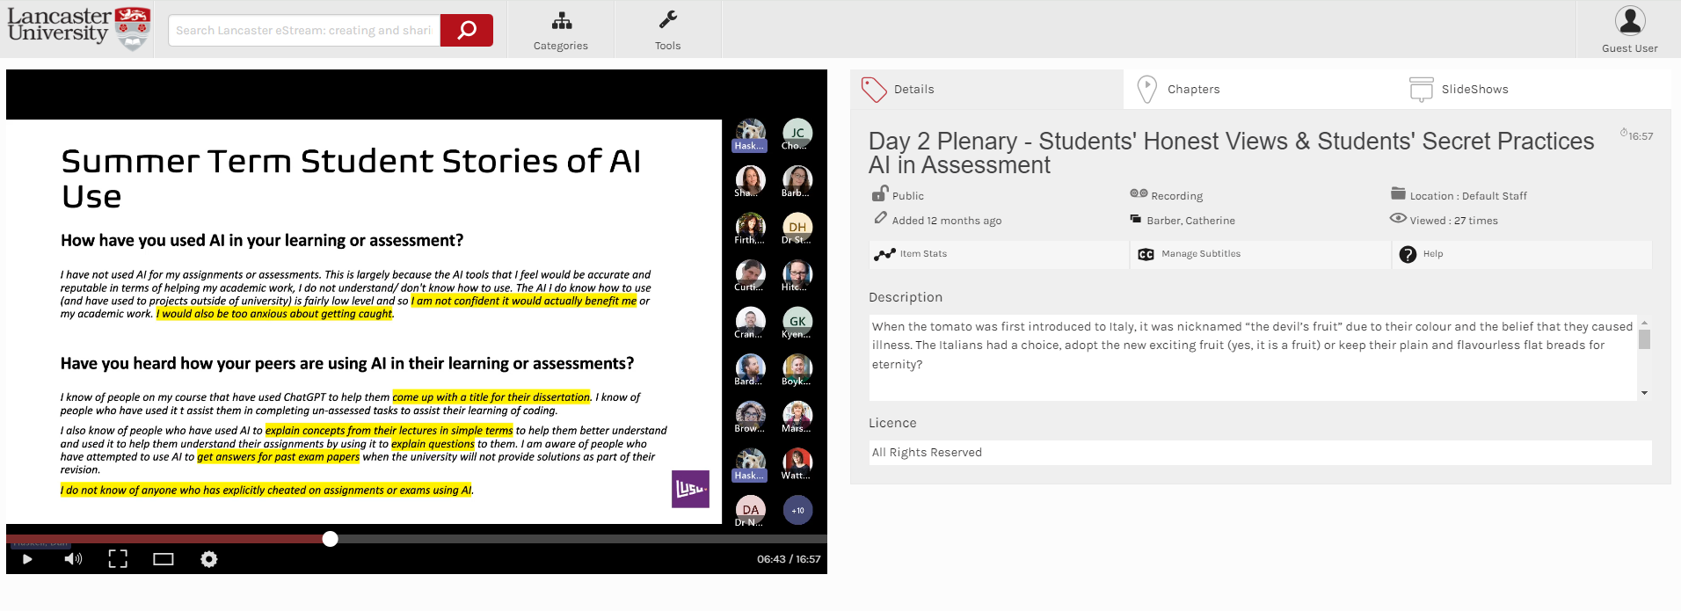
LUSU: Students’ Use of AI in Assessment
LUSU AI click through raw responses: https://lancastersu.co.uk/ai-in-assessments
https://estream.lancaster.ac.uk/View.aspx?id=68902~5m~f4ABXjcoPd&code=B9~evxuoqWKltEctieZFA6Q9ifFM2bXKjvgnNvbobI6FjApvvWOHwbwPAmen9b5&ax=7K~tDs48Sl7KMIN9P
Freeman, J., Provide or punish? Students' views on generative AI in higher education, February 2024, HEPI/Kortext Online, HEPI Policy Note 51: https://www.hepi.ac.uk/wp-content/uploads/2024/01/HEPI-Policy-Note-51.pdf
Telling Complex Stories
Notes:
Paper is a “I told you so!”

Slide 14


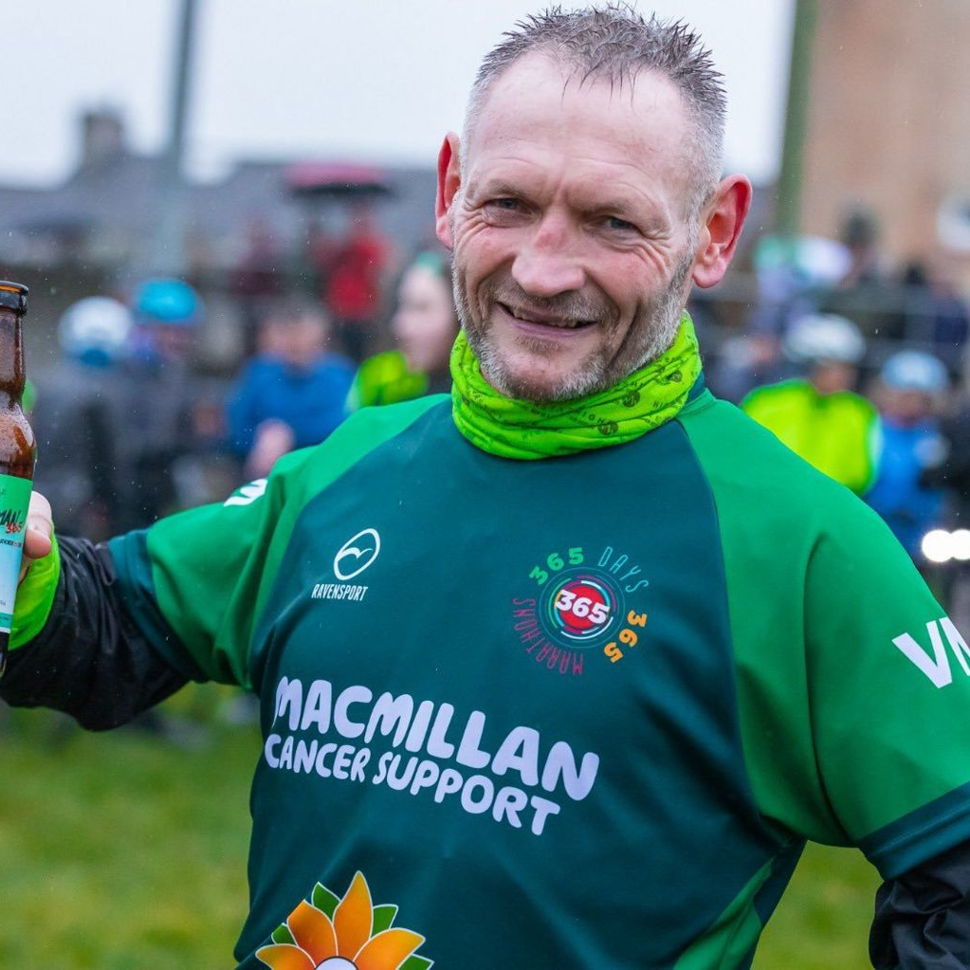
UK Endurance Athlete of the Decade
The nominees:
Jasmin Paris, Boston Marathons
Hardest Geezer, Project Africa
Gary McKee, Marathon Man
Telling Complex Stories

Slide 15
UK Endurance Athlete of the Decade
We are looking to find out who is the most deserving of this award.
In your teams, we would like you to prepare something lasting no more than 3 minutes to advocate for your athlete. The content and method of delivery are completely up to you.
However, be warned: after living through the grinding reality of a Maths degree Cerys has developed an extremely low tolerance for numbers. You are only allowed to include 3 numbers in your presentation. Use of descriptive words such as “twice”, “many”, or “higher” is permitted but frowned upon.
You have the entirety of the internet at your disposal. You are free to plagiarise and use AI.
Telling Complex Stories

Slide 16
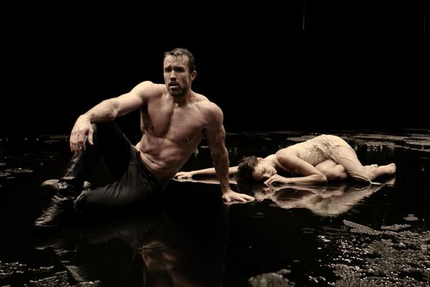
How we plan to use storytelling at LUSU
Thinking carefully about audiences: content, destination & mode of delivery.
Telling Complex Stories

Slide 17
Telling Complex Stories
Cerys Evans, LUSU President (23/24 & 24/25)
Frank Longdon, LUSU Student Insight & Voice Manager

