Slide 1

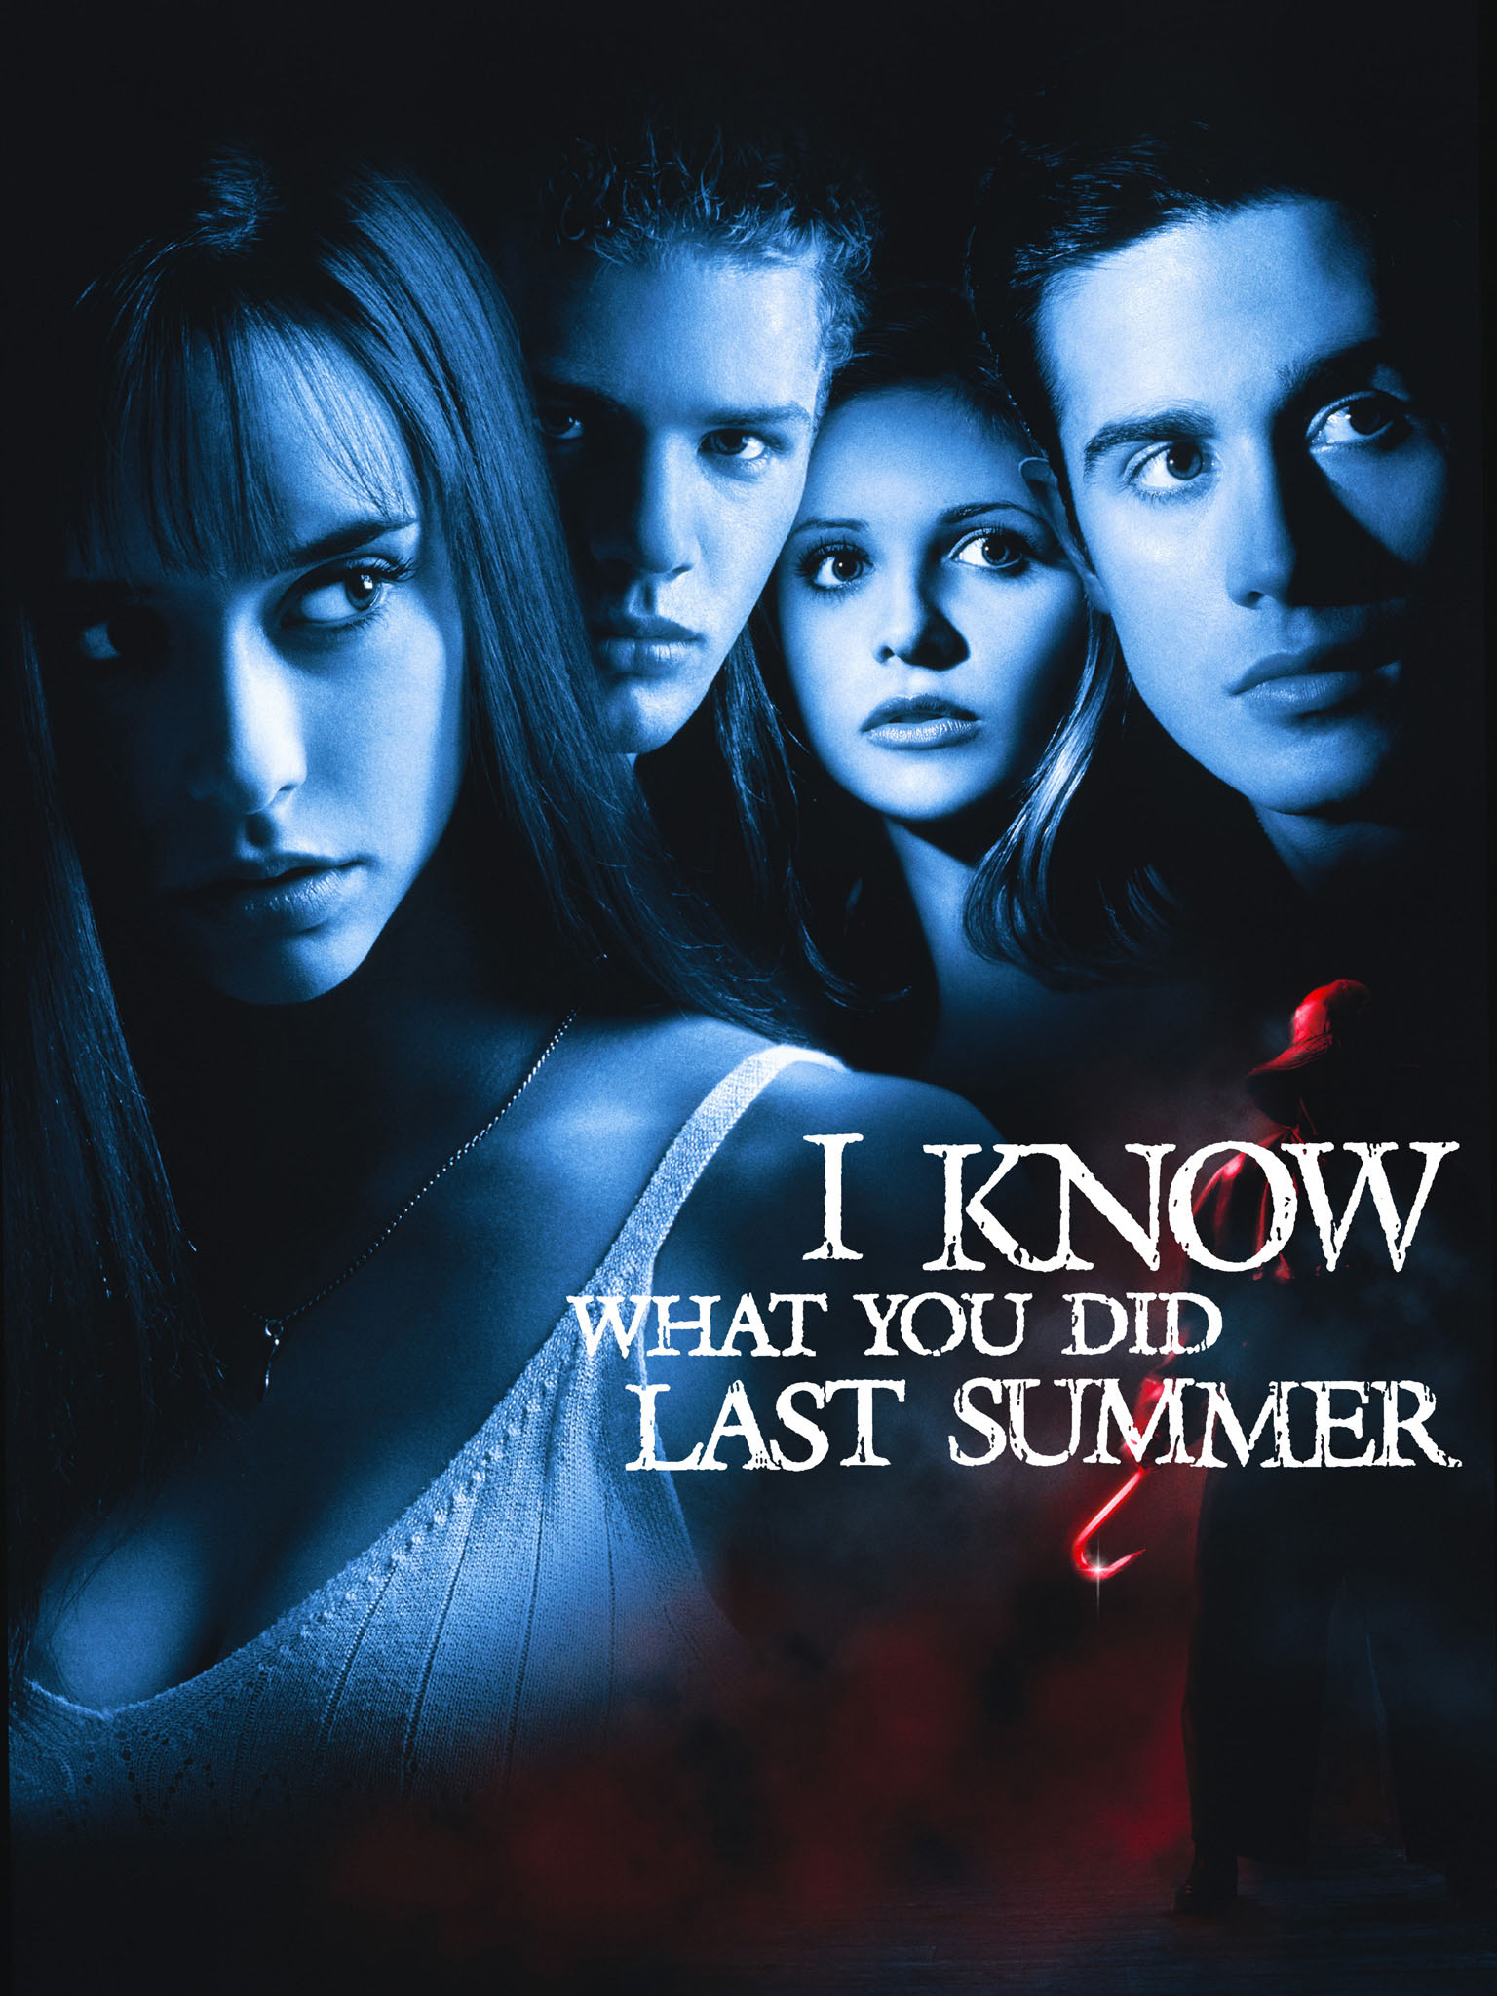




Slide 2
Hello!
I am Steve
I am Zahra
Who are you?

Slide 3
Did your sabbatical experience meet your expectations?

Slide 4
Comparison
How confident are you about working in your students' union?
Did your sabbatical experience meet your expectations? June 2024

Slide 5
How likely are you to pursue a career in the student movement?

Slide 6
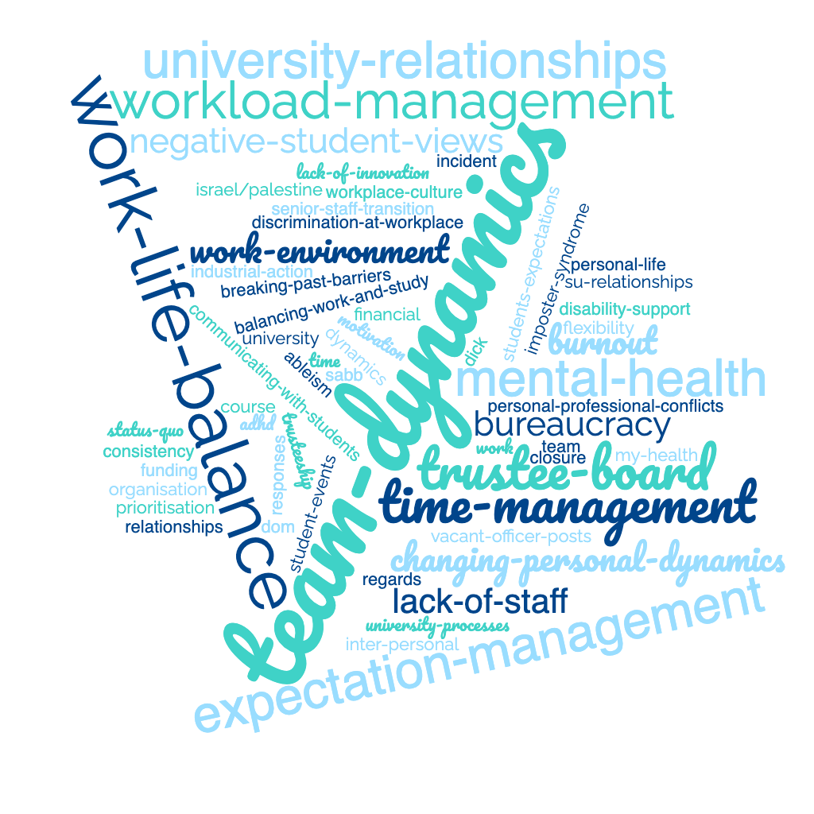
What was the single biggest challenge you faced this year (work or personal)?

Slide 7
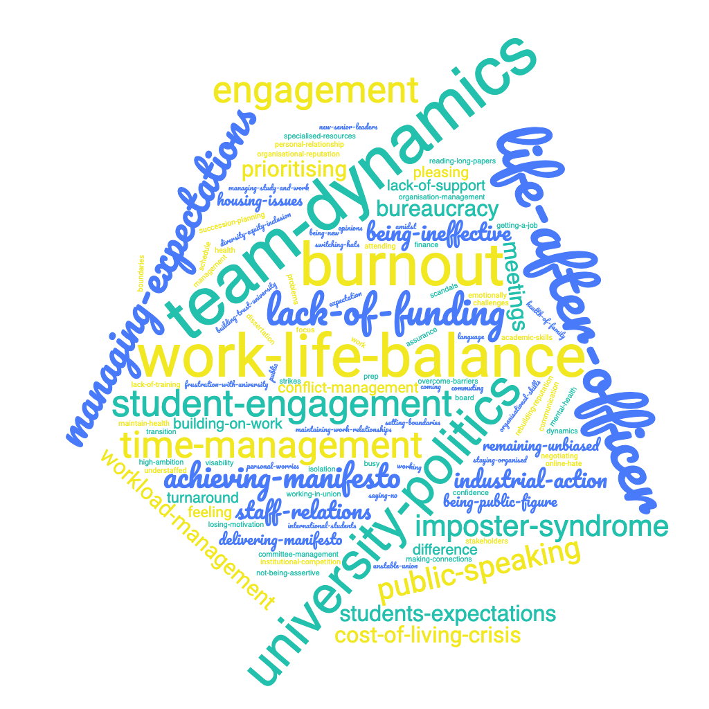
Comparison: Biggest Challenge
Onboarding
Exit

Slide 8
Which statement resonates most with you about the impact of your sabbatical role on your wellbeing?

Slide 9
What feedback or advice would you like to provide to the SU based on your experience, that you think will help the organisation to improve moving forward?
“Work hard to communicate, ensure everyone is included and equally valued as this is something everyone will benefit from”
“The little things can be important too and while doing good things always feels right, it’s even better when the system supports it (i.e. governance etc)”
“Remember that Sabbs are also staff. They want to feel a part of the whole team - being friends with staff is good.”
“We don't always have to 'play nice' with things such as staff conflict, if staff members need to improve on their own jobs, with the university and it's various departments. It's tough at the moment because of the changes and restructures, but we need to encourage the officer team to voice all and any concerns in constructive manner.”
“[SU] is such a fantastic a friendly place to work - I could sing it's praises for hours! A piece of 'constructive criticism' would be around accountability - being a bit stronger on holding people to account.”
“The developments were implementing in the SU are really making a difference and I am excited to see the union continue to grow!”
“I would have liked more practical training, how and who to lobby etc. I felt a lot of my training was about feelings.“
“There's an unequal level of workload across the team. Having a more balanced number of staff working in each department would be helpful.”
“360 review should be more constructive than just being critical and non-specific. There needs to be significantly greater transparency about what our roles entail. The jobs need a massive trigger warning, especially for some of the roles more than others. A lot of 'lower-down' staff have amazing opinions and input into projects and these thoughts should be sought more. Often, they are the ones working on the ground talking to students the most.”

Slide 10
What feedback or advice would you like to provide to the SU based on your experience, that you think will help the organisation to improve moving forward?
”Better and more regular and meaningful communication with students, schools, etc., would make the largest impact on the SU, but that is one of the most difficult things to achieve. Many students still think our only purpose is to run events and societies, and don't realise the changes we help to make at the uni.”
“Improving on staff work culture”
“Improve support for neurodiverse and disabled employees and ensure that complaints are handled effectively and seriously.”
“A focus on permanent su staff making more of an effort to get to know officers and have a good relationship with them. This will make it easier for new officers to feel comfortable talking to them and asking for help”
“Be less corporate and let students see that the SU is different to the university“
“As a whole, this job has been incredible. I have felt supported and the institution as a whole works so hard and well beyond what others our size do. There are however many issues with the SU to do with communication and how information is spread. Many struggle to communicate effectively with each other, especially in different departments and this leads to segregation and hostility between groups of people.”
“The impact of the workload and stress is significant and I think the work sabbaticals do is taken for granted because they are so amazing at doing it and enjoy the job. There needs to be serious consideration around wellbeing support.”
“Officers are often undermined by older members of staff, especially those in middle management or executive positions. Ideas can be shot down or ignored when actually, they can be the most rational or logical way forward”
“The SU should not be afraid to stand against the university management in the interest of students. The officers need to feel the support and have utmost confidence that we are on the same side “

Slide 11
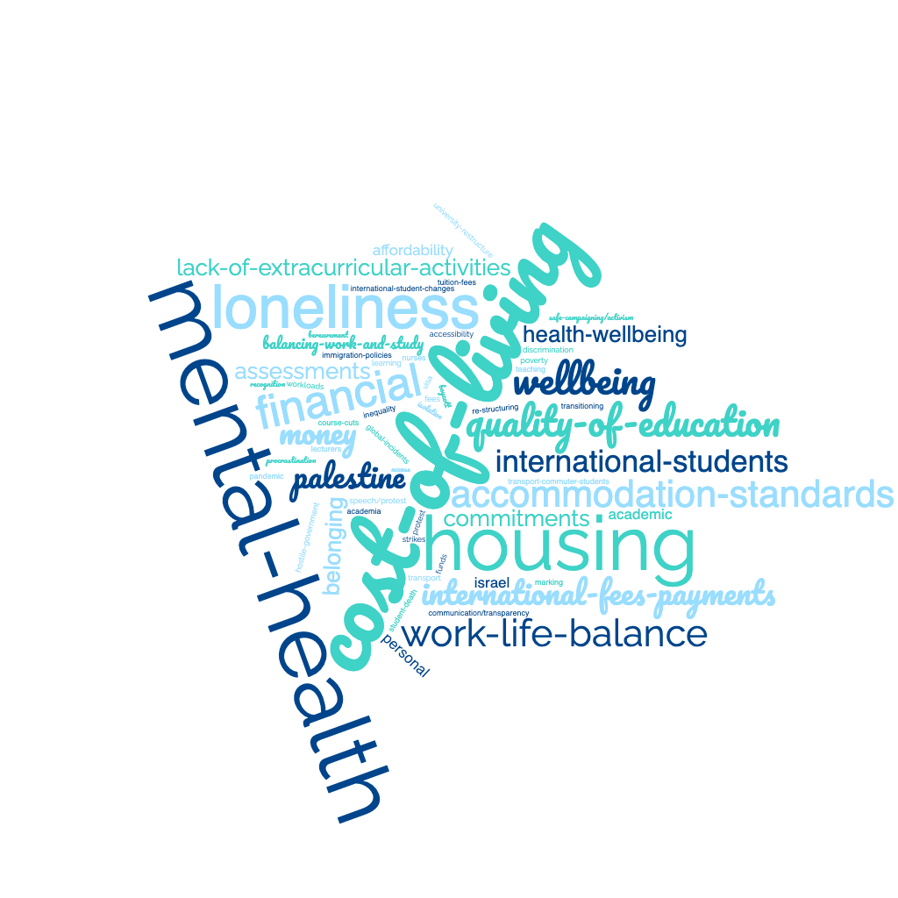
What would you say were the three biggest challenges that students faced over the past twelve months?
Onboarding
Exit

Slide 12
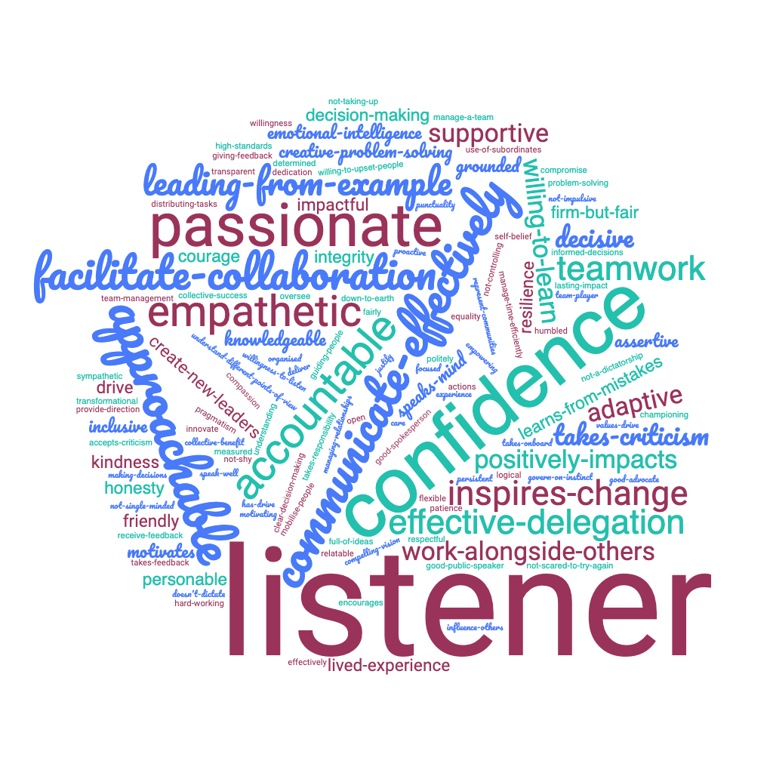

Comparison: Leadership Style
Onboarding
Exit

Slide 13
How effective was the SU at supporting your wellbeing and mental health?

Slide 14
How effective was the SU at supporting you to execute and perform in the role?

Slide 15
How would you rate your experience of being an SU trustee?

Slide 16
Would you like to be a trustee of another charity in the future?

Slide 17
Did your SU meet your development needs about being a trustee?

Slide 18
What did you enjoy most about your trustee role?
”Holding the SMT to account”
”Having the highest level of knowledge and power within the organisation.”
“The opportunity to see behind the scenes of keeping an organisation viable and the opportunity of contributing to the wellbeing of the organisation”
“Insight and skills on good governance and risk management which is often missed or difficult to do at an operational level”
“Strategy work this year. It's been really interesting working on the new structure of the union and looking into how it will enable to SU to improve in the future.”
“Making decisions at the highest level, great experience for CV”

Slide 19
What would you like to see in place for subsequent trustees at your SU?
” Closed sessions without the CEO ”
”Training on how to understand the financials”
“Conflict management training”
“The same training/induction for all trustees. Officer mentors/contacts in particular for student trustees”
“Perhaps a bit more support specifically from the SU staff attendees - e.g. explainers around strange terminology (that an incoming sabb may be unaware of). I also wonder about creating a new approach to better engage everyone. Perhaps something along the lines of each trustee (regardless of who the paper sits with) has to become an 'expert' on certain papers / reports on the agenda. This would hopefully get people more actively engaging with the papers and discussions “
“Ideally, I'd like to be able to see the board outside of the meeting room, board social events could be beneficial
”A proper handbook explaining each sabb role, how to work with different teams. Also lots of support for anything they want to do. I think also educating the full time staff on what we do as sabbs is important”
“A summary/handover of key things that were addressed at previous trustee meetings, so incoming officers are aware of the sort of things discussed. It would also key them into the position the SU is at (mainly financially) and what the priorities of the board are.”
”More support from SMT in terms of briefings (particularly for student trustees). Shorter papers and agendas for the meetings, to allow for more discussion.”
The ability for everyone to input on whether to approve things or not (by a vote and not an assumed consensus). SMT to be removed from the room a bit (it feels like they are members of the Trustee Board when they shouldn't be). I think officers should be allowed to feedback and input to the productions of TB papers.

Slide 20
What was the most valuable part of Coole Insight's officer support programme?

Slide 21
Would you recommend Coole Insight's support programme to future student officers?

Slide 22
Testimonials
”Provided the most needed tool that supported my transit within my role as a sabbatical officer”
“Having Steve allowed me to gain confidence in someone and allowed me to get things off my chest when I was stressed”
“Loved the opportunity to discuss issues with someone external to the organisation.”
” Steve and the team at Coole insights have been absolutely incredible guiding me on my journey as a full-time officer and have provided consistent invaluable all-round support. Very grateful to have worked with them during my term.”
“Coole Insight is a really good organisation with great people; they really help officers not only in relation to working but also with personal stuff that enhances their working capacity. I will recommend partnering with Coole Insight to have more productivity in both work and professional life.”
“Coole Insight has been a real back bone of my sabbatical year. I do not believe I would have had a successful year without my monthly 121s and constant support from Jamie. As someone who was fairly new to SUs and the student movement coming into the role, Jamie was incredibly supportive and a real knowledge bank of all things SU.
“Jamie has been a massive, massive help throughout my first year as a sabb. His experience shines through and his support and guidance has been much appreciated, even when I've just wanted to bounce ideas off of him. Thank you Jamie!”

Slide 23
What Coole Insight would love to see in the SU sector to improve organisation culture? (What we said last year)
Practitioner led staff networks / communities of practice at ALL levels
Connectivity between regions and nations in terms of sharing regional discussions, content, and research
An organised and evidenced based approach to collective sector problem solving, moving away from the ‘bitty’ approach that we currently have – granted that this is not helped by the volume of management consultants operating in the sector without any form of quality control or regulation
Clearer career pathways and development opportunities from student staff to Chief Executive level
Talent management systems that are overseen, quality controlled, and utilised by students’ unions during recruitment processes
More clarity on expectations of officers as employees and competency frameworks to help guide, coach, and support them through their year…

Slide 24
What is Coole Insight doing now!
Giving away a £2,000 research grant for sector improvement, or
Giving away a free study trip to ACUI to support Coole Insight’s growth in the USA, with a view to developing closer connections between Ireland, UK, and US students’ unions / student government
Developing an online SU talent showcase
  A platform for all
  Reducing recruitment costs
  A tiered model and quality assurance of future Coole Insight associates
  Employability support and interventions
  Rewarding Excellence
  Increase the external trustee talent pool
A significant piece of national sector improvement work – watch this space…
And we have been shortlisted for our efforts in the Great British Entrepreneur Awards 2024!

Slide 25
Thoughts?
What resonates?
What surprises you?
What needs to change?
How do we evolve?
What works for you?
What support do you need?
What have you experienced?

Slide 26


Thank you!
Any questions?
steve@cooleinsightltd.co.uk
07811305376
One Small plug – Leading Well & End of year showcase

