Slide 1

What would happen if we didn't risk
assess anything?
Notes:
Risk assessments and risk management is a pain in the neck - nobody wants to do it. Students don’t want to do it, we spend time chasing and it’s all hard work for nothing. Then nothing goes wrong so it was all for nothing anyway! Why not get rid of them altogether and rely on people's common sense.
Give a little back story to my career with risk management
Teaser the training offer

Slide 2

This session:
(No) Risk Assessment Utopia
Our Reality
Conceptual-ising
Differently
Take Aways
Notes:
What WOULD happen if we didn’t risk assess anything?
2.
3.
4. Take aways - I’ll finish with some clear steps you can take to improve risk management in your SU

Slide 3

A world without risk assessments…

Slide 4


Design your risk assessment-free utopia…
Activity
Notes:
Small groups - flip chart and pens - What do we gain from a world with no risk assessments?

Slide 5
Our utopia…
Less bureaucracy
Freedom to be creative
No paperwork
Easier relationships with university
….?
Notes:
A summary of some of the things that may be better in a world with no risk assessments

Slide 6

Our reality
Time to burst the bubble!

Slide 7
Our reality
Compliance
No insurance
No central governance/oversight - protecting students
Lower quality events
Saying yes more
Creativity and freedom
Notes:
Compliance - the obvious one, it’s a requirement
No insurance
No central governance/oversight means that we cannot be confident that we are protecting marginalised students
External speakers
Anti-racist work
Etc
Protecting disabled students in the event of fire etc. - able bodied students self organising may not consider this, but an assessment of the building would
Lower quality events - as less checks on organisation

Slide 8
Systems and processes
Every SU has different ways to manage risk, engage students, meet compliance.
Whole organisational approach is important
Risk tolerance
Risk confidence

Slide 9
Systems and processes
What works well at the moment at your SU?
What gets in the way or doesn’t work?
Talk in small groups
Stick your thoughts on post-its, onto the wall
Activity
Notes:
Post it note activity
Go and look at their post it notes

Slide 10

Conceptualising differently
Notes:
Call back to earlier - So how can we get to the good stuff of our utopia, but still hold onto the good stuff risk assessments offer?
Picking up on a few of the themes from our utopia…

Slide 11
A middle ground?
No less bureaucracy
Standard building RAs
Standard activity RAs
Make the paperwork easy, simple, accessible
What else?

Slide 12
A middle ground?
Saying “yes” more
Improve organisational risk confidence
  Confidence of staff, officers, student leaders through training and support
Clarity on the hard lines (risk tolerance) (for you and for student leaders)
What else?
Notes:
Understanding risk management as a whole organisation activity.
Giving staff confidence and competence in this area, pressure of coordinators.
Making sure aligned on risk tolerance for the organisation.

Slide 13
A middle ground?
Engaged students
Make the training FUN!
Clarify the skills and employability benefit of being a top notch risk manager
See risk management as event planning & student engagement quality
What else?
Notes:
Mandatory training that is not well thought out and delivered primarily to tick a box is not engaging.
Make it fun, engaging and rewarding.
Lots of benefits to students, sell those. Skill, CV evidence, planning better events. Maybe combine risk management processes with other principles of organising events and activities - help them to be better in ways they consider important and bring risk into it.

Slide 14

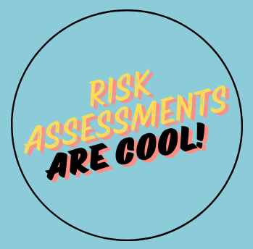

Slide 15

Our ideal
Easy and useful for students
Easy and useful for staff
Effective and compliant

Slide 16
To take away…
Blanket RAs for low risk, common issues, buildings, standard activity
Aligned risk tolerance and confidence
See risk management as an engagement tool
Make the training useful and consider your student leader training journey

Slide 17

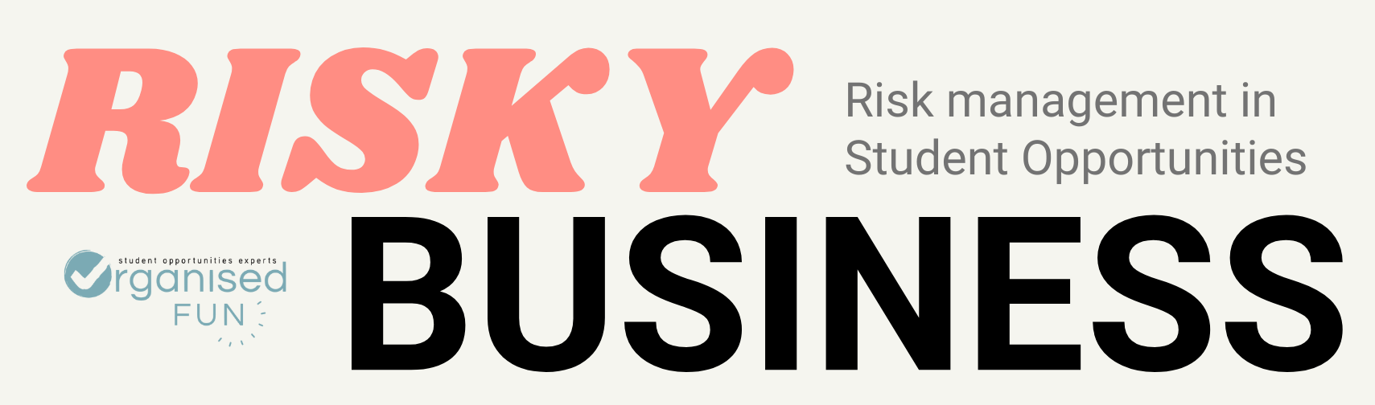
Notes:
Rosie overview

Slide 18
11th & 12th November 2024
Nottingham Trent Students’ Union
Bookings open today & close 23rd October
Notes:
Rosie overview

Slide 19
The absolute basics
Systems and sign off
Student engagement
Notes:
Rosie overview
Our training focuses on three key learning areas:
The absolute basics - what is risk management? How do you do it?
Systems and sign off - where does responsibility for risk lie in a students’ union and university, and how do you navigate this?
Student engagement - helping students to understand the ‘whys’ and the ‘hows’ and ultimately getting them to take risk seriously (in a fun way, of course)

Slide 20
Our future work
Consultancy
  Confirming projects for Spring & Summer 2025
Community
  Student Opportunities Managers Network
Training
  Anti-racist Student Opportunities
  Student Opportunities 101
  Risky Business
Notes:
Rosie overview

Slide 21
Thanks!
Rosie Hunnam
info@organised.fun
@OrganisedFunHQ
www.organised.fun
Notes:
This is the closing page - this should be a thank you, but also list contact information for the speaker

