Slide 1

On the ball with sports
memberships
Notes:
This is a title page used at the start of a presentation - this should introduce the title of the presentation only

Slide 2

Who?
Ryan Ginger, City St George’s Students’ Union
Vince Mayne, The Sport and Active Wellbeing Collective
Rosie Hunnam, Organised Fun
Notes:
Rosie open session and ask Ryan and Vince to introduce themselves

Slide 3

This session:
Context & Scene Setting
City Case Study
Exploring models
Key Learnings and conclusion
HE sport
Impacts
Our project explained
Outlining membership models
Project outcome
Other ideas
Notes:
Rosie give session overview

Slide 4

Let’s start with
some questions
Notes:
Hands up if…
Sport is fully managed and administered by the SU
Sport is fully managed by the uni
Sport is collaboratively managed by the uni and the SU
You have a participatory sport programme
You have teams competing in BUCS
You have teams competing in LUSL
You have teams competing in other leagues
You play sport yourself
You’re watching the Olympics
You’re a professional/semi professional athlete

Slide 5

Context
Scene setting
Notes:
Rosie :
What’s going on in the HE sport sector and the sport world overall?

Slide 6

Context
Students being priced out of sport?
Participation and inclusion matters
Changes in the sports sector
Notes:
Questions/discussion - Rosie and Vince
Ryan to add in any context about anything we say

Slide 7
Why does student sport matter?
Belonging (community, friendship, social capital)
Mental health and wellbeing
Physical health
Skills and employability
Notes:
Rosie - Quick overview

Slide 8

City: case study
What did we do?
How did we do it?
What did we learn?
Notes:
Rosie intro the section

Slide 9
Introduction
Sport with the SU for 1 year
Merger City and St George’s
Rising costs of running sport
Unsure model fit for purpose
Notes:
Ryan quick overview of the ‘why’

Slide 10
City and St George’s sports models
City
£50 per student
Join as many clubs
Everything covered
St George’s
‘Club-led’ - differential charging
Clubs work closely with SU to manage finances
Unclear membership offer
Notes:
Ryan quick overview of different models

Slide 11
Methodology
Stakeholders & existing thinking
Sector research
Drafting models
Team meeting exploring models
Student consultation proposal
Notes:
Rosie overview methodology
To understand the different models currently in the sector, we reviewed 32 HE institutions, comparing:
Student numbers
Number of clubs
Number of club members
BUCS League position
Social sport offer
Membership model type
Comparative price analysis for 4 sports (Cheer, Fencing, Netball & Rugby Union)

Slide 12

Sports Membership Models
Notes:
Rosie - what did we find?

Slide 13
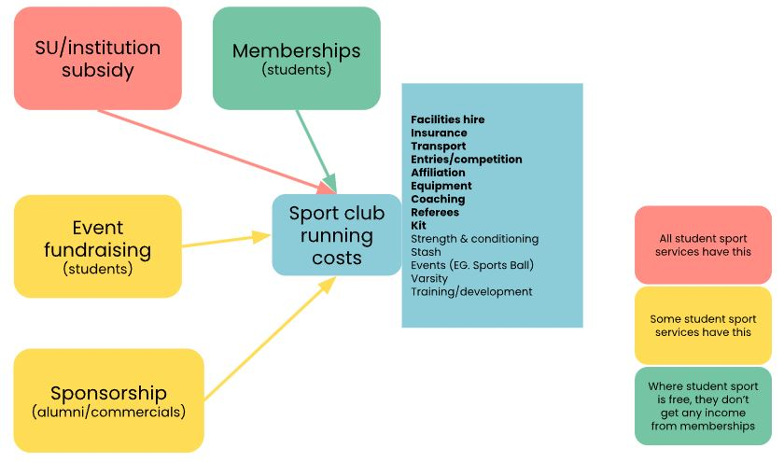
The cost of sport
Notes:
The diagram above shows how sport is funded in higher education. The blue box shows what is typically included in sports club running costs. Student sport services don’t typically include all of these, but the items listed in bold are typically included.

Slide 14
Models overview
Club-led
Tiered
Flat fee + top up
Flat fee
Free
Notes:
Will explain these now….

Slide 15
Club-led
Membership fee is determined by the club annually, usually in agreement with the SU/sports dept. Sometimes also includes differential pricing within each club.
10/32 HEIs (Royal Holloway, Worcester, Leeds)

Slide 16
Tiered
Clubs grouped based on associated costs and all clubs in tier charge the same membership fee.
5/32 HEIs (Chichester, Roehampton, Herts)

Slide 17
Flat fee + top up
Singular fee to play all sports with 'top up' for some clubs with more cost associated activities (EG. competition).
‘AU’ model
7/32 HEIs (Keele, Swansea)

Slide 18
Flat fee
Singular fee to play all sports
7/32 HEIs (City, Anglia Ruskin, Brunel)

Slide 19
Free
No cost to play sport. Usually includes all associated costs (kit, transport, training, etc)
3/32 HEIs (Northampton, Arts, UEL)

Slide 20
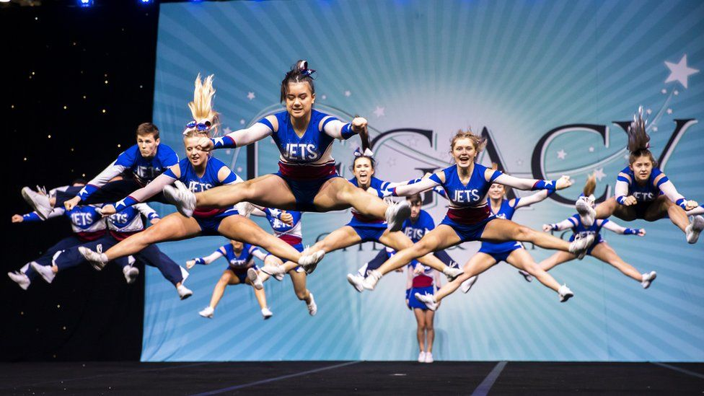
What’s
your
sports membership model?
Notes:
Activity asking people to consider own models - invite them to talk to people next to them about their sport set up
Then ask them to organise around the room - based on which model they think they have in their institution
Have a chat with the people next to you about your model

Slide 21

Key Learnings
For this project and for the sector
Notes:
Rosie and Ryan

Slide 22
Case study: project outcomes
Chose a tiered membership model - why?
How is this being implemented?
What is going to change…
…for students?
…for SU
Notes:
Ryan talk on this with Rosie chipping in

Slide 23
Ideas for HE sport
Cost of living
  Access funding
  Review your model
Student professional development
  Coaching
  Referees
  Sport Leaders
Social prescribing
Communication
Notes:
Rosie lead this with Ryan and Vince adding in thoughts

Slide 24
Questions…?

Slide 25

Our future work
Training
  Risky Business
  Anti-racist Student Opportunities
  Student Opportunities 101
Consultancy
  Confirming projects for Spring & Summer 2025
Community
  Student Opportunities Managers Network
Notes:
Rosie overview

Slide 26
Thanks!
Rosie Hunnam
info@organised.fun
@OrganisedFunHQ
www.organised.fun
Notes:
Thanks

