Slide 1

Making Data-Driven decisions and Enhancing research work
Membership Services August 2024

Slide 2
Aim
Hurdles of SU researchers
Discuss Research Methods to combat survey fatigue
Play a Prioritisation game to address competing priorities
New Quantitative methods: Predictive Modelling and PowerBI Dashbaords.
Address Time, Workload and impactful work
Qualitative methods: Listening Rooms and Student Diaries
Address connecting with students and impactful work

Slide 3

The Hurdles (5 min)
What are some hurdles that researchers face currently?
Notes:
Let's play a little game, where the person who spits out the most number of problems gets a little gift from me. A drink on me to console you for the number of problems you have.
What are the hurdles your Union faces that stops them from making the best data driven decisions.

Slide 4

Our Hurdles
Workload
Survey fatigue
Lack of time
Burnout
Competing priorities
Fast paced changes
The UNIVERSITY
Engaging external stakeholders

Slide 5

To combat Survey Fatigue, what Research methods could we use?
Let's Discuss
Notes:
5 min

Slide 6
Prioritisation
High Impact on Students
Low Effort
High Effort
Low Impact on Students

Slide 7
Quantitative - For an Impactful Research Project (10 min)
Prioritise the 'insight' and 'recommendations'
Student and University Motivations
Data transparency
Notes:
Firstly, its important to learn about the motivations of the people we need to influence. With Students, we need to focus on what is motivating a student to have an amazing life at University. Why are they here and what can we do to get them to succeed? And with regards to the University, I think Unions are quite good in understanding what we as a Union stands for, and what our values are. But how often have we listened to what the University is saying without first pushing for change they would never consider? We don't have to agree with everything they say, but how often do we seek to find common ground and gaps in their work? We are lucky that Universities are quite beauracratic, that gives us leway to work in those areas more efficiently.
Second, since we know that everyone wants data and wants to collect the data, what can we do to make sure the information we process is transparent. To help improve our workload, is there a way we can give information to people which does not mean creating hefty reports and doing analysis that takes long time?
And finally, if we have managed to give information into the hands of people which frees up our time and resources, how can we use that effectively create well-thoughout insights and recommendations that our staff can meaningful work with, rather than getting consumed and burnout in the analysis part of things? How do we better influence staff.

Slide 8
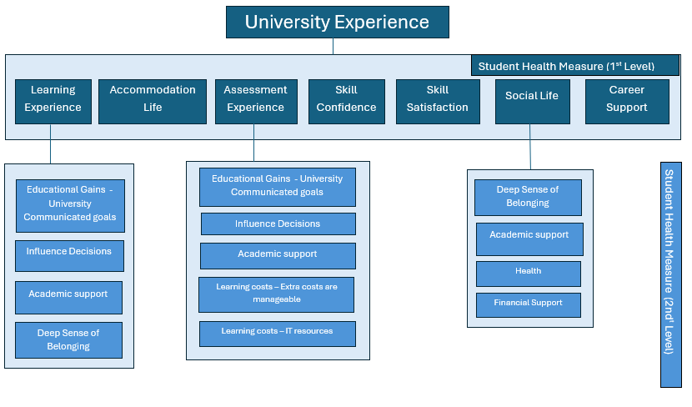
Student Experience/Fulfilment model

Slide 9
Qualitative research
Direct engagement with students
Rich, detailed data
Fill in the gaps
Notes:
5 min

Slide 10
Summary
Research methods
Prioritising our work to deliver high impact
Using Dashboards for faster work
Using Predictive modelling for targeted approach
Using Student Diaries for ongoing insights
Using Listening Rooms for creating safe spaces

Slide 11
Thanks for listening
Heard something that sounds interesting and want to chat more? Get in touch!
Ruch Fernandes, Head of Research and Insight at University of Manchester Students' Union, ruth.fernandes@manchester.ac.uk
Meg Haskins, Policy and Research Manager at Students' Union UCL, m.haskins@ucl.ac.uk

