Slide 1

DESPACITO
​
The Importance of
Co-creating Cultural Activities with and for International Students.​
​
​
​

Slide 2
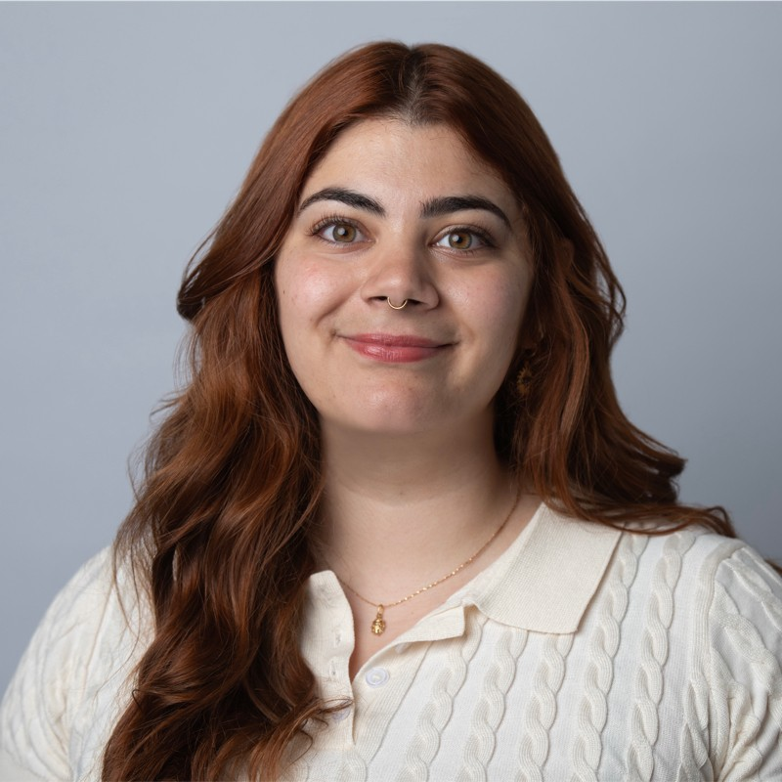

Who am I?
Immigrant
From Argentina.
MS in Digital Marketing Communications form Man Met
International Project Coordinator
Started this project from scratch
3 years developing it
Trustee for UKCISA
UK Council for International Student Affairs
1 year in the role

Slide 3
What are we covering today?
How does the international student experience look like right now?
The International Student Project at The Union in a nutshell.
How to co- create cultural activities with students.

Slide 4
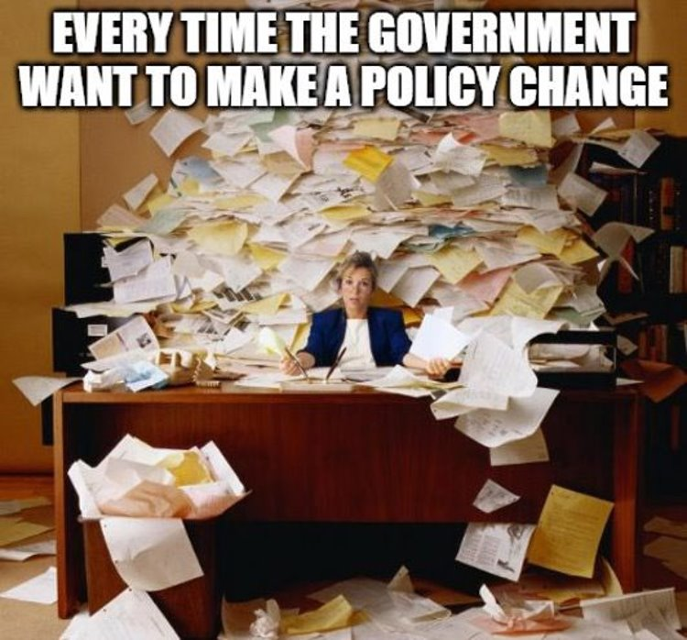

Slide 5
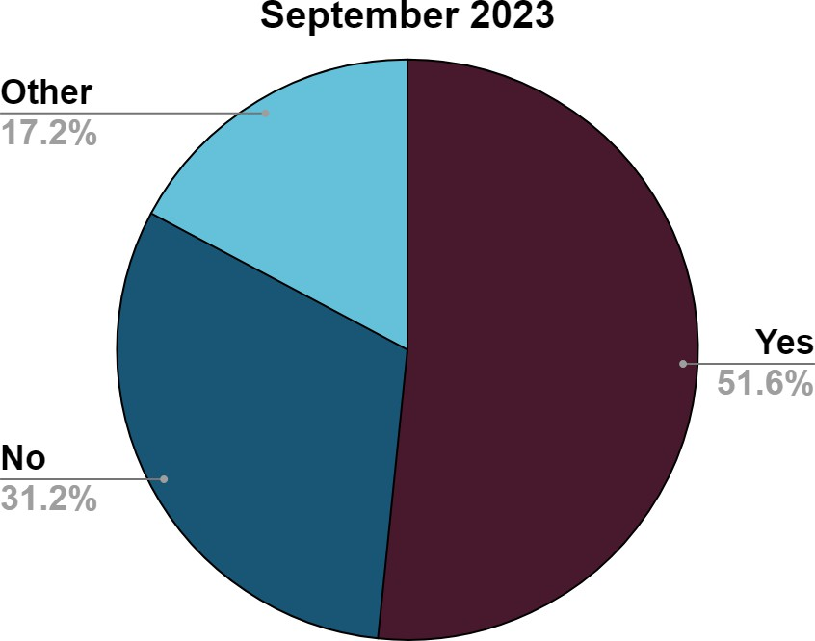
Would you recommend the UK to a friend?
“Not affordable now due to the cost and devaluation of currencies in the third world countries”
“International students are not millionaires, and they are contributing significantly to the UK’s economy already every year and can’t take the responsibility to fix the UK’s economy”
“It depends. Single students are generally better situated to deal with financial austerity. I would dissuade students with families”

Slide 6
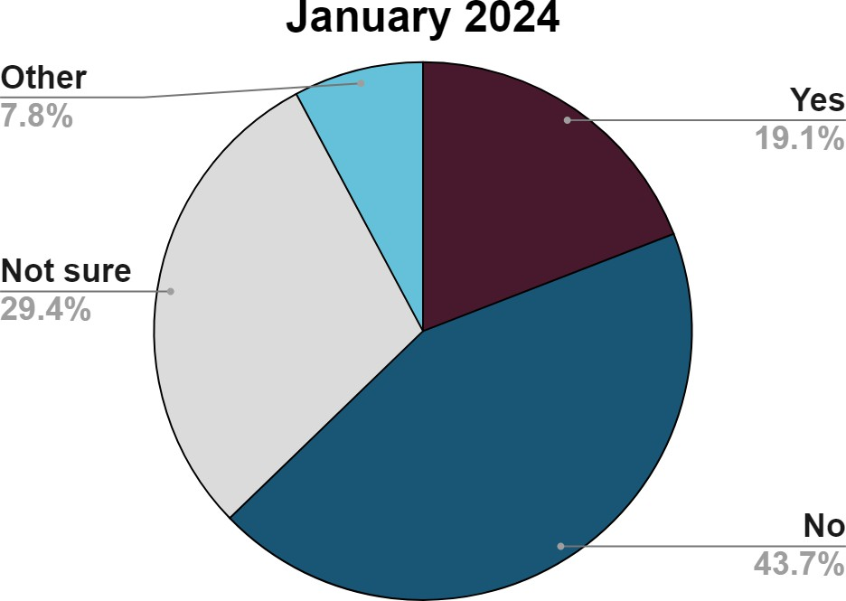
Would you recommend the UK to a friend?
“I wouldn't recommend it to people from [Nigeria] because of how difficult the visa processing is and how the govt continues to treat foreign students (particularly from poorer countries)”
“Considering the cost and a perceived anti- international students' sentiments coming from the UK government…a key consideration more so now would be getting a very good overall value for money considering the high cost of a UK education for an international student”
“I am not confident enough to recommend the UK. Countries like Germany are more welcoming and have greater career opportunities for graduates”

Slide 7
2023/2024
+ Increasing visa and IHS costs.​
+ The announcement on dependents.​
+ Cost of living crisis.​
+ Currency fluctuations
  Eg Nigerian currency plummeted throughout 2023 reaching a record low
    100 Nigerian Naira = £0.08 (8 Jan 2024)
    100 Nigerian Naira = £0.18 (9 Jan 2023)
+ Accommodation shortage and spiraling rental prices.​
+ Increase in Skilled Worker visa threshold.​
+ The review of the Graduate route review.
+ Current Riots.
+ 40% of Officers are International Students and over 90% are Postgrad.

Slide 8
IN SUMMARY - LANDSCAPING:
+ Dependents and volatile policy environment is a real thorn in the bed in an already changing global market.
+ We need to think how to better support the students that are coming to ensure they spread a positive message about the UK and want to recommend it to friends.
+ You can usually forecast with data, but it is hard with limited data.
+ Be wary of potential geopolitical changes that may affect diversity
+ FE/HE and political changes overseas affect us
    Canada is capping numbers for the next 2 years
    Australia is targetting certain kinds of student applicants and agents
    USA elections

Slide 9
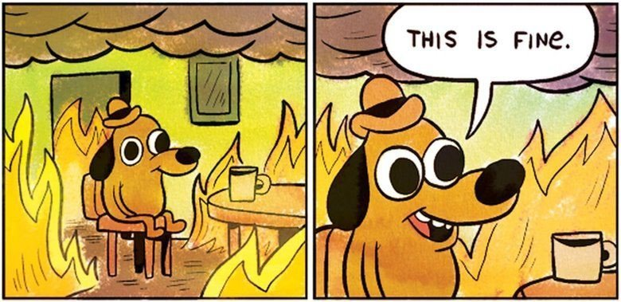

Slide 10


Slide 11
Despacito
Slowly

Slide 12
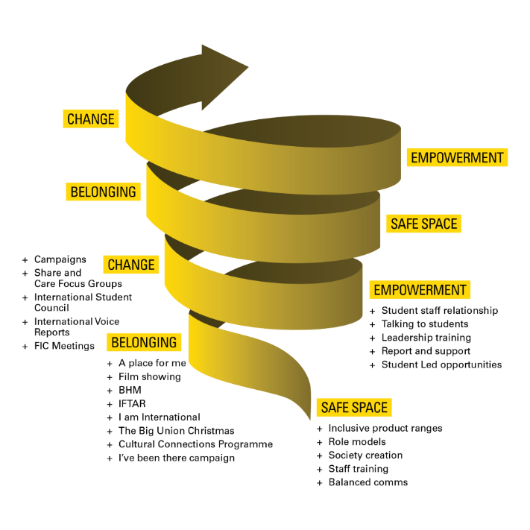
A COMMUNITY IS NOT BUILT IN A DAY!

Slide 13
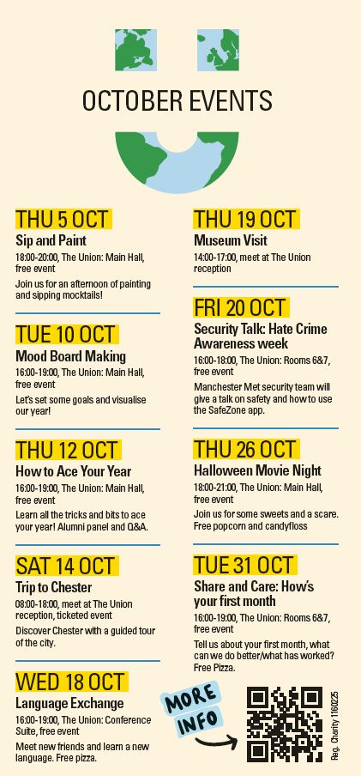
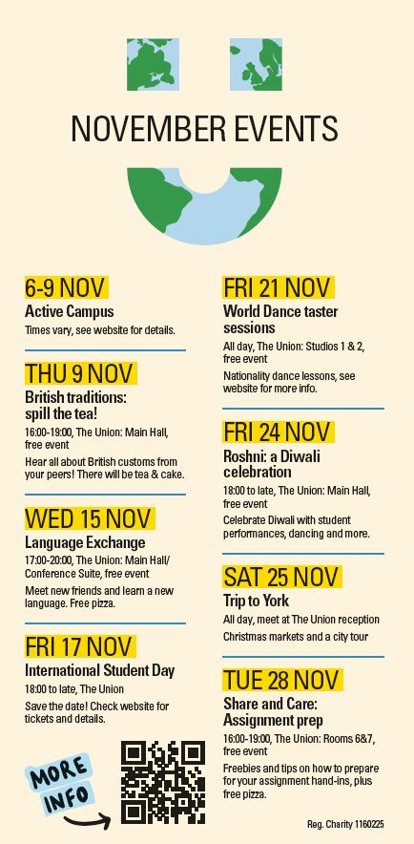
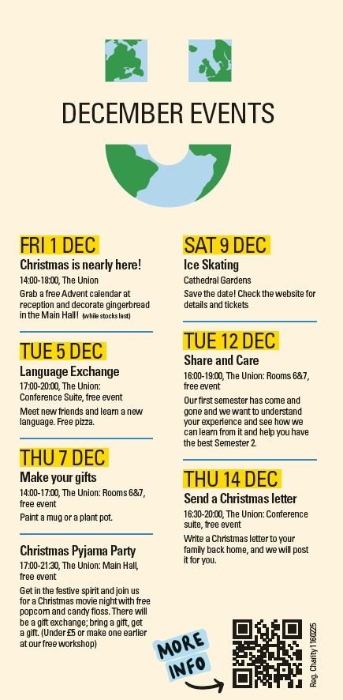
Every month:
Voice event
Creative event
Language Event
Cultural event

Slide 14
Co-created with students...

Slide 15
STUDENT LED vs CO- CREATION
CONVERSATIONS
STUDENT COUNCIL
FOCUS GROUPS
CONSULTATIONS
OPEN CALLS
SOCIETIES
STUDENT LEADS
STUDENT COUNCIL
SOCIETY EVENTS
CONTENT CREATION

Slide 16
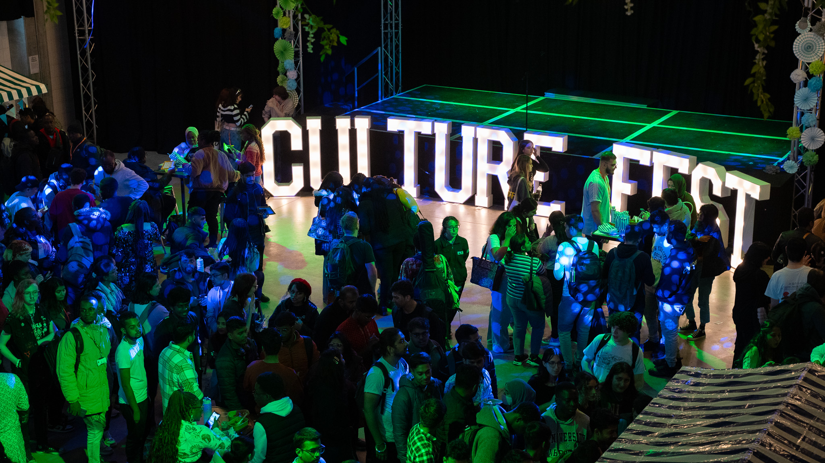

Slide 17
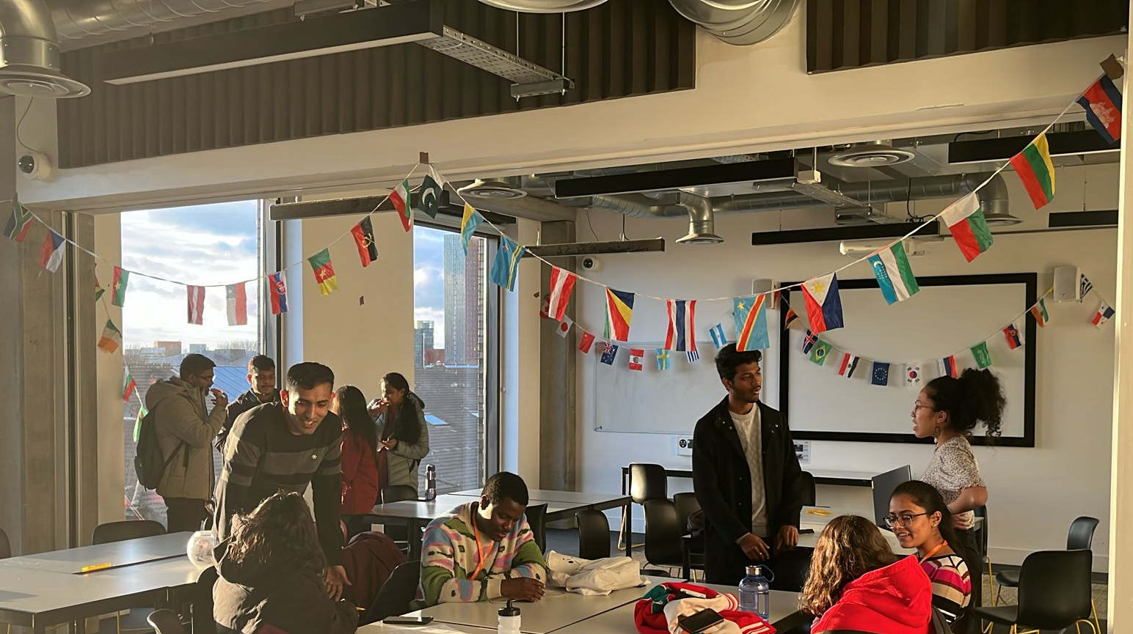

Slide 18
QUESTIONS TO ASK WHEN ORGANISING AN EVENT
+ Is this happening somewhere else?
+ Am I needed?
+ Do students want this?
+ Do we have the money?
+ Do we have the time?
+ Do we have the physical space on campus?
+ Do I have clear Aims and Objectives?

Slide 19
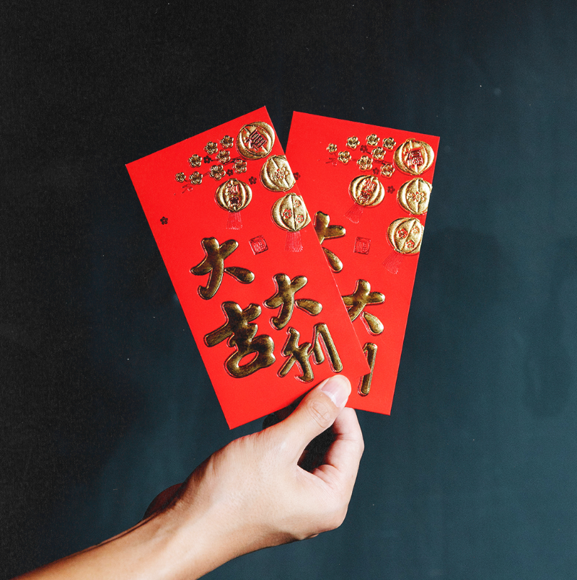
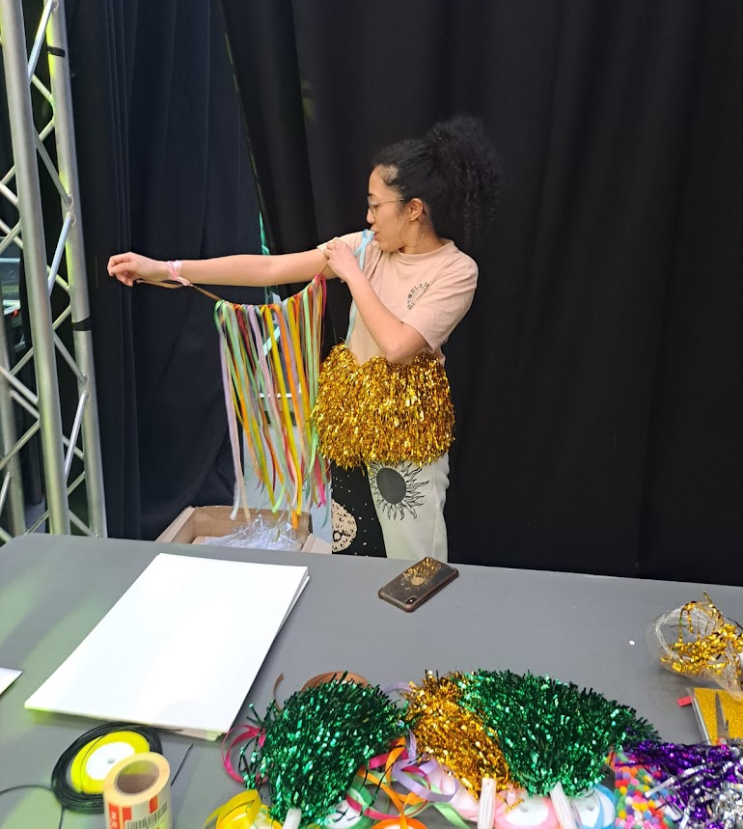
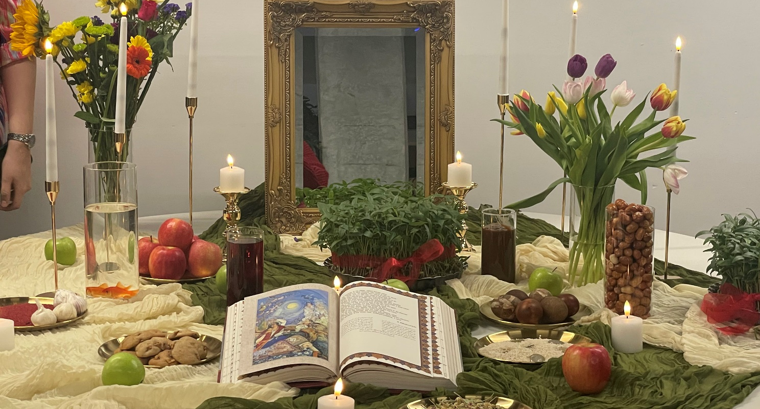
CELEBRATING IN DIFFERENT WAYS
+ Lunar New Year
  150 envelopes given with chocolates, one prize and information.
  Blog post about events in the city in partnership with the Lunar New Year Manchester team
+ Brazilian Carnaval
  Samba Dance Workshop (7 attendees)
  Crafts Workshop (20 attendees)
+ St Patricks Day
  Crafts Workshop (15 attendees)
+ International Women’s Day
  Crafts, Quiz, Movie night (25 attendees)
+ Naruz
  Supported the Persian society with their Haft Sin table and food. (60 attendees)
+ International Happiness Day
  Positivity Jars (7 attendees)

Slide 20


300
250
200
150
100
50
0
ENGAGEMENT
£0 £50 £100 £150 £200 £250 £300
MONEY SPENT

Slide 21
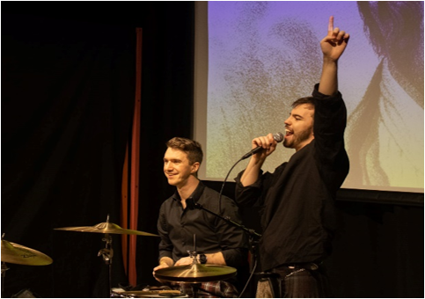
BURNS NIGHT
Society collaborations​
Engagement Activities & Food vendors​
Over 600 students in attendance​​
Student Performances and Poetry readings​​
Ceilidh live band with a caller​​

Slide 22
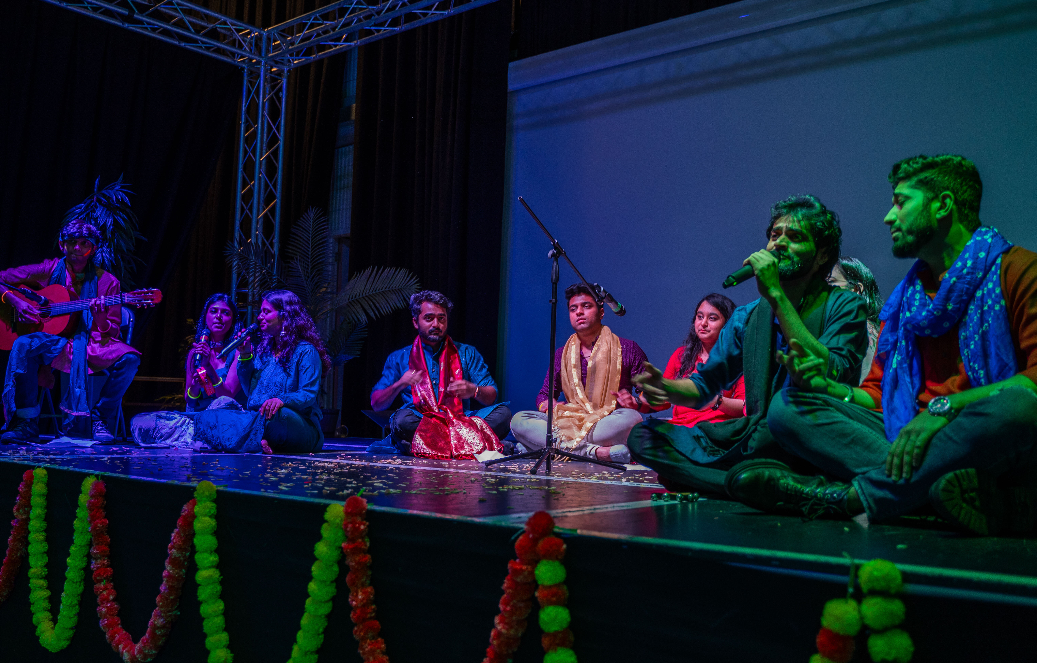
HOLI CELEBRATIONS
Society collaborations​
Henna Station
Over 240 students in attendance​​
International DJ
4 Student performances

Slide 23

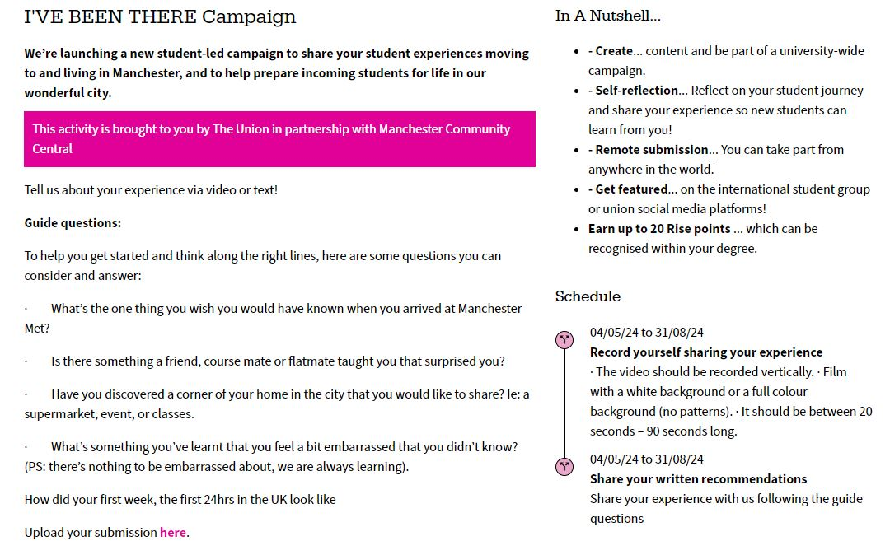
Notes:
https://rise.mmu.ac.uk/activity/ive-been-tehre-campaign/

Slide 24
A COMMUNITY IS NOT BUILT IN A DAY!

Slide 25
HOW CAN
YOU
START?
Reach
Work with your international office when possible. They can help with contacting students. Set up a focus group/ a survey with incentive.
2. Realistic Expectations
You may think it is all or nothing, but it could be as simple as a monthly social. Every little helps.
3. Resources
Collaborating with other departments can help, as well as linking event with preexisting projects (Sport activities, Wellbeing, GIAG).

Slide 26
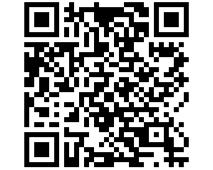
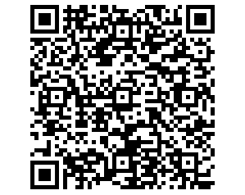
HOW CAN YOU START?
If you are looking for a community space and training & toolkits...
If you have research/ innovative ideas in mind...
Webinar 20 August: innovative ideas and research to improve the international student experience
Join UKCISA SUs have FREE membership!

Slide 27

THANK YOU!
Q&A
If you want to keep in touch...
Maria Loray
M.LORAY@MMU.AC.UK

Slide 28

EXAMPLES

Slide 29
EXAMPLES
Culture Fest
Welcome Event during re-freshers Fair
Goals
Theme
Location
Activity
Motivation
Promotion
Goals
Theme
Location
Activity
Motivation
Promotion
To make students feel part of the community
Free food , Meet new people, prizes
People Bingo , Student Performances, World map.
The Union Main Hall
Celebrating Cultures at our University, Welcome to Manchester!
To welcome student and help them make friends
Flyers , Int Office Email , Webinar
Burns night
Market License | £91 | City council
Stalls | £557 | Yoyelo
Band | £580 | Tartan trio
Photobooth | £864 | The Burbage Booth
Letters | £564 | Sterling group
Pritning | £200 | mmu print
Security | £400 | fgh
Prizes | £250 | various
Food | £1,500 | various vendors
TOTAL Estimate: £5k.
Attendees: 600+

Slide 30
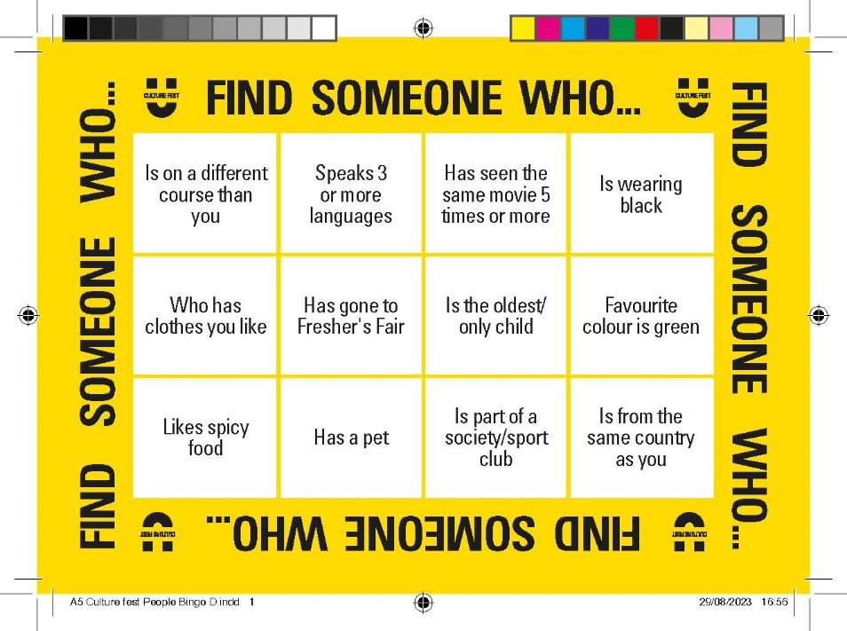
EXAMPLES

Slide 31
EXAMPLES
LUNAR NEW YEAR ENVELOPES
Goals
Theme
Location
Activity
Motivation
Promotion
Goals
Theme
Location
Activity
Motivation
Promotion
To raise awareness on Lunar New Year on campus
To make students to celebrate feel seen by the university
Lunar New Year
Reception desks
Giving away envelopes with information on city festival.
Chocolate coins, Information. A random prize!
Website blog post, social media sotry.
We got:
100 Envelopes +250 coins + 100 Info sheets.
£30 spent on envelopes
£35 spent on coins
Optional: £20 shop vouchers
£? Printing information (normal printer)
£? Time to put them together (1 hour)
TOTAL: £77
Attendees: 100

