Slide 1
The Challenges of Student Voice:
Can Sortition and/or Citizens’ Assemblies Help?

Slide 2
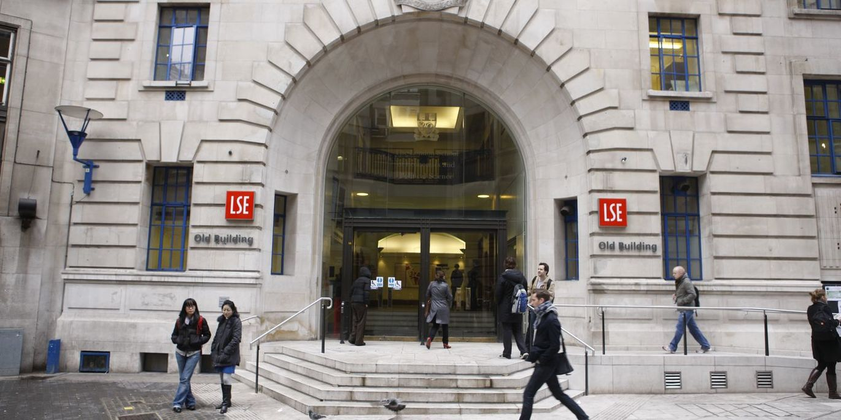
Student Voice: Can sortition help?
Welcome and introductions
  Ricardo Visinho (he/him) – LSESU Head of Student Voice
  Evan Saunders (he/him) – LSESU Student Voice Coordinator
A Brief Introduction to Sortition & Citizens’ Assemblies
Workshop Exercise
Group Feedback

Slide 3
A Brief Introduction to Sortition & Citizens’ Assemblies
Notes:
Sinead

Slide 4
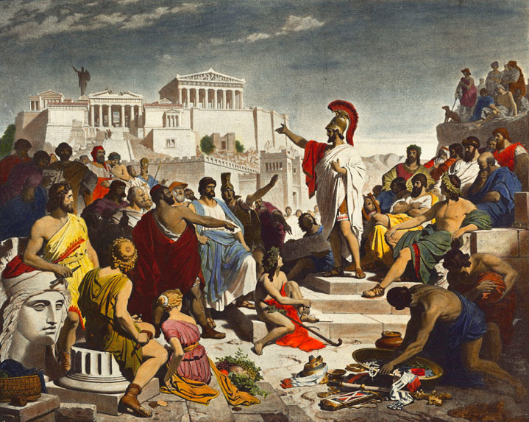
A Brief Introduction to Sortition
What do you think sortition is?
Where do you think sortition originates?
  Athens!

Slide 5
A Brief Introduction to Sortition
In 5th century BC Athens democracy meant direct democracy (rule by the people), whereas election was considered to be a form of oligarchy (rule by the few) or aristocracy (rule by the best)
Any of its 30,000 eligible citizens could attend the Ecclesia (its general assembly meeting) to propose laws, bring public lawsuits or address its fellow citizens several times per month
Where selection otherwise took place, its positions/bodies primarily appointed by random lottery:
  Jurors
  Magistrates
  The Boule – a 500 member agenda setting governing council
Only positions which were felt to require expertise (such as appointment of generals) were elected

Slide 6
A Brief Introduction to Sortition
How representative do you think Athenian democracy was?
  Only included 30,000 eligible citizens
  Excluded several groups, including women, foreigners, slaves, children and others whose rights were otherwise revoked
  It is estimated only 10-20% of the population were eligible for sortition
Also used down the years in different ways in Lombardy, Florence, Venice, India and Switzerland

Slide 7
A Brief Introduction to Sortition
Examples where sortition is used today
  Law court juries
    In some countries such as UK and US
  Deliberative poll
    Type of opinion poll designed to gauge how opinions might change when presented with more information and thoughtful discussion
  Citizens’ assemblies or citizens’ juries
    Grown in usage in recent decades
    How students now pass policy at LSESU

Slide 8
What is a Citizens’ Assembly
“A citizens’ assembly brings together a broadly representative bunch of people, selected by lottery, to decide how we should live together.”
  The Sortition Foundation
Key word here is representative
Different, therefore, to pure lottery systems in that they aim to create a microcosm of a particular public, community, group, society, etc.

Slide 9
How do Citizens’ Assemblies work?
You have sortition process and an assembly process
Sortition process
  Invitation
    Large number of invitations sent out to members of the public/community at random asking them to participate
  Stratification
    From those who respond positively, a second lottery takes place according to pre-defined criteria to select a cohort that is demographically representative
Assembly process
  Once selected, members of the citizens’ assembly are provided with time, access to people with relevant viewpoints/expertise and other resources so that they can:
    Learn deeply about the issue
    Deliberate about the issue
    Decide and issue a shared set of recommendations

Slide 10
Examples of Citizens’ Assemblies
Global Assembly
  A 100 person citizens’ assembly composed of people from around the world supported by the UN to discuss issues facing the entire world.
  First Global Assembly designed to coincide with the 2021 Glasgow COP and focused on issue of climate change
Ireland’s Citizens’ Assembly
  Set up in 2016
  Played crucial role in shaping Ireland’s policies on abortion, climate change, population ageing and fixed-term parliaments
Citizens’ Assembly of British Columbia
  Formed in 2004 and 2009
  Focused on electoral reform in provincial elections in Canada
French Citizens’ Convention for Climate:
  Set up in 2019 to propose greenhouse gas reduction measures

Slide 11
What are the pros of sortition and/or citizens’ assemblies?
Notes:
Sinead

Slide 12
Pros
Genuinely representative
More egalitarian - breaks down systemic societal biases/barriers which disproportionately prevent marginalised demographics from accessing positions of power
Counters over-representation of politically active groups
Safeguards against factionalism
Less corruptible
Cognitive diversity (different ways of seeing the world and interpreting events within it are introduced)
Greater efficiency (people are there for one purpose only)
Less political (not voted in/linked to parties, etc.), so reduces negative aspects of politics such as quid pro quos
More democratic (in original meaning of the word) - empowers and engages ordinary people

Slide 13
What are the cons of sortition and/or citizens’ assemblies?
Notes:
Sinead

Slide 14
Cons
Are ordinary people competent enough to make big decisions on every issue?
Might be less representative (if pool drawn from is too narrow)
Less legitimate vs elections (less democratic in terms of how democracy is broadly understood today)
Less accountability (people not subject to reelection or otherwise accountable for decisions taken)
Less enthusiasm (being selected by lot means the exclusion of those who might passionately volunteer to engage in those debates and decisions by seeking election, for example)

Slide 15
Workshop Time!
Notes:
Sinead

Slide 16
Workshop
What do we mean by student voice?

Slide 17
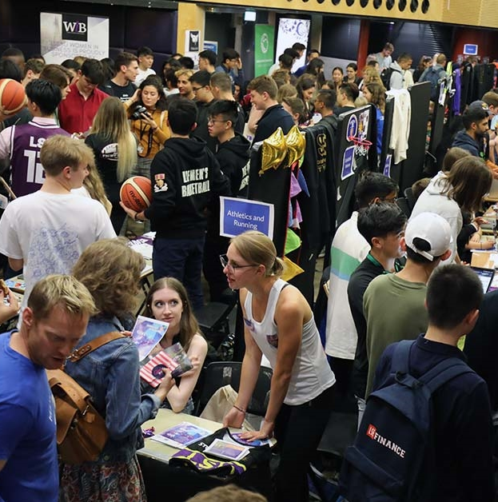
Workshop
Break into groups
Going to get you to each consider some different student voice challenges and want you to consider whether either sortition and/or citizens’ assemblies might be able to help in some way – and if so, how?
After 15 minutes, groups to feed back

Slide 18
Workshop
Student Voice Problems to Consider:
How to ensure that the voice we get from students is genuinely representative?
How to ensure that when students tell us something, that something is genuinely done with that?
How to ensure that students have the right opportunities to exercise student voice?
How to ensure that students’ feedback feels genuinely valued?
Feel free to answer from the perspective of the Union (from whichever teams/divisions) or the institution (inside the classroom or outside)
In your groups answer:
  Might sortition and/or deliberative democracy be able to play a role in addressing this?
  If so, how?

Slide 19
THANK YOU!
If you have any questions or wait to connect subsequently, you can contact us at:
Ricardo Visinho - r.m.visinho@lse.ac.uk
Evan Saunders - e.saunders2@lse.ac.uk
Notes:
Sophie

