Slide 1
Tackling Dangerous Behaviours

Slide 2
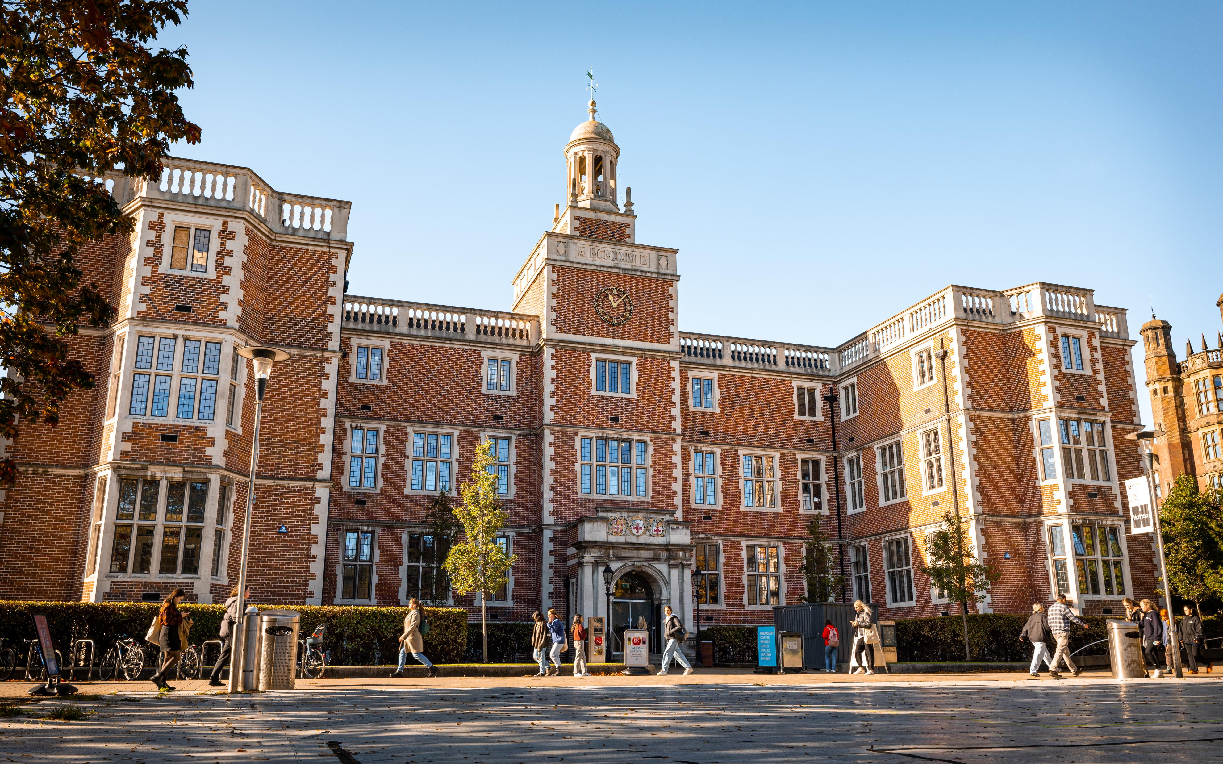

Slide 3

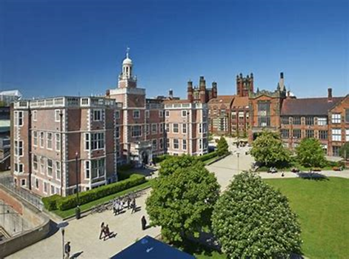
Intro and Background
  Lindsey Lockey
  CEO – Newcastle University Students’ Union June 2023 – present day
  Director of Membership Services and HR – Newcastle University Students’ Union
  2005-2021
  Co-chair of Alcohol Working Group

Slide 4
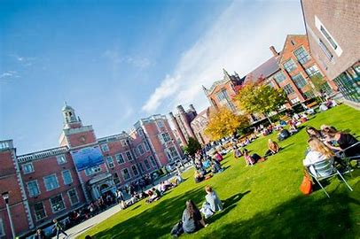

Work on Harm Reduction – pre 2016
Partnerships
Awareness Raising
Sanctions
Proactive interventions and monetary investment
Policy via Student Council
Cultural Change in FW

Slide 5
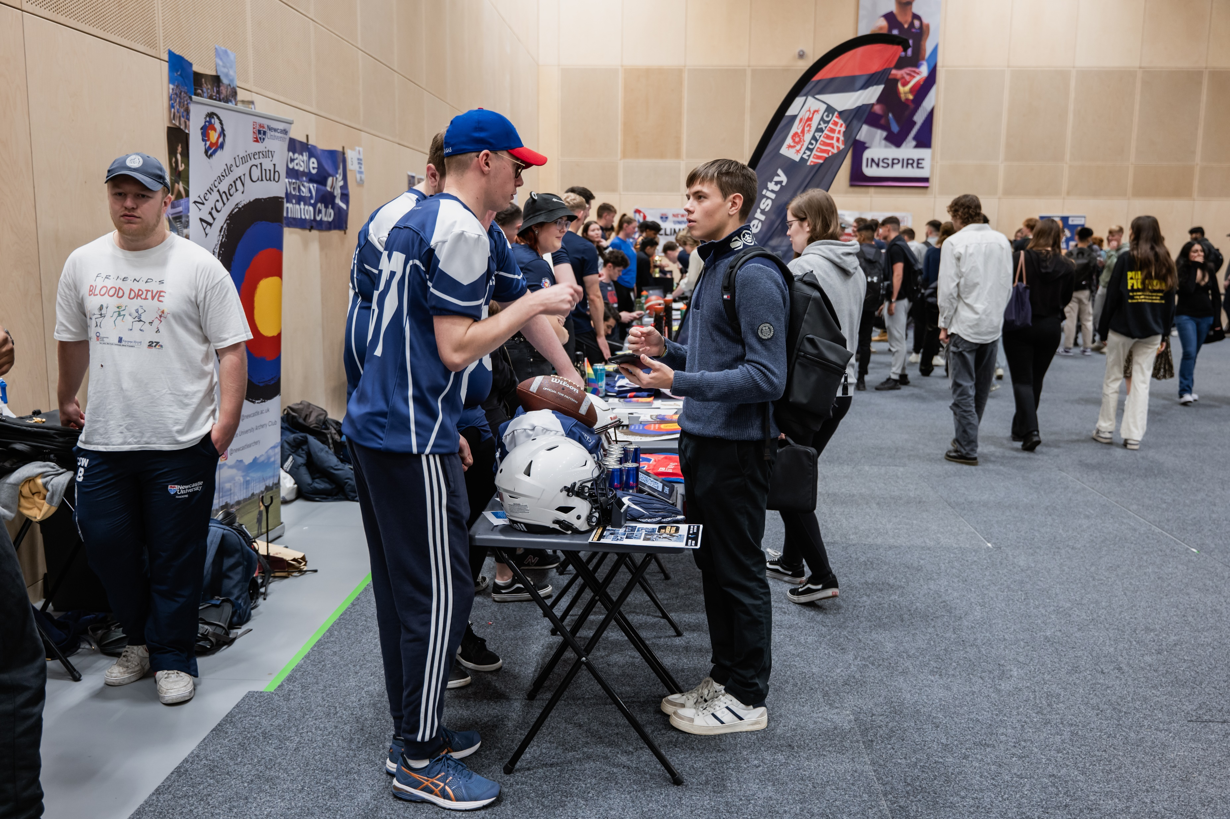
Tragic Events
December 2016
Death of Newcastle student Edward Farmer: Fresher's death due to 'toxic effects' of excessive alcohol - Chronicle Live
The coroner records a narrative conclusion that: “Ed died due to the toxic effects of an excessive amount of alcohol in a short period of time and in part because the inherent risk of doing so were not known.”

Slide 6
Actions and Recommendations
Processes between NUSU and University link with one another:
‘Where appropriate, the University will report the outcome of any disciplinary investigation relating to organised student socials to NUSU for investigation under their Disciplinary Policy.
Any result of an investigation held by the University is not indicative of the result of an investigation by NUSU.
Reports made to NUSU about student misconduct related to dangerous behaviours at organised student socials will be investigated in line with NUSU’s Student Disciplinary Policy.
Where appropriate, NUSU will report the outcome of any disciplinary investigation relating to organised student socials to the University for investigation under the Student Disciplinary Procedure. Any result of an investigation held by NUSU is not indicative of the result of an investigation by the University.
Language and Definitions:
  Dangerous Behaviours
  Coerciveness
  Imbalance of power
Whole University Approach
Update and Develop Policies and Procedures
Proportionate Sanctions – Zero Tolerance unhelpful

Slide 7

Actions and Recommendations
Clear reporting and support
Awareness Raising
Work with partners in the city to promote responsible drinking
Alumni involvement
Processes between NUSU and University link with one another:
‘Where appropriate, the University will report the outcome of any disciplinary investigation relating to organised student socials to NUSU for investigation under their Disciplinary Policy.
Any result of an investigation held by the University is not indicative of the result of an investigation by NUSU.
Reports made to NUSU about student misconduct related to dangerous behaviours at organised student socials will be investigated in line with NUSU’s Student Disciplinary Policy.
Where appropriate, NUSU will report the outcome of any disciplinary investigation relating to organised student socials to the University for investigation under the Student Disciplinary Procedure.

Slide 8
Initations | Student Wellbeing | Newcastle University (ncl.ac.uk)
Initiations at UK universities (universitiesuk.ac.uk)
Email me: lindsey.lockey@newcastle.ac.uk
Follow us: @newcastlesu
Further Information and Links

