Slide 1
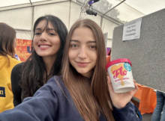
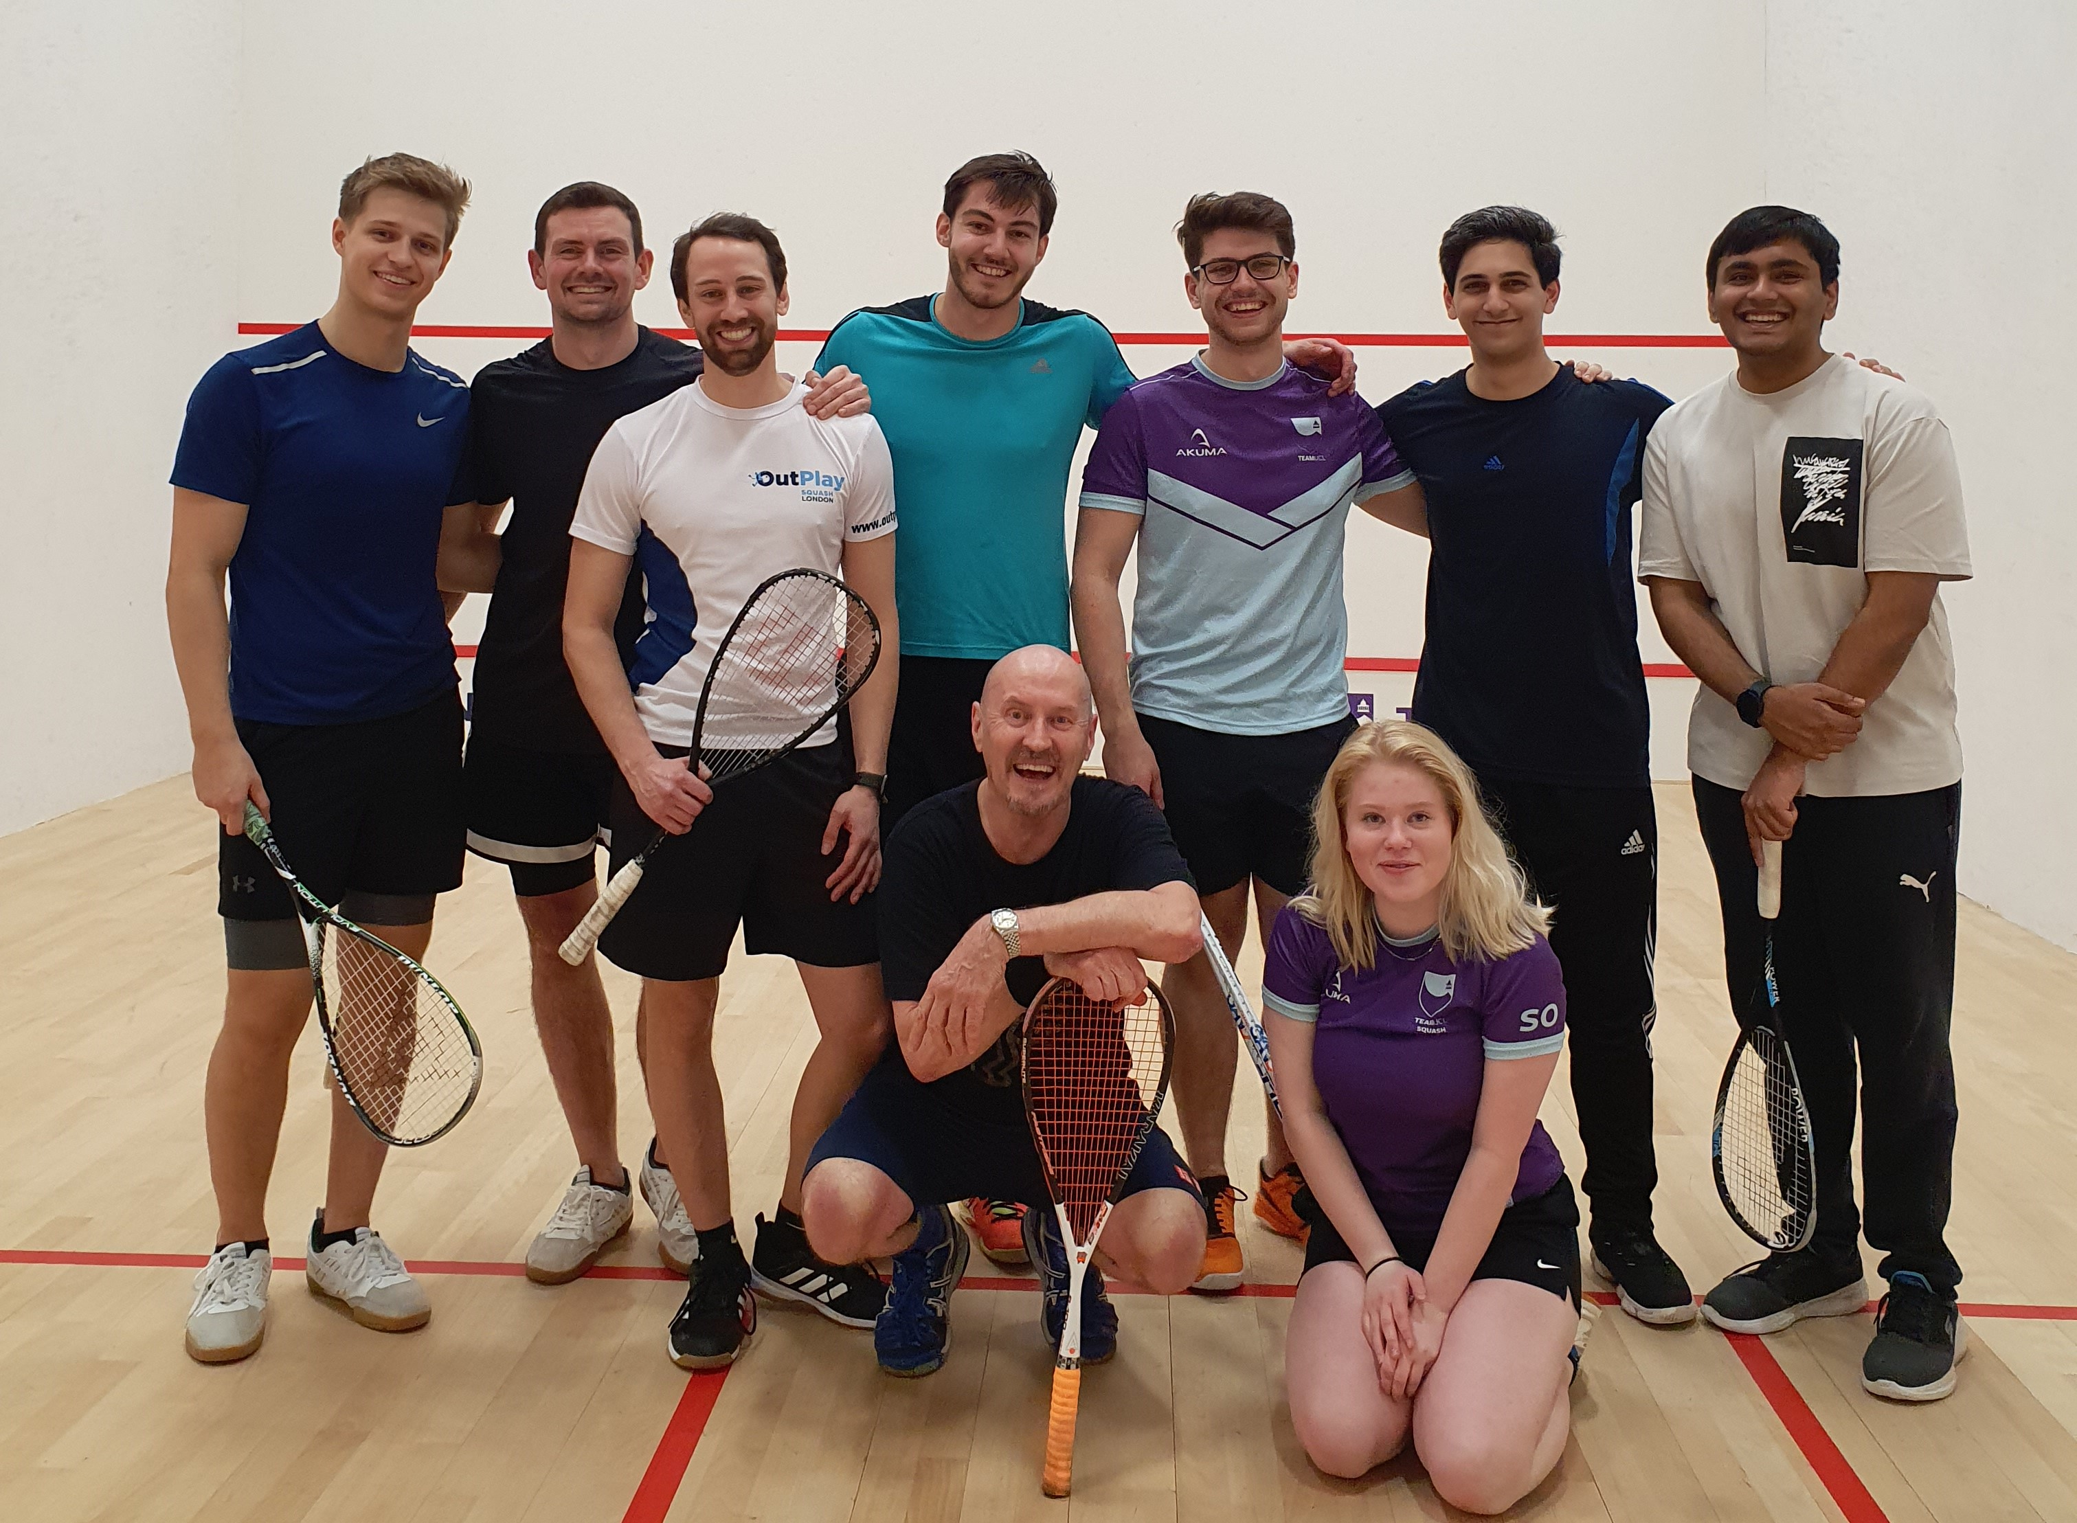
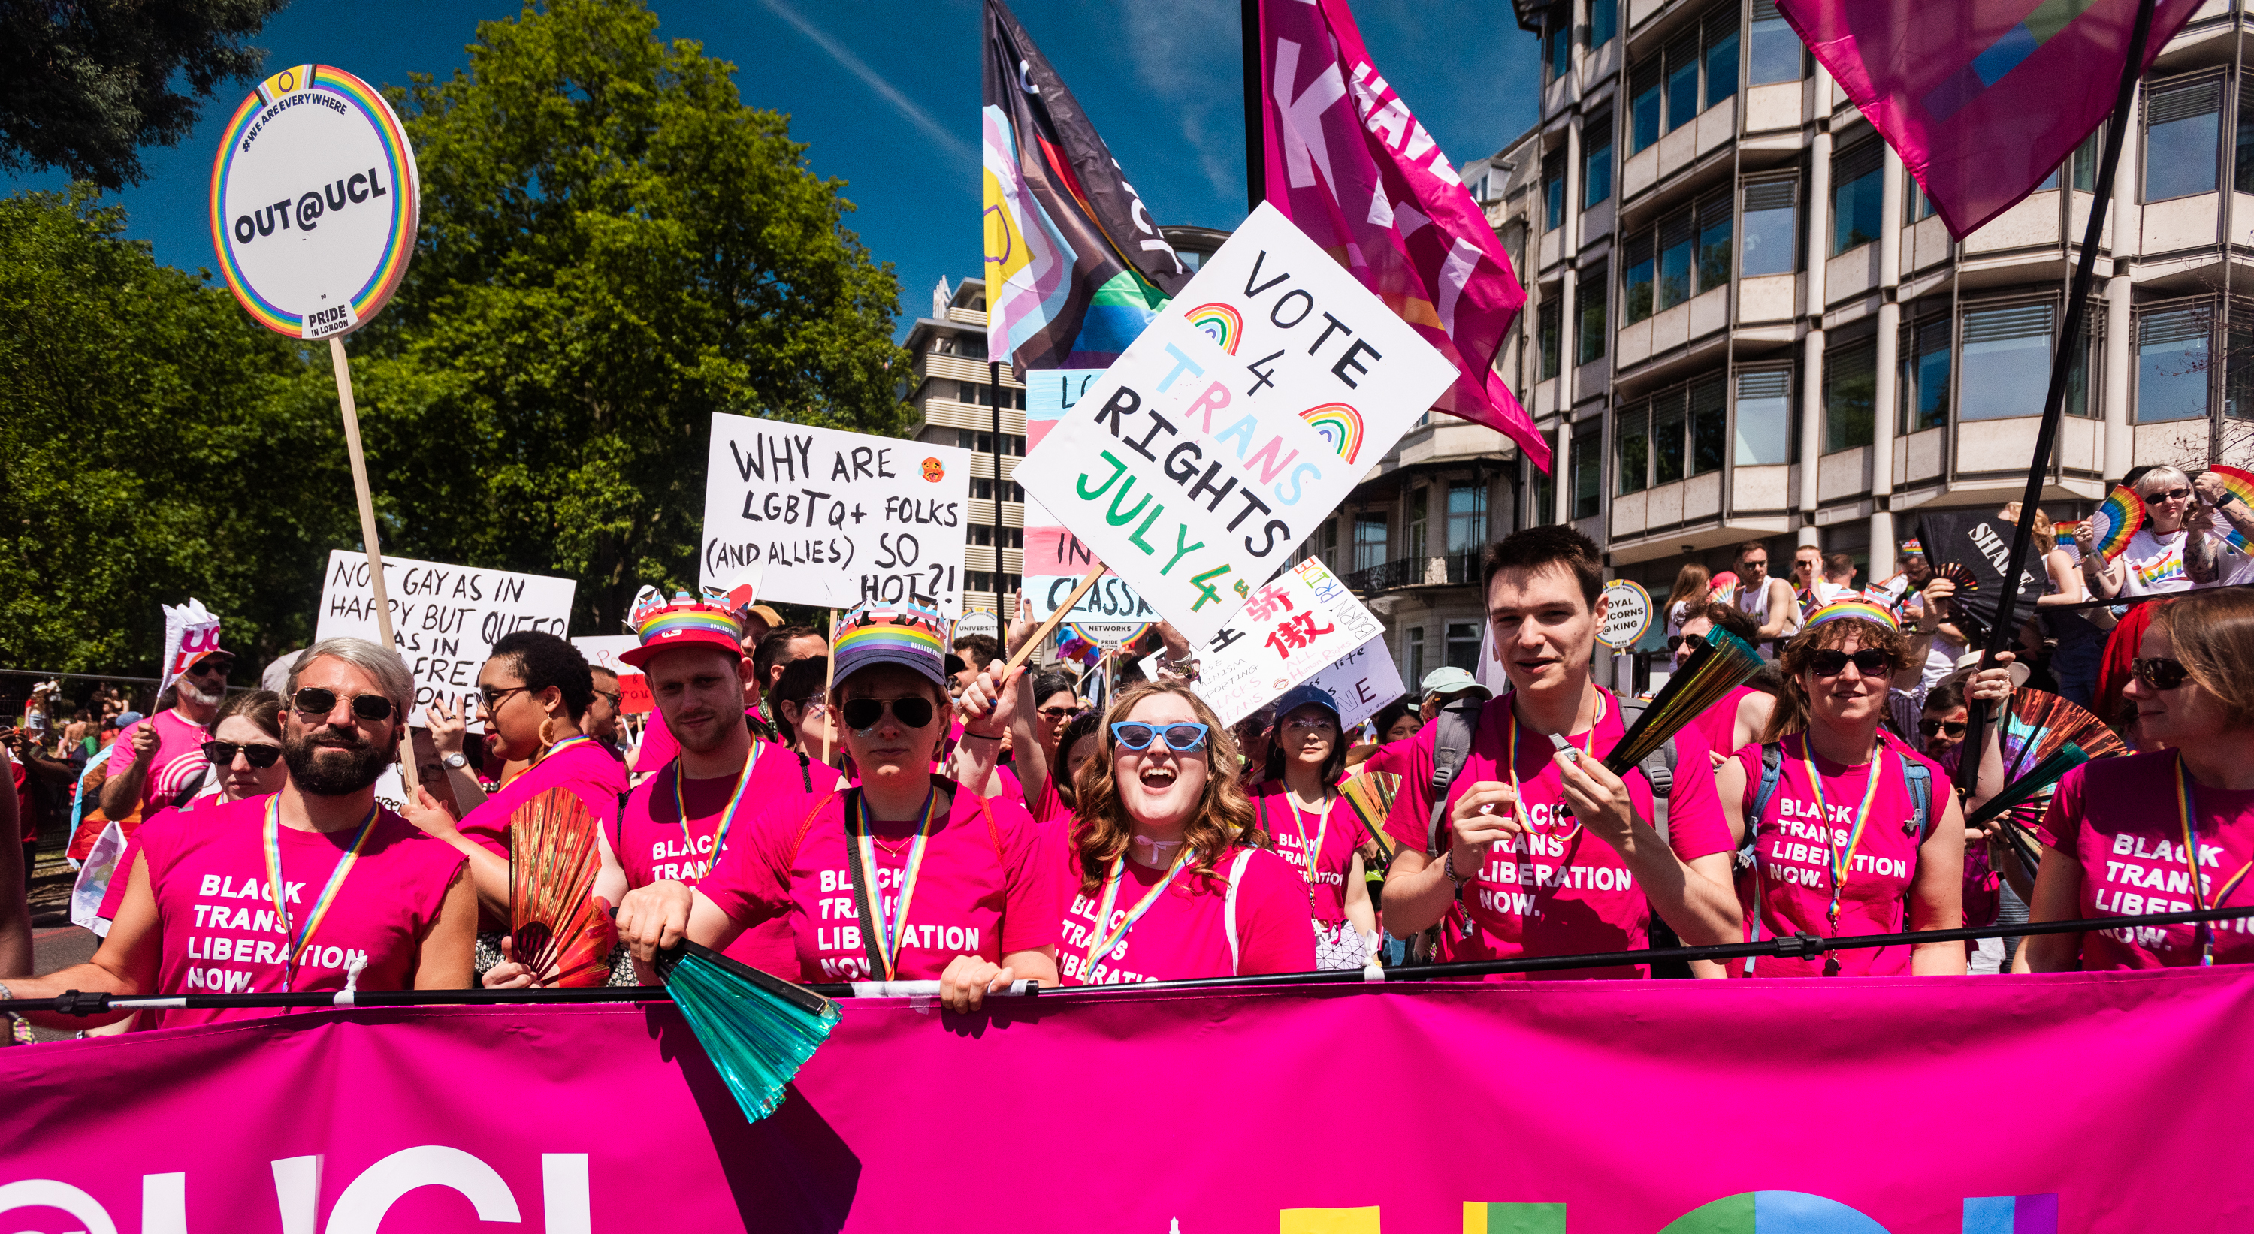
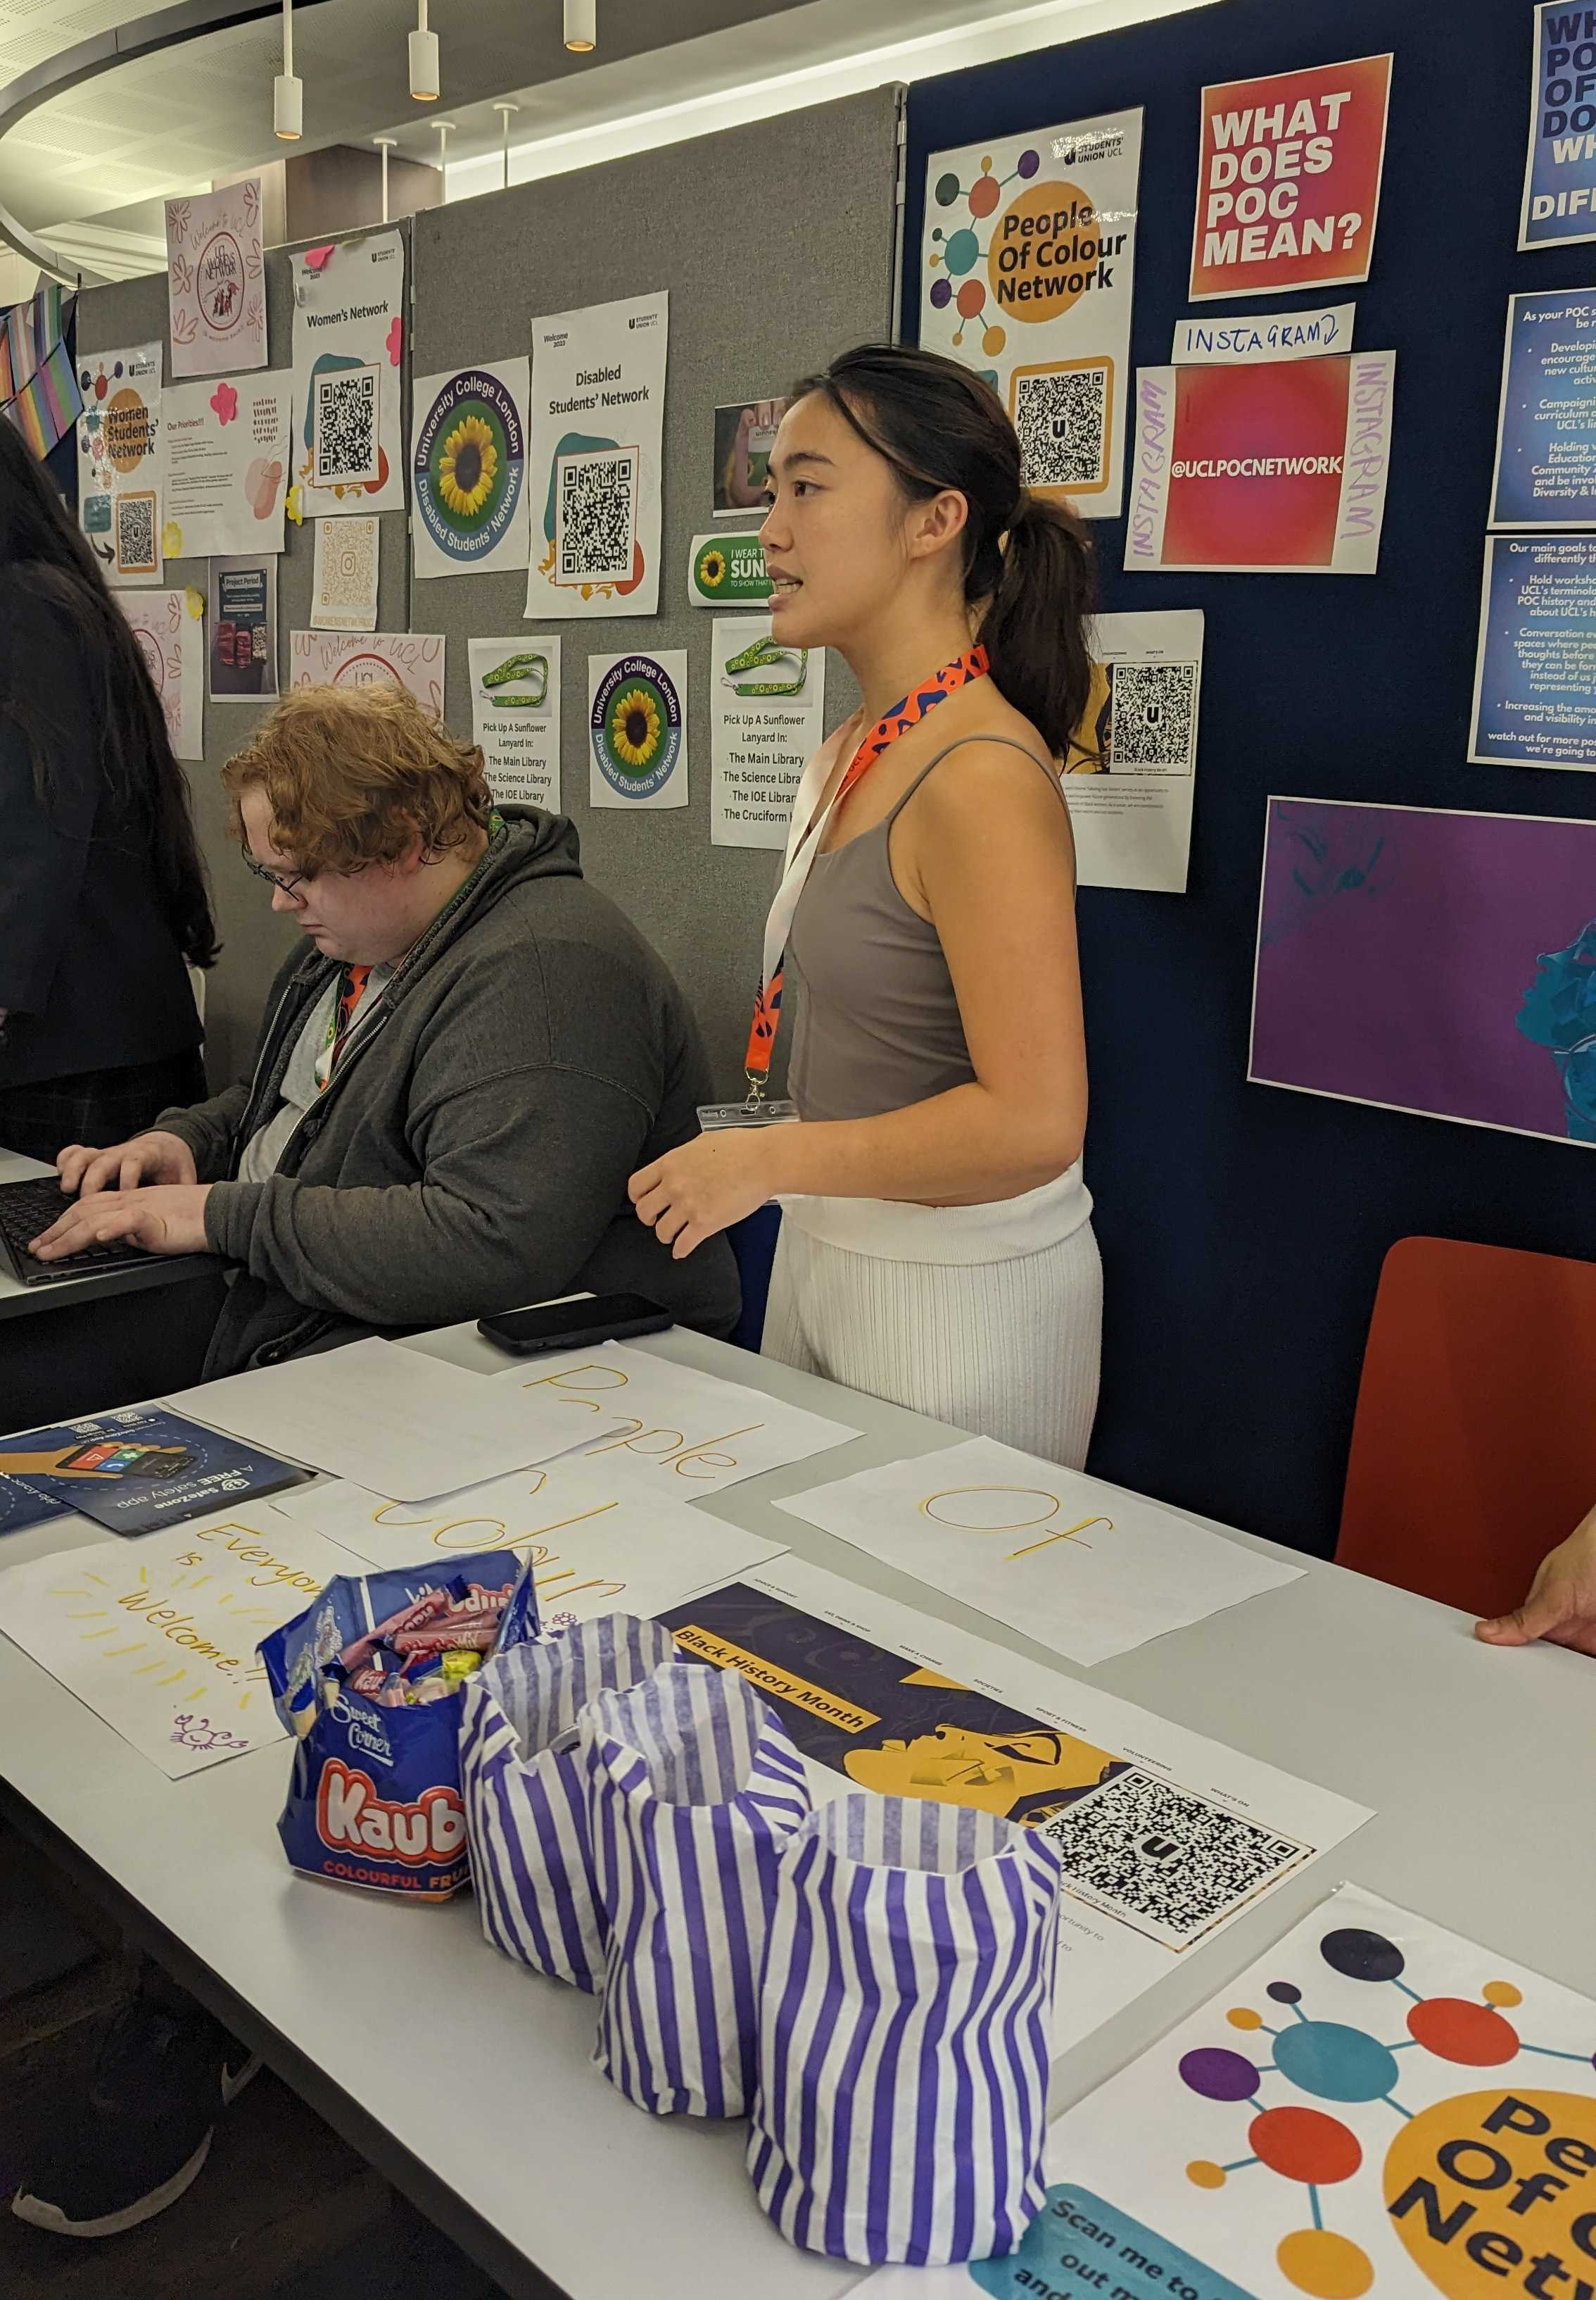

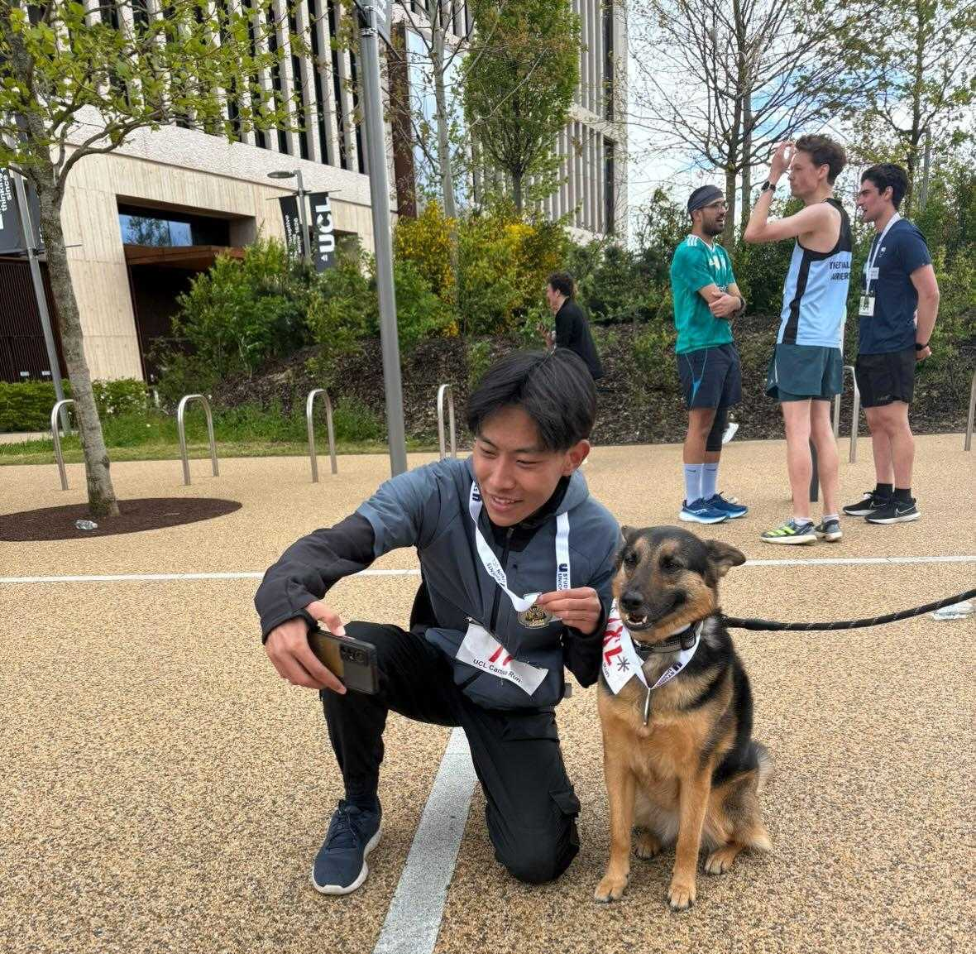
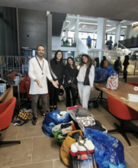
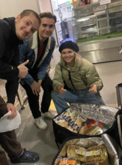
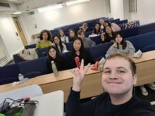
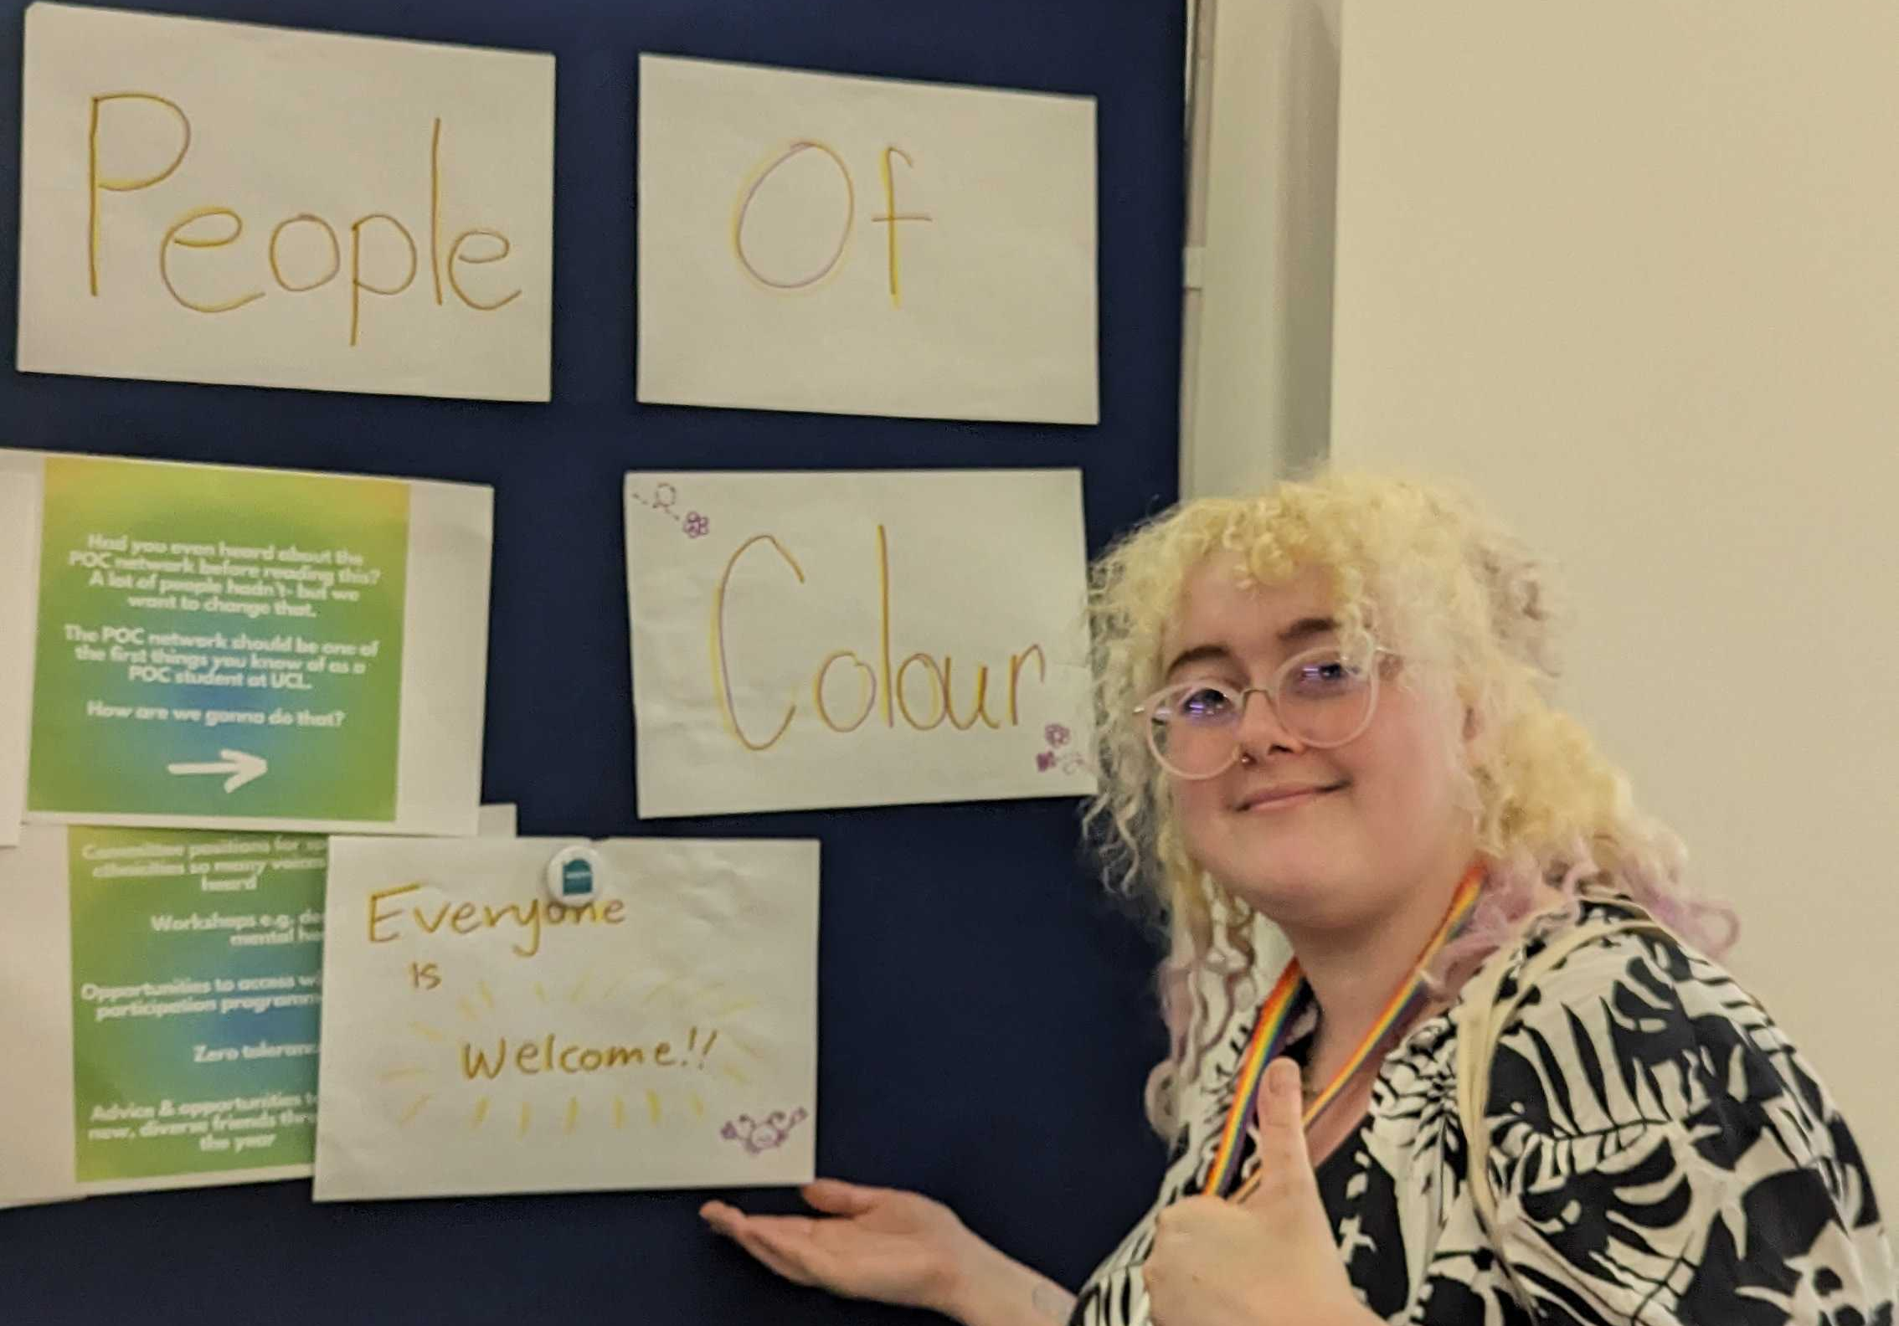
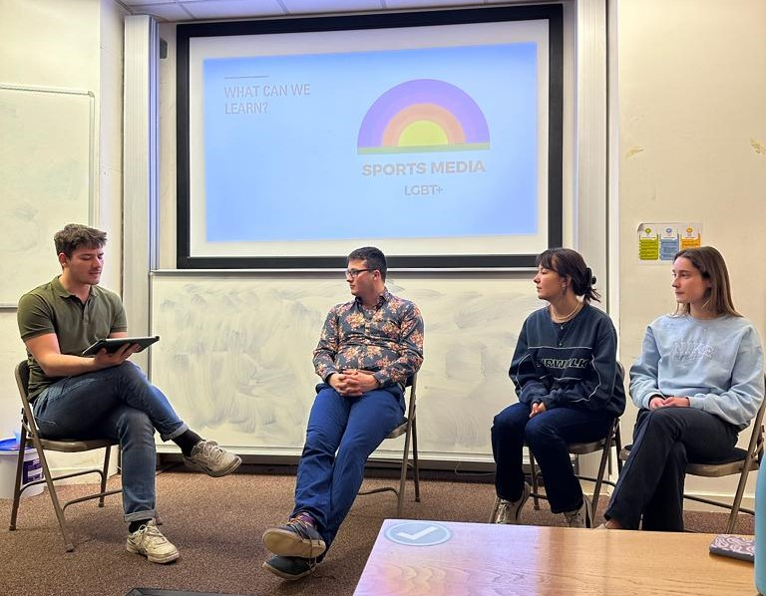



Uplifting & Empowering:
Student Officer Reward & Recognition
Jayne Flowers, They/Them

Slide 2
Content
What does Reward and Recognition mean to you?
To Consider…
  Three things to recognise
  Other Reward & Recognition: Common Factors
  SU UCL Student Officer review and support package
So, what can you do?! Mini-Hackathon

Slide 3
To Consider…

Slide 4
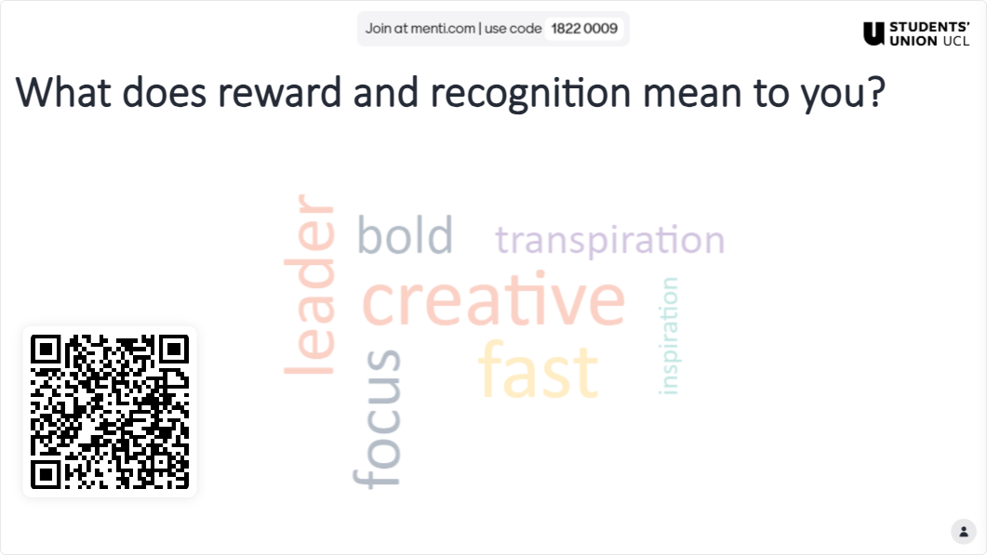
What does reward and recognition mean to you?

Slide 5
Three Things to Recognise
Student Officers are overworked, can become disengaged or roles are left vacant
In a cost-of-living crisis, more must be done to reward and recognise our most critical and influential student leaders
How can an effective support system and an equitable reward and recognition scheme be established to support our student leaders?

Slide 6
Other Reward & Recognition: Common Factors
Monetary Reward (For groups or individuals)
Community/Groups, over Officers
  OR Academic Representatives
Award-based recognition
Elected Volunteer Roles, over paid
Shout out to Oxford Brookes SU for their research into Student Network/Community Groups and best practices!

Slide 7
Student Officer Review for Support at SU UCL
We understood that:
Officers were lacking staff support, accountability and rewards for the work they did.
Roles were left uncontested or vacant during our elections
We wanted to:
Formalise Staff Support
Empower Students to be more effective in democratic structures and their communities
Create a robust accountability and reward structure

Slide 8
Student Officer Reward Checklist
5 Sections
  Section 1: Term 1, Section 2: Term 2, Section 3: Term 3
  Section 4: Tasks to be completed at least once during the academic year
  Section 5: At least one ‘large project’ from the list
Reward:
  Complete all the Term 1 tasks and 50% of Section 4 by the end of Term 1. You will receive a voucher/SU goody bag in the beginning of Term 2.
  Complete all the tasks by the end of term 3 you will receive a certificate, LinkedIn Recommendation and a £100 voucher.
Notes:
Section 1:
Attend initial training/induction
Attend Zone Meeting 1
Attend Zone Meeting 2
Complete Term 1 Report
Section 2:
Attend Zone Meeting 3
Attend Zone Meeting 4
Complete Term 2 Report
Section 3:
Attend Zone Meeting 5
Complete Handover Document
Attend Exit Interview
Section 4:
Collaborate with another Student Officer or Sabbatical Officer on an event/project
Submit an item for discussion or a policy proposal at any Zone
Meet with your designated staff support
Complete the Students’ Union Active Bystander Training
Section 5:
Gather feedback from your constituent group – e.g., Survey with Sports clubs.
Host a stall or be present at Welcome Fair
Feature on the SUs Social Media Channels or in a Newsletter
Write a blog for the SU website

Slide 9
So, what can you do?!
Mini Hackathon

Slide 10
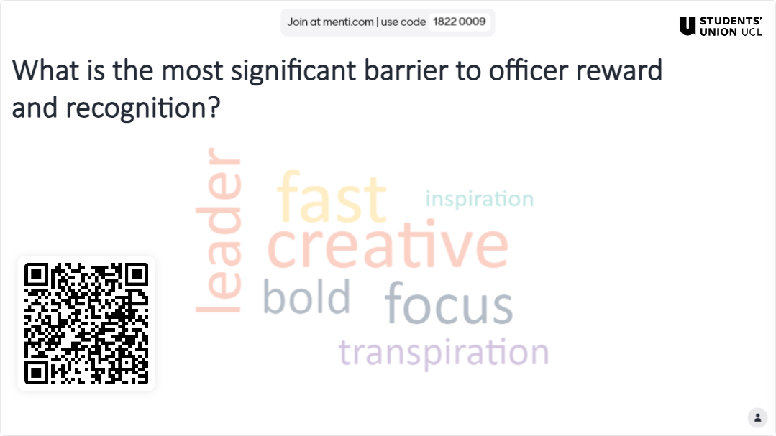
What is the most significant barrier to officer reward and recognition?

Slide 11
Hackathon
Split into two groups
You have 20 Minutes to craft a ‘magic wand’ solution to Student Officer Reward & Recognition
At the end, each group will have 2 minutes to present their resolution back to the other group, with 1 minute for questions

Slide 12
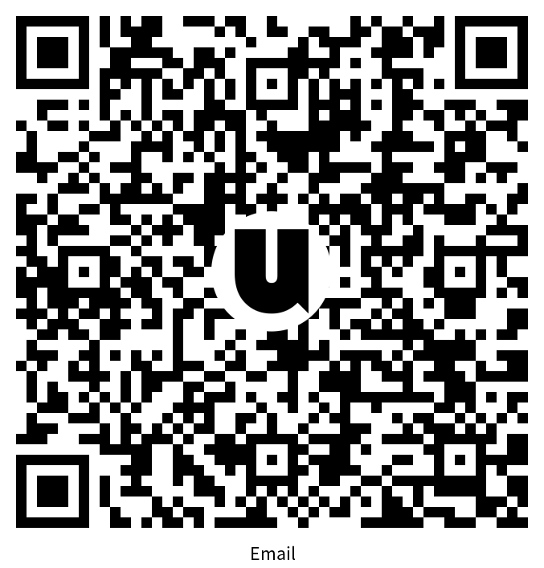
Want to continue the conversation? Contact Us:
su.democracy@ucl.ac.uk

