Slide 1
Advice service capacity: addressing caseload challenges
Jawanza Ipyana (They/Them)
Laura Pike (She/Her)

Slide 2
overview
Exploring the capacity challenges
Stepped Care Approach to Advice

Slide 3

TIME eaters
IN GROUPS DISCUSS – WHAT DO WE SPEND OUR TIME ON AS ADVISORS?

Slide 4
Enabling Advice
Advice
?
?
What enables us to advice?
Do we give ourselves enough time to do them?

Slide 5
Agree/Disagree
Your caseload is too high
You often feel like the service is on fire
Your team go above and beyond for students
Your teams wellbeing is impacted by the caseload
Your senior management/trustees recognises the extent of your capacity challenges
Your senior management/trustees is likely to give you additional resources to meet capacity challenges

Slide 6
What is in our power to change?
Increase Resources
Reduce Demand
Make Efficiencies
Reduce Scope
In groups discuss ways you could tackle the capacity challenge
Use example ideas handout to help

Slide 7
Stepped Care approach to advice

Slide 8
What is stepped care?
Sometimes used in mental health support
Principle of most effective, yet least resource intensive treatment first – ‘stepping up’ to more specialist services as required
Recognises that different people require different levels of care

Slide 9
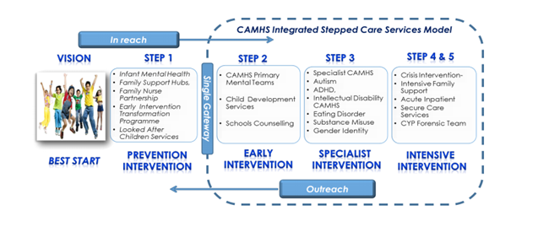
Example from elsewhere…..
Taken from: https://www.assemblyresearchmatters.org/2017/03/21/mental-health-and-illness-in-northern-ireland-2-service-provision-care-pathways-recovery-focus/camhs-stepped-care-model/

Slide 10
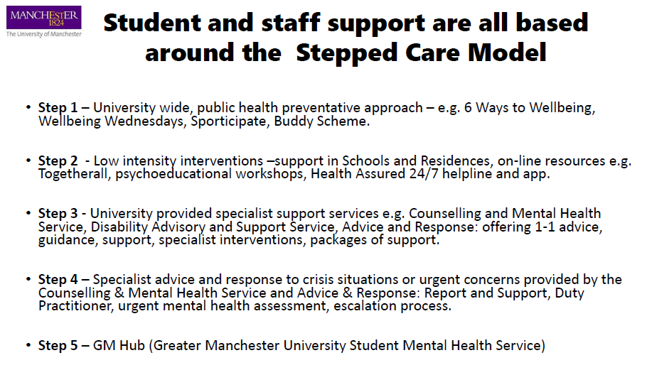

Slide 11
Stepped care at Manchester SU…….
Issues we were facing:
Growing student numbers (in excess of 45,000)
Increasing number of cases
Growing complexity of cases – taking longer
Service falling apart when 1 or 2 staff off
What we wanted to achieve:
Importance of support beyond the Advice Service
Whole Union approach
More time for advisers to do complex cases
Quick fixes for students where possible
Joint approach with University where possible
New approach for most intense times (ie appeal season)

Slide 12
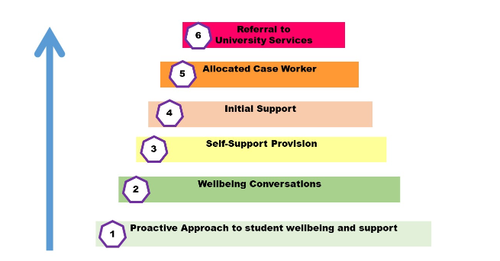
Vision: a holistic, stepped approach to student support and wellbeing
Underpinned by: a holistic view of students; understanding students and their needs; students as active citizens; a whole organisation approach

Slide 13

Better use of data and insight
Preventative campaigns
Wellbeing days
Promotional stalls and events
Lobbying University

Slide 14

Buddy Scheme – trained buddies
Society leaders training through Student Leaders Conference
Staff sessions
First disclosure training
Rep training

Slide 15

Blog posts
Social media posts and links
Website articles
Increasing online links to forms, resources etc
Better search function on website

Slide 16

Triaging
Student staff – low level cases
Student intern
Summer staff – appeals & Freshers prep
Email templates
Other orgs running drop-ins from the SU

Slide 17


Appointment, phone call or email contact from Adviser
Counselling Service
Advice and Response Team
Safeguarding/Crisis Response

Slide 18
Enablers and challenges
Other Enablers:
Some of the challenges:
Insight
Joined up approach to campaigns across the organisation
Partnership with the University
Partnership with other organisations
Budget
Student staff availability
Time to do proactive work
Not a short term fix
Still may have issues outside of control ie staff leaving etc

Slide 19
How might a stepped care approach work for you??
Step 1
Step 2
Step 3
Step 4
Step 5

Slide 20


Thank you
Laura Pike
hello@laurapike.co.uk
Jawanza Ipyana
jripyana@uclan.ac.uk

