Slide 1
Sabbatical Officer Support
Internal and External Support

Slide 2
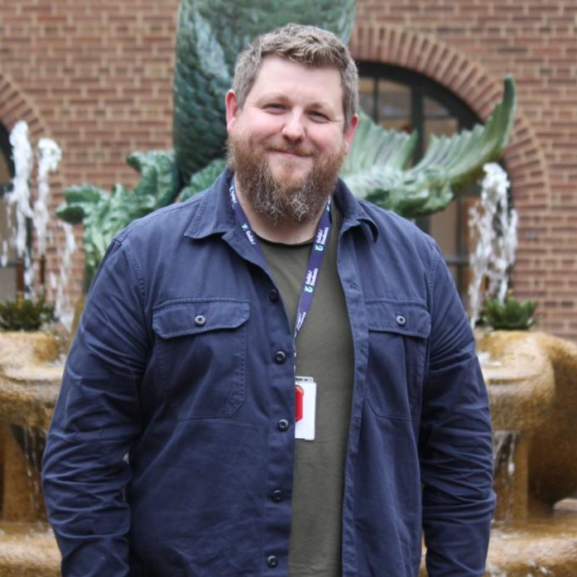

Who are we ?

Slide 3
Activity
Speak to person next to you and discuss how officer support is structured within your SU

Slide 4
Background – Birmingham Guild
Seven Full-Time Officers
  President, Education, Community & Welfare, Activities & Employability, International, Postgraduate, Sports
Support needs from Officers have changed over the past 5 years
  During and Post-Pandemic
  Background/demographic contexts
Expectation from all is for a fast start, high level discussions and impactful actions

Slide 5
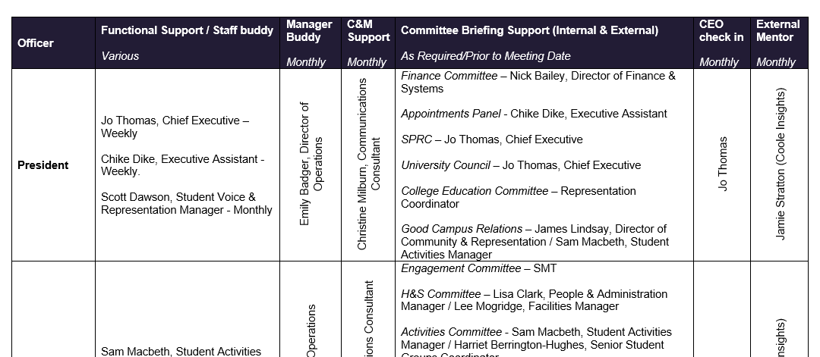
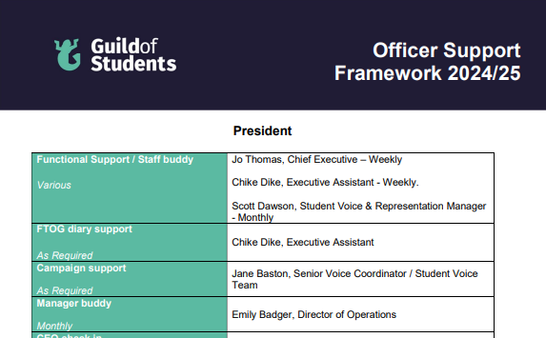
Framework

Slide 6
Why has this been introduced ?
Clarity on the support and availability is important
  Often explained at induction, but needs reiterating at various times.
  Challenges often lead to requests for support.
Framework allowed us to understand the blend of support needed, where there were gaps and anticipate challenges more clearly
Blend of internal and external has proved to be more effective.
  Less internal conflict, Officers are prepared for situations and relationship development in general.
  External route for processing challenges, coaching and guidance

Slide 7
What does external support offer ?
Blended offer between both external and internal
Added capacity
Unbiased approach and a fresh perspective
Partnership approach allows for different conversations to take place.
Value of an external 360

Slide 8
What external support isn’t
Not a substitute for internal support
Not just a generic offer – each approach is bespoke for that union
Something that exists in isolation from the rest of the organisation

Slide 9
Activity
In groups of 3-4, think about areas of officer support where you think external support would add value in your SU

Slide 10
Key Milestones
Onboarding and Induction
Term 1
Nasty November
360 Appraisals – February
Post election – Next Steps for officers
Wrap up

Slide 11
Outcomes
Happy and healthy Officer!
Empowered and upskilled Officers.
Better and more productive relationships all round.
Better prepared Officers for challenging situations.
Less internal conflict.

Slide 12
Any questions

