Slide 1

The OIA – overview, update and key casework themes
Barry McHale – Student Liaison Officer
Gemma Slade – Provider Liaison Officer
Membership Services Conference – August 2024

Slide 2
Who we are and what we do…
We run the student complaints Scheme for England and Wales
Compulsory membership
We are independent & free to students/trainees
We are an alternative to the courts
4 Key Priorities…
Review complaints about Higher Education providers
Share learning from complaints
Work with others in the sector
Continually develop our organisation

Slide 3



OIA update

Slide 4
OIA complaints: the big picture
Number of complaints received by the OIA
3,137 complaints received in 2023
3,352 complaints closed in 2023

Slide 5
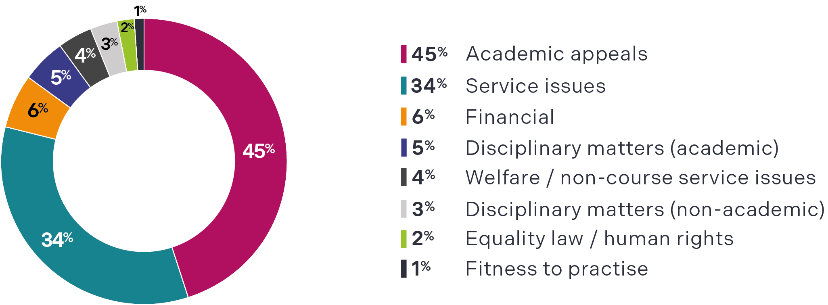
Complaint category
Complaints received by complaint category

Slide 6
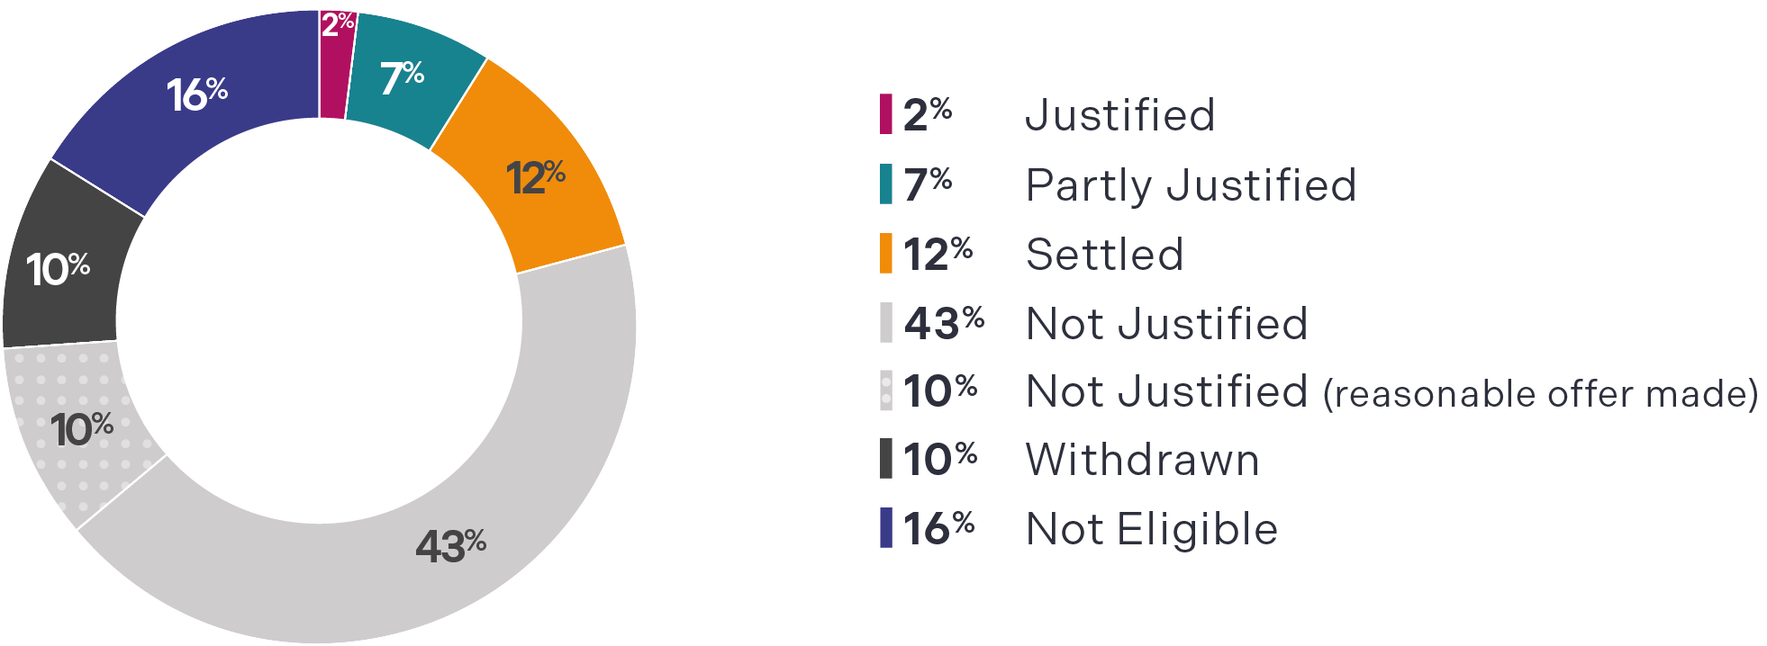

Outcome of complaints
The outcome of complaints
Learn more
https://www.oiahe.org.uk/media/szulhwcg/oia-annual-report-2023.pdf

Slide 7

Our Process

Slide 8
Common complaints
Academic appeals
Extenuating circumstances
Teaching provision and facilities
Disciplinary matters
Academic misconduct
Bullying and harassment
Fitness to practise
Discrimination
Poor student experience
Financial matters

Slide 9
Complaints we can't review...
Admissions
Academic judgment
Student employment
Legal proceedings
Not a member of the scheme
Transitional institutions
12-month deadline
Complaints made by the personal representatives of a student who has died
Learn more
www.oiahe.org.uk/about-us/our-scheme/our-rules

Slide 10
What a student normally needs to do before complaining to us
1. Complete their provider’s internal processes
2. Have a Completion of Procedures Letter.
IMPORTANT: We advise students to complain as soon as possible.
We do not accept complaints when this letter is more than 12 months old.

Slide 11
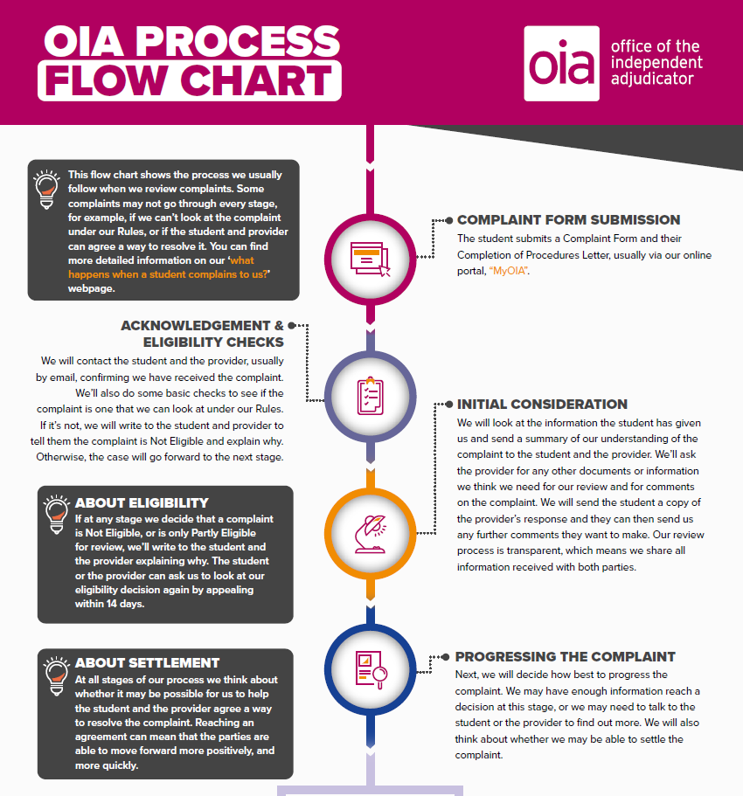
What process do we follow?
Document-based process
Transparent
Parties can comment on each other’s evidence
Providers and the student can track live complaints via MyOIA

Slide 12
Our review
We normally focus on the provider’s final decision
  This should be set out in the Completion of Procedures Letter
We review
  Not a fresh investigation
We decide whether the complaint is Justified, Partly Justified or Not Justified

Slide 13
The questions we ask
Did the provider follow its own procedures?
Were the procedures reasonable?
Was the provider’s final decision reasonable?

Slide 14
Reasons we might decide a complaint is Justified
The provider didn’t follow its procedures, or it acted unfairly
Lack of evidence to show the provider considered relevant information
Delay in the process
Inadequate teaching or facilities
Poor communication or misinformation
Discrimination issues, including disability
  But the OIA does not act like a court or make legal findings of discrimination

Slide 15
Complaint Outcome
We send the student and the provider a Complaint Outcome
  Decision
  Reasons
  Suggestions and Observations
Recommendations to put things right if Justified or Partly Justified
  Annex A
  The student and the provider have the chance to comment on our Recommendations

Slide 16
Putting things right
Student focused: aim to put the student back in the position they were in before whatever they complained about happened
  We can also Recommend other remedies, like financial compensation, if this isn’t possible or doesn’t go far enough
Good Practice: aim to improve policies and practices at the provider
Learn more
www.oiahe.org.uk/about-us/reviewing-complaints/what-happens-when-a-student-complains-to-us/putting-things-right

Slide 17
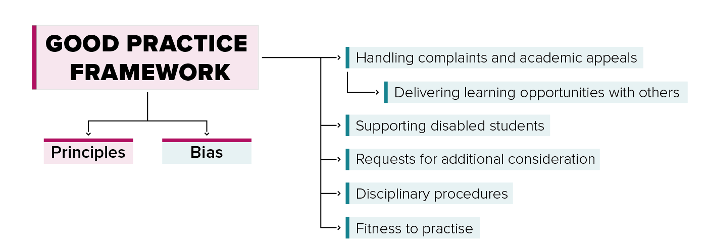
Encouraging good practice
  Casework notes and other guidance
  Casework notes: Postgraduate students; Placements; Academic/Non-academic misconduct; Pregnancy, parenthood and childcare
  Responding to the cost-of-living crisis
Briefing Notes covering:
Strike action
Sexual misconduct and harassment
Course, campus or provider closure

Slide 18


Overcoming hurdles…
Complaining both internally and to the OIA can mean having to overcome various hurdles. In groups we’re going to now explore those hurdles and look at the ways providers, SRBs and the OIA can help students overcome them.

Slide 19
…breaking down barriers…
Reflective Questions:
Identify 3 key barriers to students complaining/appealing
Who controls the barrier?
Who needs most help overcoming those barriers?
Who can help students overcome those barriers?
Discuss in groups – 5 minutes

Slide 20
…and finding solutions
Swap your lists with another group and we want you to propose solutions to the challenges that the other group identified - outlining actionable steps to implement these solutions – be creative!
Discuss in groups – 5 minutes

Slide 21

Some thoughts…
Making students aware, helping them understand procedures
Addressing fears of repercussions or consequences & instill confidence in procedures
Test fairness of procedures
Consider time constraints and a flexible approach
Complaining to the OIA!

Slide 22

Key casework themes

Slide 23
International Students complaints
Highest level yet in 2023
90% from non-EU students
  Political issues/world events
  Personal & Financial investment
  Adjusting to life & study in the UK
  Away from home, family, friends and other sources of support
  Travel, attendance and visas
Specific issues
Service issues – value for money, expectations not met
Academic misconduct
Engagement/attendance/ withdrawal

Slide 24

Disabled students
One third of OIA complainants identified as disabled in 2023
Three types of complaint:
  Issues affecting any students
  Issues that have greater impact on disabled students
  Issues affecting only disabled students
Changes to course provision; communications; access to support and reasonable adjustments.

Slide 25

Academic Appeals
Largest category of complaints to the OIA
Barriers to complaining
Evidence
Flexibility

Slide 26

The OIA & Student Representative Bodies
Raise awareness of the Scheme
Providers and SRBs exchange learning gained from complaints.
Working with providers to improve regulations and procedures
Collect and represent the views of the student body
Representing students!

Slide 27


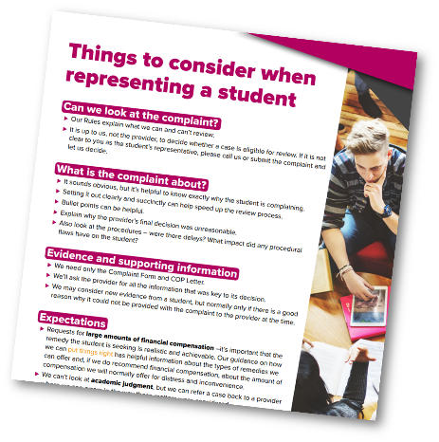
SRB Toolkit
https://www.oiahe.org.uk/student-advisers/toolkit-for-student-representative-bodies/

Slide 28

Any Questions?

Slide 29
How to contact us

Slide 30
OIA – Useful Resources
oiahe.org.uk/good-practice-framework
Good Practice Framework
oiahe.org.uk/resources-and-publications/learning-from-our-casework
Briefing and casework notes
oiahe.org.uk/case-summaries
Case summaries with keyword search
oiahe.org.uk/srb-toolkit
Toolkit of resources for Students’ Unions/Guilds/Associations
oiahe.org.uk/annualreport2023
Annual Report 2023

