Slide 1
Is your institution preventing sexual
violence or just responding to it?
MSC’24

Slide 2




Hello! I’m Farrah
She/They
Enough is Enough Project Coordinator
Qualified Sexual Violence Liasion Officer (SVLO)
Active Bystander → Gender Equality Officer → 2nd Woman RSU President
S.H.A.G Week, Period Poverty, improving lighting on campus
Consultancy TBC
Fun Fact…
Notes:
Hello, I’m Farrah
My pronouns are She/They
I’ve worked at SOAS Students Union for just over a year as their Enough is Enough Project Coordinator
I lead on their Sexual Gender Based Violence Project
I am also a qualified Sexual Violence Liasion Officer thanks to Lime Culture
As a student I went from joining the Bystander project, to becoming the Gender Equality Officer, to becoming the 2nd ever female president at the RSU, there had been no female sabbs in the time I had been at roehampton. Most of my manifesto project were gender equality related, including running a SHAG Week, starting a Period Poverty campaign and getting Grace & Green period products put in toilets in the library, and improving lighting on campus
I am also branching into my own consultancy service- will be plugging shamelessly at the end
Fun fact: I am profoundly deaf in this ear, so I have a mute symbol tattooed behind it

Slide 3
Before we begin…
Content warning
Clarification of terms
  SGBV
  Reporting student
  Reported student
  Sexual Violence
Sexual Gender Based Violence
Student who has reported experiencing sexual violence
Who a report of sexual violence has been made about
Umbrella term for behaviour that is both violating and of a sexual nature
Notes:
There are going to be conversations around sexual violence including rape throughout, so please take care of yourselves and if you feel that for any reason you’d be better off leaving then please feel free and know that I won’t be offended or upset.
Also I’ll be happy to take any questions at the end, but if in the moment you are especially confused and want me to clarify something as I go please feel free to ask
I’ll just take a second now to clarify the terms I’m using: I tend to say sexual gender based violence or just sexual violence, but if ever I acronym it as SGBV anywhere- this is what I’m referring to
Where I will refer to someone as the reporting student or sometimes the survivor, I am talking about the person who have experienced sexual violence. When I refer to the reported student I am referring to a student someone has accused of sexual violence, such as a student who under investigation.
And sexual violence is an umbrella term encompassing harassment, assault, rape etc- not just rape or physical assault

Slide 4
Student Scenario
Halls- They need a standard practice in place that is specific to their accommodation
No support for the reporting student- At no point did anyone ask what support they needed
No support for the reported student- Reported students also deserve support
Disciplinary hearings- Sabb’s can come in having absorbed all kinds of victim blaming beliefs
The outcome- Does not consider the reporting student. No part of this process has.
Notes:
At the risk of being potentially a bit overdone within SU spaces, let me take you through a classic student scenario:
A student is raped. They tell the university, who opens an investigation. The reported student lives in the same halls as the reporting student, where the incident took place. They are temporarily suspended, but halls don’t have the room or provisions to re-locate either of them. The reported student also works in the student shop on campus, who are not informed of their suspension so they keep coming to campus to work. The reporting students constantly fear running into them in halls or on campus near the shop, so they stop coming to university all together causing their attendance to drop and for them to fall behind in class.
Finally, the disciplinary hearing arrives which is attended by multiple members of staff the reporting student does not know or trust, and the newly elected student union president. During the hearing, the student president questions the reporting student's account of the incident, asking if they had been drinking when it happened, whether they had a relationship with the reported student, and why they haven’t reported this to the police.
The student leaves the disciplinary hearing feeling that they weren’t believed, and starts wondering if they perhaps should’ve reported their incident to the police after all. However, they soon realise that it’s now too late for them to collect any forensic evidence as they hadn’t even considered this as an option within 72hrs of the incident happening. Without that they fear it is only their word against their rapists, and after leaving the hearing not feeling like they were believed by their university, they don’t see any point in reporting to the police.
The student reaches out over a week later to find out what the outcome was, to find out the reported student will be suspended and held back from university for one year. The reporting student is in their first year, meaning their rapist will be back on campus by their final year. They are also asked to sign an NDA now that their case has been closed. After their whole experience of the disciplinary process they no longer trust the university to keep them safe, and decide to move to a new university and start again there.
Problems:
Halls- whole host of problems, specific to different universities, but they need policy in place to know what the standard practice is. If they have no room in halls to move anyone too, the reporting student is forced not only to live where they could see the reported student regularly but potentially in the space where the incident took place.
No support to the reporting student- at no point has anyone asked the reporting student what kind of support they would like, or signposted them to any internal or external services. No one has referred them to even the universities own wellbeing department.
No support for the reported student. Reported students do also deserve support, regardless of if they’re innocent or not, being reported is distressing. In this incident, had they been forced to move out of halls they would be homeless- if they are an international student, they’ll be less likely to have anywhere else to go and could affect their visa if they don’t have a permanent address. If they hadn’t been able to go to work, they would also lose a source of income they could be relying on. None of this is to say what they go through is comparable to the reporting student, but especially when a disciplinary hearing hasn’t yet taken place they do deserve support from the university
Disciplinary hearings- how prepared are the staff attending them on handling matters of sexual misconduct with a trauma informed approach. A sabb is, whilst an elected student rep, still just a 20-odd year all who has absorbed any number of victim blaming myths that could’ve gone unchecked before this point
The outcome- the outcome does not consider the reporting student. In fact, no part of this process has the reporting student’s needs at the heart of it. They had to take every step, even down to having to reach out to know the outcome. Even if they wanted access to support, they would have to find out that information themselves.

Slide 5
“We take sexual misconduct extremely seriously…”
Preventing
Reporting
Supporting
Responding
Notes:
Not too sound too cynical, but everyone is familiar with a university saying this- typically within a statement following a highly publicised incident either sent around to all students and/or publicised within media articles that make the university look really bad.
But how seriously can they be taking sexual misconduct, if they are doing little to nothing to prevent them from happening?
If you only take sexual violence seriously at disciplinary panels, you are only only responding to sexual violence as and when that happen. That means you are treating sexual violence as if it is an inevitability, and it is not.
Providing students the tools and the paths to report incidences and to access support is vital. But in order to truly tackle sexual violence, you have to prioritise prevention.
Otherwise, you are only reacting after the violence has occured. And this puts an unfair burden onto the survivors of sexual violence, who are disproportinately thse who are already marginalised in society and within your institution.
Look at the student case scenario- the survivor had to initiate every step of that process, as far as having to call up themselves to know the outcome- even the reported student did less work. Whilst also struggling feeling unsafe in their accommodation, not being able to make it into class and falling behind on their course, likely struggling with their mental health because understandably they’ve just experienced something traumatic.
And then they hear the institution they dreamed and worked hard to attended, who they’re doing to be financially in debt to for the majority of their adult life, who didn’t have anything in place to prevent their rape, and then did the bare minimum to offer them support afterwards, who’s student union president they likely voted for and who’s supposed to represent them made them feel they weren’t believed, claim to “take sexual misconduct extremely seriously”.
And that’s not the worst case scenario, that is what has been the given so far. At least at this university, the reporting student didn’t have to face the reported student at the disciplinary hearing. At least the reported student did face some consequence for their actions, even if it probably didn’t feel like enough to the survivor. At least they weren’t asked to sign an NDA.
This isn’t the worst case scenario, until recently this has been the given. We have a through disciplinary process, we have a wellbeing service. What more could students need?

Slide 6
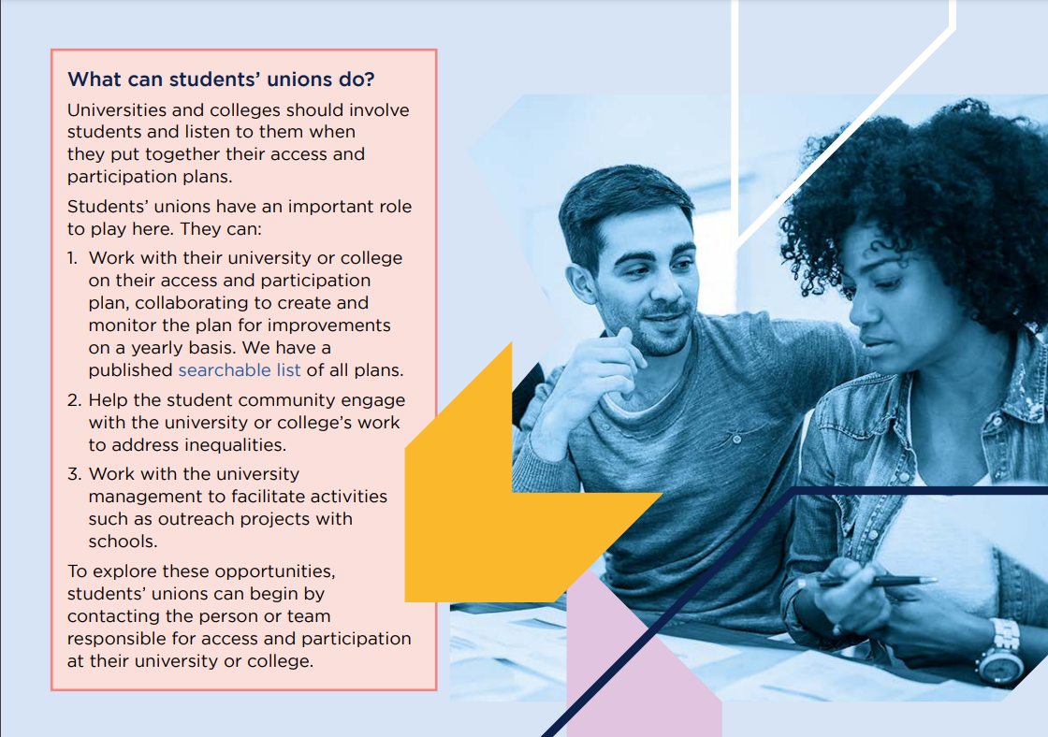
The Ofs Condition of Registration
NDA’s banned from September 1st 2024
CoR comes into force 1st August 2025
Universities still don’t have the same burden of proof that courts do- which is good
Start bugging your university about this from today!
Notes:
Well, it’s not just me saying this anymore because the OfS agrees and while I was preparing this talk they finally confirmed that their condition of registration on sexual violence will come into effect from August 1st 2025.
So by the next Membership Services Conference, all of your institutions will need to very familiar with this. I’ve noticed this year that there’s more talks than ever focused on sexual violence which is amazing, and this is likely the reason why.
It states on their website that they expect universities to be working towards meeting these expectations from today, including working with students to update their policies.
From September 1st this year, NDA’s will be banned where they cover allegations of harassment or sexual misconduct which is fantastic news, it means we’re finally putting student safety ahead of university reputations which is great. It means we can work towards having a better understanding of what the problem really looks like because none of it will be hidden away.
The Ofs have clarified that although the definitions of what is harassment and sexual misconduct are borrowed from the Equality Act and Protection from Harassment Act, that doesn’t mean they require universities to use the same criminal standard of proof within their own investigations- which is something I’ll come back to later in terms of supporting reported students
I’m not going to go through the entire statement because you can or probably have already read it for yourselves, and also frankly I’m expecting you’re going to be sick of hearing about it by tomorrow. But this is just your routine reminder to get very familiar with all this because it’s happening now and if you’re institutions didn’t just care about keeping students safe from sexual violence out good moral sense, they now acutally have to to not get in trouble

Slide 7
What can preventing look like?
Notes:
I’m going to go through three examples of what prevention can look like going from lowest to highest amount of resource- by which I primarily mean money because that is what is almost always comes down to, but I will be highlighting where actually maybe it won't cost a lot but it can take a lot of time and energy you know your team simply does not have.
That is of course a weigh up on you can really make within your own institutions, but just see this as a rough guide from someone who has experience doing all of these.

Slide 8
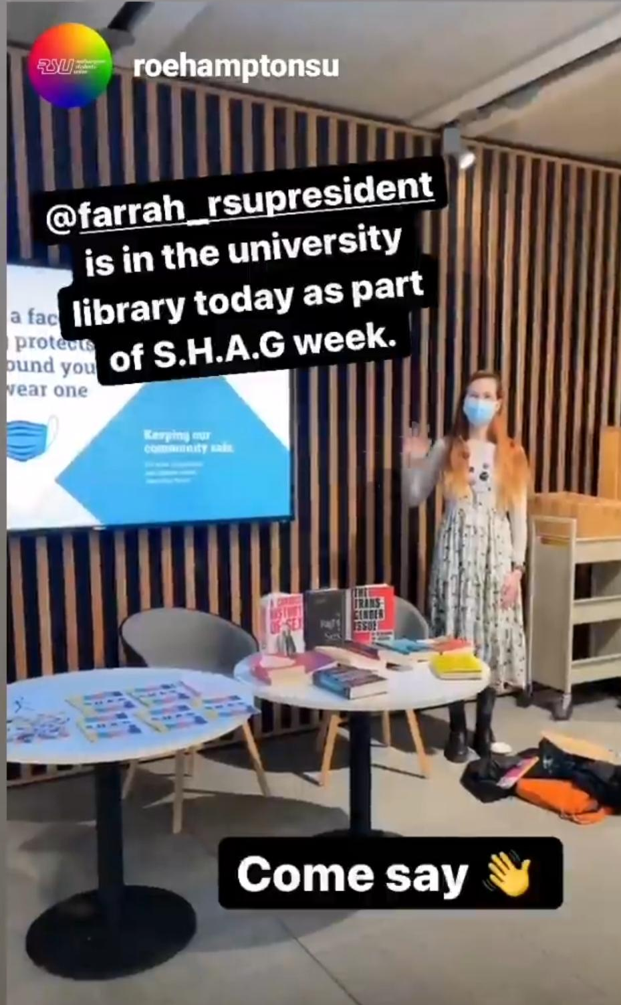
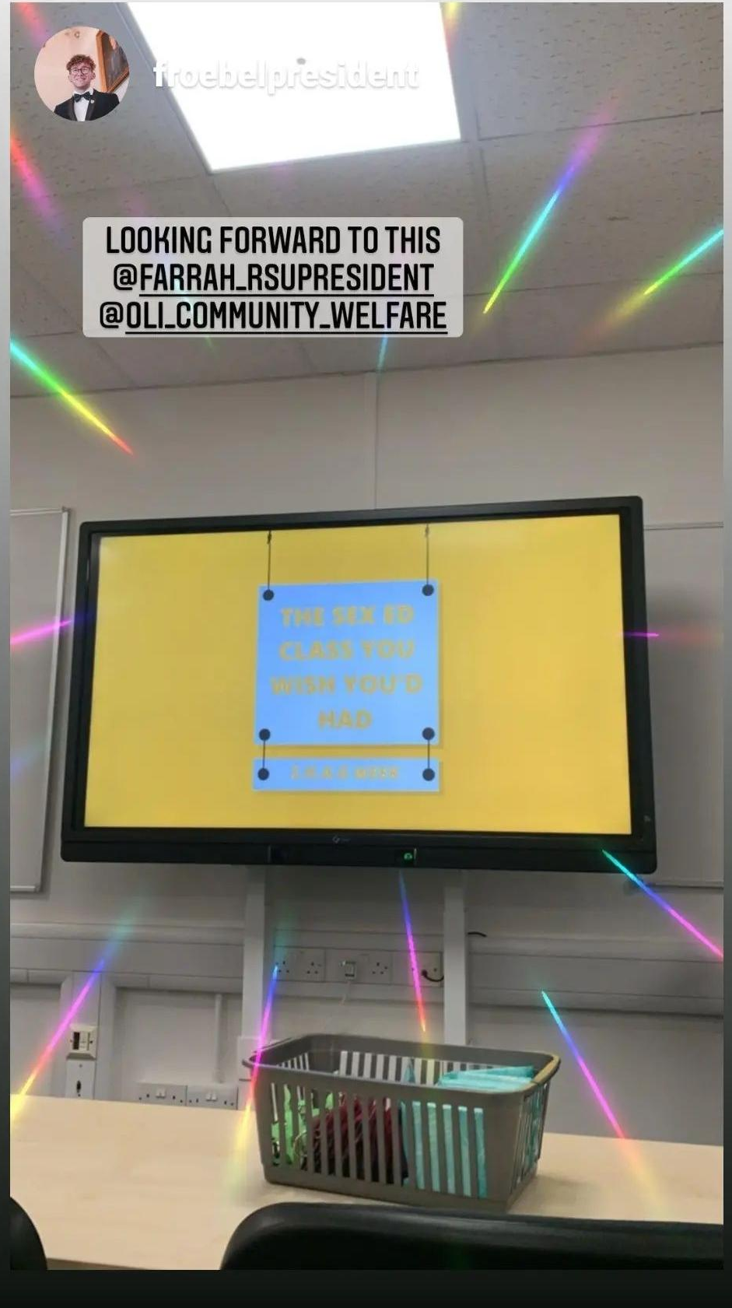
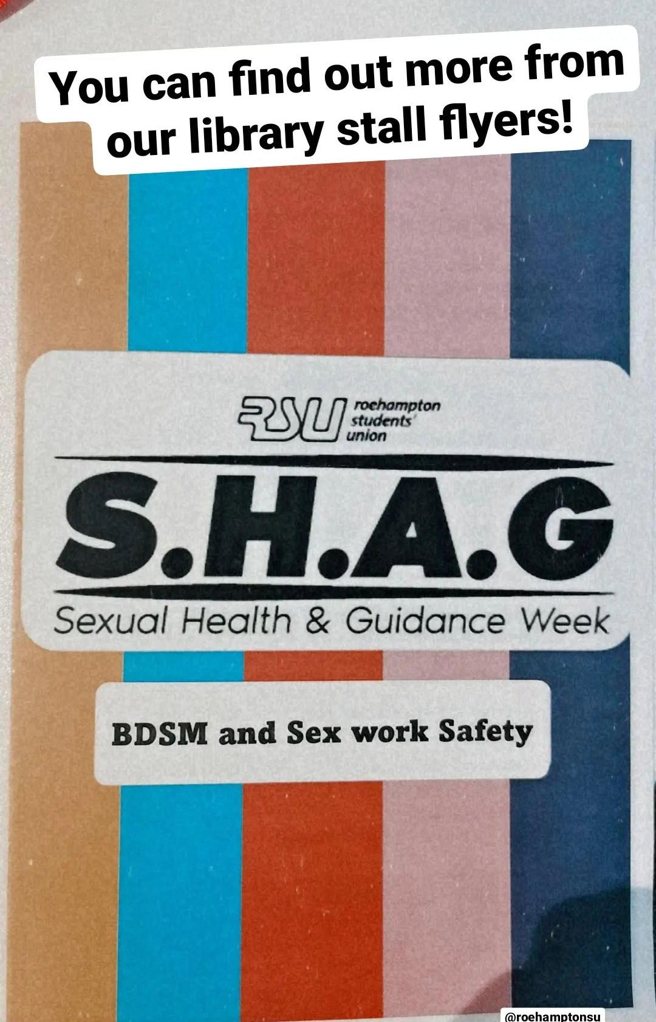
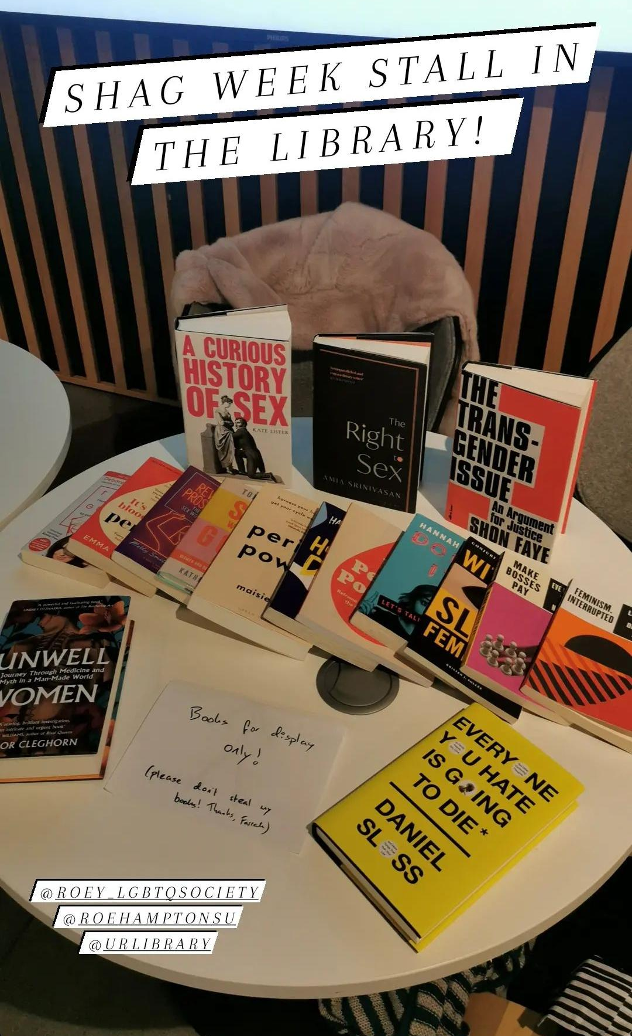
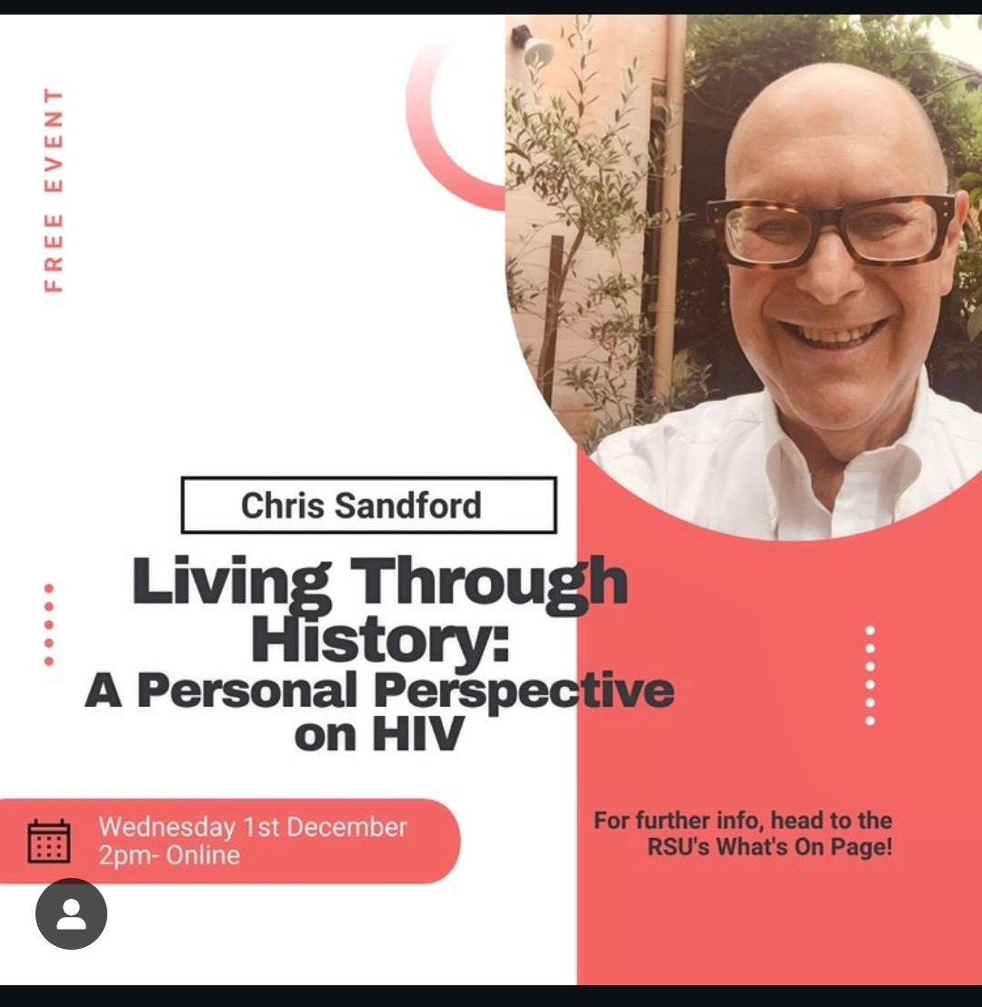
S.H.A.G Week Campaign
Sexual Health Advice & Guidance
Cover multiple topics in one campaign
  Sex education, consent, AIDs Awareness, sexuality, sex work safety, BDSM/kink safety
  Pregnancy, Reproductive health, Periods, Healthy relationships, Masculinity, Ally workshops, spiking
Notes:
I absolutely love S.H.A.G Weeks- SHAG stands for Sexual Health Advice and Guidance. Every SU in the country and maybe the world over is familiar with a week-long campaign project, and SHAG week’s provide an opportunity to cover many related topics in a really fun and light-hearted way.
Myself and my former VP Oli organised an incredibly last minute one while we were sabbs, and we gave each day a different topic theme and were able to arrange a talk or event relating to that theme for each day.
The topics we chose were: Sex Education, Consent, AIDs Awareness, Sex and Sexuality, Staying Safe in Sex Work and BDSM.
It gave us the avenue to get students and staff talking about really taboo but important topics, without having to make a campaign about just that one topic. Maybe we could’ve run a week long campaign about staying safe whilst experimenting with kink and BDSM, but I don’t think it wouldn’t been as engaging are appealed to the widest student population.
Covering a combination of topics also allowed us to balance the heavy darker topics with ones that could be more fun and silly, which against helped to engage more students but also kept the week enjoyable for everyone involved. It’s notable none of our chosen themes was straight-up sexual violence, becasue we managed to find a way to weave it into each topic across the week. It made the topic less daunting and less of an inviting workshop to attend, by sprinkling it within a each day.
Realistically, only people like me are going to attend a talk or a workshop that is solely about sexual violence prevention- most students who have a million other activities competing for their attention won’t, but they’ll maybe come to a workshop called “The Sex Ed Class you wish you’d had” which is one I ran on the first day of our campaign, because they wish they’d received better sexual health education at their school. And maybe a portion of that where they talked briefly about sexual violence, gets them interested in coming to the next workshop on consent, and so on…
Other topics or themes you could cover could include:
Pregnancy: knowing your contraception options and accessing an abortion, trying to conceive whilst studying, managing pregnancy whilst at uni, complications and trauma around pregnancy and birth.
Reproductive health: Menopause at uni for your mature and post-grad students, awareness for students with PCOS, endometriosis etc
Periods: full stop (haha)
Healthy relationships- romantic, sexual, friendships, etc
Masculinity: toxic/positive, could even link it to sports and ‘locker room banter’
Ally Workshops: navigating the patriarchy, being anti-racist in an interracial relationship, how to be a supportive friend for someone transitioning, how to be there for someone who’s experienced sexual violence
Spiking: If you have a first aid society you could include them on spotting the signs of having been spiked and how to prevent and respond to it.

Slide 9
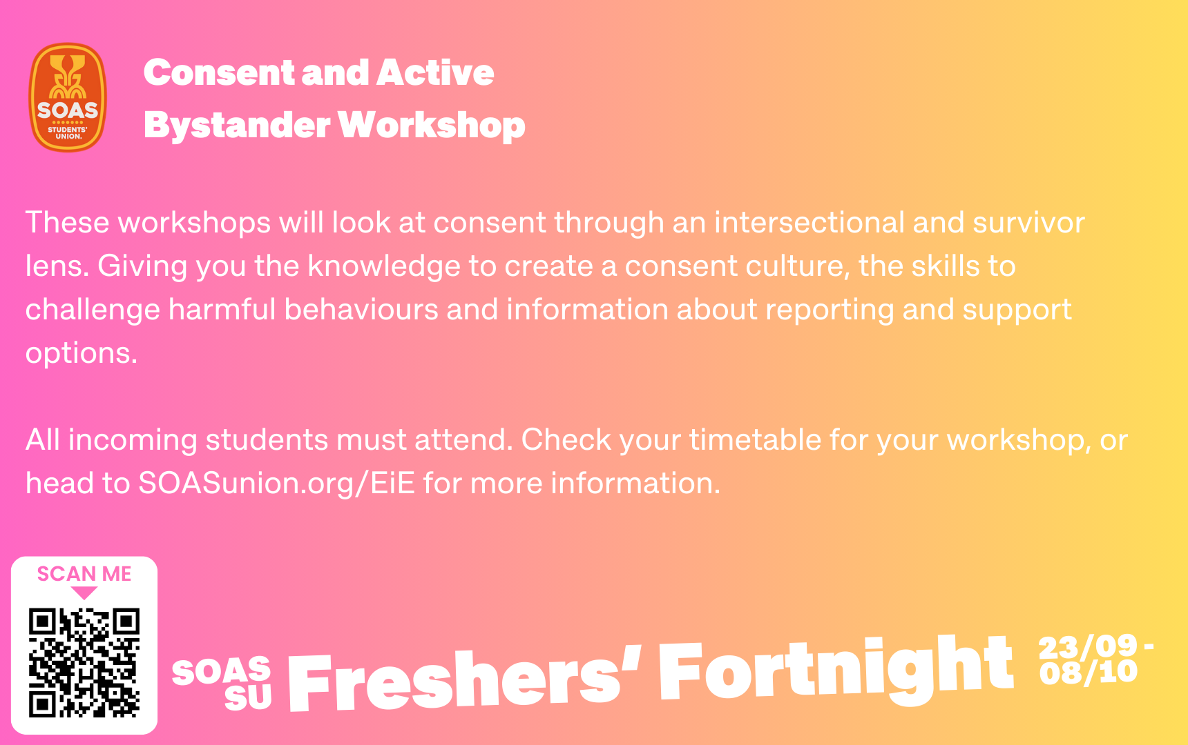
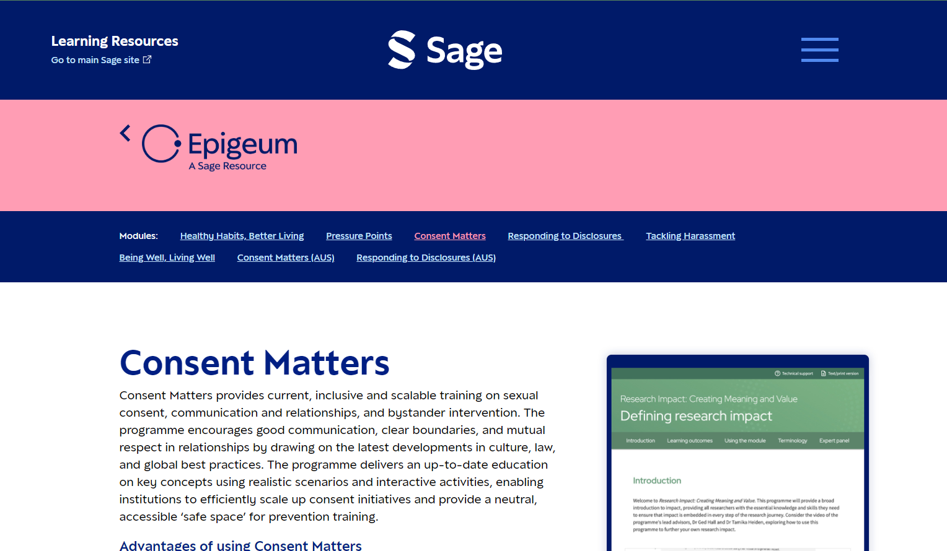
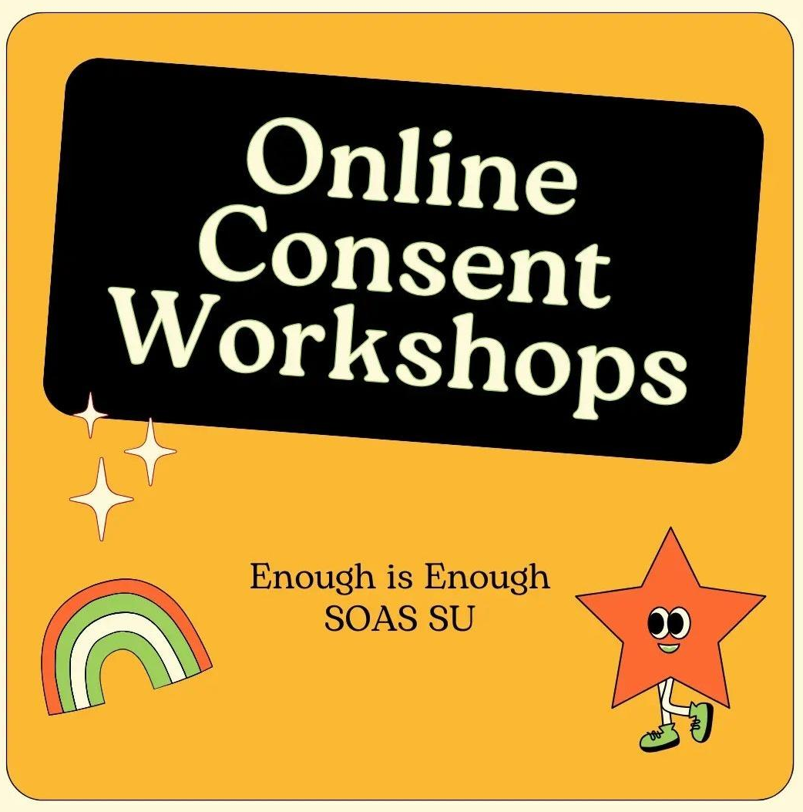
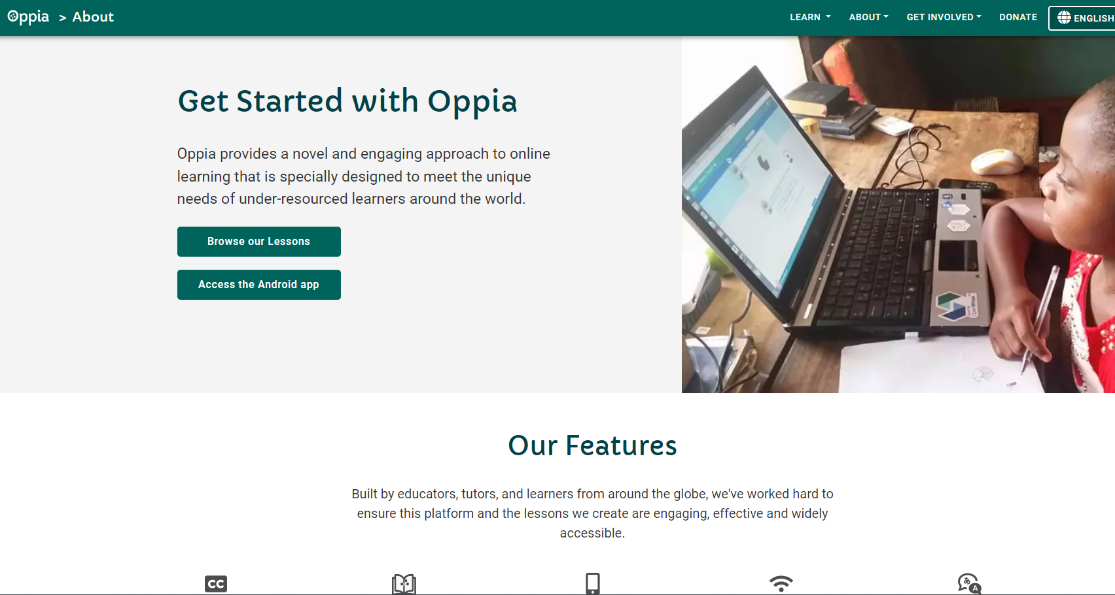
Consent Workshops
Ideally in-person and peer led, but this is resource heavy
Online click-through is better than nothing
  Can work well as part of staff induction training
Notes:
Another very popular option has been to provide consent workshops, ideally mandatory.
This is the largest part of what the Enough is Enough Project does at SOAS. We run the workshops in three phases across Term 1, so phase 1 is five workshops a day between Monday to Friday for welcome week and the first week of teaching. Phase 2 is three more workshops on Wednesday afternoons for three weeks, and then phase 4 is we have a slightly adapted workshop that have less participation and involvement so it is more like a lecture and hold three of them in one afternoon in our largest lecture theatre.
This upcoming academic year we’re also trying something new: last year our workshops ran for around an hour and a half to two hours, which based on student feedback was too long. So this year I had planned to revamp the workshop material anyway because it was a little outdated, so I’ve recently finished refining the core consent workshop down to an hour and covering just the most important basics for students to go forth and be respectful to one another. Then the more expansive, academic elements of it we’ll be offering as optional follow-up workshops throughout Term 1.
The hope that this makes the mandatory element more accessible to the students who might otherwise be quiet disengaged or resistant, who are the students we need to target the most. Whilst still offering the opportunity to learn more to students who are interested, and being able to maintain that engagement beyond welcome week. I haven’t made the optional workshops yet so they’re not set in stone, but currently the planned topics are around: how attitudes around consent have and continue to evolve, queer consent and relationships, transformative justice, etc.
Another option is to have workshops that are online and you can just click through, there are a few different providers out there whole offer this training, such as Epigeum’s Consent Matters when I was at the University of Roehampton they had this. Or you can make your own, there are also several platforms that give you the option to do this. My former VP Oli did this as well at Roehampton using a site called Oppia, and I’ve recently made a similar thing with SOAS universities HR team to be included within staff induction training on what the EiE project is, identifying rape culture, being an active bystander and how to handle disclosures.
In my personal opinion, it’s definitely better than nothing but it’s not preferable to having in-person workshops because these provide so much much involvement and discussion from students, they give students the opportunity to ask questions- all well understood teaching pedagogy stuff within an academic institution?
However, in-person workshops are definitely more cost and resource heavy- at SOAS our workshops are peer-delivered by our Welfare Contact student staff members (more on them later) so all-in-all this does require recruiting the facilitators, planning out the schedule, booking the spaces, fighting with timetabling and university comm’s to help new students even know this is happening, training the facilitators when they may not even be in the country until the first workshops are starting- before the workshops have even begun, and without even thinking about the workshop material.
So, if online click-through workshops are the only realistic option, then even though they are less engaging and plenty of students will just click through without reading or somehow find ways around it even if it’s embedded within the enrolment system, as I said it is better than nothing. I just urge you to not settle for it as a tick-box exercise, but to keep working towards more through and involved learning environments.

Slide 10
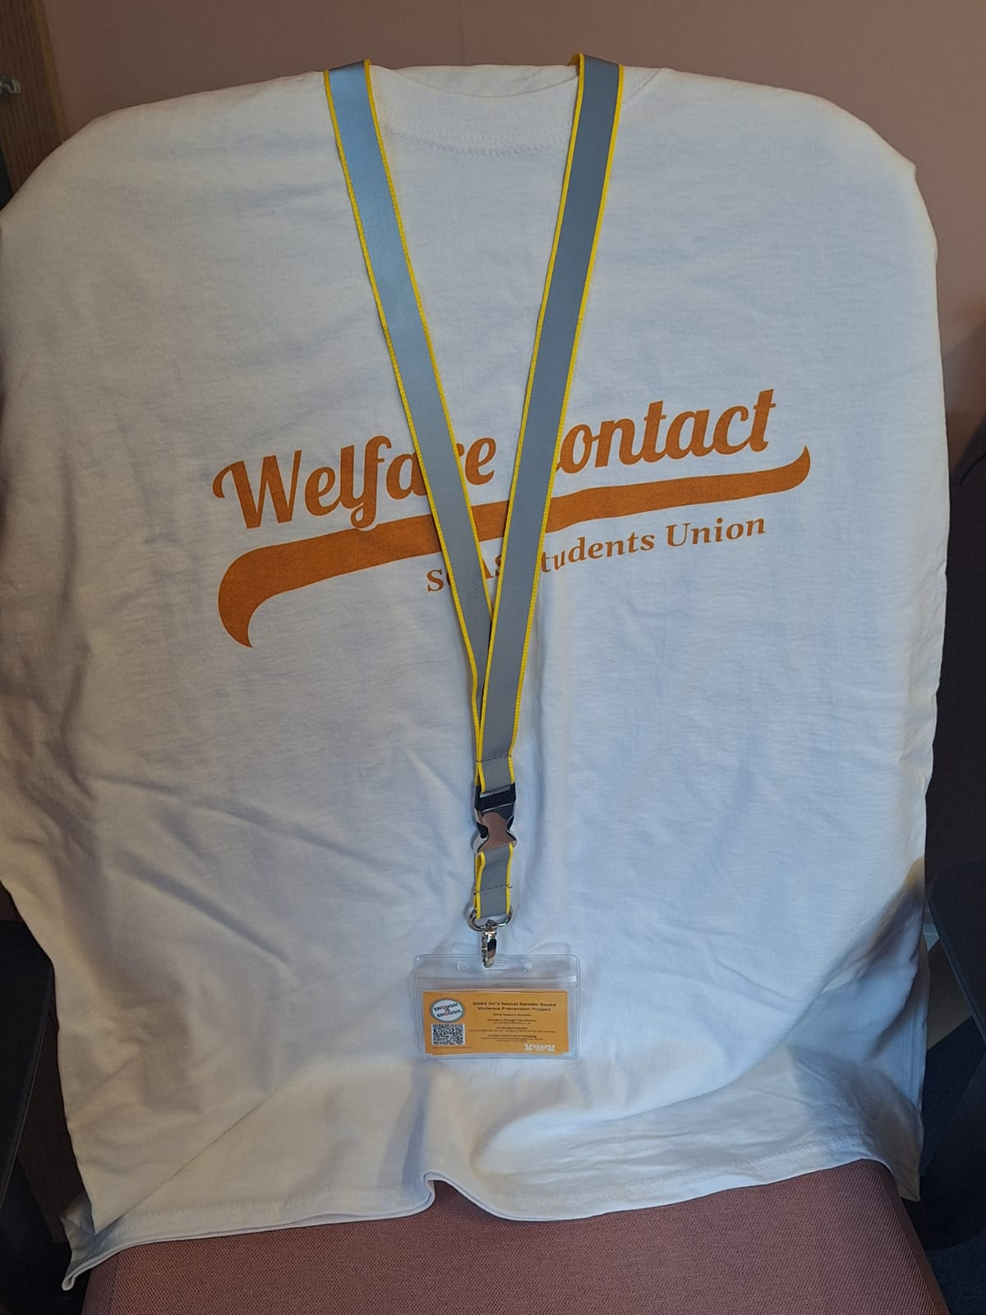
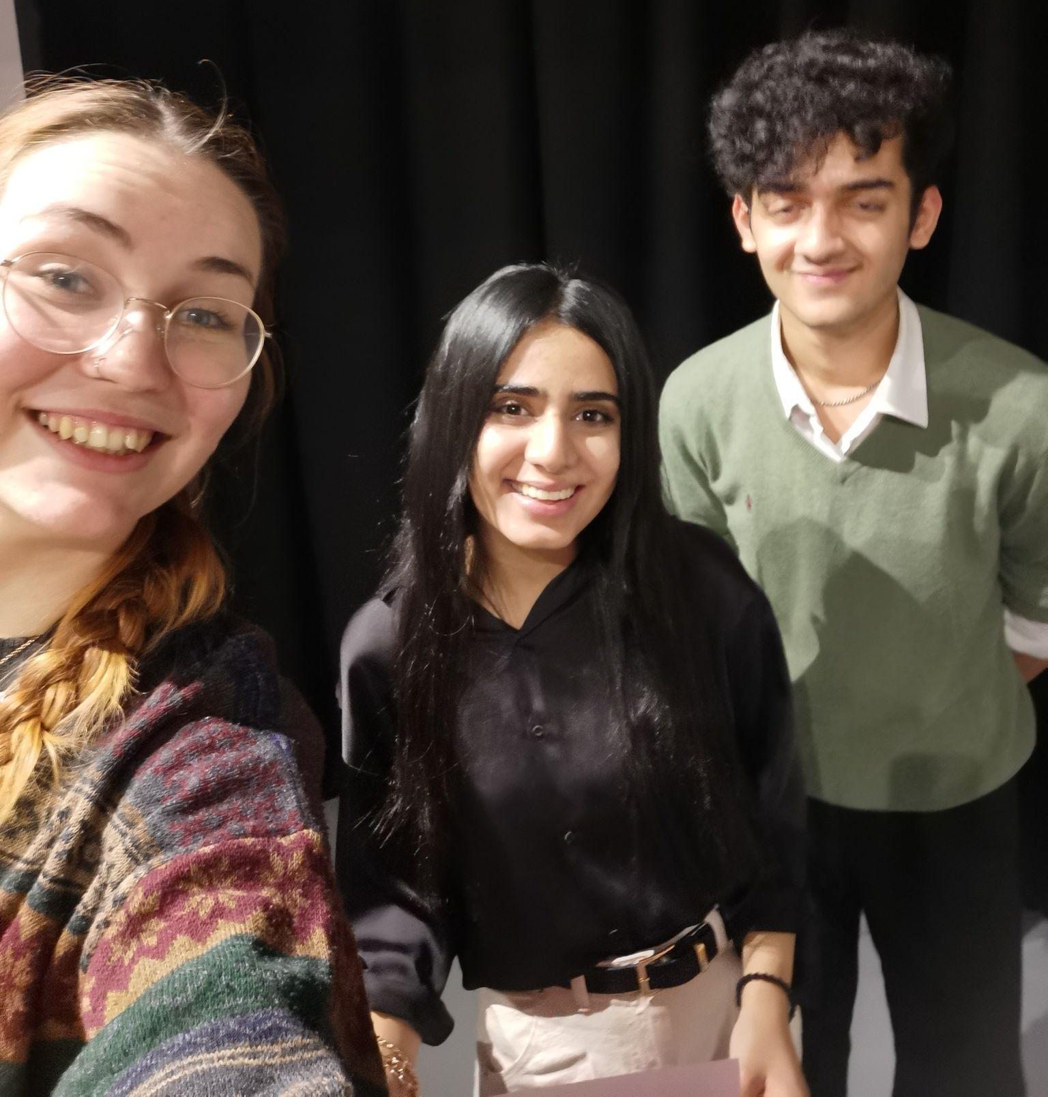
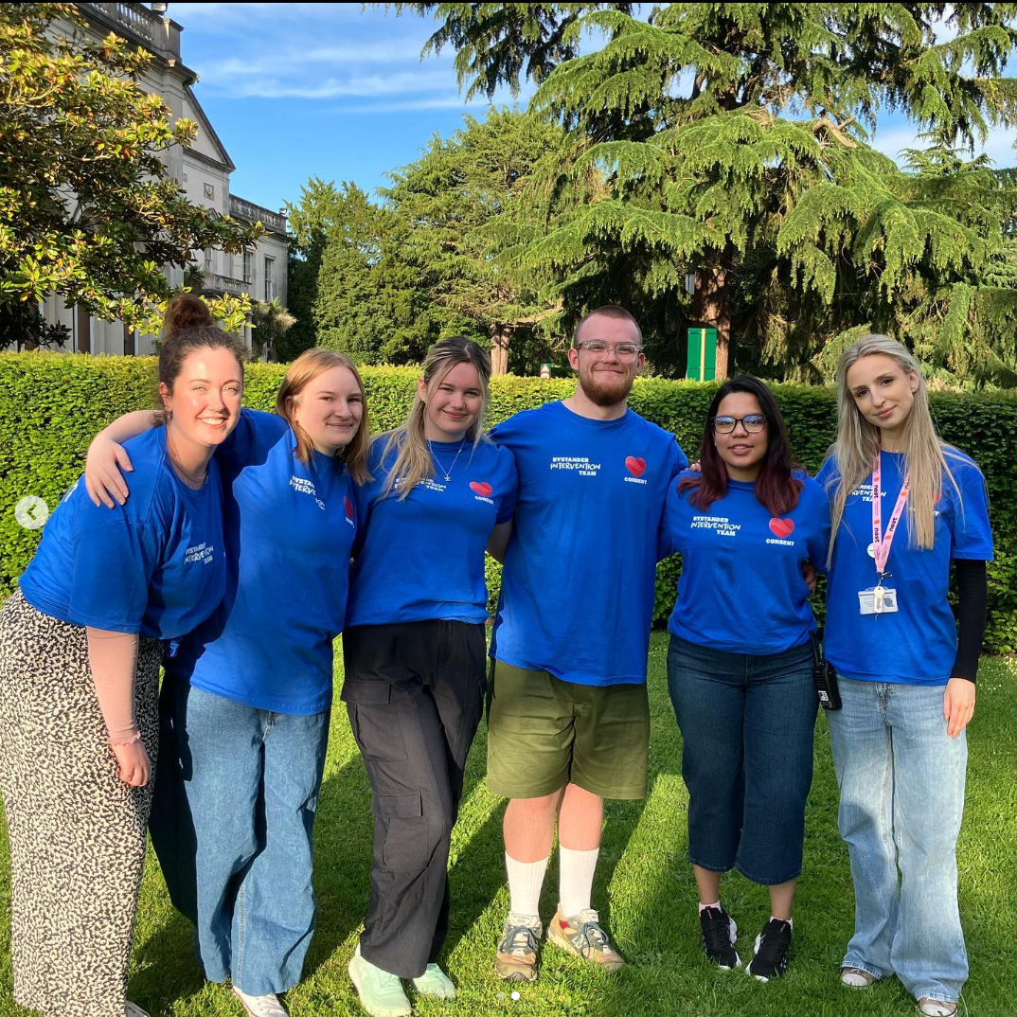
Bystander Intervention Programme
Cover late night events looking out for students wellbeing + promoting a culture of consent
Like the designated driver without the car
Can have repeat issues with agency security who don’t understand their role
Notes:
So I mentioned SOAS SU’s Welfare Contacts, they are my personal minions that we recruit to support the work of the Enough is Enough project. The primary thing they do is deliver the workshops, however also act as active bystanders during our late night events.
I did something very similar as a student at Roehampton, which still exists their today although it is facilitated through the universities Wellbeing team rather than the SU- funnily enough, by my former VP Oli who’s now doing essentially the same role as me!
During these event, their role is to be visible- ours wear a logo’d t-shirt and a high-vis lanyard- and to be there looking out for any problematic behaviour, and to intervene to ensure students are having a safe night out. They also support students who’ve had too much to drink or are very distressed, and just ensure they they are in a safe enough condition to get home okay.
At Roehampton this was a little easier in that it’s a campus university so if the student lived in halls we could literally walk the student home all the way to their bedroom door and leave an empty bin by the side of their bed just in case- I once helped two students inflate an air mattress because one of them was actually a students friend from home who’d come to visit and needed to sleep on her friends floor
Similar to the workshops, this is definitely more cost and resource heavy in that you have to recruit and train the team, and then you’re also paying them for typically around 6-7 hrs of work for however many late night events you need to cover- at SOAS it’s rough around 1 every month and a half, at Roehampton while I was there it was three a week which was in hindsight absolutely insane.
You also need a supervising body, so someone like myself or Oli, because there is the potential of quite serious instances happening that it is safer to have a more experienced body there to step in and take over if needed. For myself at SOAS, I don’t get paid extra when I cover a late night event but I do claim the hours back typically the following workday as TOIL- but that still means having to account for my workload if realistically I have to miss a full workday every month.
At Roehampton with the sheer number of party animal behaviour, our supervisor Vilde simply couldn’t be there every night so instead trained a section of us to be supervisors and one of us would be an acting supervisor on each shift- which we did get paid extra per hour for, so there was still an additional cost. Another factor, and again this heavily depends on your university, but at SOAS we also cover all the Welfare Contacts and myself’s taxi home because the shifts end at around 2am so for safety and peace of mind, it is a factor I highly recommend considering it.
A constant hurdle I experienced at both places is that often at late night events, the events team higher external agency security and they just do not get what this role is, and they can be at best confused and a bit dismissive and at worst territorial and rude. I wish I could recommend to you which agencies I have found good to work with, but frankly there was only one in my five years at Roehampton and I cannot for the life of me remember who they were and when that was.
It’s something that if you do plan to go ahead with this, which if you can I do strongly recommend it is so valued and appreciated by students, it could literally save a students life as well as make so many students worst days at university significantly less traumatic than without. But, you do have to work very closely with whoever your events or commercial teams are and be sure that they fully back the project because it can be challenging to do when there is a disconnect there- especially when it comes to having to communicate to new security members at every event, that the students aren’t trying to do their jobs for them.

Slide 11

Bonus
Clear and constant signposting! If information easily available to students? Students in distress?
Engage with student-facing staff- do they know how to handle disclosures sensitively? Do you?
Please share anything you have or heard about that I’ve not mentioned!
Notes:
Bonus extra things I wanted to throw in:
Clear and constant signposting! How’s your website looking? Is there any information on what services are available both at university and in the local community? How easy is it to find- think from the perspective of someone who’s incredibly distressed and needs to find clear information easily and quickly. Do your students know where their nearest SARC is? Do they know they can collect evidence following a rape without having to report it to the police, and that it can be stored their for around two years- so they can hold off reporting it until they’re more ready, or potentially until they’ve finished their exams. Do your students know they have to collect this evidence within 72 hrs of the attack?
I mentioned it briefly but engaging university staff- get staff aware of rape culture, and knowing they need to intervene and call it out when students say problematic things in class or are treating other students- especially those of marginalised genders and races- with disrespect. And make sure they know how to handle a disclosure effectively, otherwise they could say something or start questioning a student in such a way that they don’t feel believed, and they won’t seek out the support they need.
Implement this for university staff, for the sake of the students you represent. And implement this within your own SU- you’re all staff members, how much do you know about this? How would you react if a student told you they were raped? Do you know where the nearest SARC is?
Does anyone have any preventative measures at their institution they’d like to share? Any I’ve not mentioned here?

Slide 12
What can reporting look like?

Slide 13
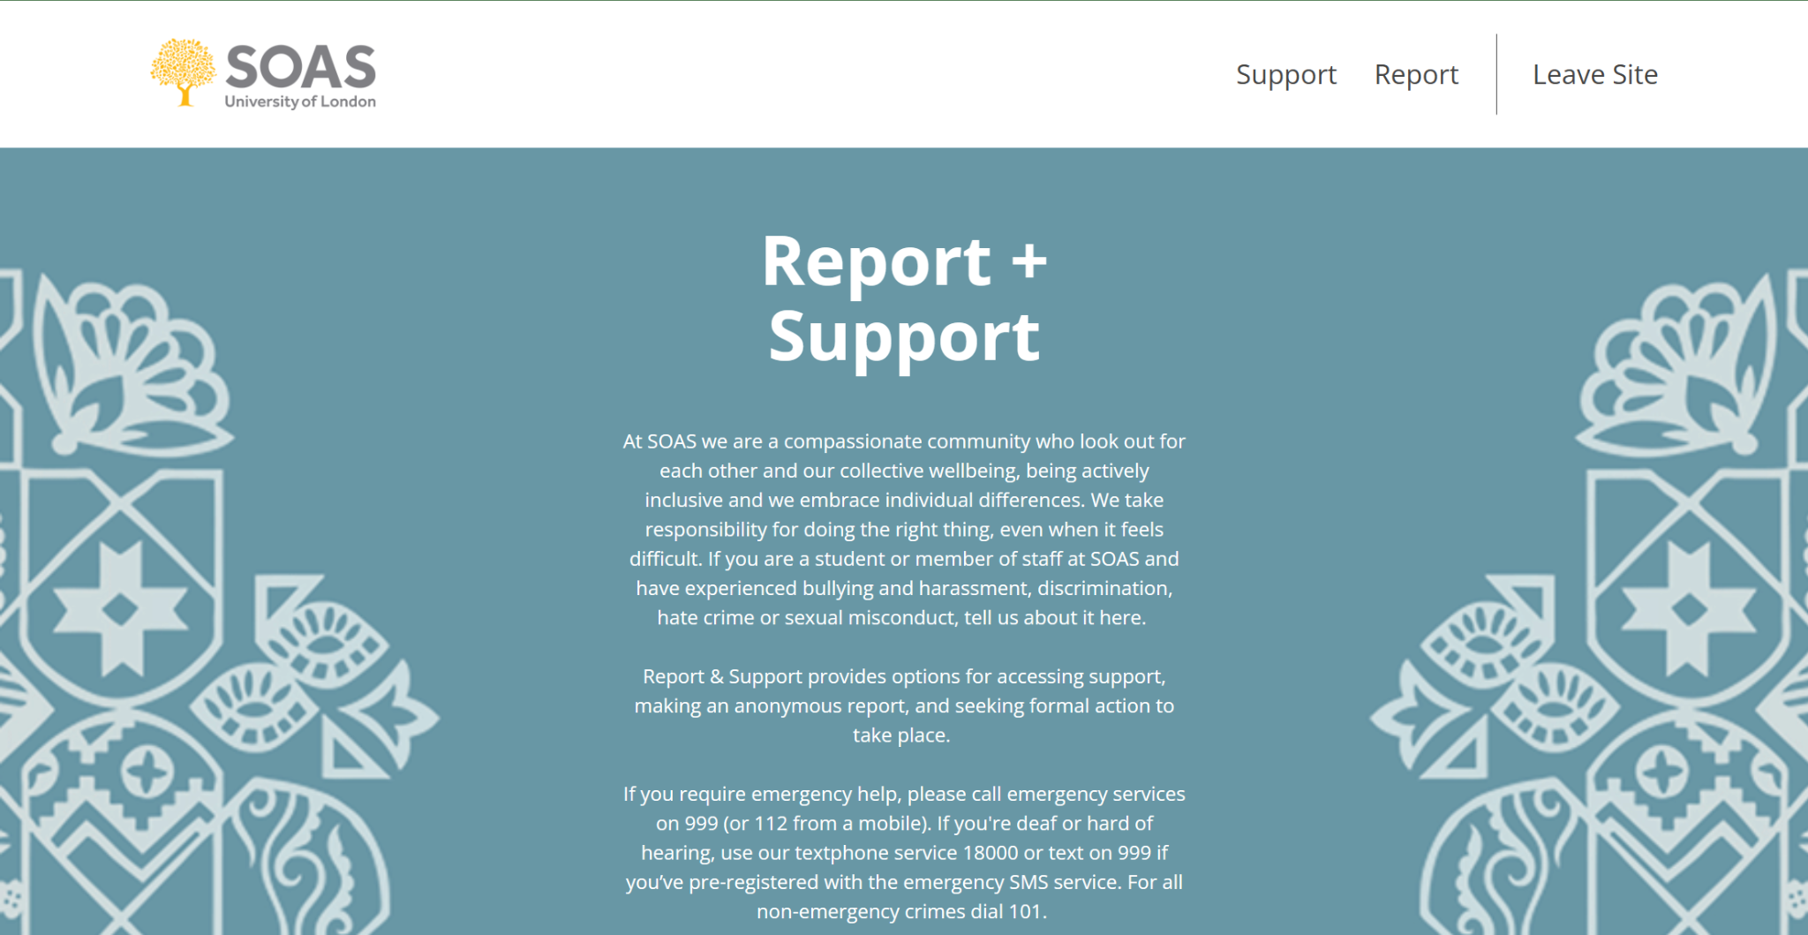
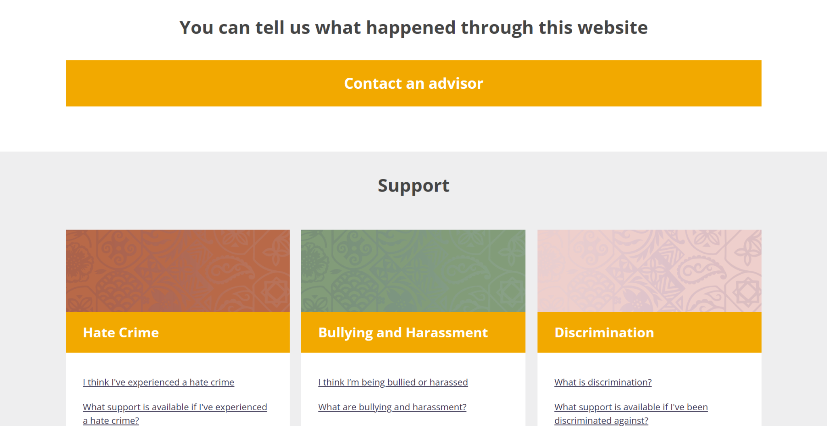
Report and Support Tool
The push is for the university to adopt this, not the SU
Helps to tackle cultural issues beyond targeting individuals with disciplinaries
Allows survivors to report people who don’t attend their university
Notes:
Practically every university has this, but I have to include it just in case there’s somewhere that doesn’t. Report and Support is a tool that allows students to report incidences anonymously if they choose to-they don’t have to- and they can report on behalf of someone else.
The way this works is if a student reports anonymously, if does of course mean there’s likely not a lot the university can do about it to investigate. But, if several anonymous reports come in about the same student and then someone is willing to report them, they can consider those previous reports within the investigation. Or at the very least, it helps to give the university a more accurate picture of what the sexual violence situation is within the student community by providing survivors a middle ground between not telling the university at all, or having to subject themselves through a whole disciplinary process.
It could be there there are multiple anonymous reports all within the same accommodation building. Then whilst you can’t necessarily investigate any individuals, you know to focus your attention there and work out what is it about that accommodation that might be leading to these incidences- does the lighting outside need to be improved? Do students tend to drink together in shared spaces or just outside, could you start asking security to regularly check by there? Is there proportion of any one college, department, sports team etc that live in that building- maybe you can speak to their department head about getting some training or messaging to them, talk to lecturers, coaches etc about whether they’ve noticed anything and encourage them to be an active bystander.
Also because most universities now have this same tool easily available on their website, something even I didn’t know until recently: apparently if a student is assaulted by a student at a different university to them- so for instance, SOAS is just down the road from UCL so if a SOAS student knew that the person who assaulted them was a UCL student, they can Google “UCL report and support” and report that student to their university, who would then be able to investigate it.
I don’t have experience implementing this personally- it was something me and my SU team successfully pushed the university for in my first year year, but I will be transparent here that the in’s and out’s of actually purchasing it I’m not hugely familiar with, but I did some research for this.
It’s provided through Cultureshift Communications LTD. Their pricing is split between bronze, silver and gold packages and dependant on the number of users, but they do have discounted prices for educational institutions. However even then, a university between 10,000 to 14,999 students costs between £11,000 to £17,200 so it isn’t the cheapest. But, it’s not you paying for it, it’s the university! But if your university doesn’t have this, I would still recommend pushing them to get it, it’s just helpful to know exactly how much money you’re pushing them to dedicate to this in case you’re helping sabbatical officers with funding proposals through a senate board which is how ours got through at Roehampton.

Slide 14

Training for everyone! ESPECIALLY SABBS!!
A sabb is not an expert on trauma informed care just be proxy of the student democratic process- train them!
You can’t assume they’ll feel comfortable or confident enough to tell you it’s too difficult for them if you don’t let them know they can opt out
Notes:
I’ve touched on this already but training for everyone, especially everyone who touches or might touch disciplinary panels. You could even lobby the university to not allow members of staff to sit on disciplinary panels for sexual misconduct cases unless they have completed training around sexual violence sensitivity and/or trauma informed care.
I fairly recently wrote a blog article for Alkhemy about this, but I know when I was a sabb I never received any training like this before sitting on disciplinary panels and I know it something we’re still trying to figure out at SOAS. But for sabbatical officers especially, as much as they are elected representatives of the student body, they are still 20-odd year olds and they are not experts on anything other than whatever their degree happened to be in and being a student at your university. The odds of them being prepared to handle that panel with the sensitivity, thoughtfulness, and confidence that it needs are not fantastic.
And statistically if your sabbs are marginalised genders, there’s a high likelihood they have themselves experienced some form of sexual violence or could do during their time in the role. Early on in the job, they won’t necessarily feel comfortable or confident to openly say “actually this sounds like it could be really triggering for me I don’t feel I can safely be a part of this” unless they are given that opportunity by someone directly telling them “if it ever feels too much and it’s affecting your wellbeing, please let us know and you don’t have to be a part of this we can find someone else to cover”
So, talk to your sabbs before they sit on and panels about handling them sensitively, so they don’t risk deeply upsetting someone else or themselves. You also could just include this training across your whole team when the sabb’s start- like I said earlier, do you confidently know how to handle a disclosure? Does your team know about the 5 D’s and being an active bystander? How does your workplace culture reflect a culture of consent and respecting boundaries? It’s harder to push for students to know all these things, if the staff supporting and representing them don’t even know these things themselves

Slide 15
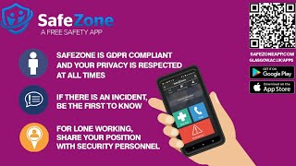
SafeZone
Notes:
I’ll talk more about this later on but when I was doing my SVLO training with LimeCulture, there was a moment where the entire lesson went off the rails because everyone in the call could not stop raving about how great Safe Zone is
SafeZone is free for students to download on from the Apple or Google app stores, and it allows them to quickly share their location and details with the local response team who can then get the right assistance to them.
It also lets them report non-urgent concerns straight to the right people and can connect them to wellbeing services
When I worked at Roehampton SU this was something we just managed to implement as mine and my VP’s terms were coming up so unfortunately I wasn’t there to see it’s use for that long, but the month or two that I did see it was very well received by university security and wellbeing, the biggest challenge was just getting students to know about it and download it but that is something that if heavily pushed during Welcome Week I can’t imagine being a problem for long- especially at places in big cities like London where new students who are new to the area might feel especially nervous about their safety, will appreciate having this as a tool.
What I do remember from Roey and from hearing about it at from other’s is the cost to implement it within your organisation is somewhat dependant on the radius area you your organisation that you want to cover- so for campus universities where the university area is fairly contained this is pretty straightforward, for somewhere like SOAS in the centre of London it can be a little harder to determine how much area you want to cover, and of course lots of universities have odd buildings or colleges orr departments that are seemingly randomly 45 mins down the road that could end up left out- so that is the one downside I’ve ever heard about to just be aware of
But I do highly recommend it, especially if you also develop a bystander intervention team. When I was a Bystander student at Roey, after every night out had finished we would do a lap of the campus in pairs just in case we found any students in trouble, passed out on a bench, fallen in the lake etc and just make sure everyone got home safe- and this works as a perfect addition to that because you know where to immediately send a bystander or Welfare Contact, security, first aid etc rather than having people wonder around and hope to eventually come across them.

Slide 16
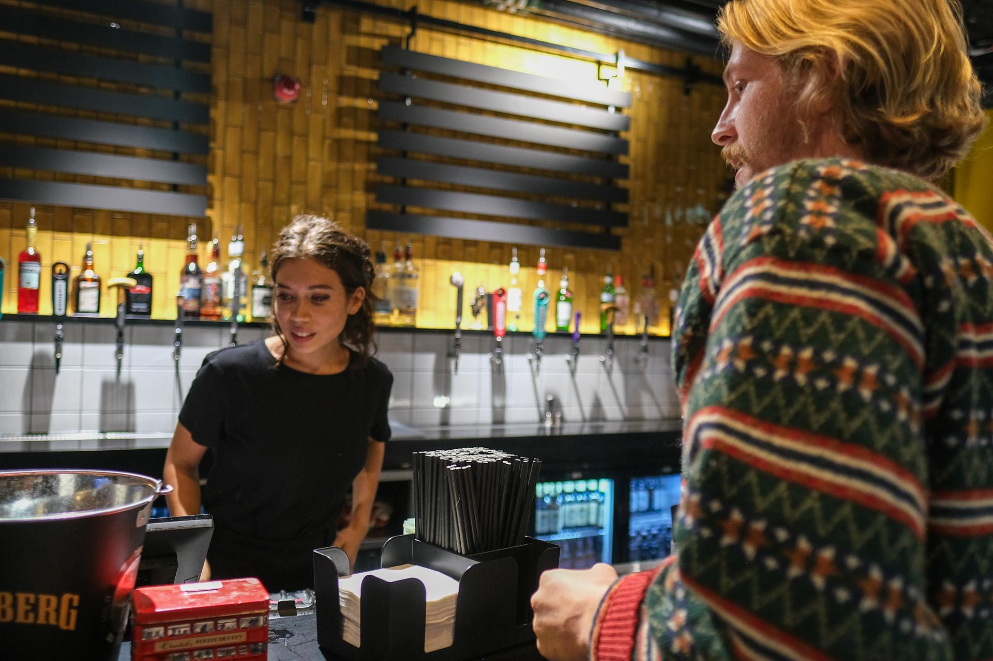
Bonus!
Streamline reporting processes as much and wherever possible to avoid survivors having to repeat themselves
Please share anything you have or heard about that I’ve not mentioned!
Notes:
Bonus slide!
If you do adopt the Bystander Intervention Project I mentioned earlier, you can then take that to the next level and implement an incident report system between the Welfare Contacts and the university Wellbeing team. We had this at Roehampton, where anytime I had an incident I supported a student through I would ask for their consent to include their name and student number within an incident report. If they consented, I would write that up and submit it, which would then go to both my supervisor Vilde and the Wellbeing team. Then no matter what the incident was, even if the student said they were completely fine, the wellbeing team would reach out through email just to check that they were okay and to offer support if they needed it.
If that student then later on decided actually they did want support, the wellbeing team would already have their report of the incident so the student didn’t need to repeat everything that happened all over again, which can be retraumatizing. To my memory, I can’t remember if that same report would be passed on to a disciplinary team if they decided to report the incident, but that’s always something to explore the logistics of at your own institutions- obviously taking the students consent to share that information and GDPR into consideration, never just send it off without their consent.
Does anyone have or know about any examples to support reporting?

Slide 17
What can support look like?

Slide 18
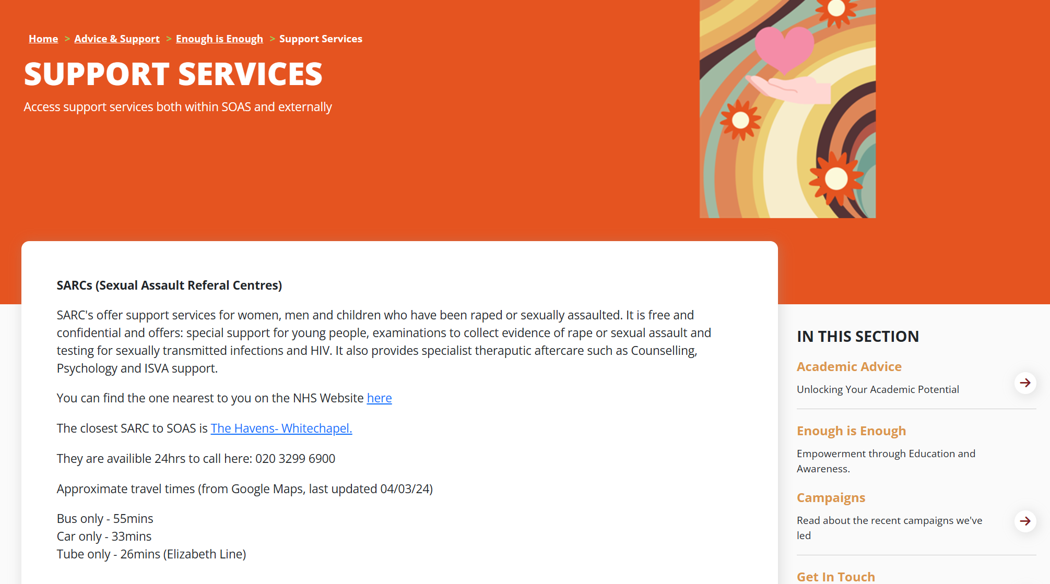

Know where you’re signposting
If no one on your team knows, there’s a solid chance most students don’t know either
Help students to know everything they need to, before they need to, so they have one less thing to worry about in the aftermath
Blanket signposting students to wellbeing isn’t enough
Notes:
I feel I have harped on about this, but it’s because it truly is the simplest and least resource heavy thing you can do: You, or someone on your team, or perhaps an exceptional freelance consultant (me) can spend a bit of time researching how your university disciplinary system actually works step by step, who actually works within the wellbeing team and what services do they provide.
What services are available in the local community, and how long do they take to get to from campus?
What are the transport routine like and how much do they cost?
Could the university or SU subsidised the cost of a toxi or Uber for survivors- again, consider that rape evidence needs to be collected within 72hrs, so not only might every hour count but an incredibly emotionally vulnerable person may not feel safe jumping on the underground or a crowded bus, to go do something that is also incredibly scary and vulnerable.
Where can students access emergency contraception? Is it on campus- if not, why not?
What does a student need to know and do if they need an abortion? Remember, you almost definitely have students at your university who have come from countries, or states, where abortion is illegal so they could be completely clueless of what the process in the UK is. Do you even know yourself?
Once again, is this information readily available, up to date, and easily to find and understand if you are distressed on your SU website?
Just blanket suggesting to students “speak to wellbeing”. “Use the report and support tool”. “Call 999”. Is not the most supportive you can be. It’s still leaving the majority of the practical and emotional labour of managing the aftermath of an assault, to the survivor of that very assault.
We all have the capacity to lighten that load for survivors by just taking the time to be more knowledge and to ensure that information is shared clearly. Or at the very least, paying someone else to.

Slide 19
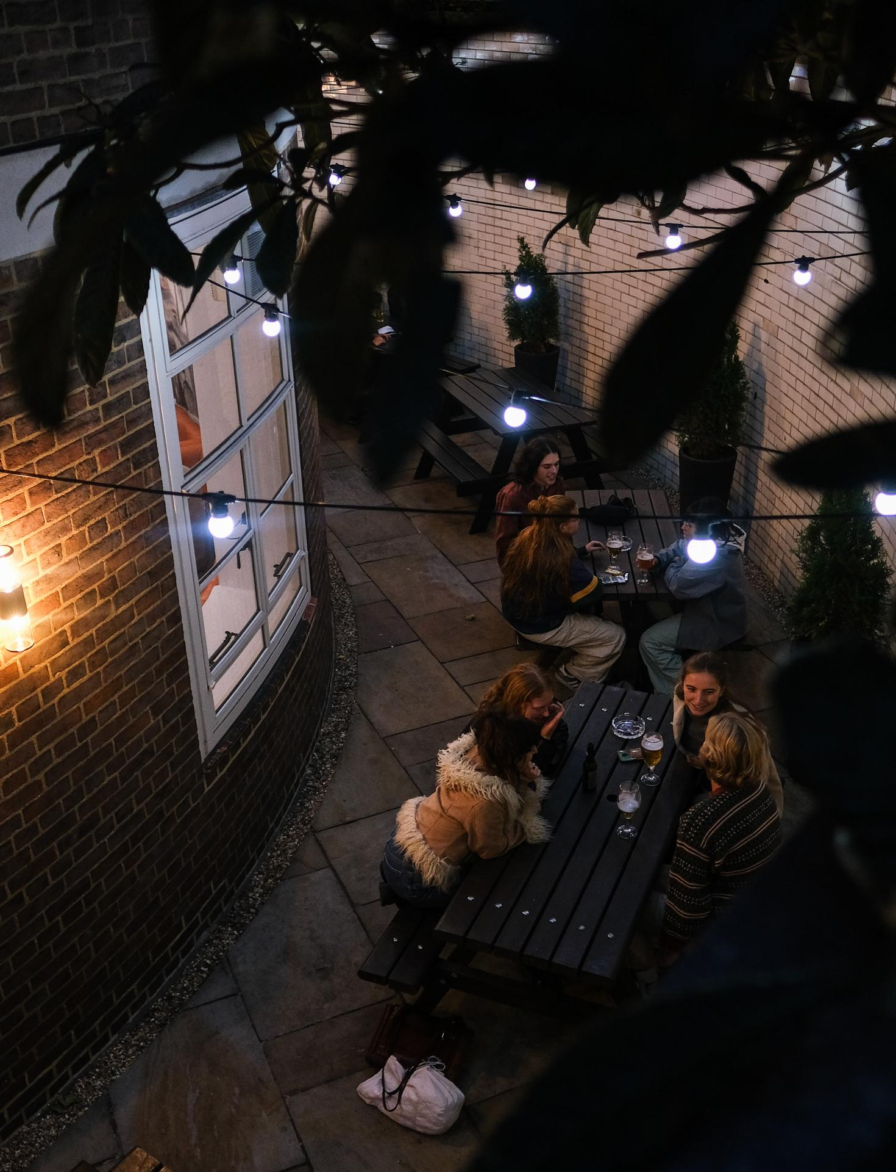
Who’s supporting the reported students?
Ensure your advice service feels comfortable and equipped
Need to manage conflict of interests- one person can’t support the reporting and reported student
Reported deserves support, but it will look really bad if they ask for advice first and then your one advisor can’t support the reporting student
Notes:
Something that can get left out the conversation is acknowledging that reported students do still deserve access to advice and support. Ensuring that your advice service feels equipped to handle that, or at least knows who to signpost them to, is pretty crucial.
You have to be aware of managing a conflict of interest, meaning if for instance you have one student advisor on your team and a reporting student comes to them for advice and support on reporting their assault to the university, if the reported student then also asks them for support, the advisor cannot support them.
A potentially worse situation occurs if a reported student speaks to the SU advisor first, and then a reporting student tried to and discovers because of the conflict of interest they now can’t access support but their rapist can.
The solution to this will really depend on your own staff team and the services available to students, but I’m just bringing it up here because what matters most is that this is something you are all aware of and have considered. A potential issue as well with reported students ios that if a survivor chooses to report their assault to both the university and the police, there are then two parallel investigations into the reported student at once. The statistics on reports of rape leading to justice are frankly abysmal; according to the Home Office and in the governments End-to-End Rape Review report, only 1.6% of rapes that are reported actually lead to anyone being charged. This is not because these are the only cases that are true, as actually only 3% of rape allegations are considered to be false- meaning 97% of the time, they’re real- yet the vast majority of the time, never go aware.
This does not mean the reported student is innocent, and this will not necessarily- or at least it shouldn’t- stop the universities own investigation. As I mentioned earlier when talking about the OfS Statement of Expectations, universities are still- including after August next year- not held to the same burden of proof as a criminal investigation would be, meaning a disciplinary board can make a judgement to suspend or expel a student without having to meet the same ‘beyond any reasonable doubt’ that a court would have to.
This doesn’t in any way mean that a university can just kick a student out at the slightest whisper of an accusation, not that that’s even happening anyway. But it just means the threshold for evidence from a reporting student is not as high, and again remember that not all- in fact, statistically most, survivors don’t report to the police and don’t want to pursue criminal justice. But then in most contexts beyond a university, you’re not as likely to be potentially living with and in the same classes as your attacker. So it’s ultimately positive for universities to be able to make decisions that make sense within the university context, without having to meet such a high threshold or have the police involved if the reporting student doesn’t want them to be.
This can be a tricky thing for reported students to understand, particularly if they think that the case being dropped means they didn’t do anything wrong. Just something to be aware of as an area where a student may especially seek advice from their student union as a separate body from the university, because to them they may think at least initially that the university continuing its own investigation is unfair to them.
One approach we are going to be trying in the next academic year at SOAS is I am a recently qualified SVLO- a sexual violence liasion officer, I will explain more about what that means in the next slide- and we have one advisor on our team. So we’ve decided that if a reported student needs advice, the advisor takes them. If a reporting student needs advice, I take them. Even without an SVLO if you have more than one advisor on your team, or someone at the university where you can make this kind of relationship with, having a clear distinction between who handles what cases can help eliminate conflict on interest issues.
But SVLO’s are the best and here’s why:

Slide 20

Train staff as SVLO’s / ISVA’s
Highly recommend LimeCulture, they’re amazing
Most SVLO’s do it alongside their primary role
Having SVLO’s on team or at least at the uni easily covers the last two points- you can just signpost to them
ISVA’s can’t work at a uni/SU but the training is still helpful
Notes:
I am a qualified SVLO! I was trained through Lime Culture, I do highly recommend the training, I haven’t yet completed the ISVA training but I really want to.
An SVLO is a Sexual Violence Liasion Officer. It is a role that could be done on it’s own, although a lot of the time it’s actually an additional qualification someone already employed can gain and then do alongside their role. So myself for instance, my primary role at SOAS is still the Enough is Enough Coordinator but alongside that I can support students as an SVLO
An SVLO is similar to a student advisor, but very specific to instances of sexual violence. It’s a role that is specific to higher education environments, but they are able to also form a relationship with local services to support students by signposting or through referrals to whatever support or reporting avenue is right for that student. So I’ve asked a few times if you and your team all know where the nearest SARC is- maybe you don’t, but if you had an SVLO you’d know that not only do they definitely know but they also might know the people who work their, they might be able to process a students referral for them so they have one less thing to worry about, they might be able talk to the student through what the space looks like and exactly what happens when they go there to collect evidence so that they feel more confident and prepared and they know nothing is going to come as an unexpected shock while they’re feeling incredibly vulnerable.
They’re not mental health professionals, they are not someone a student can fully disclose the details of what has happened so it’s not as emotionally taxing as it might sound and actually students are often relieved to know they don’t have to describe anything.
ISVA’s are something similar but distinctly different: ISVA stands for Independant Sexual Violence Advisor, and they do a similar role to SVLO’s in signposting and referring survivors, however they are not specific to universities they tend to work within SARC’s or similar organisations
An SVLO is a role designed specifically for the Higher Education environment, whereas an ISVA is an independent sexual violence advisor so an ISVA actually cannot work within a university or SU in that role, because then they wouldn’t be independent because they are directly affiliated with the institution- that’s not at all to say, you can’t have ISVA training and work at a university! I have spoken to SVLO’s who have gone on to get ISVA training supplementary to their SVLO role just to build upon their skills and knowledge and they’ve said it is extremely useful.
A primary thing ISVA’s can do which SVLO’s can’t is ISVA’s can support survivors through the criminal justice process- so they can literally go with a survivor to court and sit with them throughout, just to be there as a supportive body as well as helping them through all the admin and talking them through each of the steps of the process, generally just lightening the load. An SVLO can’t do this because obviously, a courtroom is beyond the jurisdiction of a university.
So instead, and SVLO could have a relationship with ISVA’s working locally and could refer a student to them, and they could then support the student together- the SVLO managing the load of a university disciplinary process, and an ISVA supporting them through the criminal justice process after reporting to the police.
This relationship is especially helpful because the criminal justice process in the UK with sexual violence crimes takes 5 years on average, which is obviously longer than a typical student might even be at your university. SO having that connection to someone externally who can support them from the outset and then continue that support throughout and long after they’ve graduated is significantly more useful than referring them to university wellbeing services who would have to end contact once they graduate or if they decided to drop out of university because of what’s happened- and then they might have to continue to seek justice, potentially alone depending on their own support network, for another 2-3 years, or longer.
Training to be an SVLO is currently £1,350 per person, and does take in total eight full days per staff member- and ideally you would have multiple SVLOs across the institution, at the SU and/or the university. Currently at SOAS I am the only SVLO period which isn’t ideal, I don’t recommend and we are working to push the university do more.
It is then an additional responsibility on top of a staff members role, and it is crucial to the role to ensure they have access to supervision so they don’t wreck their own wellbeing in the process. The more SVLO’s you have, the easier it can be across a team because you can better share the load between you so it doesn’t eat up too much of people's time away from their primary role, and could run a group supervision to save even more time and money- as long as that was still felt as effective for everyone, it’s not something you should skimp out on otherwise
So it is undeniably resource heavy to set up initially, however it isn’t resource heavy to continue long-term and the benefits are huge in terms of the support you are then able to offer to students so I do strongly feel that if feasibly every university and/or SU should have an SVLO

Slide 21
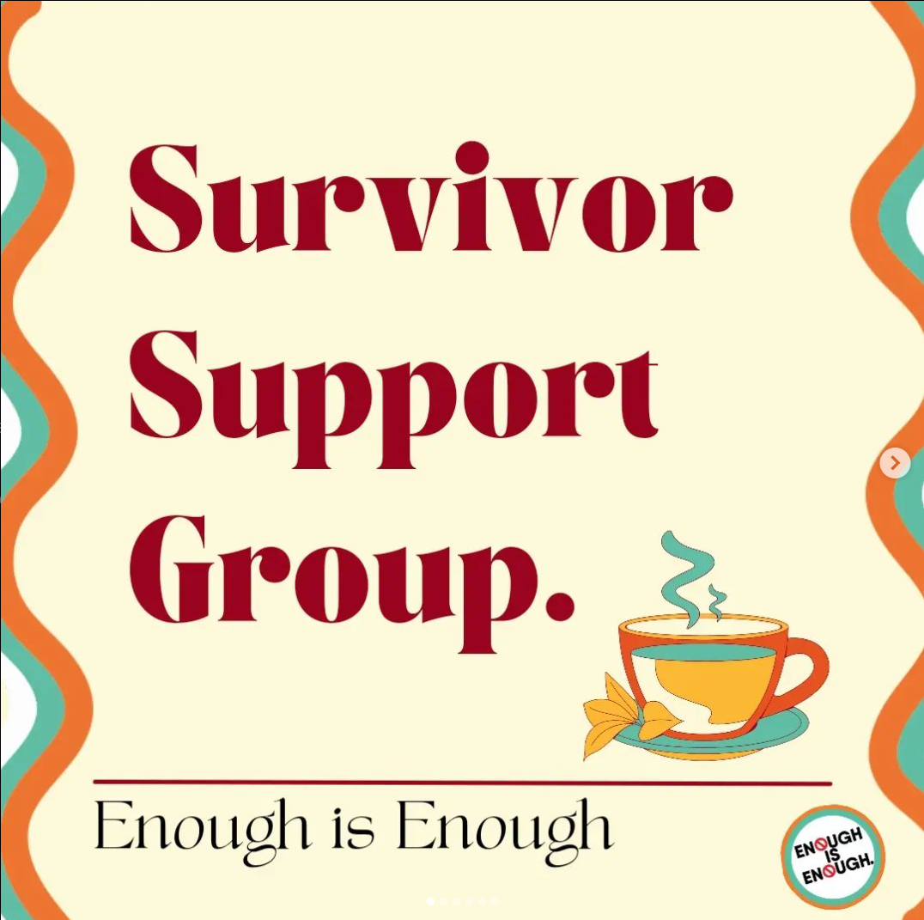
Bonus!
Set up a survivor support group, maybe with your wellbeing services or by hiring a facilitator
Please share anything you have or heard about that I’ve not mentioned!
Notes:
Bonus slide!
You could look at establishing a survivor support group- this is something we haven’t done at SOAS yet but we’ve been looking at it for a while now, and then found out our university wellbeing team have been looking at doing the same so potentially it might be collaborative but we’ll see. If you can get a mental health professional as a facilitator that could be great as providing a group therapeutic environment, but also primarily in US universities there have been more and more non-therapeutic spaces where survivors can just do mindful activities together and not talk about their experiences at all, just exist socially with others they know identify with their experience which in itself can be very supportive.
Does anyone have or know about any examples to support reporting?

Slide 22
Preventing
Reporting
Supporting
Notes:
So now we’ve covered each corner of the triangle, hopefully you can see how there’s a potentially bigger picture approach to tackling sexual gender based violence through multiple areas of student life.
As I said at the beginning, without prevention you’re just responding to sexual violence which means you’re treating it as though it is an inevitability, when it isn’t.
Every instance of sexual gender based violence is preventable, because they entire hinge on people decision to either do the right or wrong thing. There is nothing inevitable about it.
However, just because every instance of sexual violence is preventable, doesn’t mean any level of prevention is going to get it right 100% of the time. Let’s revisit that student case scenario from earlier and how it looks when each of these elements are in place:
On a student night out, two students are making misogynistic jokes with their friends. One of their friends remembers their consent workshop during freshers week talking about rape culture and being an active bystander, now doesn’t feel comfortable letting these jokes slide. They call their friends out for their behaviour, one friend feels embarrassed and apologises. The other gets defensive and storms off, leaving them for the rest of the night.
Later that night, a Welfare Contact sees that student groping a very drunk student who doesn’t seem aware of what’s happening. They intervene, go with the drunk student to help them sober up and inform security. Security remove the student from the venue, and the Welfare Contact later writes a report of what they witnessed which the SU event staff are made aware off.
Sadly, later that night a student was raped by them in their halls. They remembered hearing something about sexual violence prevention during Welcome Week from the students union, so checked the SU website and found a page of information. There they found that if they wanted to collect forensic evidence it needs to be within 72hrs, the address and contact details of the SARC closest to the campus, and that the university can refund their journey if they want to call a taxi there rather than have to get public transport. They are able to get to the SARC and have their evidence stored, but are still not sure if they want to report to the police. The SARC are familiar with the students university because the SU’s SVLO has built a relationship with them, and so they can signpost the student to booking an appointment with them.
Once they meet the SVLO, they discuss what reporting to the university might look like, what reporting to the police entails, and what support options are available to the student. They decide they want to report to the university, but don’t want to report to the police. The SVLO is able to support them throughout the reporting process, as well as refer them to counselling services within the wellbeing team.
Once the university open an investigation, the reported student is informed that they are temporarily suspended from the campus, including their job at the student shop who have been informed. They are signposted to the SU senior advisor, who is able to provide them advice on their finances and applying for the hardship fund. Accommodation offer a new room for the reporting student, which they choose as they don’t want to stay where the incident took place. They are able to still go to campus without fear of running into the reported student. The SVLO has supported them in accessing mit circs without having to go into detail or provide extensive evidence to the university, so the student isn’t worried about their education being affected.
Ahead of the disciplinary meeting, the SVLO is able to talk them through what they can expect. They tell the student that the university has a policy that everyone who sits on these panels has completed training around sexual violence prevention and has a trauma informed approach, and that the university will never ask them to sign an NDA. They attend the hearing, and leave feeling that it was handled in a sensitive and considerate way.
Later, they are informed directly that the outcome is that the student has been immediately expelled. They meet with their SVLO to debrief the outcome and how this whole process has been. Because it wasn’t as difficult as they had expected, and because they know their evidence is already stored at a SARC, they decide they now do want to report this to the police. After talking to the SVLO about it they understand that criminal justice processes can take 5+ years on average so this will likely continue until long after they’ve finished university. The SVLO is able to refer them onto an ISVA who will be able to continue support with them during and after university, throughout their reporting process.
Just because every instance of sexual violence is preventable, doesn’t mean any level of prevention is going to get it right 100% of the time. But at least here, where prevention failed, reporting and supporting was there and ready to respond. And ideally, because responding is no longer the only approach, they’re less overwhelmed and have more resource and availability to handle the cases that do fall through the cracks.
And crucially in this scenario compared to earlier, it starts long before any assault takes place. There were multiple steps that attempted to stop the reported student, and they can continually be improved upon so that they do stop students like them in the future. But even here, they did stop that students friend who got embarrassed after being called out for a joke- maybe if they hadn’t, they would’ve assaulted
Sexual gender based violence is so deeply systemically embedded within every fiber of society- try as we might, we’re not going to eradicate it from every student who walks through our doors like some kind of patriarchy car wash.
But we have to try anyway- otherwise, what are we working at students unions for? We have to help make sure as many as possible get through university as happily and as safely as possible, so they can take everything they’ve learned, make the real world even better, and give the SU’s and universities of the future an easier time tackling this

Slide 23
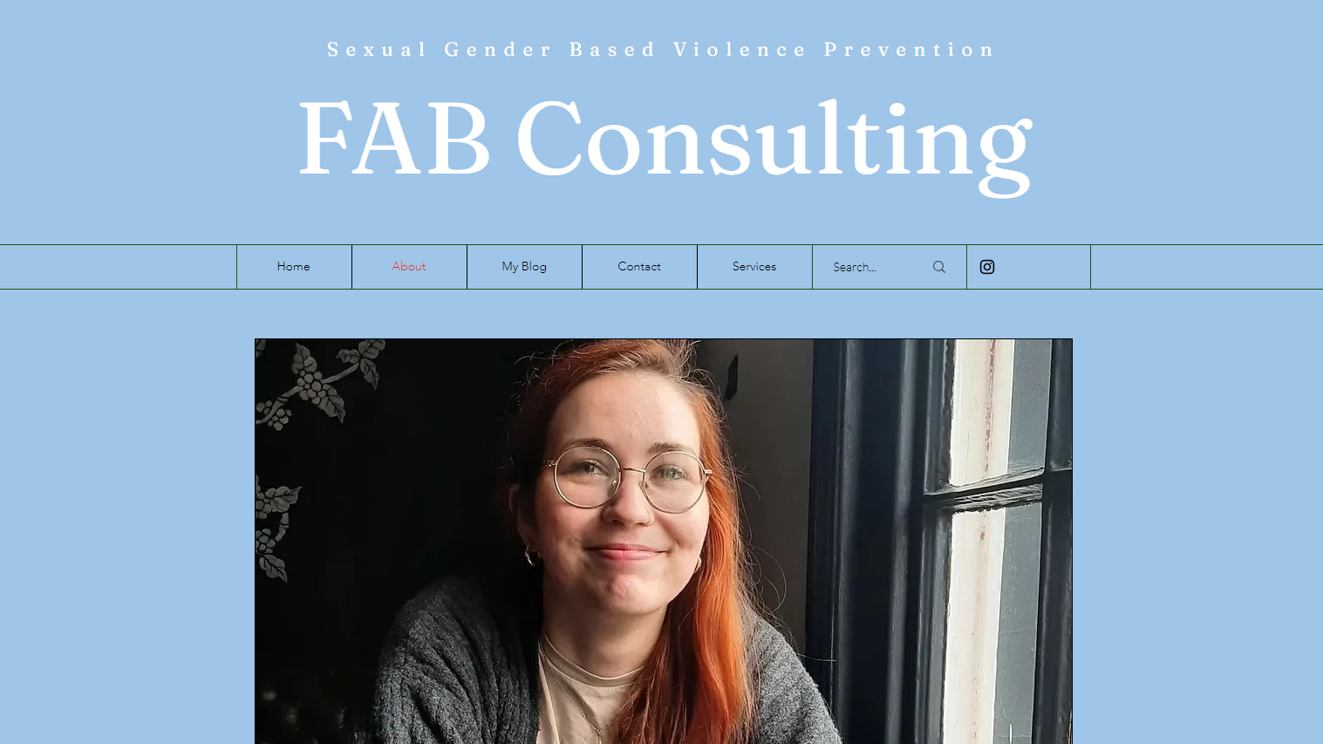
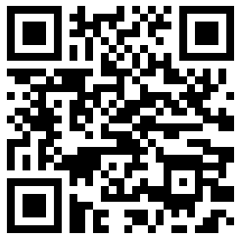

Notes:
There was no way I would be able to end this without a shameless plug.
I do have experience in almost everything I have mentioned today, and have worked as an SGBV Prevention Coordinator for over a year now. I know not every university or students union will have a role like mine or any resources or energy to create an entire prevention project like Enough is Enough. So if any of this felt overwhelming, or you suspect your universities aren’t going to know where to even start with the OfS conditions, I am offering my services as a consultant on a freelance basis.
I’m very new- I’ve literally never done anything like this! So I’m primarily looking to build some experience, but also genuinely want to see more of these measures implemented everywhere, and in a way that is thoughtful and knowledgeable so that it’s as effective as possible from the start. So please come have a chat later on or get in touch at any time, there’s a QR code to my website at the top there.
Thank you and enjoy the rest of your day!

