Slide 1
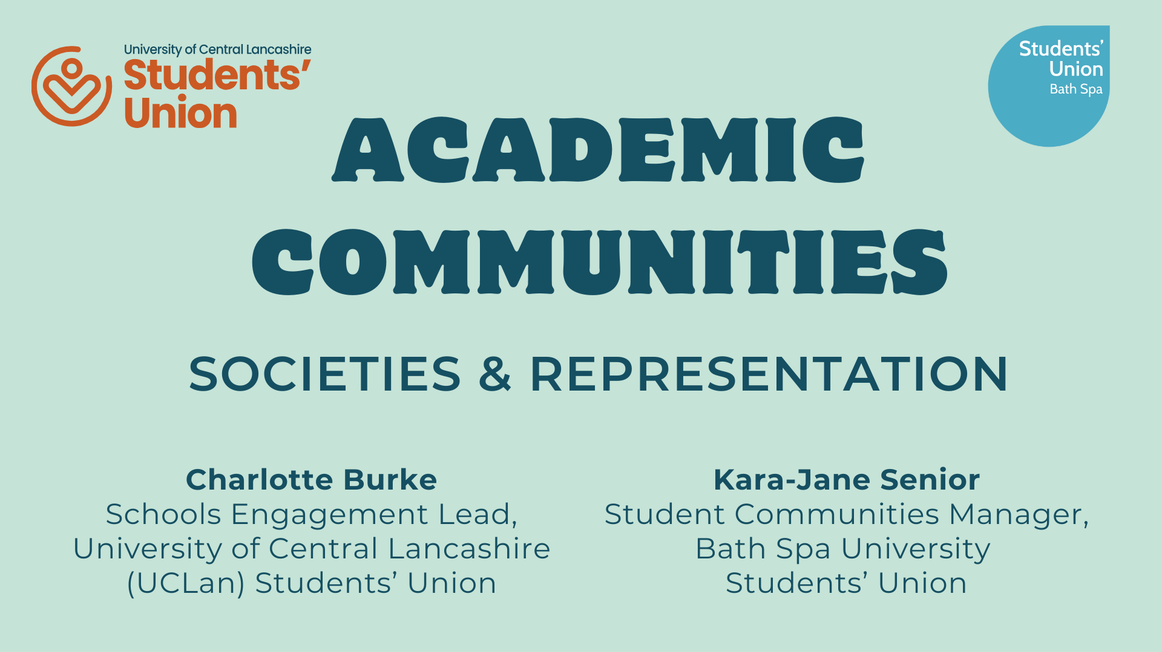

Slide 2


Slide 3
Transforming Academic Communities
Kara-Jane Senior (she/her)
Student Communities Manager
Bath Spa University Students’ Union

Slide 4
Where we started
2022 - Representation systems and typical student opportunities decreasingly relevant or accessible to students today.
Bath Spa Big SU Survey in 2022 reported:
Students working 22 hours each week on average
56% said they felt lonely daily or weekly
Commuting distances up to 90 minutes one-way to class
Clubs and societies gave students a sense of belonging

Slide 5
Where we wanted to go
Support students to build connections
Raise students’ confidence and develop important skills
Create academic communities of students and staff
Pay students for their time
Enable students to take an active role in making the change needed
Create a more effective representation system

Slide 6
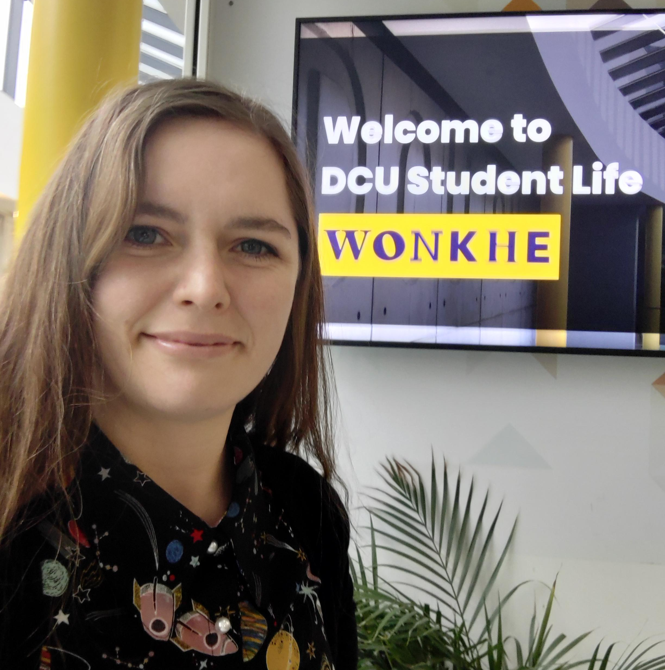
How we’ve gone about it
Workshop with key university and students’ union staff summer 2022
Research approaches to student representation and communities around the UK and Europe
Two workshops with academic representatives and academic society committee

Slide 7
What we’ve done this year - pilot year 1
Focused on undergraduate representation for Bath based students
School based approach
New paid student role combining representation and community building
Pilot schools: Business School and School of Music and Performing Arts

Slide 8
What we’ve learnt
Paying students is the way forward, but more hours are needed
A defined structure and clear expectations for students holding representative roles will support students to take ownership over the system
More training and developmental support
Flexibility to tailor the system within schools is important
Names matter – Student Community Leader
Physical space is supportive of building community
We do not have to be radical with the transformation, just make sure that things work for everyone involved

Slide 9
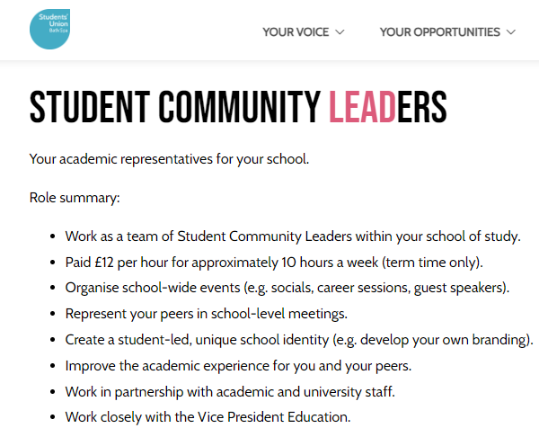
Where we’re going next - pilot year 2
Roll out across all schools at undergraduate level in Bath
Students taking the lead in quality assurance
Development of academic communities as a flexible form of student group
Social opportunities for all academic representatives

Slide 10
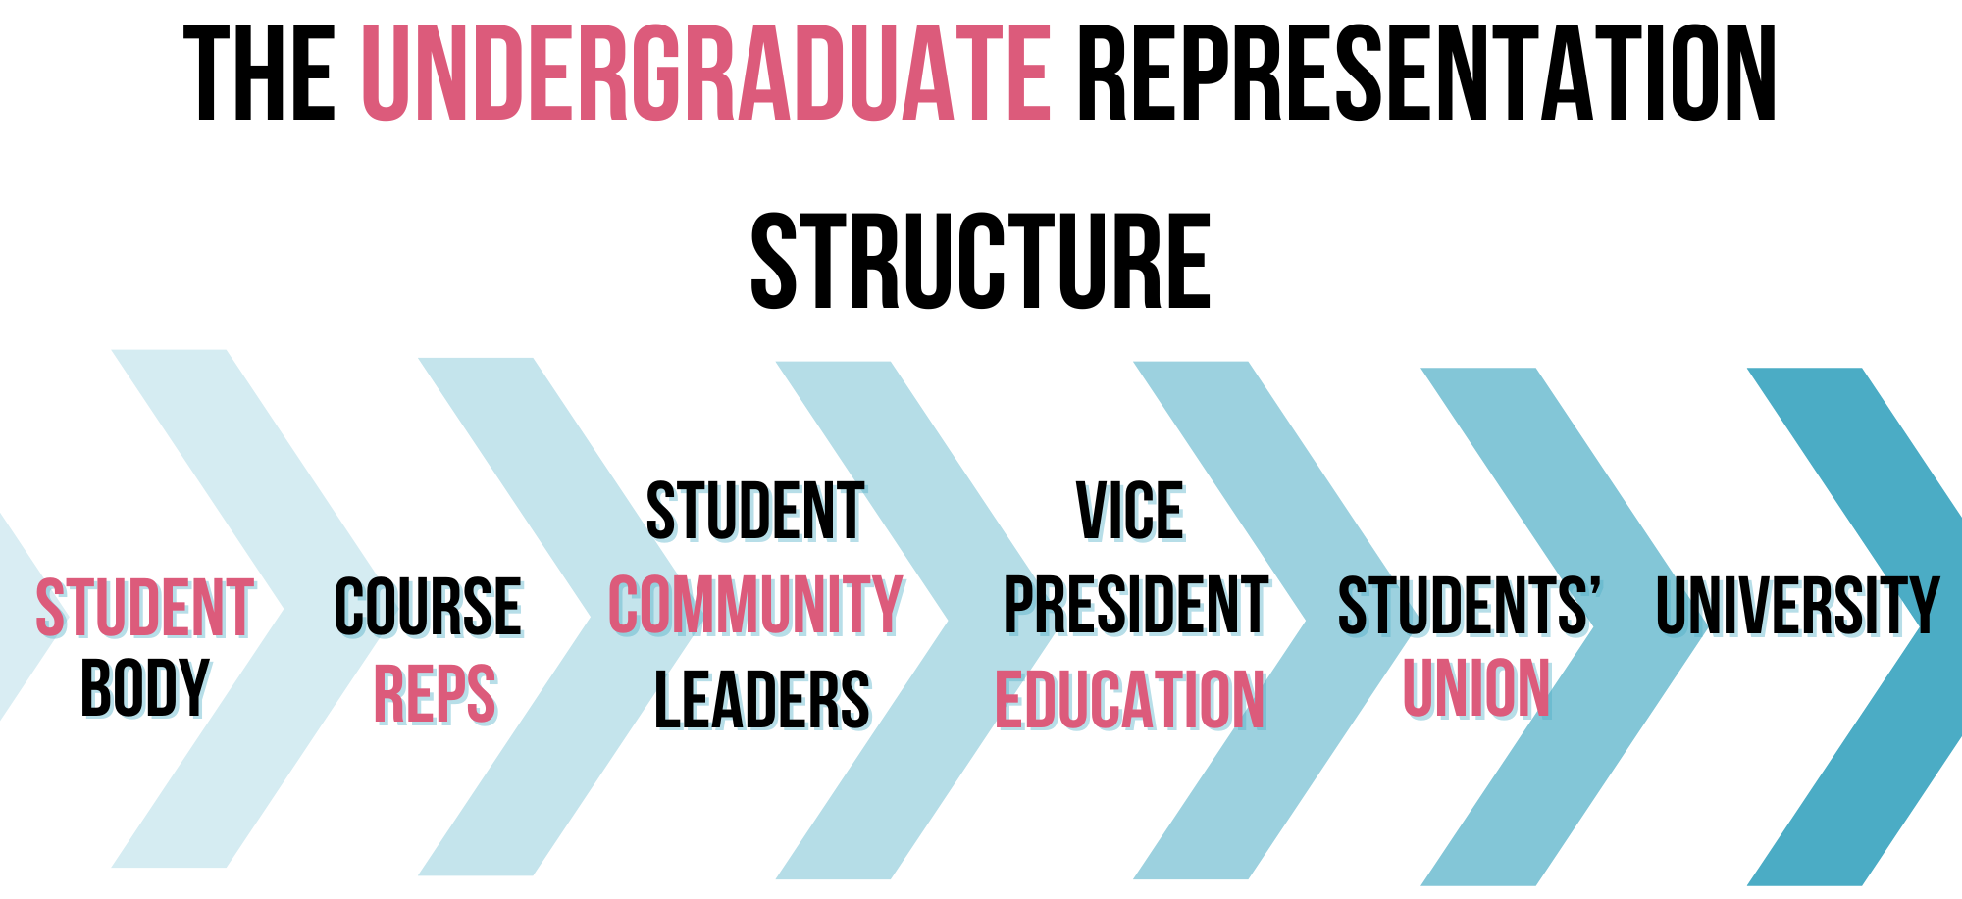

Slide 11
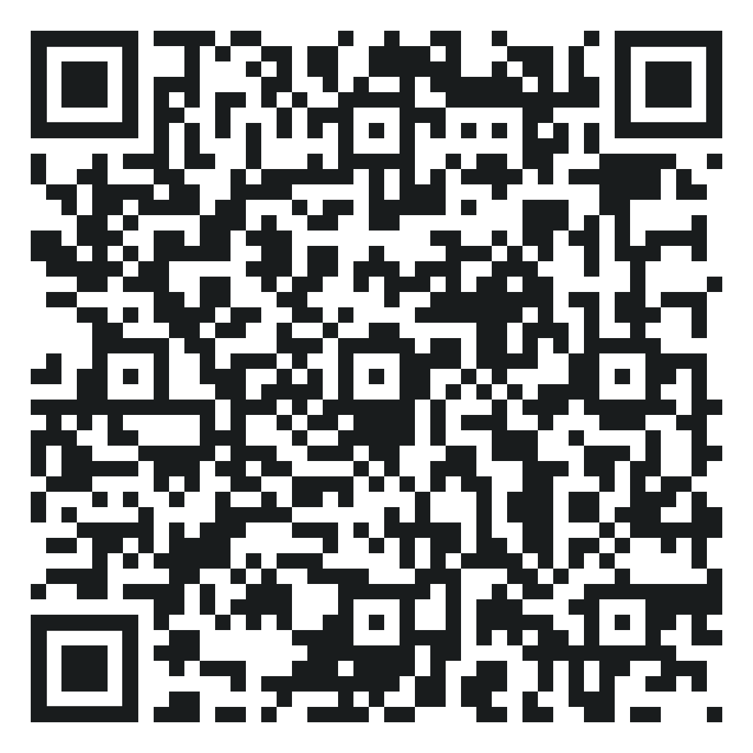
Thank you for listening!
Find out more:
bathspasu.co.uk/voice/leadandrep
Get in touch: su-academicreps@bathspa.ac.uk

Slide 12
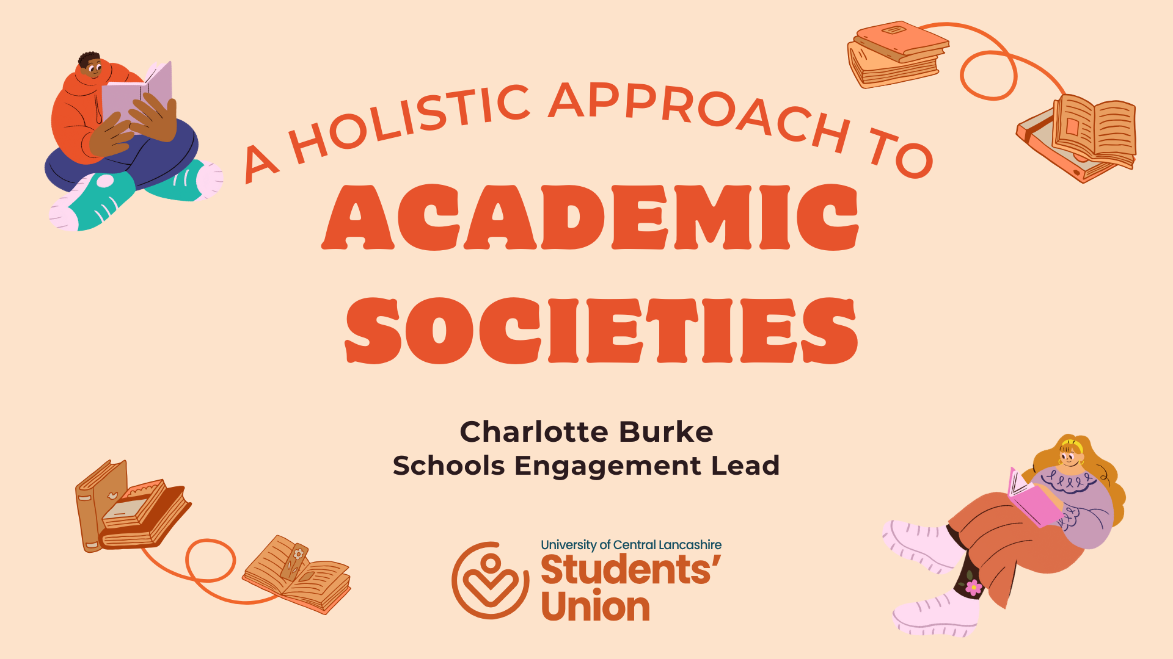

Slide 13
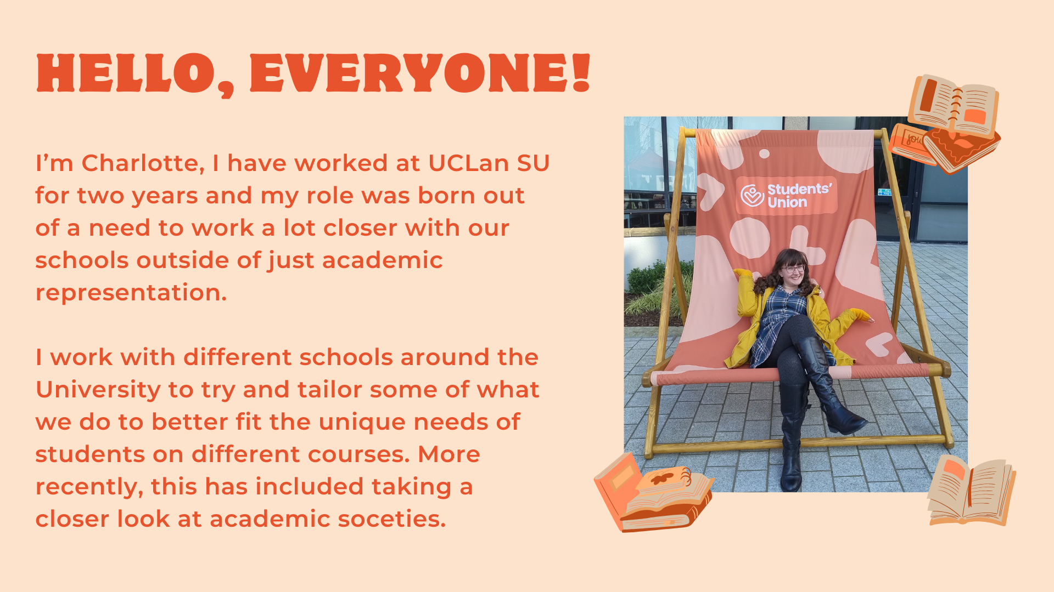

Slide 14
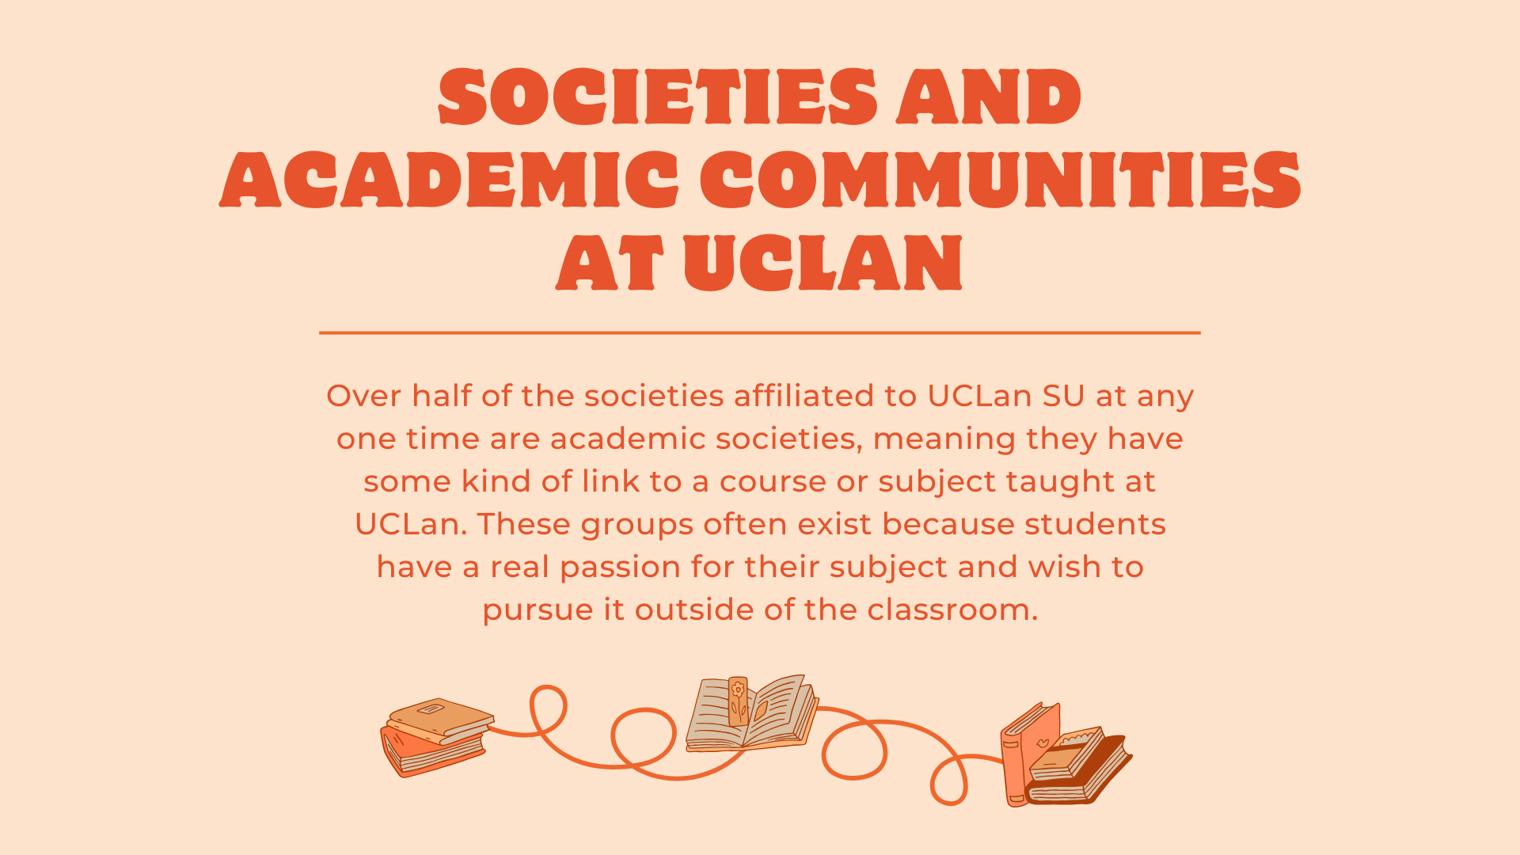

Slide 15
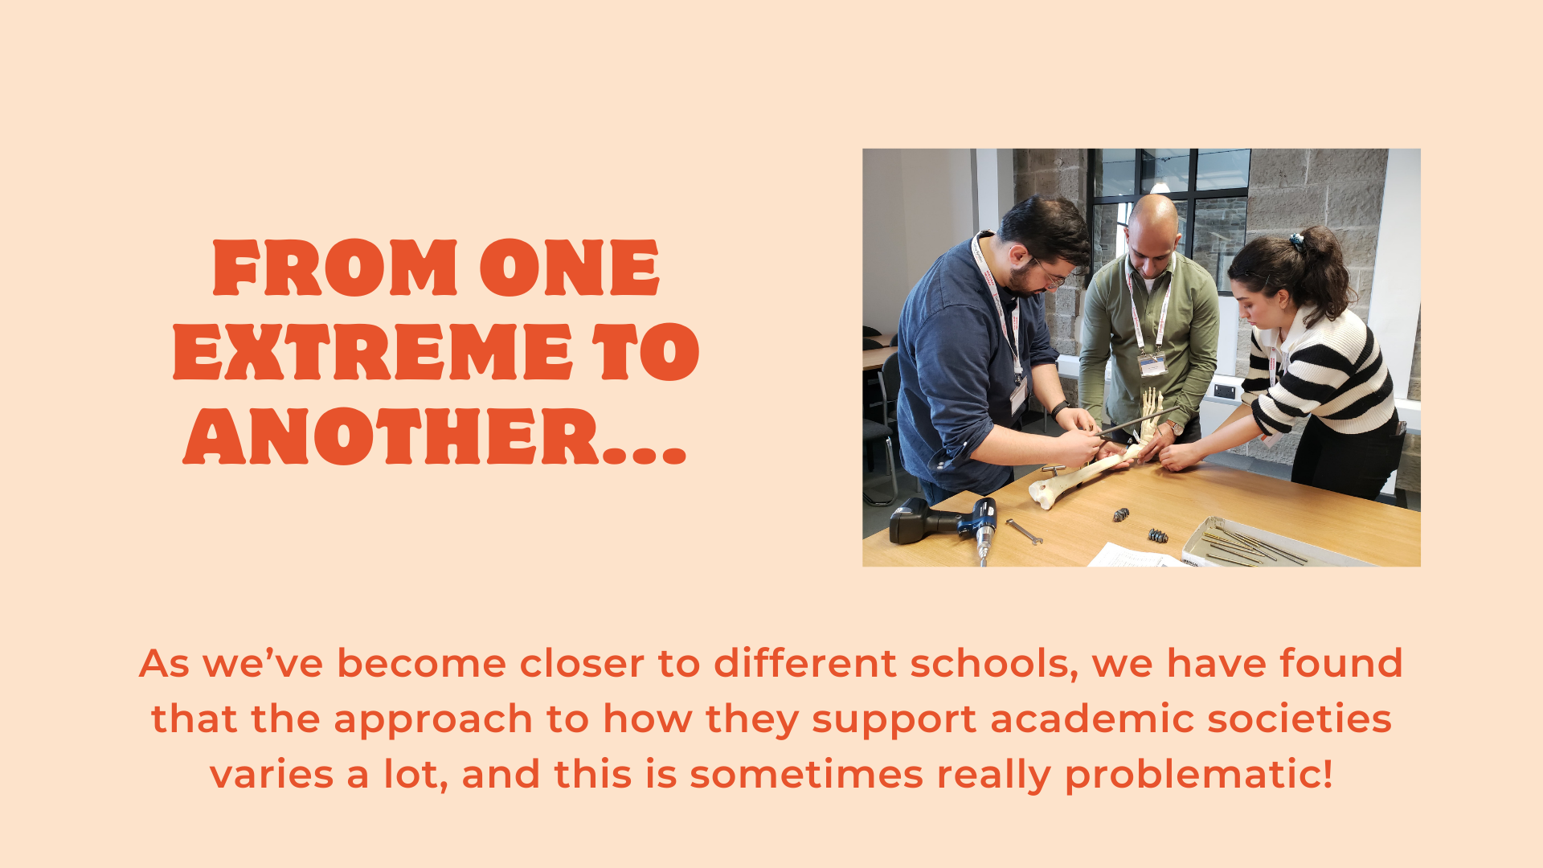

Slide 16
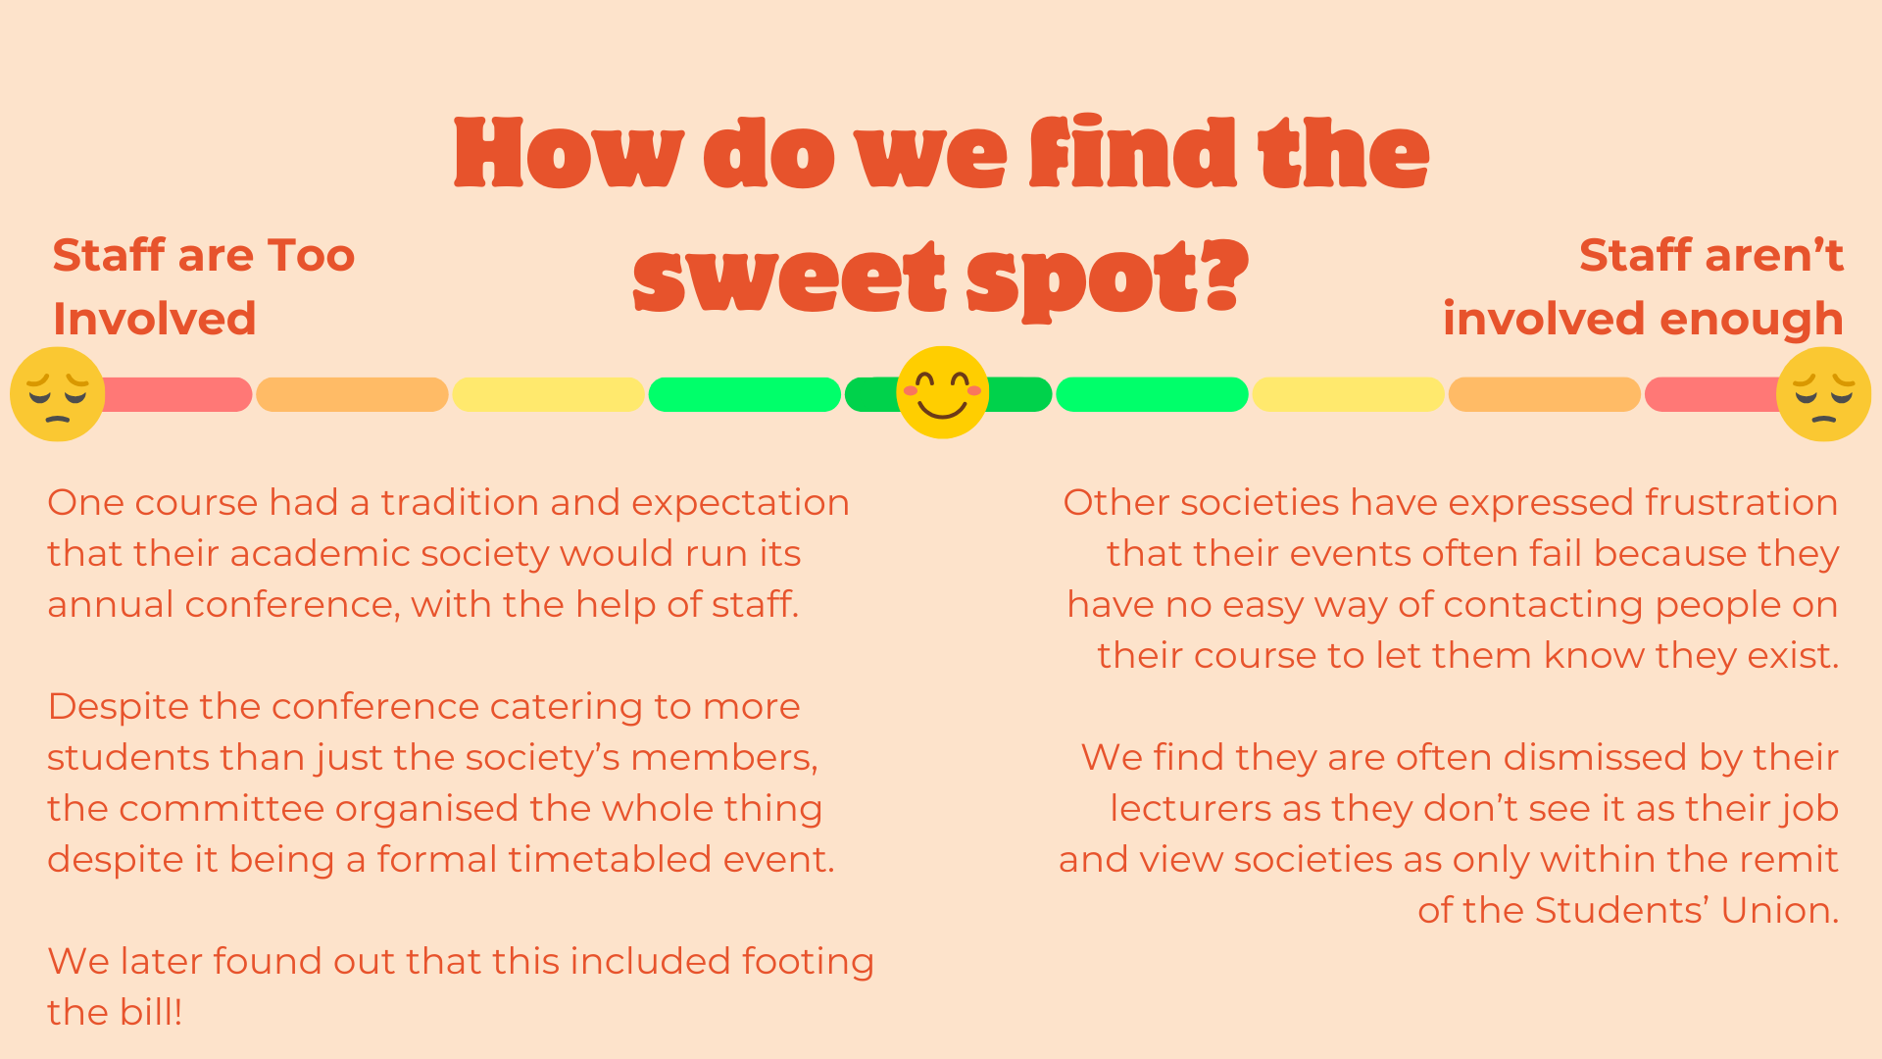

Slide 17
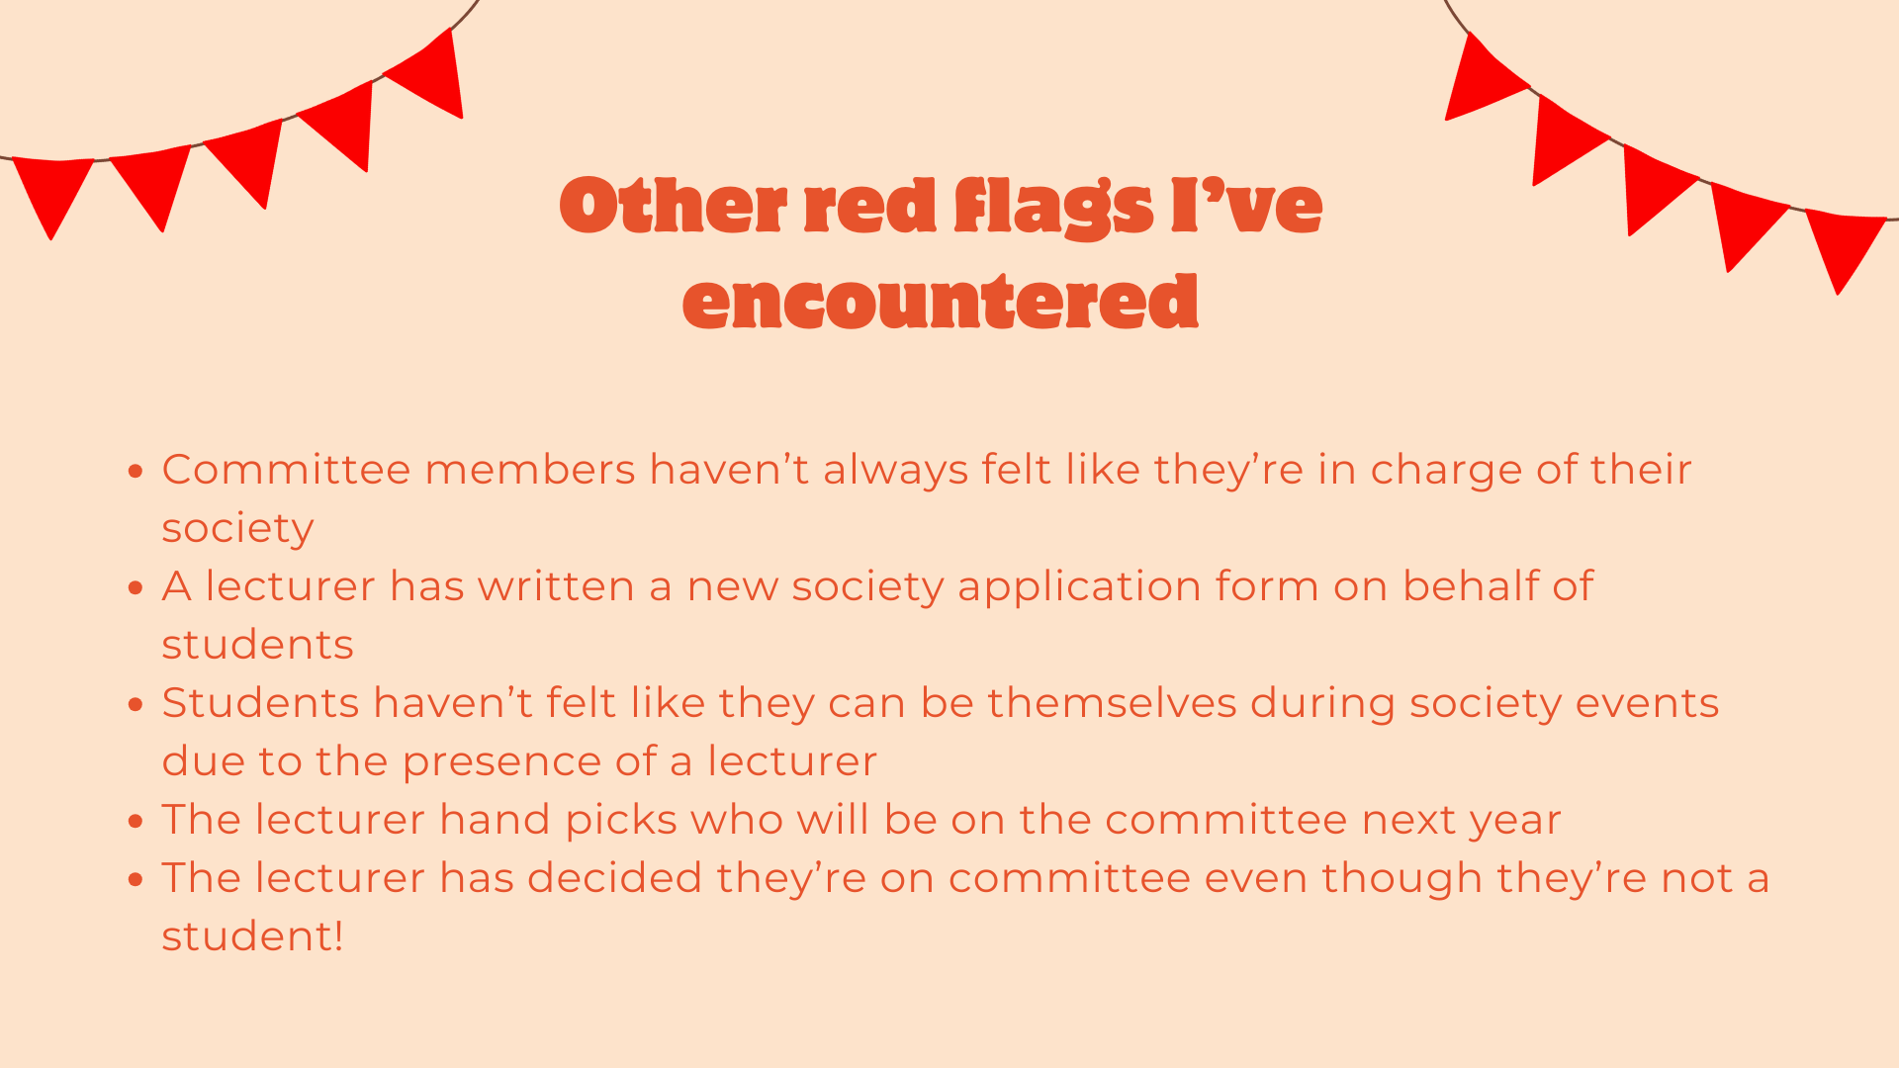

Slide 18
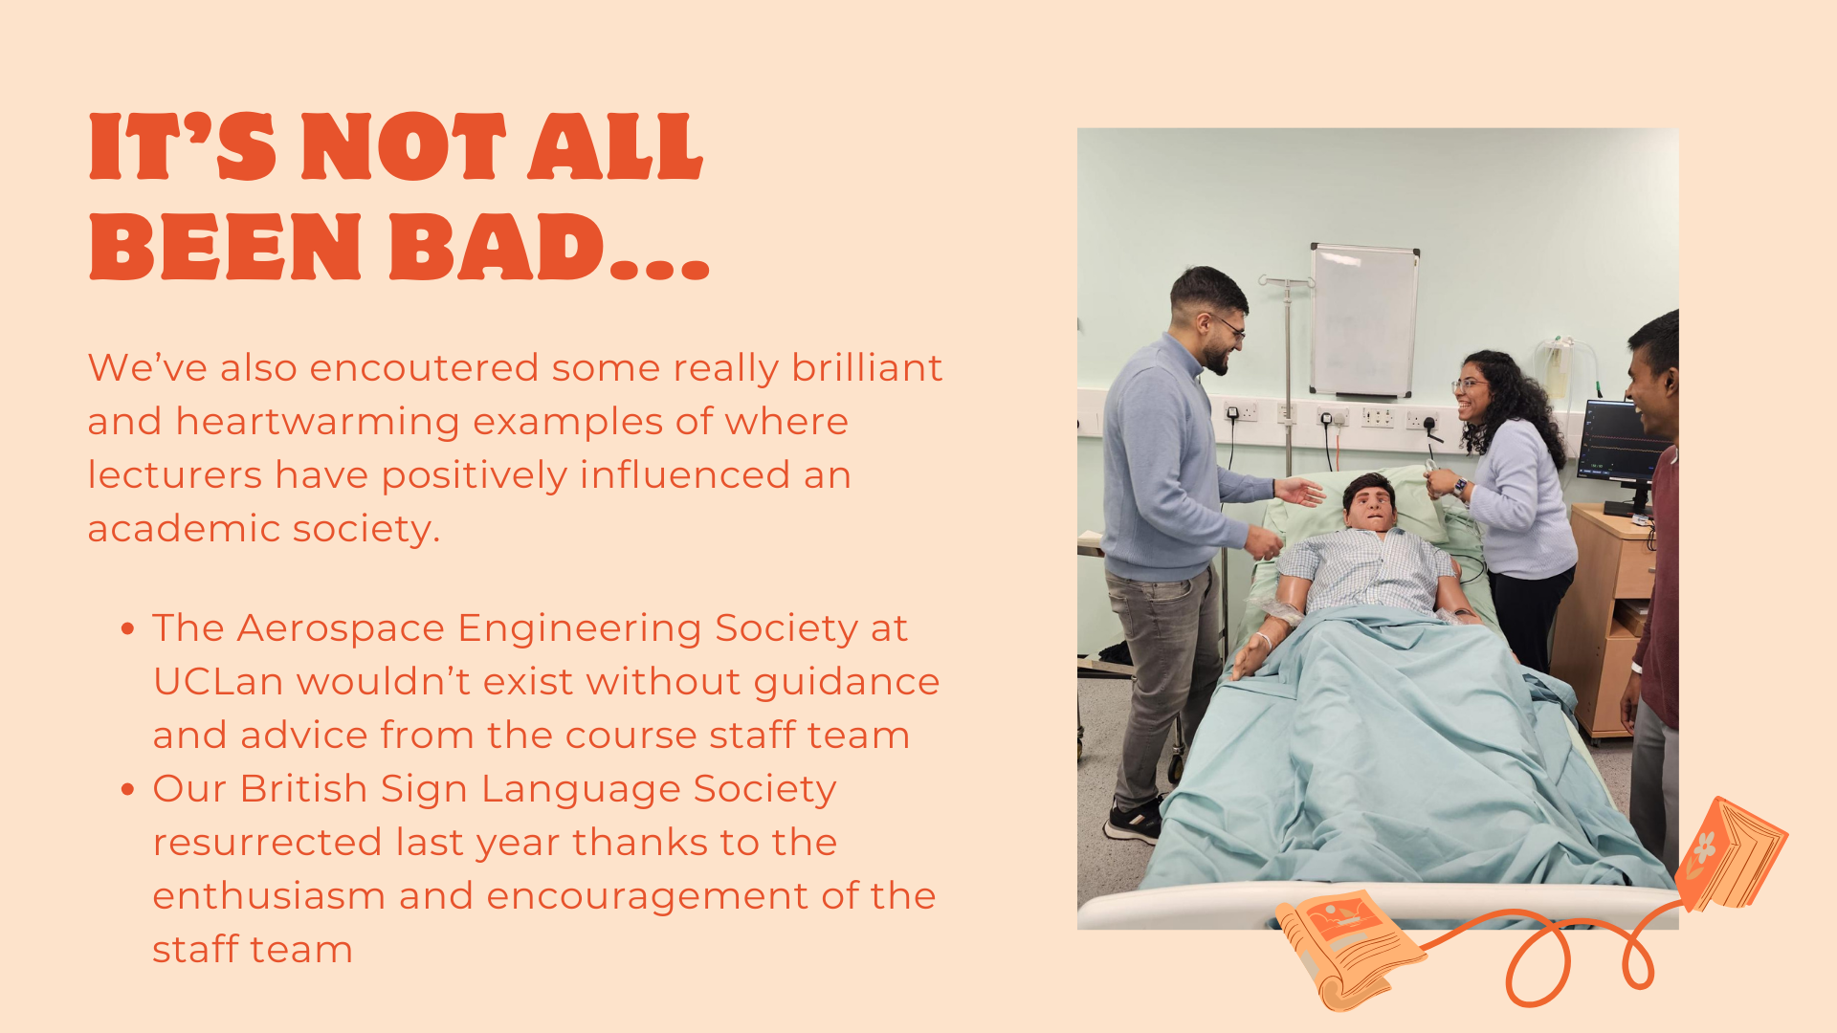

Slide 19
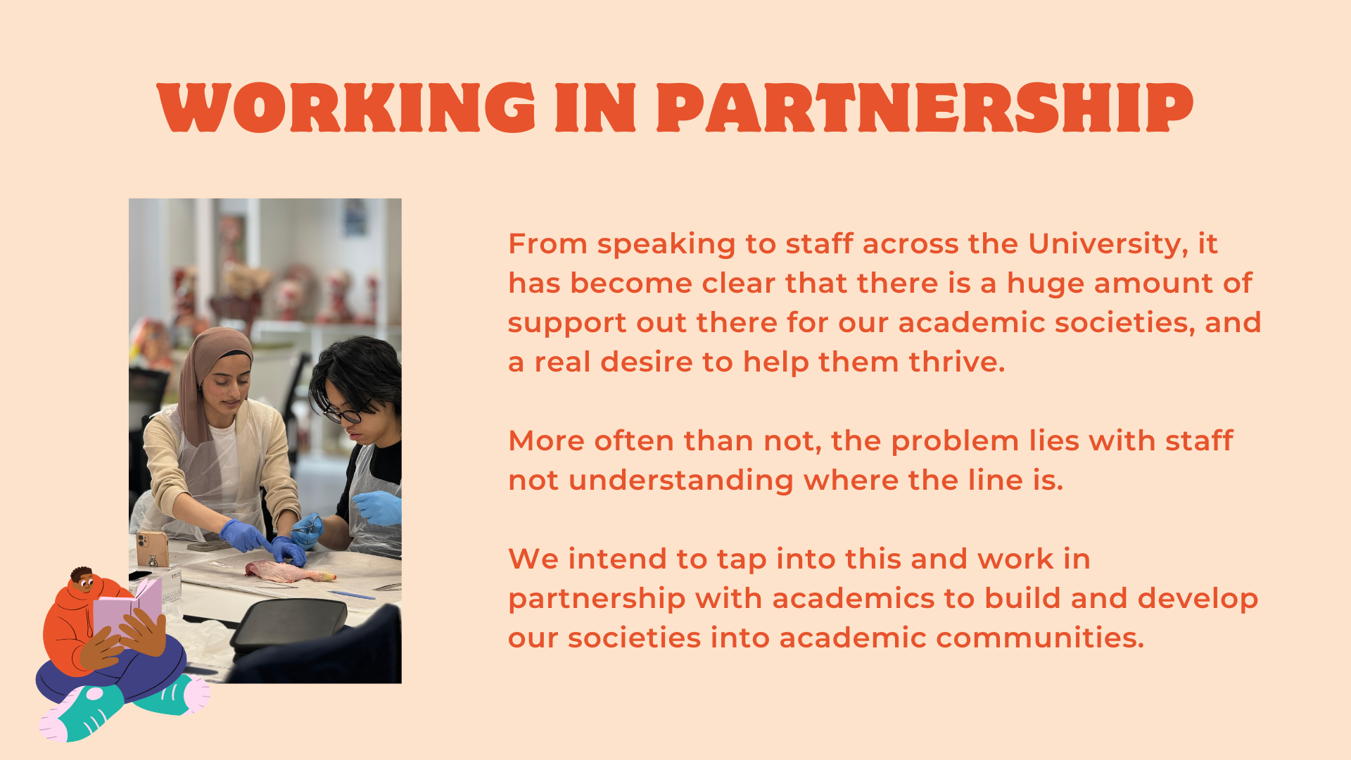

Slide 20
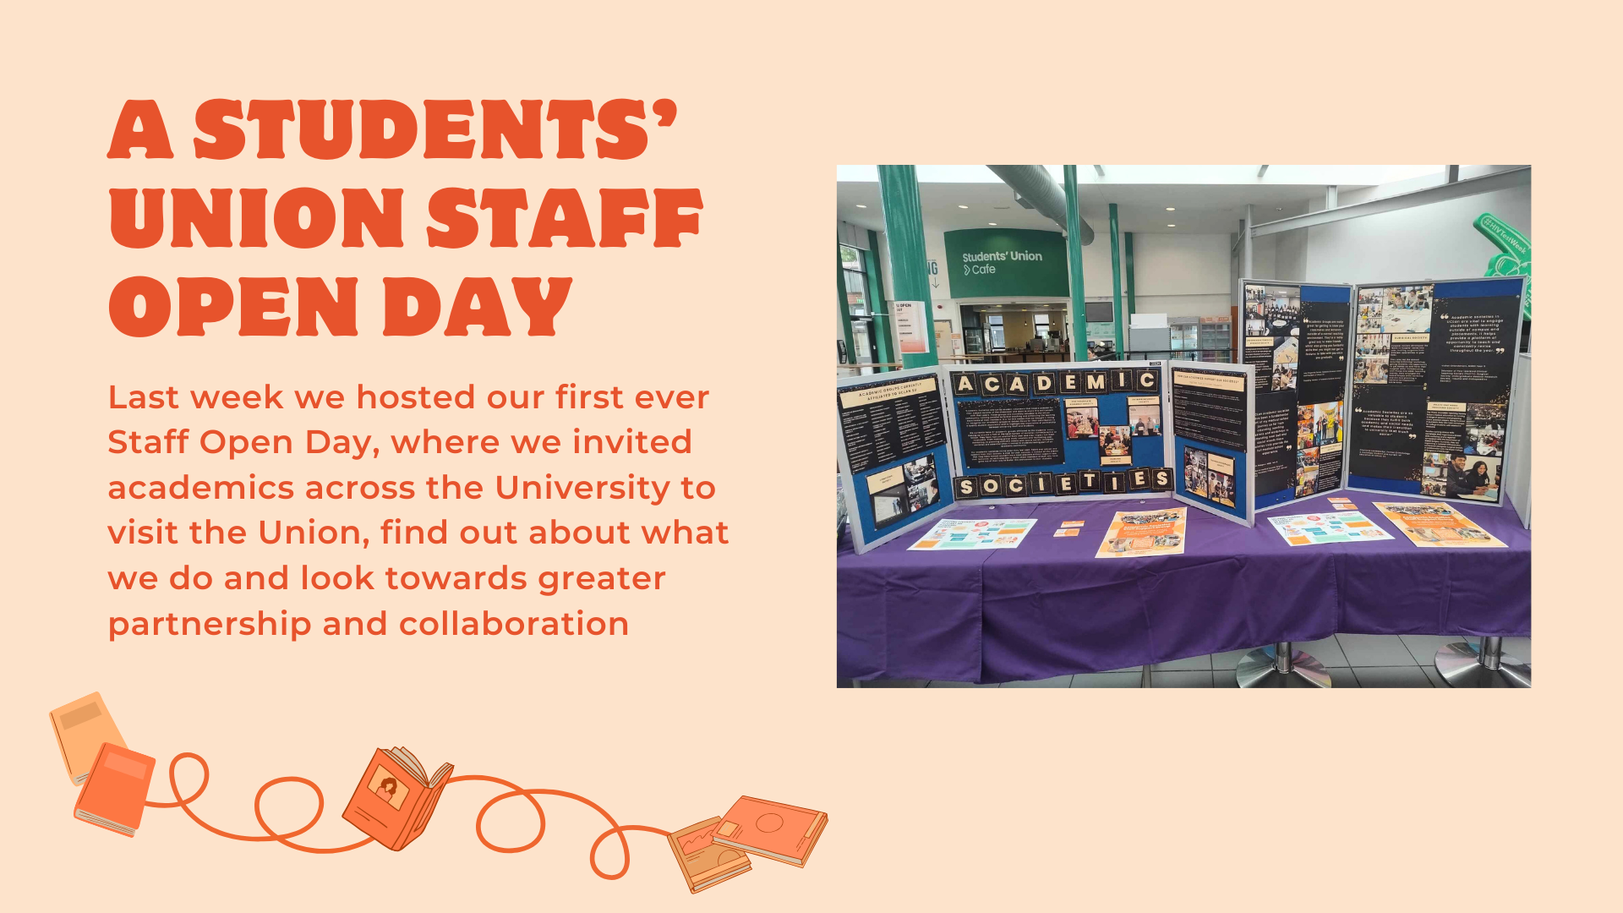

Slide 21
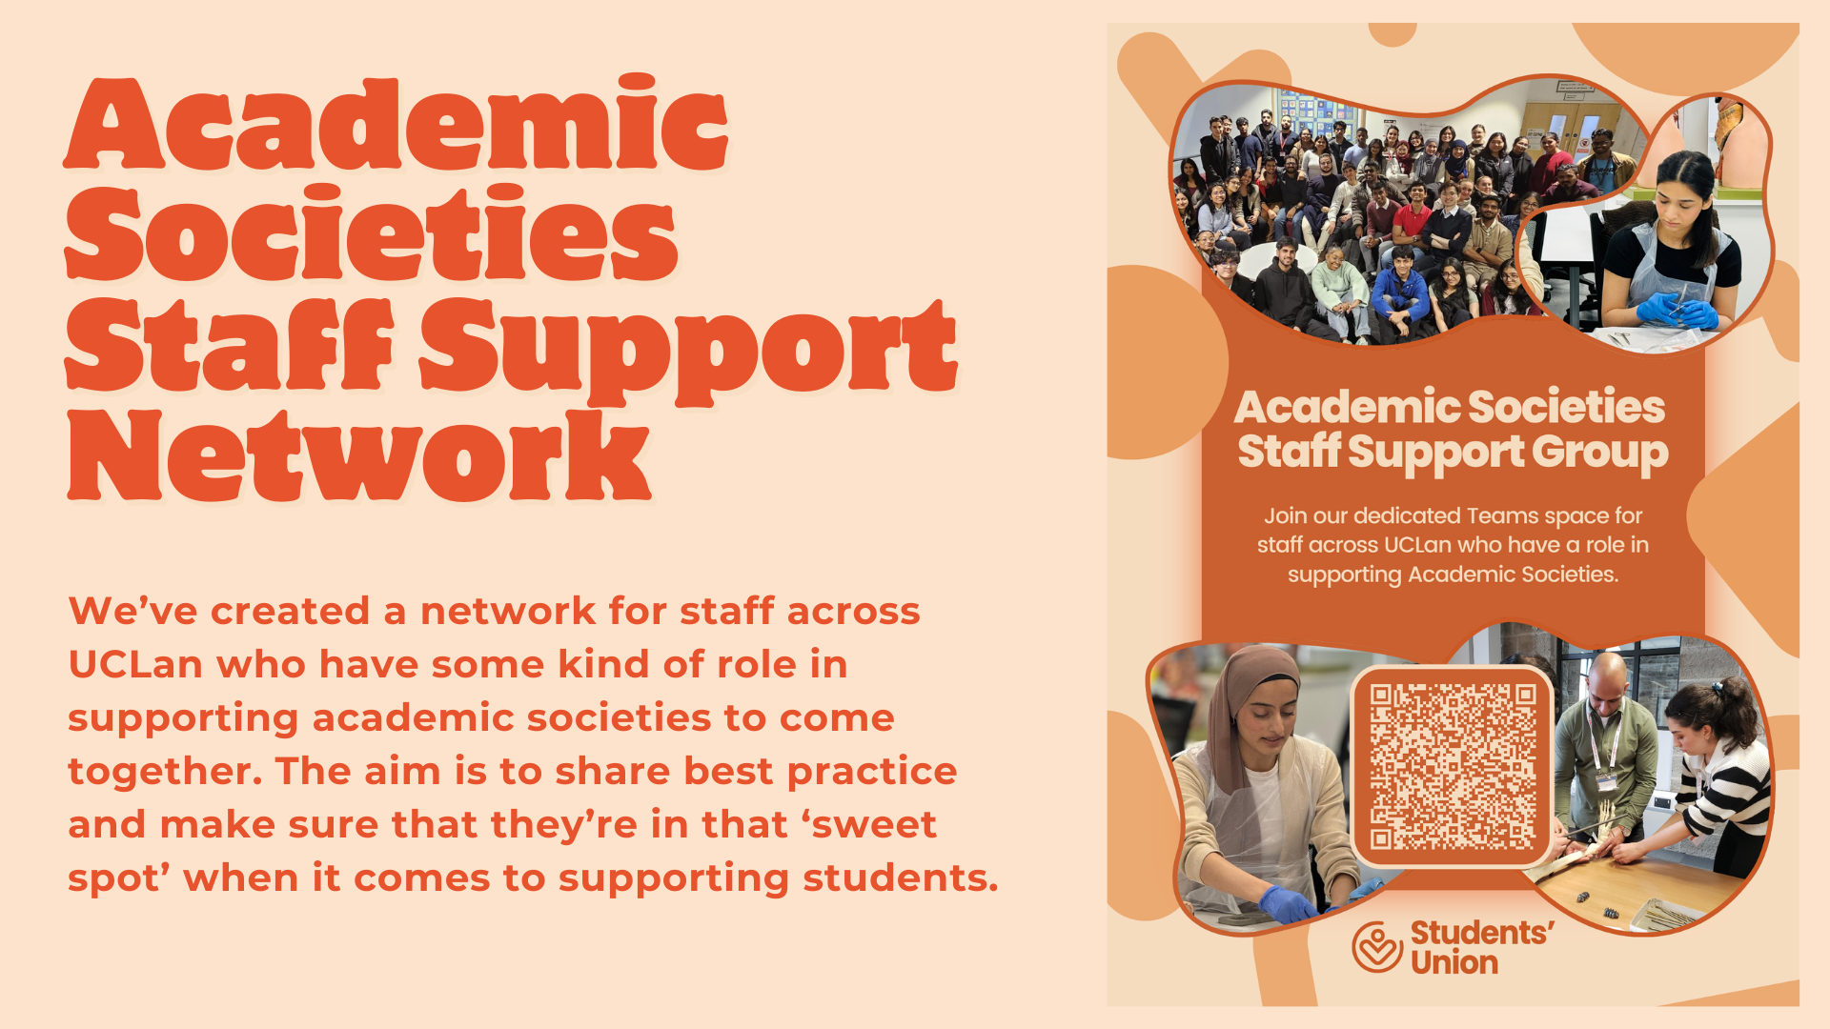
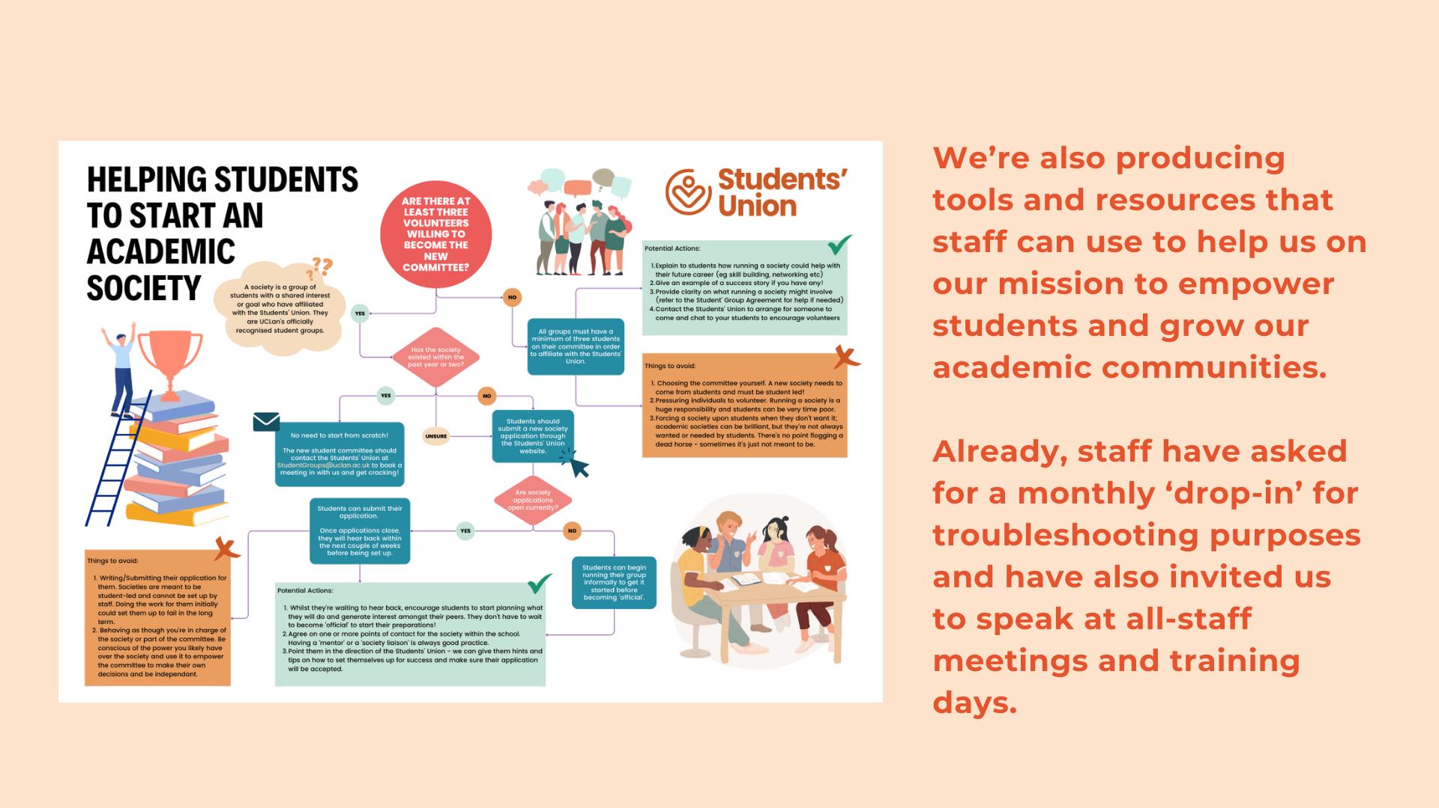

Slide 22
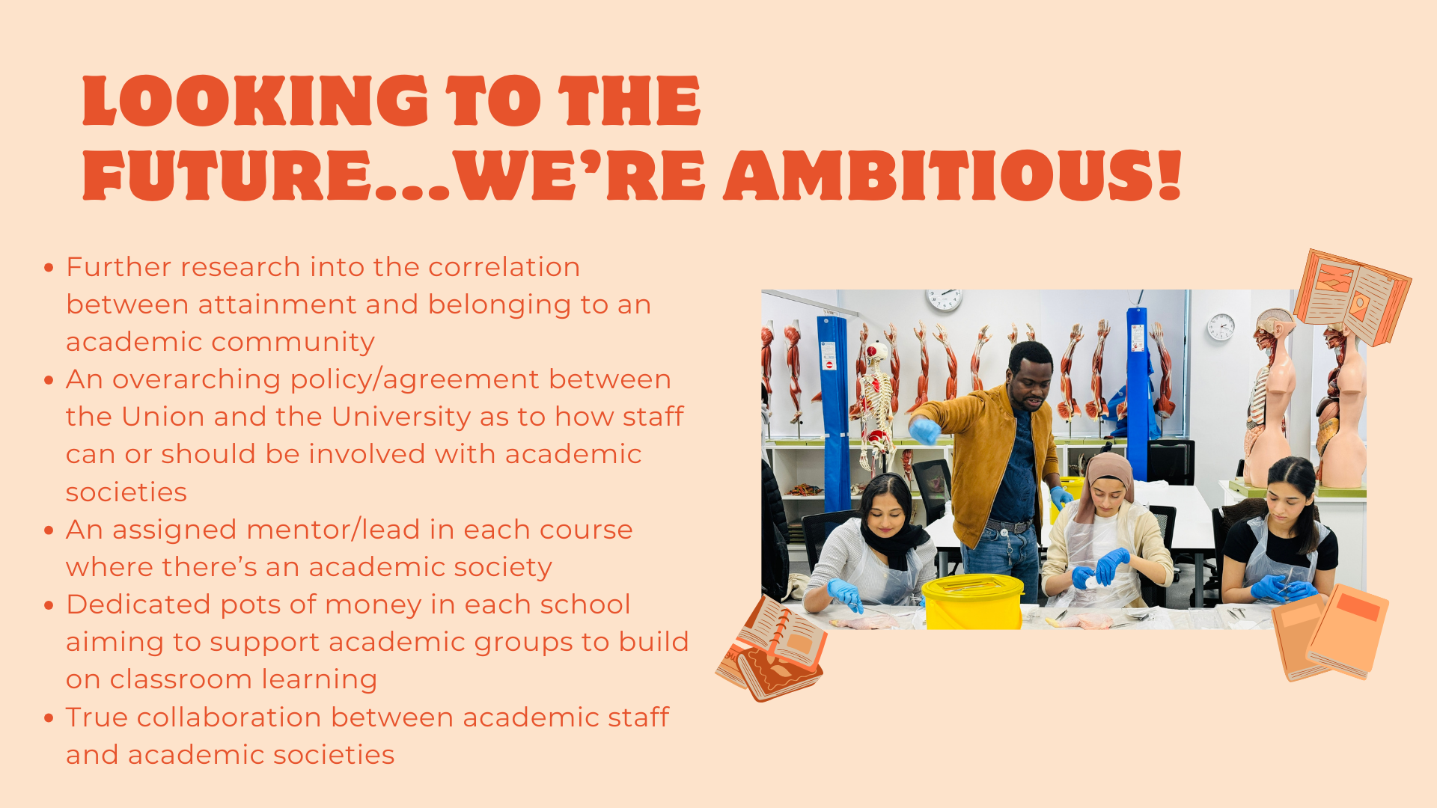

Slide 23
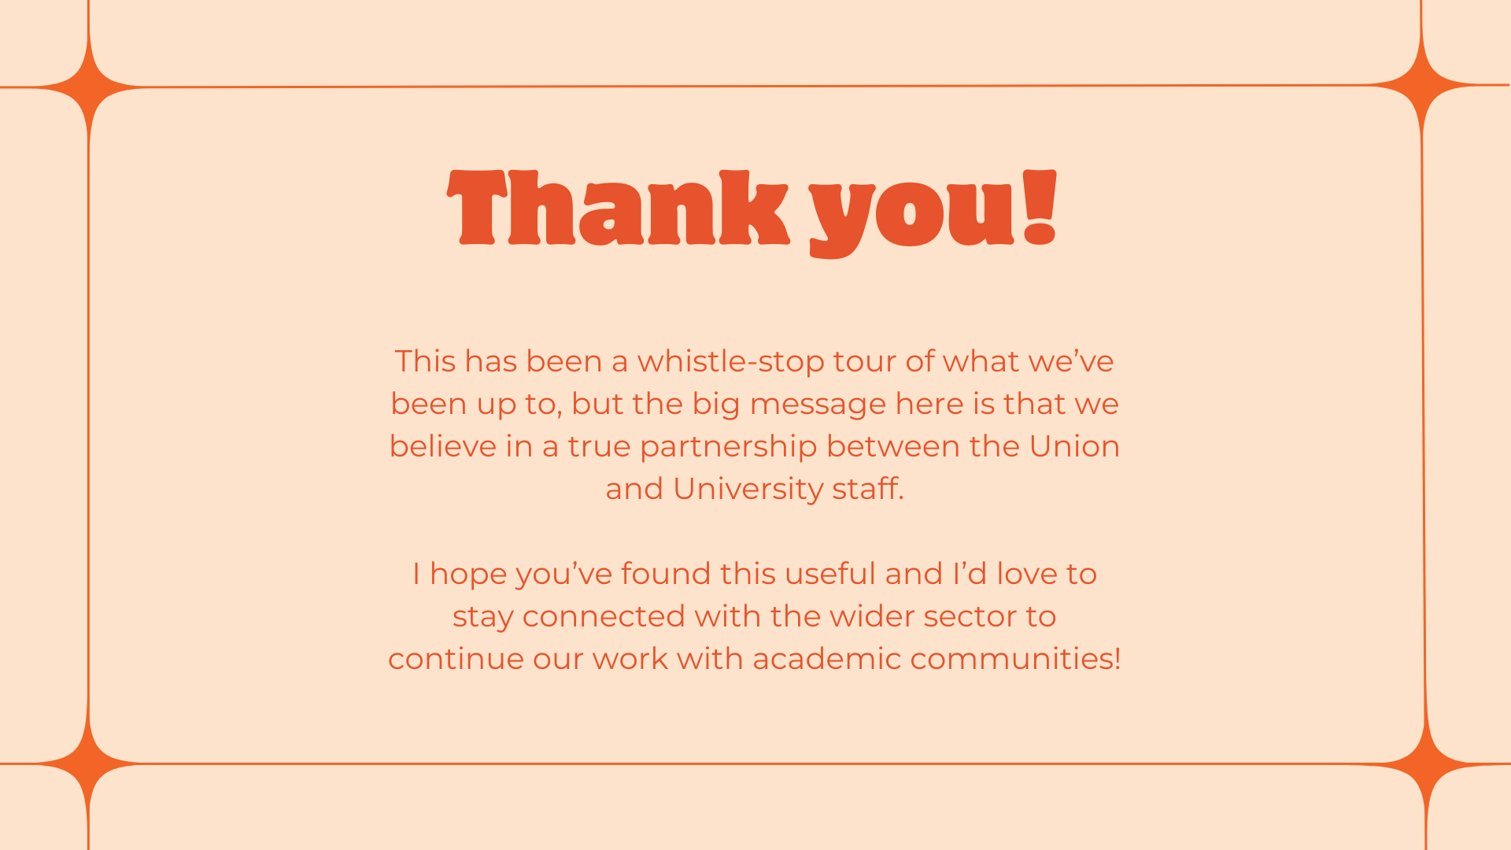

Slide 24


Slide 25
